Slide 1
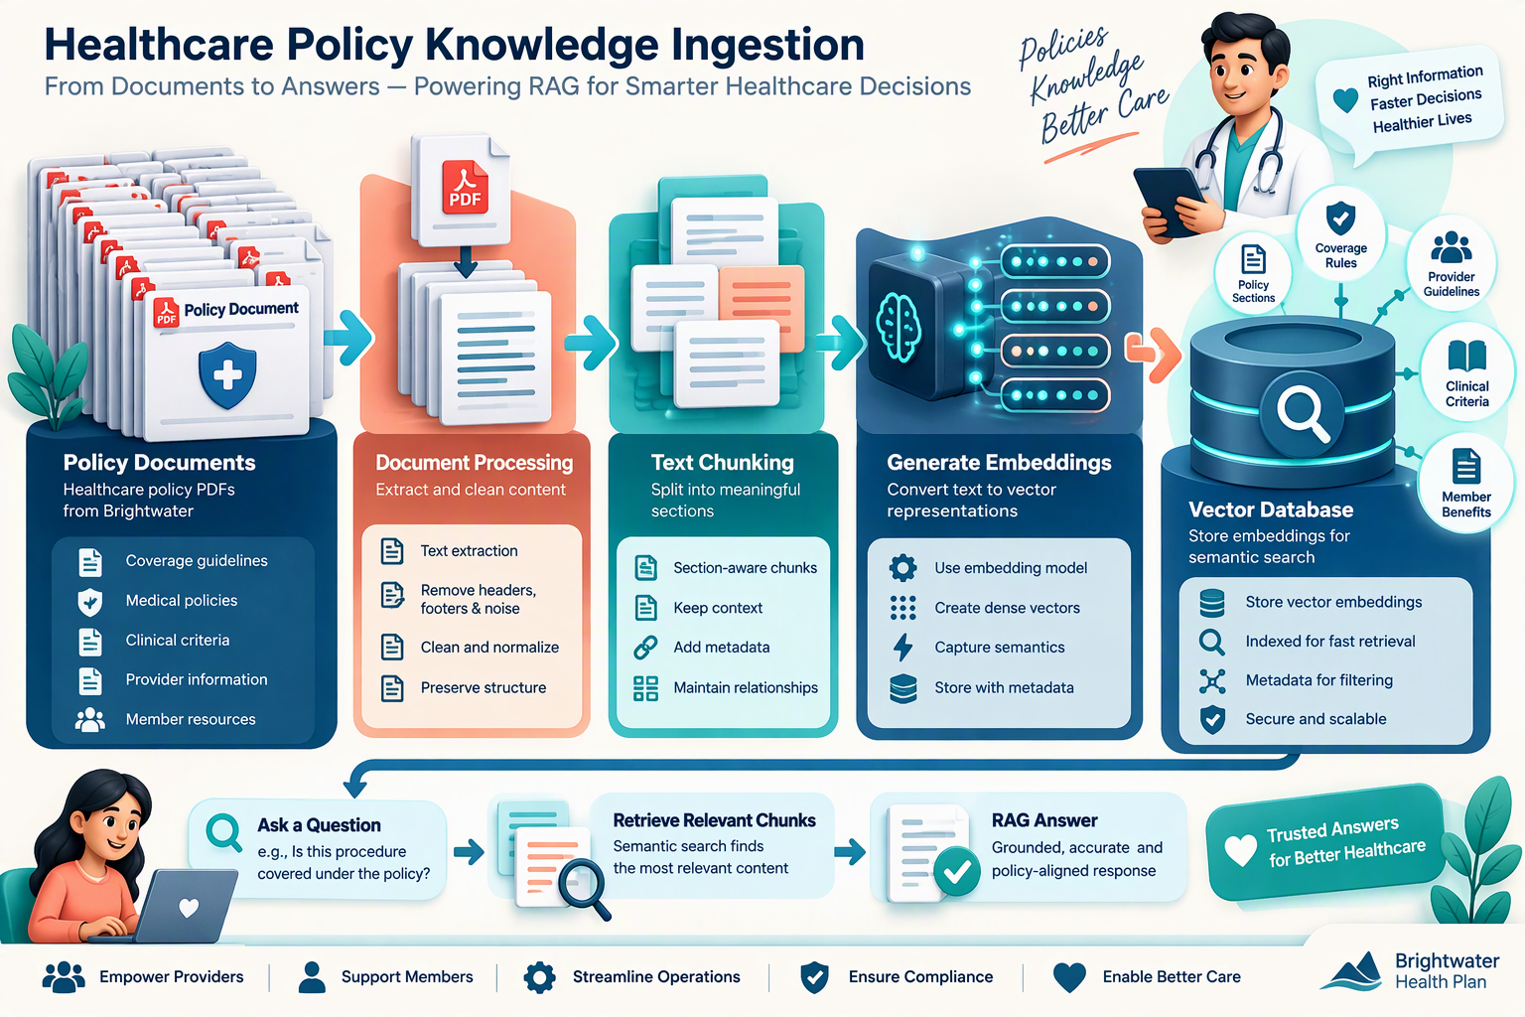
PHASE 1 • ONE-TIME / SCHEDULED SETUP
Build the Brightwater knowledge base
INPUT: 16 policy PDFs
Convert the 16 project PDFs into searchable reference material for RAG lookups and staff Q&A.
1
Extract text
2
Clean + split
3
Add metadata
4
Create embeddings
5
Store in ChromaDB
PyPDF reads each page.
Check for empty pages and preserve the document name.
Remove repeated noise, then create overlapping, section-aware chunks.
Attach source PDF, section, page and chunk ID so evidence can be traced.
all-MiniLM-L6-v2 converts every chunk into a semantic vector.
Save vector + chunk text + metadata in a searchable collection.
IMPORTANT
RAG retrieves and explains source material. It does not determine criteria or approve requests.
16 PDFs: 5 medical policies + 8 evidence guides + Prior Authorisation Rules + UM Policy + Past Reviews Casebook.
Notes:
Knowledge-base setup happens before live review. Explain that the PDFs are processed once and refreshed when policies change. Metadata is important because the final answer should show where the supporting evidence came from.
[Sources]
- Visual on this slide was generated with Microsoft Copilot.

Slide 2
PHASE 2 • RUNS FOR EVERY PRIOR-AUTHORISATION REQUEST
Screen, prepare the review, then stop for the UM Nurse
The requesting office provides the questionnaire. The nurse does not write a RAG question in the core review flow.
1
Request received
2
Normalize
3
Screen criteria
4
Read evidence
5
Prepare review
6
Human decision
Portal, fax or EDI sends a service questionnaire and clinical documents.
Clean formats and convert units so answers can be compared correctly.
Deterministic logic checks the correct policy: Met, Not Met or Not documented.
Analyse clinical sentences and flag disagreement with the questionnaire.
Combine results, evidence flags, estimates and a recommended decision.
System stops. The UM Nurse reviews and makes the final decision.
WHERE RAG FITS
RAG retrieves source passages from the 16 PDFs for policy explanation, evidence guidance and citations. It also supports a separate staff Q&A assistant.
RAG DOES NOT
set Met/Not Met
or approve a request
Question → embed → cosine search in ChromaDB → Top-K chunks → LLM answer with sources
Even when all criteria are Met, the system only recommends. The UM Nurse makes the final decision.
ClearAuth AI • Project-brief workflow
Notes:
Use the questionnaire example to show how the review question is grounded in the submitted clinical evidence. The query is embedded with the same model used for the stored chunks. Cosine similarity ranks the policy chunks, and the LLM receives only the most relevant chunks plus the case context. The UM nurse verifies the response and makes the final decision.
[Sources]
- Visual on this slide was generated with Microsoft Copilot.

