Slide 1
Pakistan Crime and Safety Data Pipeline
Tools & Techniques End-to-End Data Pipeline Project
Replace placeholders with your project evidence, screenshots, live links, and contribution proof.
Group No: 05
Project Title: Pakistan Crime and Safety Data Pipeline
Members: M. Zeeshan Zahid, M. Yahya, Syed Minhal Naqvi
Instructor: M. Rizwan
Tools & Techniques End-to-End Data Pipeline Capstone

Slide 2
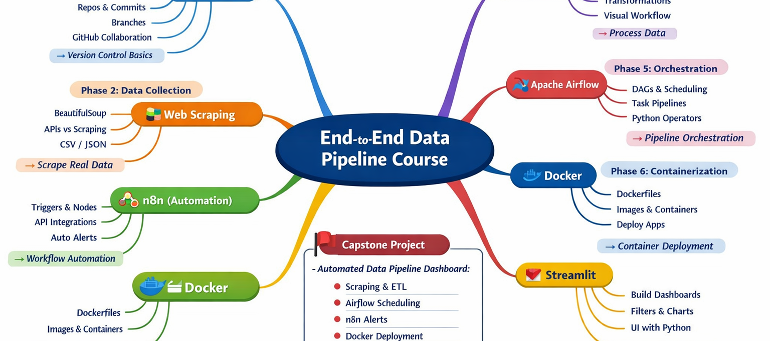
Course Tools Roadmap and Project Scope
Automated collection, processing, visualization and alert generation for crime incidents reported across Pakistan using publicly available news sources.
Tools & Techniques End-to-End Data Pipeline Capstone

Slide 3
1. Project Overview
Explain the project in one minute.
Core Pipeline Dawn / Geo / Express Tribune → Scraping → NLP Extraction → KNIME ETL → Airflow Automation → n8n Alerts → Streamlit Dashboard → Docker Deployment
Project Summary Pakistan Crime & Safety Data Pipeline is an automated crime intelligence system that collects crime news from leading Pakistani news websites, extracts structured information using NLP, processes it through ETL workflows, generates automated alerts, and visualizes trends through an interactive dashboard.
Expected Users
Security Analysts
Journalists
NGOs
Government Agencies
Expected Buyer / Adopter
Security Companies
Insurance Firms
Real Estate Developers
Main Output Crime Dashboard + Automated Email Alerts
Why this project is necessary: Crime data is scattered across multiple news sources.
What decision it supports: Identifying high-risk cities and crime trends.
What makes it useful: Provides centralized, automated crime intelligence.
Evidence required: final system screenshot or one clear pipeline screenshot.
Tools & Techniques End-to-End Data Pipeline Capstone

Slide 4
2. Problem Statement
Make the problem specific, measurable, and realistic.
Current Problem Crime information is spread across multiple websites with no centralized system for monitoring incidents.
Current / Manual Method Manual reading of news websites and TV channels.
Limitations
Time consuming
No trend analysis
No alerts
No structured database
Impact Delayed decision making
Missed crime trends
Lack of public safety awareness
Pakistan lacks a centralized automated system for collecting, analyzing, and visualizing crime incidents reported across major news sources.
7/14 respondents wanted a crime trend dashboard.
7/14 actively follow crime news.Do not present a solution before the problem is clear.
Evidence required: survey finding, screenshot, interview quote summary, or data sample that proves the problem exists.
Tools & Techniques End-to-End Data Pipeline Capstone

Slide 5
3. Why This Project Is Necessary
Question | Your Answer
---------------------------+--------------------------------------------------------------------------
Why is it necessary? | Crime data is fragmented and difficult to analyze manually.
Why will someone use it? | Users receive instant crime insights and alerts.
Why will someone adopt/p… | Reduces monitoring effort and improves situational awareness.
What decision improves? | Resource allocation and risk assessment.
Value Proposition "Our system helps organizations monitor crime trends and receive early warnings through automated data intelligence."
Tools & Techniques End-to-End Data Pipeline Capstone

Slide 6
4. Target Users, Buyers, and Beneficiaries
Role | Who | Problem | Benefit
Primary User | Security Analysts | Manual monitoring | Centralized dashboard
Secondary User | Journalists | Scattered data | Quick trend analysis
Buyer | Security Companies | High monitoring cost | Automated intelligence
Beneficiary | Citizens | Lack of awareness | Improved safety awareness
Tools & Techniques End-to-End Data Pipeline Capstone

Slide 7
5. First 100 Users / Customers Plan
Show how your project could reach real users.
Segment | Where | Approach | Offer
Security Firms | LinkedIn | Live Demo | Free Trial
Journalists | Media Networks | Demonstration | Dashboard Access
NGOs | Conferences | Pilot Program | Free Evaluation
Adoption Strategy Offer 30-day trial
Demo dashboard
Collect feedback
Improve features
Convert pilots into paid users
Tools & Techniques End-to-End Data Pipeline Capstone

Slide 8
6. Survey / Requirement Collection Method
Survey Method Google Forms
Required Attachment Survey_Responses.xlsx
Survey_Questionnaire.docx
Survey_Summary.docx
Type | Question
Problem Frequency | Do you follow crime news?
Feature Priority | Alerts, trends or comparisons?
Adoption Interest | Would you use a dashboard?
Open Feedback | What feature matters most?
Tools & Techniques End-to-End Data Pipeline Capstone

Slide 9
7. Survey Findings and Requirement Changes
Show numbers, not only statements.
Finding | Evidence | Decision
Dashboard Needed | 7/14 Yes , 4 Maybe | Build Streamlit Dashboard
Real-time Alerts Needed | 7/14 preferred alerts, 4 Maybe | Add n8n alerts
Manual Tracking Common | 14/14 manual | Automate collection
City Comparison Important | 9/14 Alerts | Add n8n alerts
Most Important Requirement Real-time crime alerts.
Feature Removed / Reduced Urdu-language article support due to scope limitations.
Tools & Techniques End-to-End Data Pipeline Capstone

Slide 10
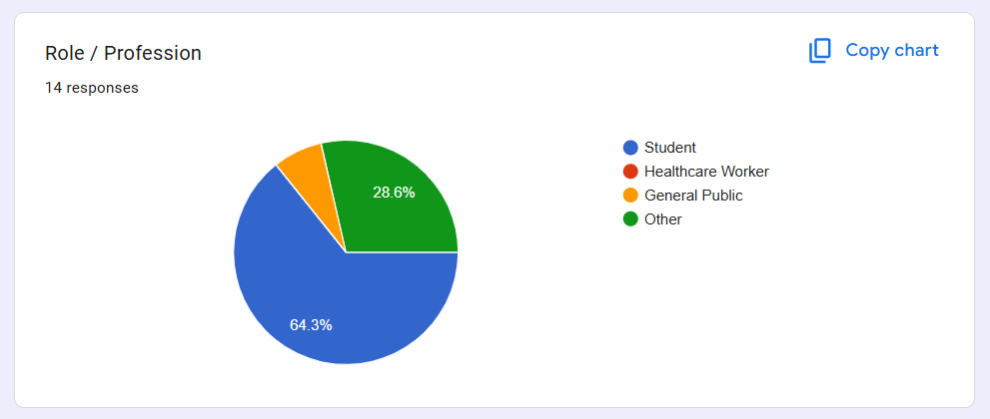
8. Contributors / Respondents Record
Category | Count
Students | 9
General Public | 1
Other Professionals | 4
Tools & Techniques End-to-End Data Pipeline Capstone

Slide 11
9. Tools Used / Skipped Matrix
This slide is mandatory.
Tool | Used | Purpose
GitHub | Yes | Version Control
Selenium | Yes | Scraping
CSV/JSON | Yes | Data Storage
KNIME | Yes | ETL
Airflow | Yes | Scheduling
n8n | Yes | Alerts
Docker | Yes | Deployment
Streamlit | Yes | Dashboard
Tools & Techniques End-to-End Data Pipeline Capstone

Slide 12
10. Complete Project Architecture
Replace the placeholder with your actual architecture diagram.
Architecture Diagram Placeholder Flow:
News Sources → Scrapers → Raw JSON → NLP Processing → Extracted CSV → KNIME ETL → Cleaned CSV → Airflow → n8n → Streamlit Dashboard → Docker Deployment
Tools & Techniques End-to-End Data Pipeline Capstone

Slide 13
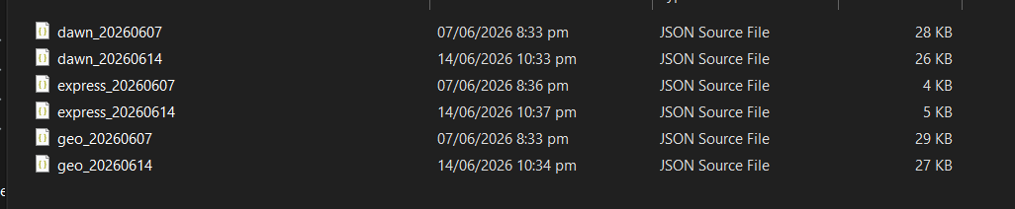
11. Data Collection
Source | Type | Records
Dawn.pk | Scraping | 15
Geo.tv | Scraping | 13
Express Tribune | Scraping | 13
Raw Data Proof
Collection Issues Dynamic loading
Rate limiting
Different HTML structures
Tools & Techniques End-to-End Data Pipeline Capstone

Slide 14
12. Raw vs Processed Data Summary
Show that data changed through your pipeline.
Stage | File | Rows | Change
Raw | dawn.json geo.json tribune.json | 41 | Original
Deduplicated | extracted.csv | 25 | Removed duplicates
Filtered | cleaned.csv | 22 | Pakistan-only
Final | aggregated.csv | 16 | City aggregation
Data Dictionary city, crime_type, severity, source, headline, latitude, longitude, date
Tools & Techniques End-to-End Data Pipeline Capstone

Slide 15
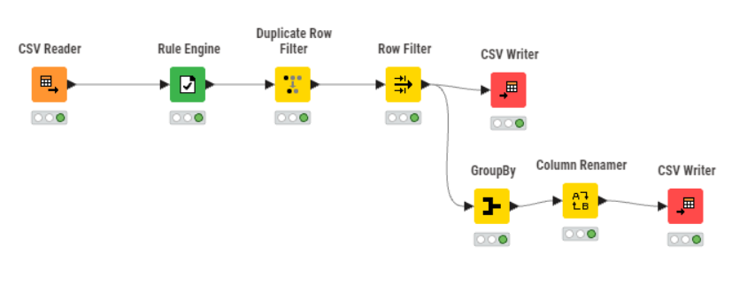
13. ETL / Cleaning / Transformation
Show KNIME workflow or justified processing approach.
KNIME / Processing Workflow Screenshot
Main Cleaning Steps Missing values handled
Duplicate removal
City standardization
Geo-tagging
Aggregation
Issue | Action | Result
Duplicate articles | RapidFuzz | Reduced 41→25
Missing city | Filled National | Cleaner dataset
Inconsistent names | Standardized | Reliable analysis
Tools & Techniques End-to-End Data Pipeline Capstone

Slide 16
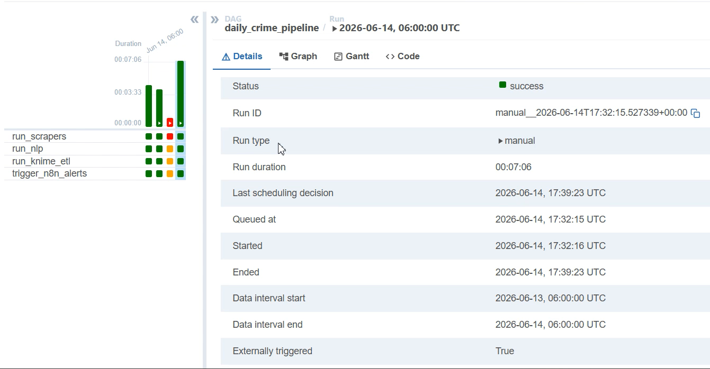
14. Apache Airflow Orchestration
Show DAG, tasks, schedule, and successful run.
Task | Purpose
run_scrapers | Data Collection
run_nlp | Extraction
run_knime_etl | Processing
trigger_n8n_alerts | Alerts
Schedule Daily: 6 AM
Weekly: Sunday 8 AM
DAG Screenshot
Tools & Techniques End-to-End Data Pipeline Capstone

Slide 17
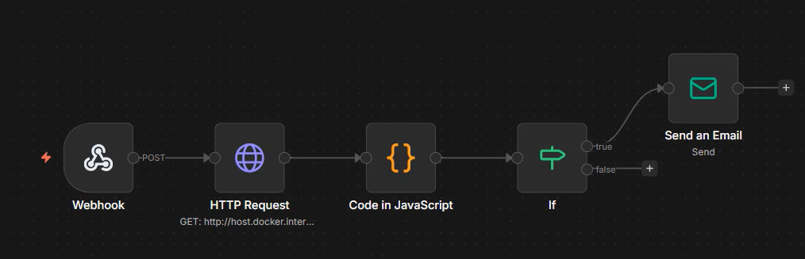
15. n8n Workflow Automation / Alerts
Show trigger, workflow, and message/output.
Trigger Airflow Webhook
Workflow Actions → Fetch CSV → Detect Spike → Send Gmail Alert
Alert Output Severity ≥ 7 OR Incident Count ≥ 2
n8n Screenshot Placeholder
Tools & Techniques End-to-End Data Pipeline Capstone

Slide 18
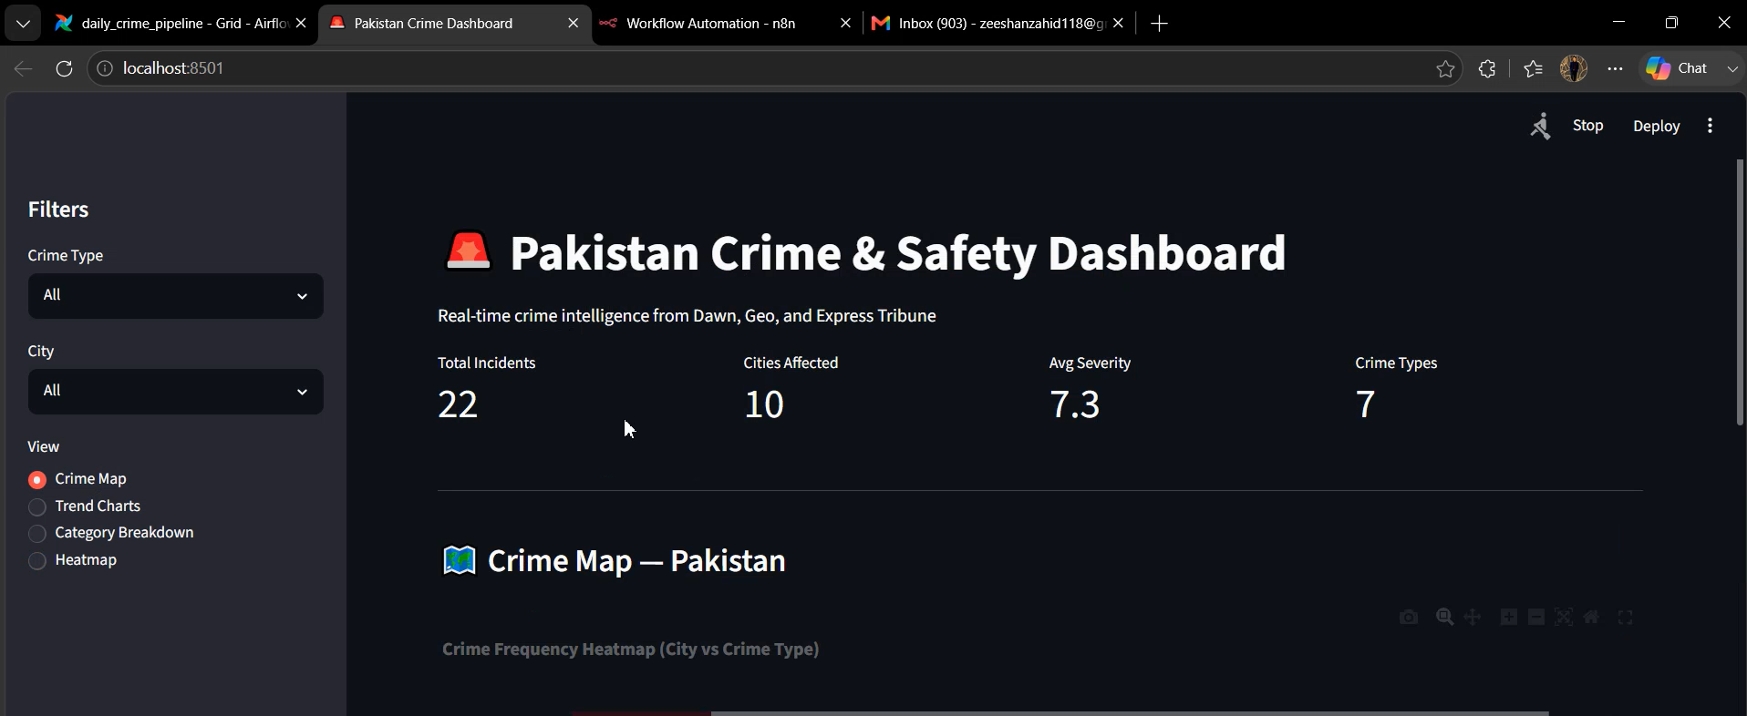
16. Streamlit Dashboard / Application
Show live interface and main features.
Dashboard Screenshot Placeholder
Main Features Crime Map
Trend Charts
Category Breakdown
Heatmap
Sidebar Filters
Tools & Techniques End-to-End Data Pipeline Capstone

Slide 19
17. Docker and Deployment
Show how the project runs outside your notebook.
Item | Details
Docker Compose | Yes
Airflow | Container
n8n | Container
Streamlit | Container
Postgres | Container
If Docker Was Skipped Docker deployment was skipped due to limited system resources and time constraints. The team focused on implementing and testing the core functionalities of the project.
Alternative Deployment Proof:
Airflow DAG executed successfully locally.
n8n workflow generated alerts correctly.
Streamlit dashboard ran successfully on localhost.
Complete pipeline was tested end-to-end in the local environment.
Tools & Techniques End-to-End Data Pipeline Capstone

Slide 20
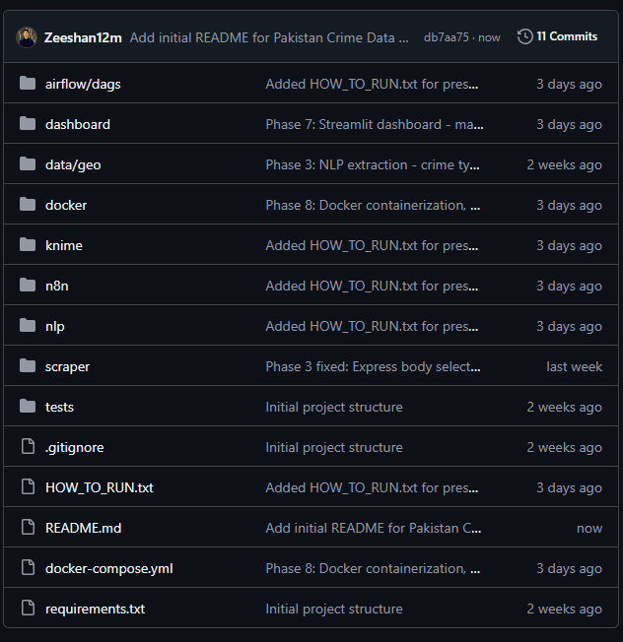
18. GitHub Collaboration and Version Control
Show real contribution proof.
Repository Link Zeeshan12m/pakistan-crime-pipeline
Member | Role
Zeeshan | Scraping + n8n
Yahya | NLP + KNIME
Minhal | Airflow + Dashboard
Repository Screenshot Placeholder
Tools & Techniques End-to-End Data Pipeline Capstone

Slide 21
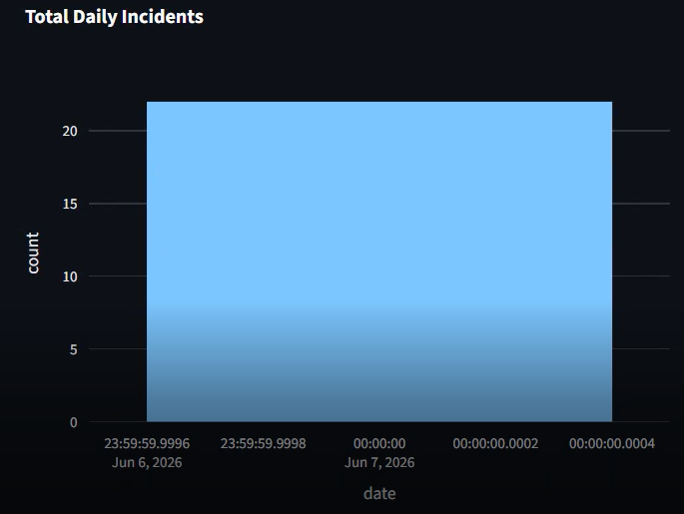
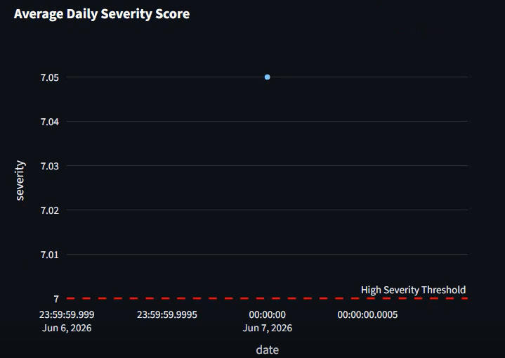
19. Final Results and Insights
Present outputs that answer the original problem.
Key Result 1 41 articles scraped
25 unique incidents
22 crime records
Key Result 2 16 city-crime combinations
Key Result 3 12 email alerts generated
10 cities detected
Charts / Output Placeholder
Tools & Techniques End-to-End Data Pipeline Capstone

Slide 22
20. Testing and Validation
Show expected vs actual results.
Test | Expected | Actual | Status
Scraping | Collect articles | 41 articles | Pass
NLP | Extract fields | Success | Pass
ETL | Clean data | Success | Pass
Airflow | DAG executes | Success | Pass
n8n | Alert sent | Success | Pass
Dashboard | Load data | Success | Pass
Tools & Techniques End-to-End Data Pipeline Capstone

Slide 23
21. Challenges, Limitations, and Skipped Tools
Be honest and technical.
Challenge | Cause | Fix
Dynamic Websites | JS Rendering | Selenium
Duplicate News | Multi-source reporting | RapidFuzz
Missing Cities | Poor location references | Custom city matcher
Site Changes | HTML updates | Modular scrapers
Limitation
English articles only.
Tools & Techniques End-to-End Data Pipeline Capstone

