Slide 1

2023
Presented By:
Reversible Watermarking
B.Tech final year minor presentation under the guidance of

Slide 2
2023
INTRODUCTION
The significance of concealing and conveying information discreetly has grown significantly over the past two decades, owing to advancements in the generation, storage, and communication technologies of digital content. While watermarking stands out as a promising solution for detecting tampering and safeguarding digital content, it bears the risk of harming sensitive information within the cover work. Consequently, achieving the precise recovery of the cover work at the receiving end becomes challenging. Moreover, certain applications cannot tolerate even minor distortions in the cover work before downstream processing. In such scenarios, reversible watermarking, as opposed to traditional watermarking, is employed. Reversible watermarking enables the complete extraction of the watermark along with the full restoration of the cover work. In recent years, reversible watermarking techniques have been increasingly adopted, particularly in critical areas such as military communication, healthcare, and law enforcement. Given the swift evolution of reversible watermarking techniques, there is a pressing need for a comprehensive review of the latest research in this field

Slide 3
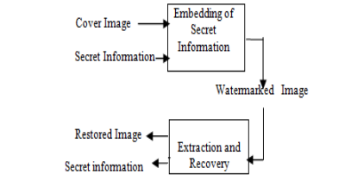
Basics Of A Watermarking System

Slide 4
Histogram Shifting Technique
Histogram shifting is a fundamental technique in image processing that plays a pivotal role in adjusting pixel intensities, thereby influencing the visual characteristics of digital images. This technique is widely employed for tasks such as contrast enhancement, dynamic range adjustment, and, as presented in this research, reversible watermarking. Histogram shifting involves redistributing the pixel intensity values in an image, altering its overall appearance while maintaining the structural content.
Histogram shifting is a technique used in reversible data hiding, which is a method of embedding data into an image in such a way that the original image can be perfectly restored. This technique is particularly useful in fields like medical and military applications where the exact retrieval of both the watermark and host data is crucial.
There are various methods that utilize histogram shifting for data hiding. For instance, a hybrid method combines histogram shifting with prediction error expansion to offer higher embedding capacity with lesser distortion1. Another method divides the image into nonoverlapping blocks and embeds the watermark individually using the histogram method.

Slide 5
These techniques aim to improve the quality of the watermarked image, increase the hiding capacity, and ensure the watermark cannot be easily hacked. They also enable lossless reconstruction of the watermark and the host image.
Histogram shifting is also used in image processing to manipulate the brightness of an image. It involves applying a mathematical function to the intensity distribution of an image.
Here’s how it works:
Histogram Sliding: In histogram sliding, the complete histogram of an image is shifted rightwards or leftwards. This shift results in a noticeable change in the image, particularly in its brightness.
Increasing Brightness: To increase the brightness of an image, the histogram is slid towards the right, or the whiter portion. This is achieved by adding a certain value to each pixel intensity in the image. For example, if the image has pixel intensities at 0 (pure black), adding a value of 50 would shift all these values to an intensity of 50, making the image brighter.
Decreasing Brightness: To decrease the brightness of an image, the histogram is slid towards the left, or the darker portion. This is done by subtracting a certain value from each pixel intensity in the image. For instance, subtracting a value of 80 from a previously brightened image would make it darker.

Slide 6
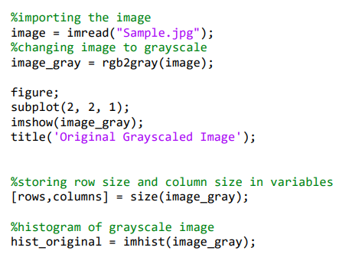
Methodology And Implementation
In this section of code we are doing these tasks:
Importing the Image: The imread function is used to read an image from a file
Changing Image to Grayscale: The rgb2gray function is used to convert an RGB image to grayscale
Displaying the Grayscale Image:
Storing Image Dimensions: The size function is used to get the dimensions of the grayscale image.
Creating a Histogram of the Grayscale Image: The imhist function is used to compute a histogram of the grayscale image.

Slide 7
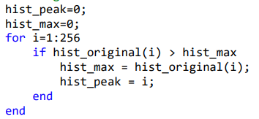
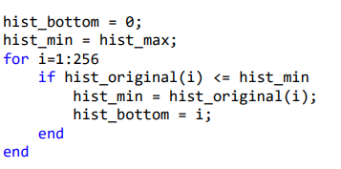
Methodology And Implementation
In this section of code we are finding maximum histogram count and its corresponding intensity level in the histogram of a grayscale image.
hist_max: Pixel that is occuring maximum no. of time in histogram.
hist_peak: Intensity of pixel which is ocuring maximum number of time.
In this section of code we are finding minimum histogram count and its corresponding intensity level in the histogram of a grayscale image.
hist_min: Pixel that is occuring minimum no. of time in histogram.
hist_bottom: Intensity of pixel which is minimum number of time.

Slide 8
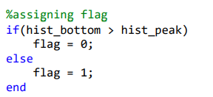
Relation Between the Intensity Levels
In this section of the code we are assessing the relationship between the intensity levels corresponding to the minimum and maximum histogram counts.
Case when hist_bottom is greater than hist_peak:
That means image more white pixels than black.
In that case, we are assigning flag as 0.
Case when hist_bottom is lesser than hist_peak:
That means image more black pixels than white.
In that case, we are assigning flag as 1.

Slide 9
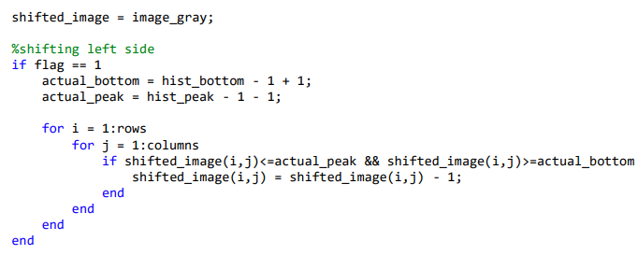
Determining Shifting Directions
The relationship between the peak and bottom values guides the shifting direction. If hist_bottom is greater than hist_peak, it implies a leftward shift; otherwise, a rightward shift is performed.
CODE FOR LEFT SHIFT

Slide 10
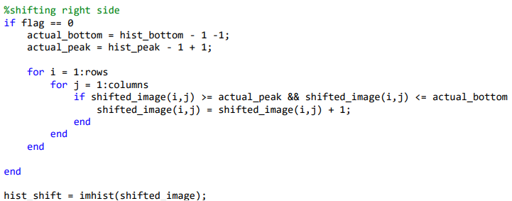
CODE FOR RIGHT SHIFT

Slide 11
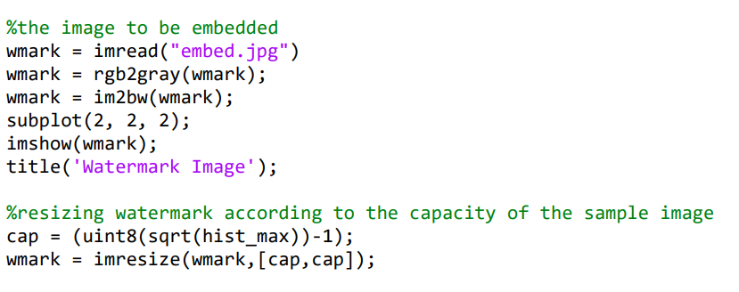
Watermark Embedding
Before embedding watermark on image, we are first importing image to be imbed.
Then we are converting it RGB to grayscale.
The imresize function is used to resize the watermark image according to the capacity of the sample image.

Slide 12
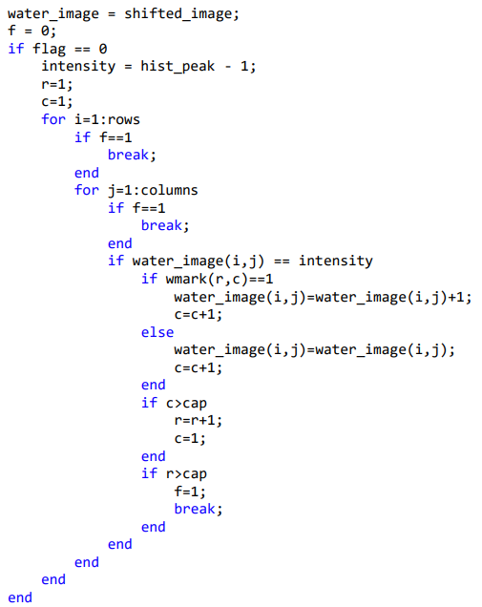
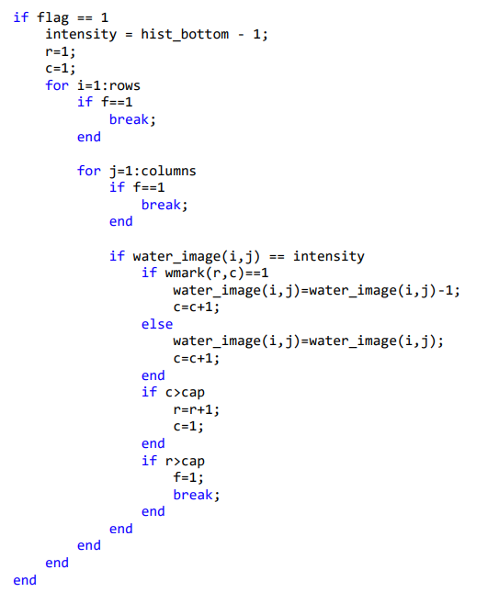

Slide 13
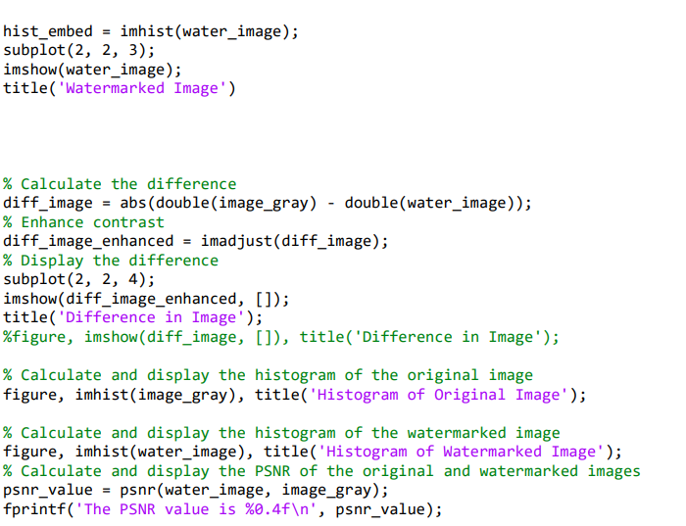

Slide 14
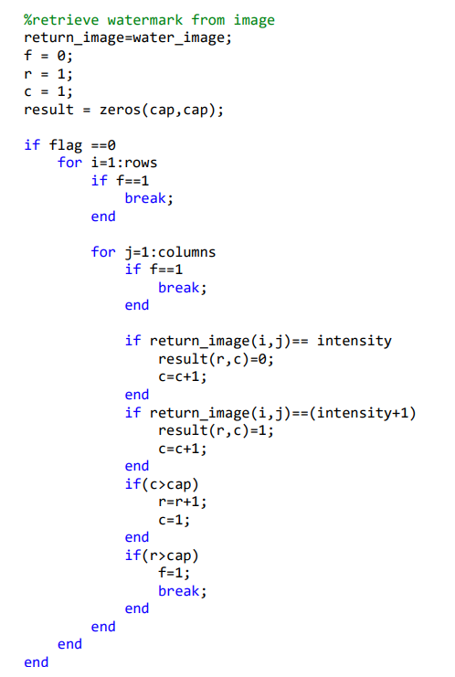
Watermark Retrieval
Initialize Variables:
The watermarked image water_image is copied to return_image. This image will be used to retrieve the watermark. The variable f is initialized to 0. This flag is used to break the loops once the watermark has been fully retrieved. The variables r and c are initialized to 1. These will be used to index into the watermark. The variable result is initialized to a cap x cap matrix of zeros. This will store the retrieved watermark.
Retrieve Watermark (Left Shift):
If flag is 0, the watermark is retrieved by examining pixels in return_image with an intensity equal to hist_peak - 1. If the intensity of a pixel is hist_peak - 1, a 0 is added to the watermark. If the intensity of a pixel is hist_peak, a 1 is added to the watermark.
Retrieve Watermark (Right Shift):
If flag is 1, the watermark is retrieved by examining pixels in return_image with an intensity equal to hist_peak - 1. If the intensity of a pixel is hist_peak - 1, a 0 is added to the watermark. If the intensity of a pixel is hist_peak - 2, a 1 is added to the watermark.

Slide 15
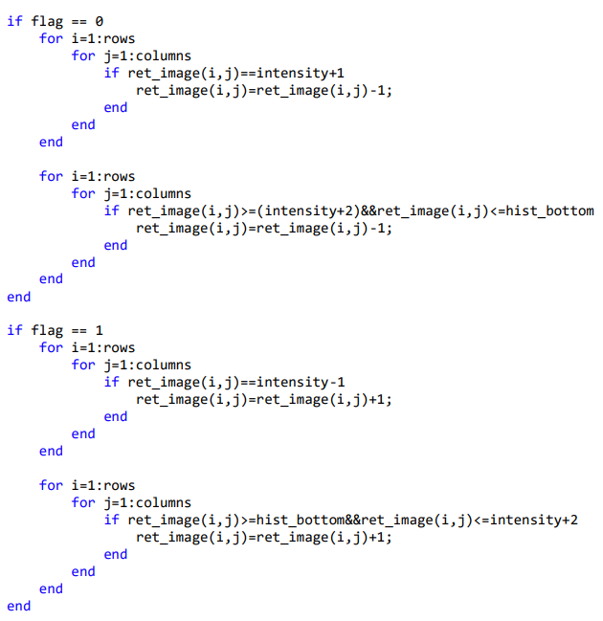
Image Retrieval
Initialize Variables: The watermarked image return_image is copied to ret_image. This image will be used to retrieve the original image.
Retrieve Original Image (Left Shift):
If flag is 0, the original image is retrieved by increasing the intensity of certain pixels in ret_image. The specific pixels to modify are those with an intensity equal to hist_peak - 1 or between hist_peak + 1 and hist_bottom. If the intensity of a pixel is hist_peak - 1 or hist_peak + 1, the intensity of the pixel in ret_image is decreased by 1.
Retrieve Original Image (Right Shift):
If flag is 1, the original image is retrieved by decreasing the intensity of certain pixels in ret_image. The specific pixels to modify are those with an intensity equal to hist_peak - 1 or between hist_bottom and hist_peak + 2. If the intensity of a pixel is hist_peak - 1 or hist_peak + 2, the intensity of the pixel in ret_image is increased by 1.

Slide 16
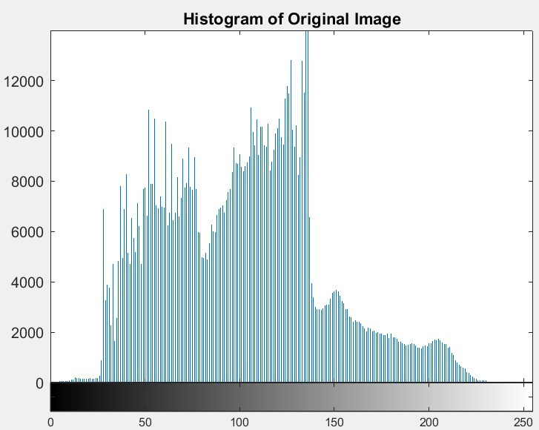
Histogram Analysis

Slide 17
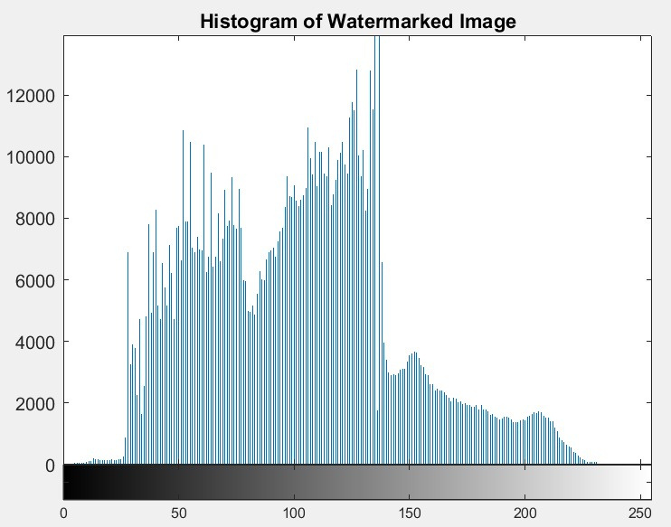
Histogram Analysis

Slide 18
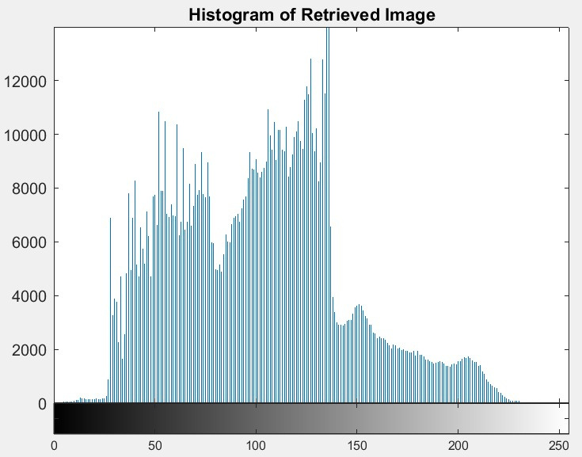
Histogram Analysis

Slide 19
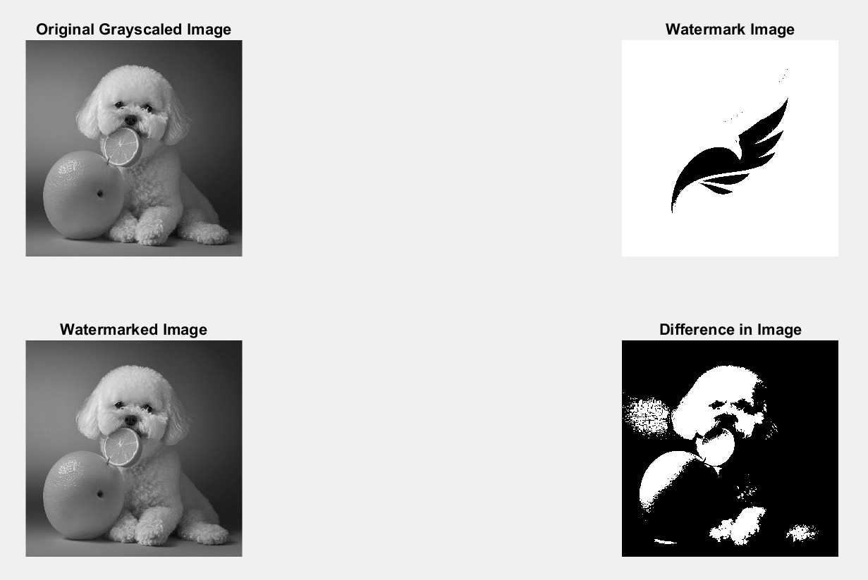
Comparision of Watermarked and Original Image

Slide 20
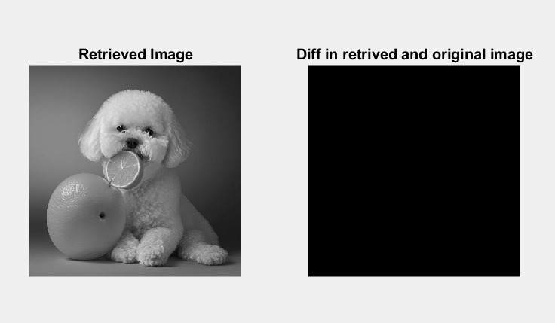
Comparision of Retrieved and Original Image

Slide 21
Implementation Details
The implementation of the methodology is realized in MATLAB, utilizing the image processing toolbox. The code reads an input image, converts it to grayscale, performs histogram analysis, determines the shifting direction, applies intensity shifting, embeds and retrieves the watermark, and finally, restores the original image. Key components of the implementation include:
Iterative pixel-wise operations for intensity shifting.
Dynamic determination of shifting direction based on histogram analysis.
Binary watermark embedding and retrieval based on pixel intensity values.
Reversibility to ensure that the original image is fully recoverable.

Slide 22
Reference
Reversible Image Watermarking Based on Histogram Modification E. Chrysochos, V. Fotopoulos, A. N. Skodras, M. Xenos
Reversible Image Watermarking Based on Histogram Shifting Technique Pallavi P. Salunkhe,Dr.Y.K. Kanse
A Recent Survey of Reversible Watermarking Techniques Asifullah Khan*, Ayesha Siddiqa, Summuyya Munib, and Sana Ambreen Malik
'A modified Histogram Shifting Based on Reversible Data Hiding,Wien Hong, Tung-Shou Chen, 'Kai-Yung Lin and 'Wen-Chin Chiang
A Survey on Reversible Watermarking for Multimedia Content: A Robustness Overview ALEJANDRA MENENDEZ-ORTIZ1 , CLAUDIA FEREGRINO-URIBE2 , ROGELIO HASIMOTO-BELTRAN

