Slide 1

IE-5374 G-16
Youtube Trending Videos
YouTube Video Data Analysis for Major English-spoken
Countries
Fengbo Ma
Ankita Yadav
Shaikh Zeeshan Ali

Slide 2
Overview
Sentiment analysis
Wordcloud
PMF and CDF
Joint Probability
1:
PROBABILITY
2: CLUSTERING
3:
TEXT MINING
4:
TIME SERIES
K-means
Gover distance
Heat Plot
Regression Plot

Slide 3

Data Cleaning
Date change
Check for NA (Accept NA for description)
Duplication
Only deleting two excactly the same for all columns
Same video title (series)
Different published date
Different view count
Enriching
Category ID

Slide 4
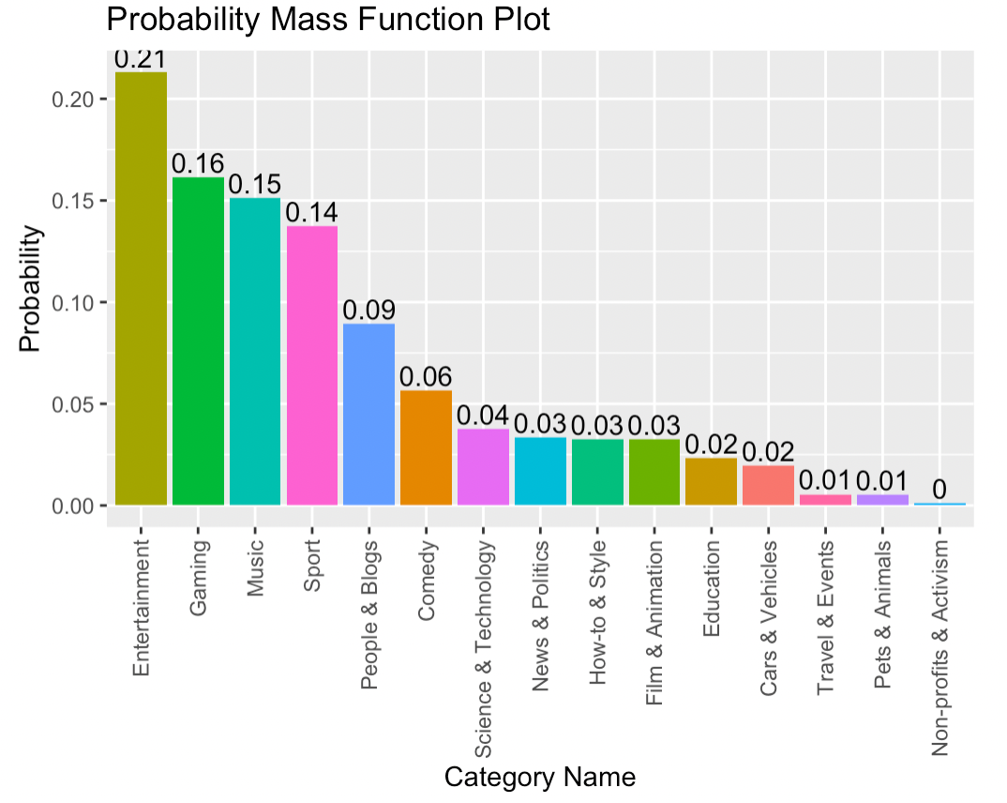
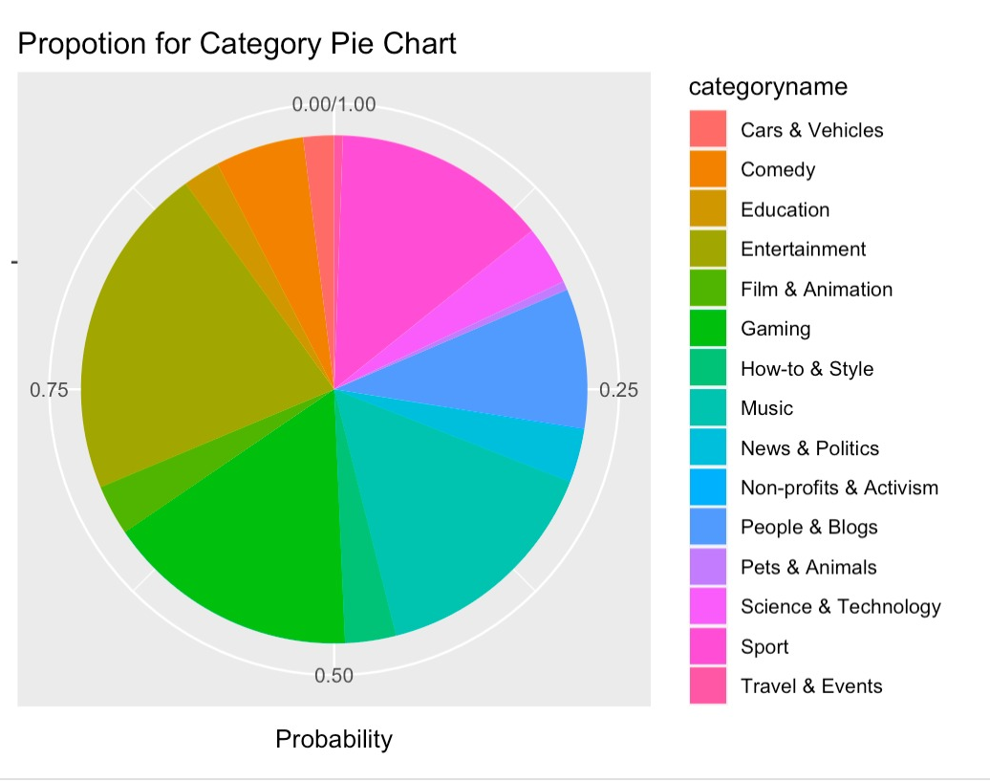
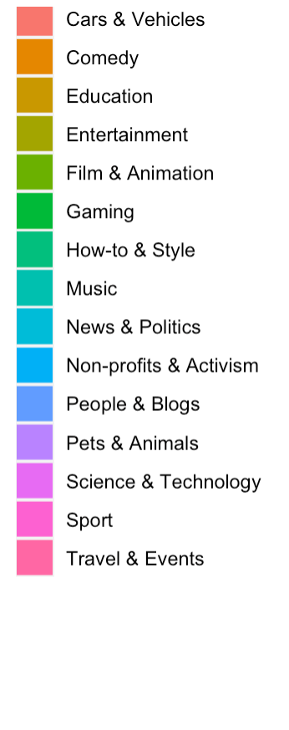
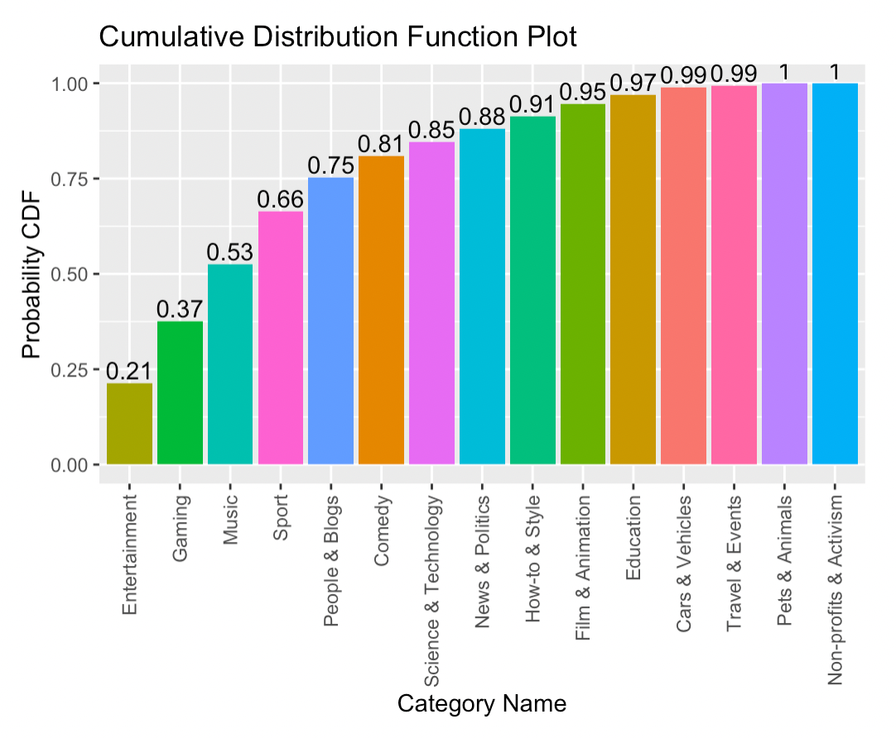
Most Trending Categories
PMF:
f(x)= P(X=x)
CDF:
F(x) = P(X ≤ x)

Slide 5
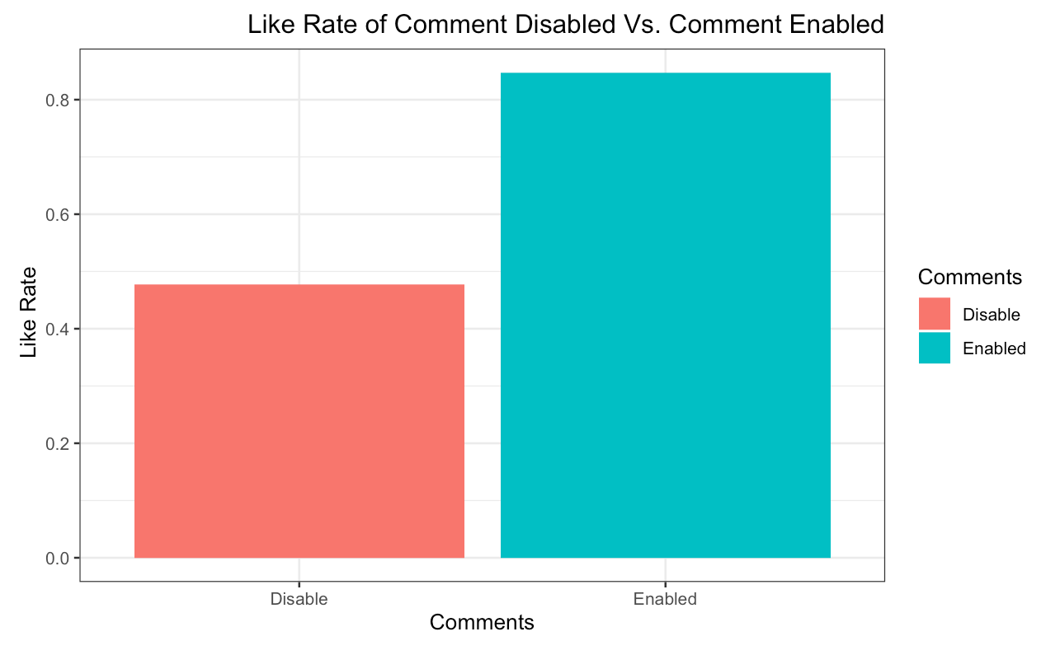
What is probability of getting a higher like (>10000) and getting comment disabled?
Will disabling the comment bring more likes to the video ?
P(A) - Likes greater than 10000 = 0.8469564
Total Records
P(B) - Number of videos with comments diabled
Total Records
P(B) = 0.00952318
Probability: P(A ∩ B) = P(A) * P(B) = 0.00799544

Slide 6
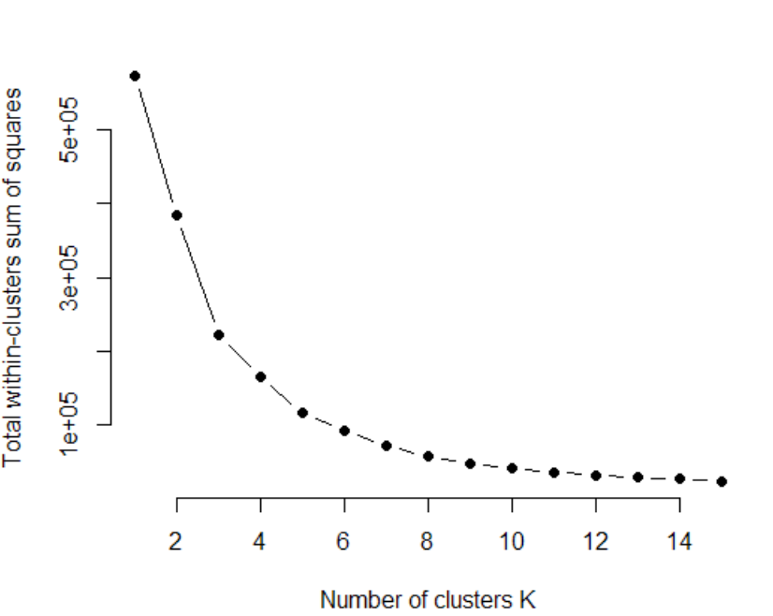
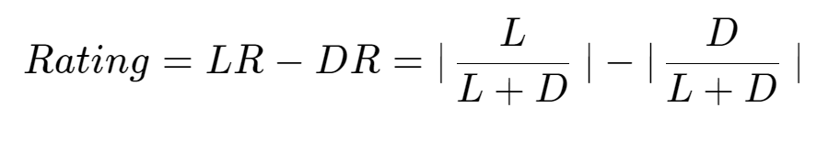
Analysis Clusters Between Number of Views and Rating
Rating (-1 ~ 1)
Number of view
K-mean
Find K by Ellbow Method
K = 5

Slide 7
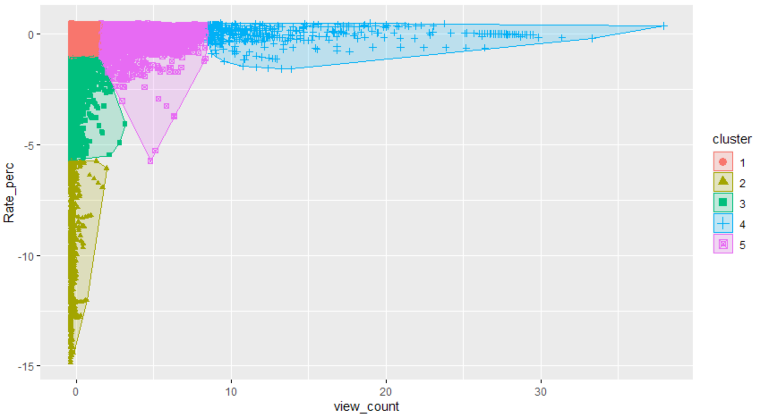
Analysis Clusters Between Number of Views and Rating
Videos few people watch (1.5M)
Few likes
Zero likes
Few dislikes
More people watching (25M)
Divergent rating
Top trending video (100M)
Also high like rate
Observation
No high view low rating
Why

Slide 8
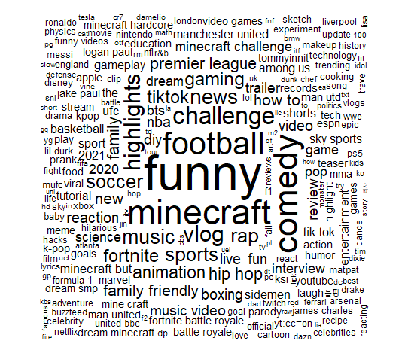
Text Mining for Tag Appeared the Most (Word Cloud)

Slide 9
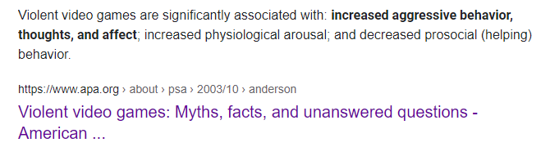
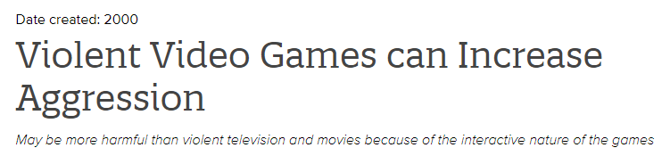
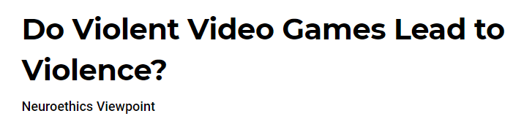
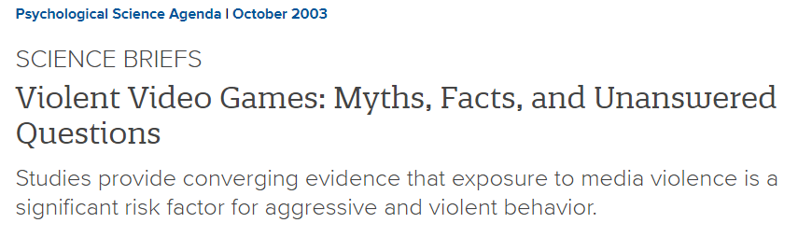

Slide 10
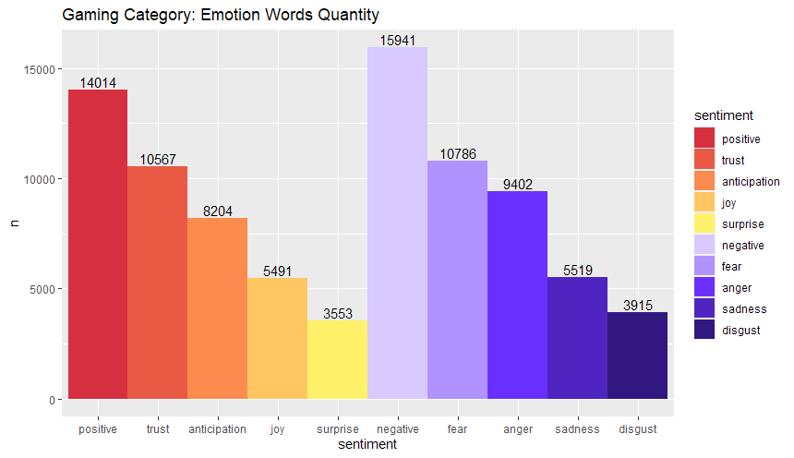
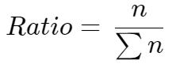
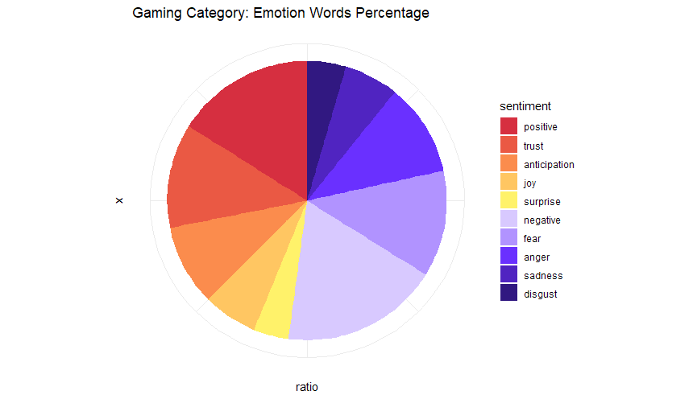
Do Video Games Increase Negative Feeling for People?
Text minning on video titles
Remove symbols
Remove stop words
Bring in Sentiment Lexicons
NRC
Ratio (sum up to 100%)

Slide 11
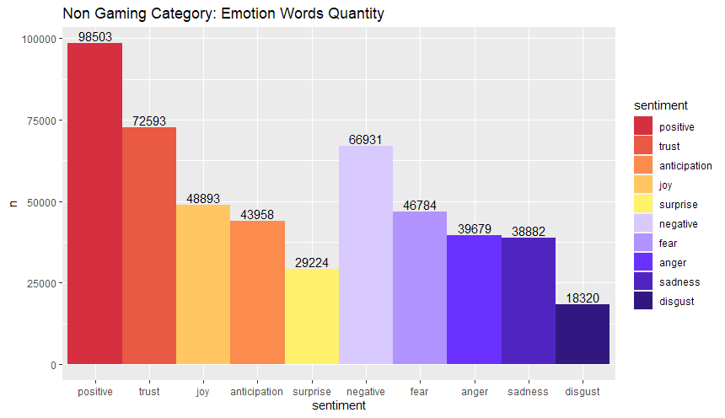
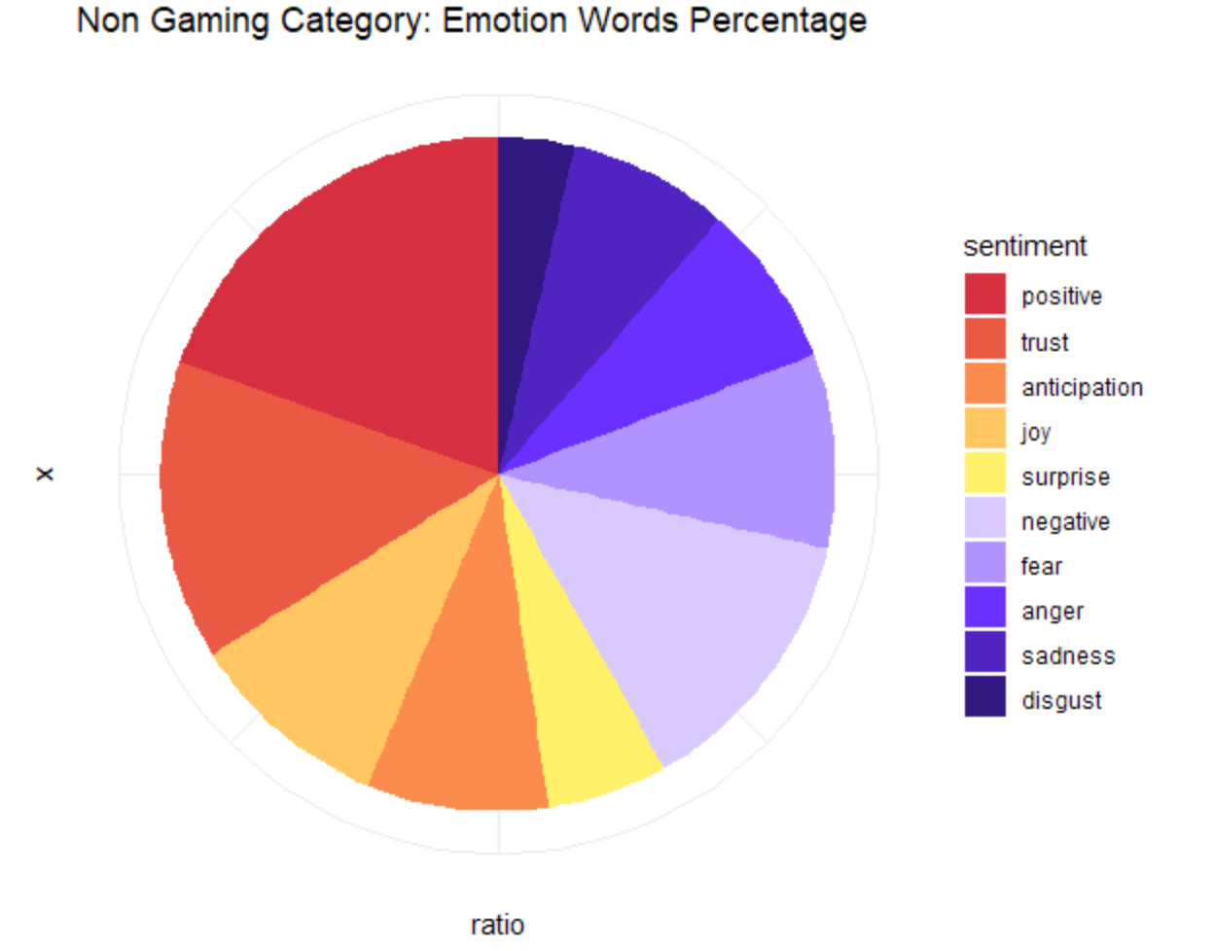
For Non-gaming Categories…
Observation
More positive words
More positive community
Maybe games really drives people crazy…
But is this true?

Slide 12
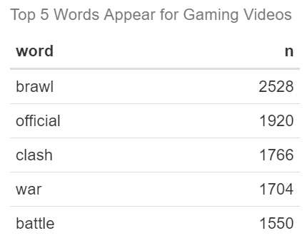


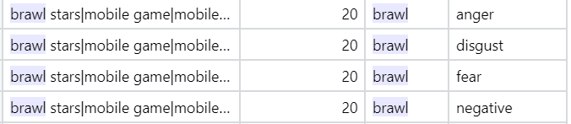
We Could Not Say for Sure
Our way of approaching is not perfect
Top 5 words appered the most for gaming video title
Game name contain negative meaning
Unable to clean out game names
Game names matters
Example
Brawl - a rough or noisy fight
Brawl Stars (MMOTPS)
Negative words count mutiple times
Bias
Actual meaning of the title
NBA 2K top shooting clips
Maybe gaming community is not that bad at all…

Slide 13
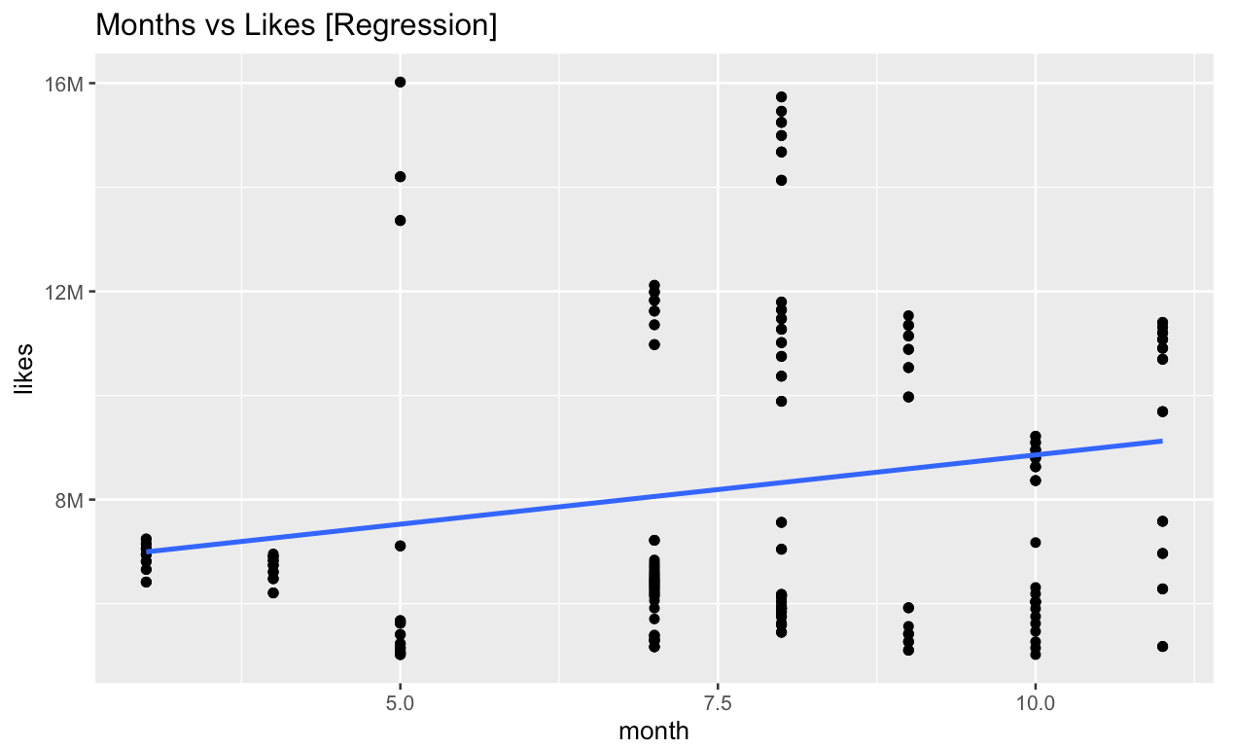
Is youtube community having more and more high quality videos (likes over 5M) being published?
Method:
Filtered 5M likes
Used lm() function
Plotted the regression plot for all the months
Observation:
A positive linear trend

Slide 14


Thank You

