Slide 1
SHELFSENSE
On-prem store server
price compliance
Using an edge AI model
llama3.2:3b
Meta Llama 3.2 · 3 billion parameters · about 2 GB
Local Ollama on the store GPU. The photo and the model stay in the store.
Notes:
Open with the one-sentence purpose: catch a wrong shelf price before a customer does, on hardware that stays in the store.

Slide 2
What this achieves
An associate points a phone at a shelf label.
The phone reads the barcode and the printed price. The photo stays on the device.
The laptop, acting as the store server, checks those numbers against the price list.
A wrong label becomes a short task, with a one-hour or four-hour deadline from the store SOP.
If the network or the model is down, the scan is kept and the task is still written.
Notes:
Bigger picture before any architecture. Compliance and revenue: a shelf price lower than the system may have to be honored at checkout.

Slide 3
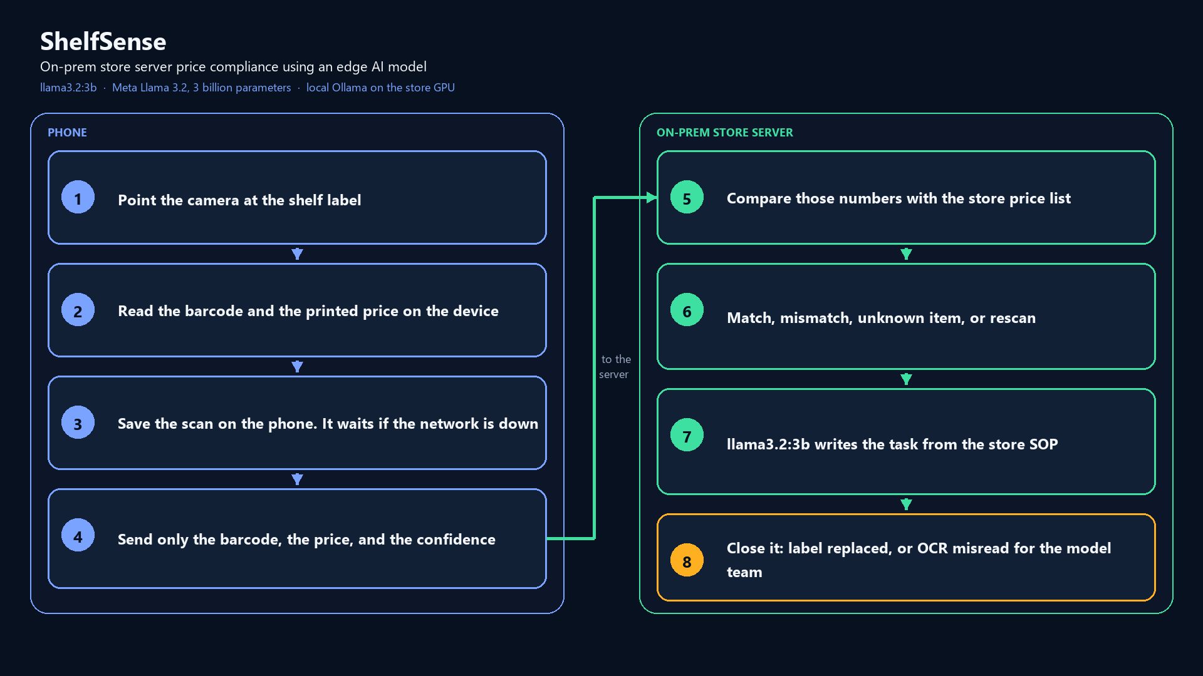
Notes:
Walk the eight steps. Stress step 4: only barcode, price, and confidence cross the network. Step 7 is llama3.2:3b. If Ollama is stopped, the source flips to rules.

Slide 4
Phone side
Camera looks at the label. Barcode and price are read on the device.
The associate taps Capture. The scan is stored on the phone with its own id.
Airplane mode does not lose the scan. Sync now sends it when Wi-Fi returns.
A retry is safe. The server ignores a scan it has already stored.
On a rugged handheld, the hardware scanner can fill the barcode. A regular phone uses the camera for both.
Notes:
The demo phone is any Android device with a camera. Point shelfsense.baseUrl at the laptop Wi-Fi address, with a trailing slash.

Slide 5
On-prem store server
price compliance using an edge AI model
This laptop is the store server. Dashboard: http://127.0.0.1:8000
Price check is a rule against the price list, not a guess by the model.
Edge model: llama3.2:3b, Meta Llama 3.2, 3 billion parameters, about 2 GB.
It runs locally with Ollama on the store GPU and writes the associate task.
Stop Ollama and the same task is written from fixed rules. Source changes from llm:llama3.2:3b to rules.
Notes:
API key for the dashboard is the SHELFSENSE_API_KEY you started the server with. llama3.2:3b is pulled with Ollama and is not stored in this repo.

Slide 6
How a scan is decided
Match. Shelf price and system price are the same. An open issue for that item closes.
Mismatch. Prices differ. Shelf lower than system: fix within 1 hour. Shelf higher: fix within 4 hours.
Unknown item. The barcode is not in the price list. Set it aside.
Rescan. The price was missing, or confidence was under 0.60.
Close a mismatch as Label replaced, or as OCR misread. A misread is kept as a labeled example.
Notes:
Demo labels: Cola 12pk at $6.99 is a match. AA Batteries label is $9.99 versus system $10.99, the 1-hour case. Tissue Box label is $3.99 versus system $3.49, the 4-hour case. Read the price columns before reading the model sentence.

Slide 7
Five-minute demo
1. Dashboard is empty. This laptop is the store server.
2. Scan Cola at $6.99. Match. Only two numbers crossed the network.
3. Scan AA Batteries, label $9.99, system $10.99. Mismatch, 1-hour task, source llm:llama3.2:3b.
4. Airplane mode, scan two labels, then Sync now.
5. Stop Ollama and scan again. Source becomes rules. Then mark one row as an OCR misread.
Notes:
Labels file: D:\AI\projects\shelfsense\server\labels.html. Backup with no phone: python simulate_scans.py --server http://127.0.0.1:8000 from the server folder, with SHELFSENSE_API_KEY set.

