Slide 1
FOOD SWIPE
SRS DOCUMENT PRESENTATION

Slide 2
01
02
03
Who we are
What we are offering
Market & Competition
Food swipe is an internet-based application and web browser through which customer order from our site and allow restaurants to sell on a widely used platform.
with the largest marketplace through which customers can easily access and order from multiple categories at a cheap cost with different payment option
Other than other apps we are providing low-service chargers from sellers. And an exceptional customer service as they are first priority

Slide 3
Stakeholders
Customer
Project Manager
Business Analyst
Application Architect
Designer
Developer
Product Owner
Data Modeler
Process Analyst
Tester
Product Manager
Quality Assurance Staff
Documentation Writer
Database Administrator
Hardware Engineer
Infrastructure Analyst
Business Solution Architect
Seller
Delivery Man
Banking Companies( Visa, Easypaisa etc)
FBR
Government Agency
Share Holders
Hosting Servers
Development Manager
Marketing
Operational Support Staff
Legal Staff
Information Architect
Company Owner
Sales Staff
Installer
Maintainer
Program Manager
Usability Expert
Subject Matter Expert
Executive Sponsor
Project Management Office
Manufacturing
Training Staff
Portfolio Architect
Infrastructure Support Staff
Acquirer
Procurement Staff
Contractor
Subcontractor
Business Management
Program Manager
Beta Tester
General Public
Material Supplier
Venture Capitalist
Market Research Specialist
Lawyers
Product Champion
Session Leader
Analyst
Scribe

Slide 4
Our Deliverables
Software requirements specification document
Prototype of customer module
Prototype of seller module
Prototype of delivery module
Design of customer module
Design of seller module
Design of delivery module
Main requirements implemented of customer module
Main requirements implemented of seller module
Main requirements implemented of delivery module
Integrated application with all the prioritized requirements
Initial version of the application ready for deployment
MyDelivery

Slide 5
Success Criteria
1M+ Downloads
The application will be considered a success if within a year after the initial launch it will have over 1 million downloads across all smartphone devices. The application should be used to order food 200,000 times across a week on average after 8 months of launch and should amass a collection of at least 2000 sellers over the aforementioned period. The application should also have a rating above 4.5 stars on Google Play store and Apple store.

Slide 6
Constraints
Only a registered user can order
Non-Registered users can view only the Restaurant and their menu
Within 4-6 km our rider will be delivering the food
The memory usage of the app will have to be constrained by the devices it is intended to run. Since most Tablets and mobile may have limited apps
Internet enable is required
The system would require permission for data storage
The primary candidate toolchains are Java/Swing, C++/SQL
The system must provide a capacity for parallel operation and system design should not introduce scalability issues about the number of surface computers, tablets, or displays connected at any one time
If the system is down, then customers must not notice or notice that the system recovers quickly (seconds)

Slide 7
Assumptions
Food delivery is quite convenient and all raw materials are available
The quality of food may not suffer
Every order from a customer must be satisfied by exactly one delivery vehicle
The transportation time between delivery centers and customers is fixed based on distance (It is assumed that traffic conditions are always fixed)
All the cars are maintained and are unlikely to breakdown
No customer demand will exceed the capacity of a transportation vehicle
The operating hours for the online system are as the business operation hours which is from 8:00 AM to 12:00 PM every day
The operation depends on the changes being made by the restaurant regarding available food and delivery.

Slide 8
Action Enabler
If some item is not available then notify the user.
If user ordered a meal from a restaurant then recommend “beverages” and “desserts” items to user before completing the order.
If the restaurant is closed then the order will not be confirmed and the user will be notified via email
If user submits unsatisfactory feedback about delivery service then the server will call the user for clarity
If the user orders from one restaurant then the order will be directed to the user history.
If the user uses credit/debit or any other card method for online payment, then he/she will be notified about the amount deduction by our delivery app.

Slide 9
Computations
Sales tax of 8% shall be added to each order
A state income tax of 5% is to be withheld from the total pay
The food delivery application will pay income tax of 20% of their profits to the government
The restaurants will pay 25% of their profits they make by our food delivery application
A generic formula for calculating ETAs (estimated time of arrival) before an order is placed would look like this Pre order ETA = Max [{(Order Preparation Time) * (Peak Hour Multiplier)} + (Delivery on Road Transit Time)]

Slide 10
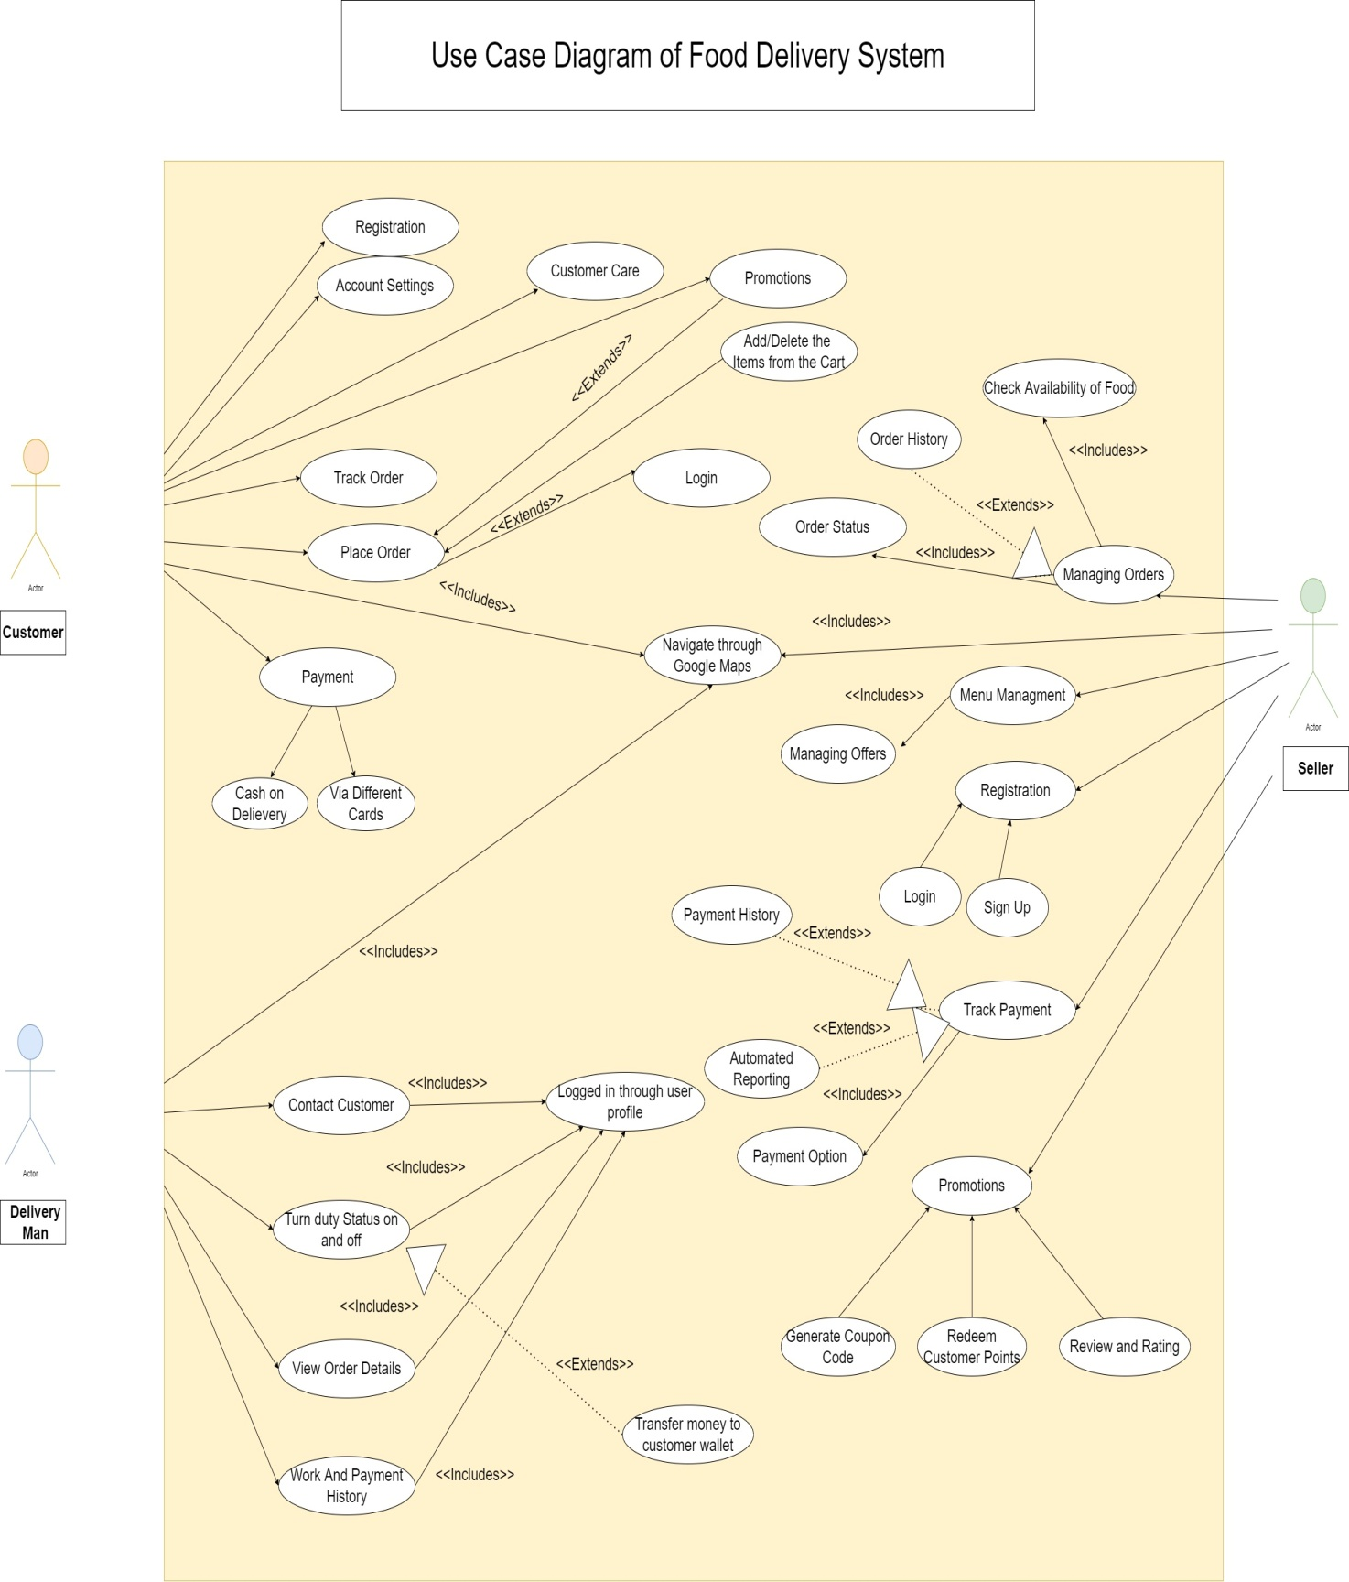
Use Case Diagram

Slide 11
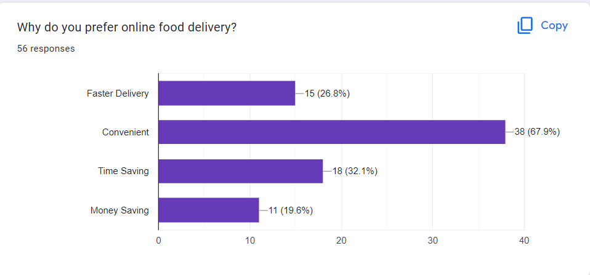
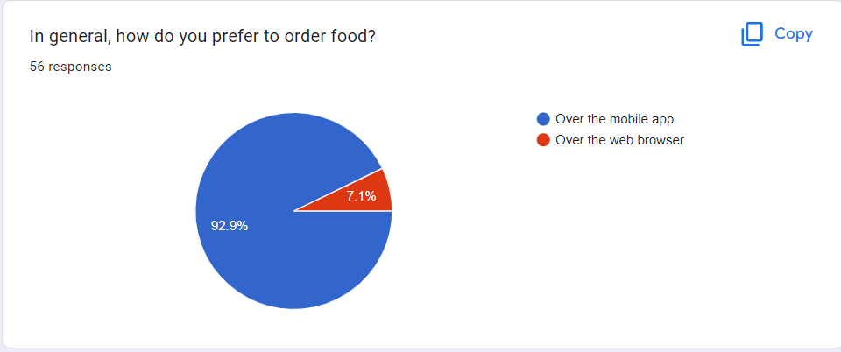
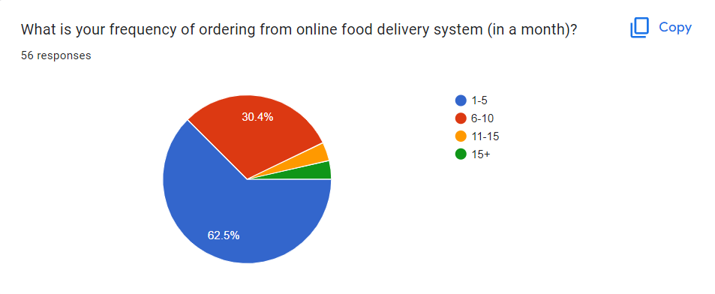
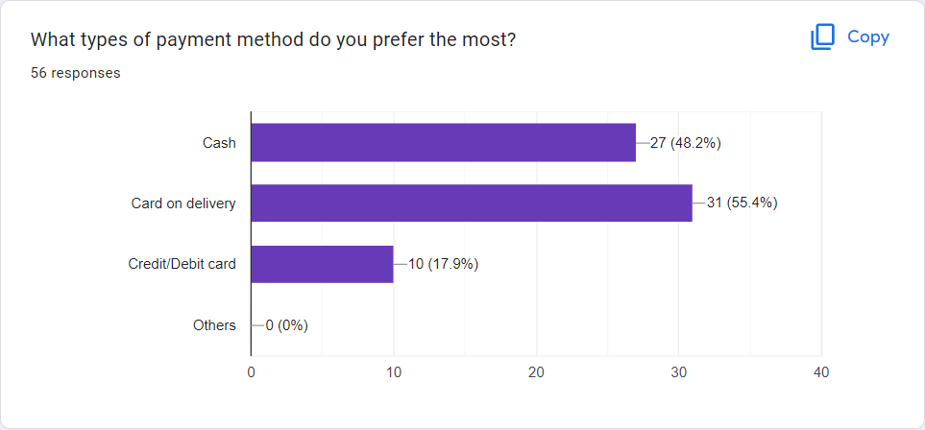
Google Form Response

Slide 12
Our Team
Hussain Mustafa (21k-3808) Ahsan Nadeem (21k-3803) Zeeshan Mustafa (21k-3919) Muhammad Kashif (21k-3818) Suleiman Mohiuden (21k-3887)
Jamaima Baig (21k-3831)

