Slide 1
Citizen Journalism

Slide 2
What Is Citizen Journalism?
The idea behind citizen journalism is that people without professional journalism training can use the tools of modern technology and the global distribution of the Internet to create, augment or fact-check media on their own or in collaboration with others. For example, you might write about a city council meeting on your blog or in an online forum. Or you could fact-check a newspaper article from the mainstream media and point out factual errors or bias on your blog. Or you might snap a digital photo of a newsworthy event happening in your town and post it online.

Slide 3
Goals and objectives
Enhancing the concept of citizen journalism.
It would be a central information based platform(website)
By the end of this project we will be able to provide unbiased newspaper (on our website) with respect to interest of user.
Providing platform for citizen journalism.
Providing unbiased news
Trying to fill the gap between T.V news and public news.
Informing about local issues of Pakistan

Slide 4
Goals and objectives
8. With help of twitter’s data we will be able to know people’ needs, and their likes and dislike. It will help people in business as they will know which good field for investment.
9. Information related to new projects of Pakistan Government can be find there.
10. People will be able to give their point of view on current topic, issues or any policy etc. So, we will be able to know real picture of discussion.

Slide 5
What kind of audience you will have?
Our audience are of two types.
All internet user who have account on social media so that we would be able to provide information more precisely to their interests.
Any user who will access our website to know the current discussion or want to give his point of view on any topic.

Slide 6
Operating Environment:
DataBase:
MongoDb:
Python
Mongoengine (mongodb driver)
Tweepy (twiter api)
Web development
Django (frame work)
HTML5
CSS3
Java Scripts

Slide 7
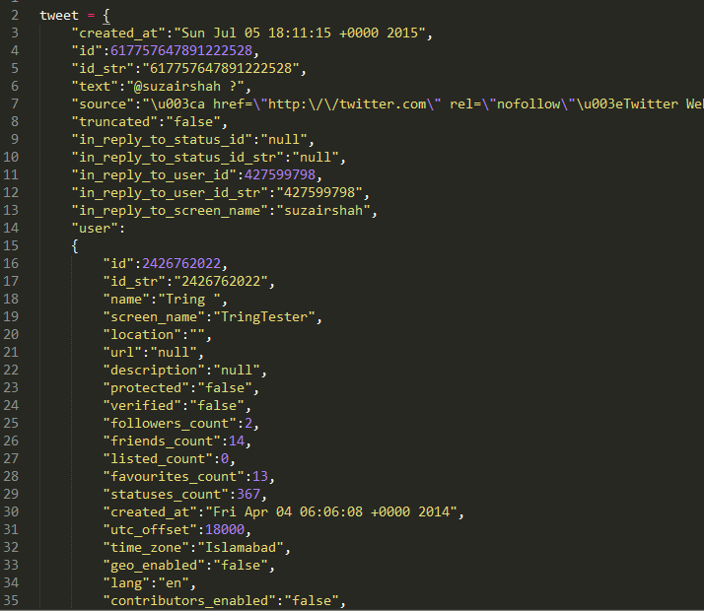
Data and Functionality:
Data of social sites specifically twitter’s data

Slide 8
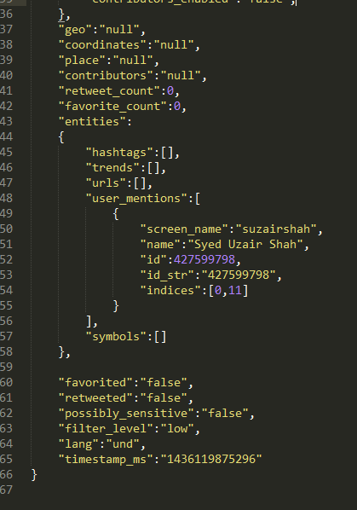

Slide 9
How will you present the data to your user?
When a user will login, a profile will be created against his name. It will be helpful to provide him personalize news related to his interest.
When a user will login we will show him top trends (Top stories) that could be a news or any other special discussion.
In the tab of “hot topics” our system will show most discussed topic of a day and top 5 tweets related to that topic that will help people to understand the summary of that discussion. It will also show statistic by some graphs that how people point of view varies on this “hot topic”. Every user can also give his views by commenting on those statistical graph. About that, hot topic we will also shows numbers how many people tweets about it.
User can also search by “keyword”. In result of that keyword our system will show top 5 tweets about that keyword along with numbers that how many people used this word in their tweets.it will also give list of top 5 people who are talking about it this most frequently. In the end against that query system will show views discussed on new channels and some graph that will show opinion of news channel and opinion of people about his query.

Slide 10
How will you present the data to your user?
Query result will be in three categories opinion of public, anchors and news channels. It will be helpful to compare opinion from different resources.
Every query will give result by comparison of people, anchor, and news channels (as some kind of graph) or top 5 tweets by each category.
User can also search by specifically to some person. As a result system will respond a graph (bar chart) that will show about which topics this person talks a lot. It will be helpful to know activities of that person.
It will also tell which query is searched a lot in our system
User can also download graphs or some other information related date from our website it will also keep track how many people downloaded it

Slide 11
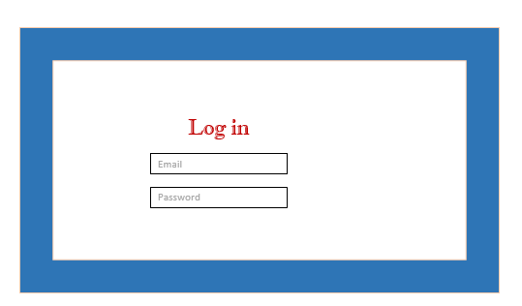

Slide 12
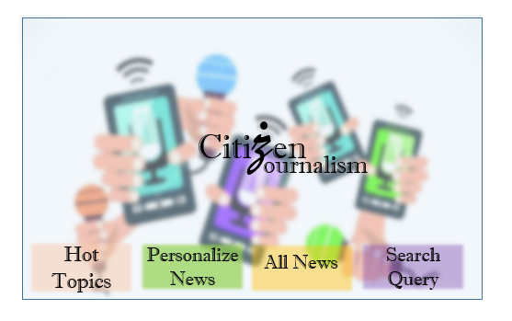

Slide 13
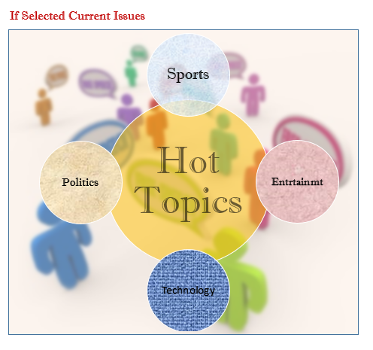

Slide 14
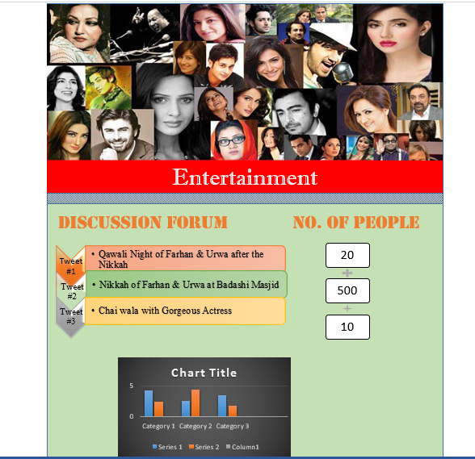

Slide 15
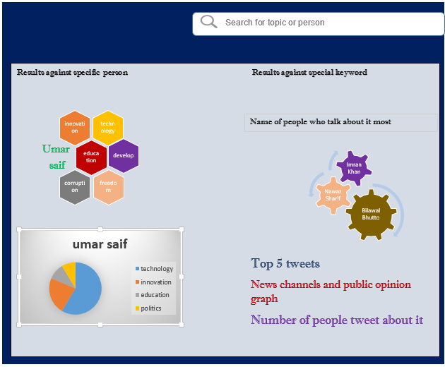

Slide 16
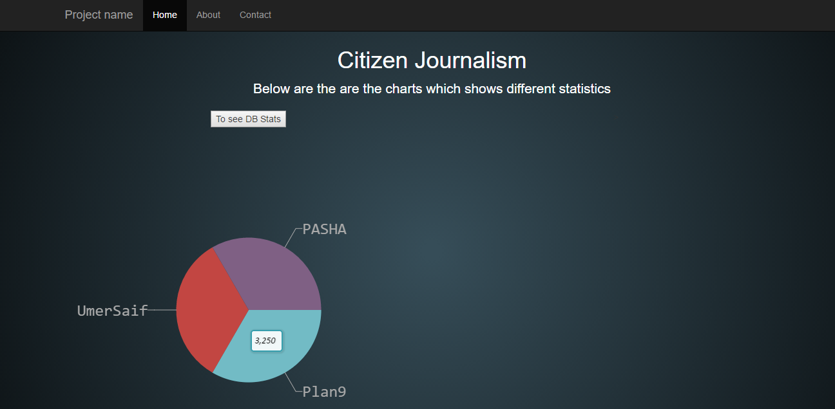
Following is the screen shot of website we are working on

