Slide 1
Presented by: Zeeshan Muzammal BSCS13010 Ayesha Asghar BSCS13033 Arslan Ahmad BSCS13023 Abdul Monam BSCS13039
Citizen Journalism
Presented To:
Dr. Zubair Malik

Slide 2
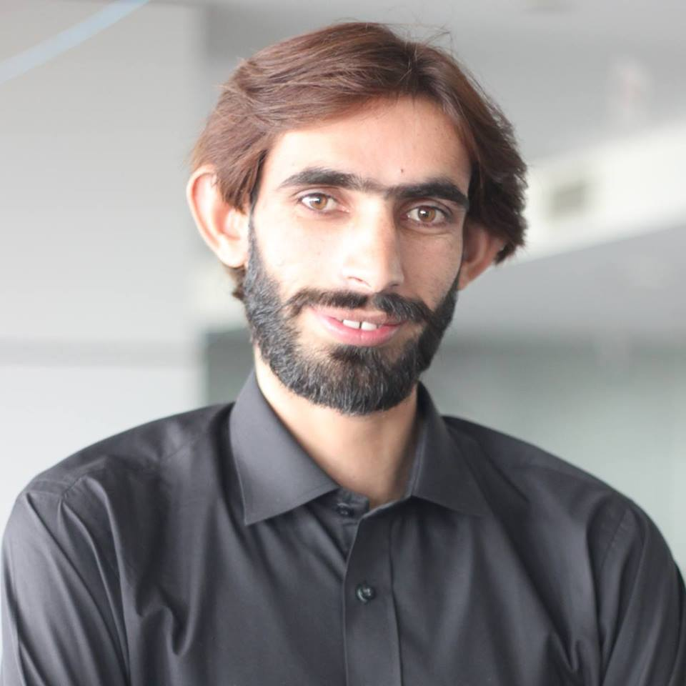
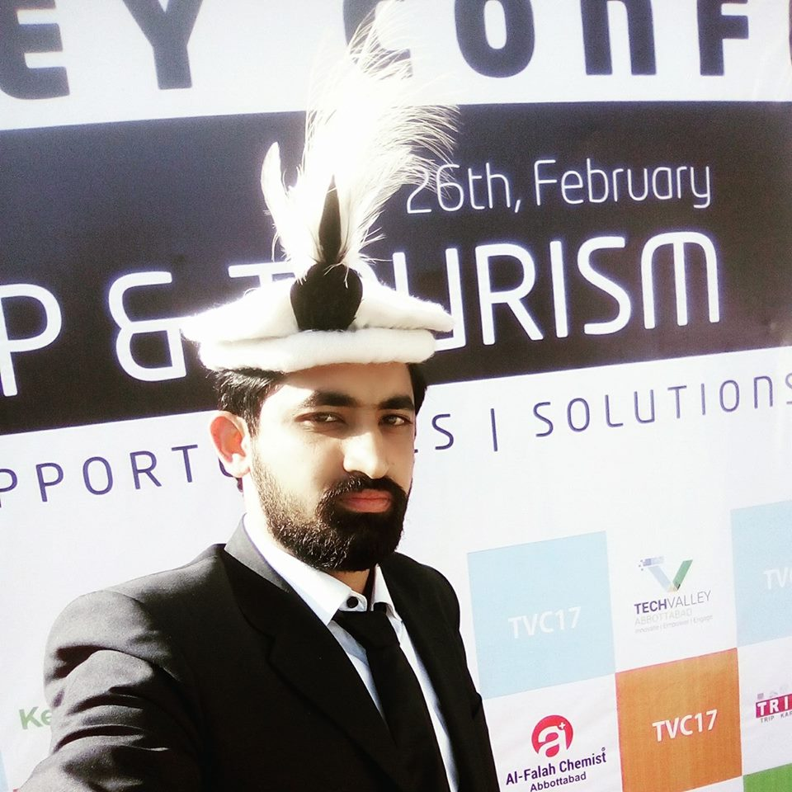
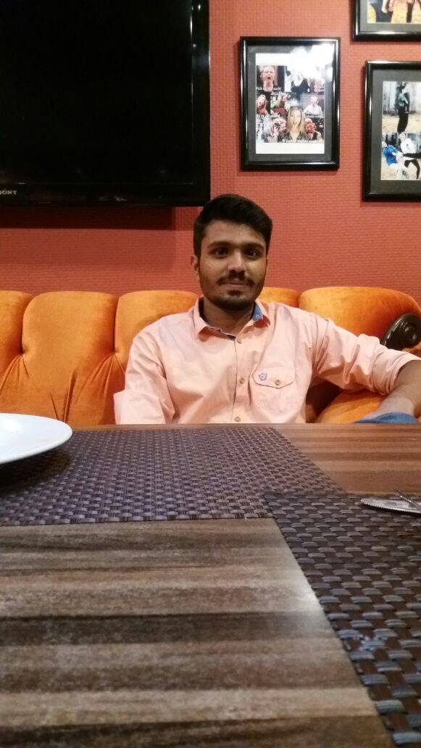
Additional Interviews
Problem Domain: Online News
We interviewed three more people related to our problem domain.
Fahad
Mohabbat Ali
Rana Usman

Slide 3
Outline
Additional Interviews
POV Development
HMW Generation
Best HMWs
Brainstorm Solutions
Best Solutions
Experience Prototyping

Slide 4
POV-1
We met with Fahad Rana, Lahore Business Student don’t have any interest related to news. He do go through news some time when some other person change the channels or when he found out newspaper accidently.
Amazed to realize
He hate news. He think “everything is lie in the news”. He said “I believe on what I see with my eyes are what seems argumentative to me”.
Game Changing to
It will be game changing if one day he would think news are not lie (fake).

Slide 5
POV-2
We met Rana Usman, Fsd, Who follow different pages on social sites to get news and updates about society or world.
Amazed to realize
He used to follow different pages so sometimes news from different channels contradict with each other, so the pages he used to follow consider them biased and not trustworthy.
Game Changing to
Providing a platform which provide unbiased news and public point of view gets importance.

Slide 6
POV-3
We met Mohabbat Ali, CS-student. Watch news channel daily. Listen almost 5 news bulletin in a day. He visit almost 6 different type of channel. He enthusiastically follow news. He also read newspaper daily and almost newspaper of 3 different type.
Amazed to realize
Amazed to realize he spend a lot of time for news. In order to follow lot of new channels he is waste a lot of time. He said some news channels are biased to some specific society. Some are biased for some special personalities. Some channels are biased for some politicians. He has to visit a lot of news channels for unbiasedness
Game Changing to
It will be game changing if he get actual news on one channel. It will save his time.

Slide 7
HMW for POV-1
Q1: How might we create importance of news in his mind?
Q2: How might we create awareness about issues happening around him as a news?
Q3: How might we present news in a way to remove factor that they are not valid?
Q4: How might we create habit to take interest in news?
Q5: How might we make them feel that news source is credible? (news are fake)
Q6: How might we make him feel that news are reality?
Q7: How might we learn that why he is not interested in news?
Q8: How might we make him realize that news is a good source of knowledge?
Q9: How might we make him feel that news are good source for general knowledge?
Q10: How might we make him feel that news are learning curve for his life?

Slide 8
HMW for POV-2
How might we build trust among people for news related program?
How might we let people know about importance of their point of views?
How might we will able to provide unbiased news?
How might we differentiate between biased and unbiased news?
How might we help him to figure out news is biased towards particular party?
How might we help him to validate that news general public providing is valid?
How might we inform that news is biased towards specific issue?
How might we convince user about correctness of particular news?
How might we reduce biasness of the data we provide?

Slide 9
HMW for POV-3
How might we provide news of all channel at one place?
How might we save his time?
How might we provide un- influential news?
How might we reduce biasness of news channels?
How might we give overview of all newspaper only once at a time (together)?
How might we stop him from visiting a lot of channels?
How might we make him realize that news are not biased?
How might we provide him un-biased newspaper so he don’t need to visit other newspaper
How might we provide him alternate of other sources?
How might we help him to trust a specific news provider over others?

Slide 10
3 Best Selected HMW
Q.1 How might we stop him from visiting a lot of channels by providing news on one platform to save his time?
Q.2 How might we provide him un-biased newspaper related to his interest so he don’t need to visit other newspaper and visit only once at a time (together)?
Q.3 How might we create awareness about importance of news and about issues of news channels?

Slide 11
Brainstorm Solutions
Q.1 How might we stop him from visiting a lot of channels by providing news on one platform to save his time?
Possible Solutions:
Provide a new news channel that should be unbiased
A news channel that show overview of all a news in term of news obtained by all channels
Get video of a news from all channels related to o news and provide that on website
Get news through any source and provide news on website as a written form
Providing a website where people will talk about a news and and as majority will be talking about it so it would be an unbiased

Slide 12
Brainstorm Solutions
Q. How might we provide him un-biased newspaper related to his interest so he don’t need to visit other newspaper and visit only once at a time (together)?
Provide central platform which will contain all sorts of information
Personalize newspaper which can be attracting part in platform
Combine all news of newspaper in such a way that they will feel they have overview of all news paper
Get information about their interest and always make a e-paper format and and put the content of news based on majority voting

Slide 13
Brainstorm Solutions
5. A website on which news of all newspaper is accumulated.
6. On that website he can select his interest and can get all news according to his need.
7. He should select a credible source of news and most accurate source of news so, that he could refrain from other news sources.
8. News accumulative on one blog
9. Video sources on which all news are presented at one time.

Slide 14
Brainstorm Solutions
Q.3 How might we create awareness about importance of news and about issues of news channels?
Through social sites
Awareness campaigns
Target more active and trustworthy people to communicate problem/issue
Through blogs by giving different examples
TV shows of popular channels
Ads on TV and radio
Plan different events
Magazines and newspapers
Personally visits communities and aware people

Slide 15
Best Solutions
How might we stop him from visiting a lot of channels by providing news on one platform to save his time?
Get news through any source and provide news on website as a written. Providing a website where people will talk about a news and as majority will be talking about it so it would be an unbiased

Slide 16
Best Solutions
How might we provide him un-biased newspaper related to his interest so he don’t need to visit other newspaper and visit only once at a time (together)?
Personalize newspaper which can be attracting part in platform and based on news from all news channels

Slide 17
Best Solutions
How might we create awareness about importance of news and about issues of news channels?
Through Social Sites

Slide 18
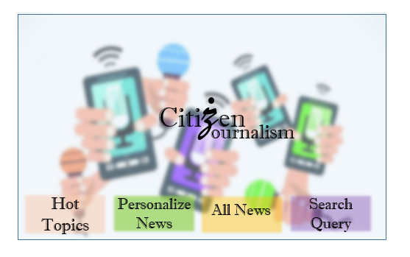
Prototype

Slide 19
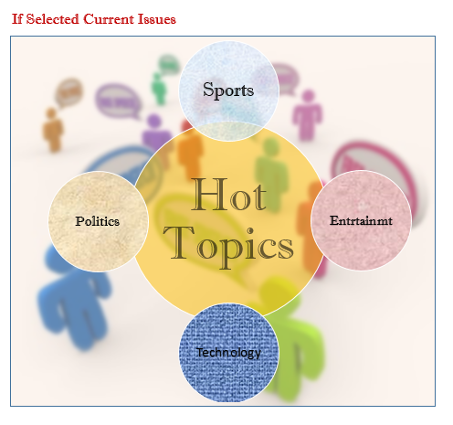

Slide 20
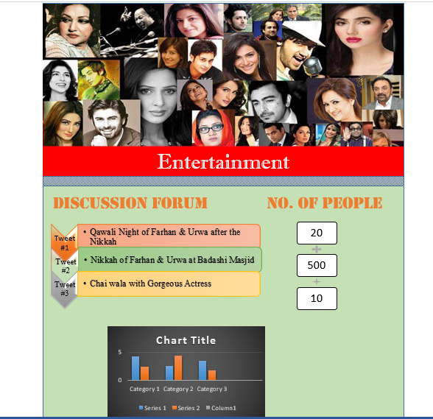

Slide 21
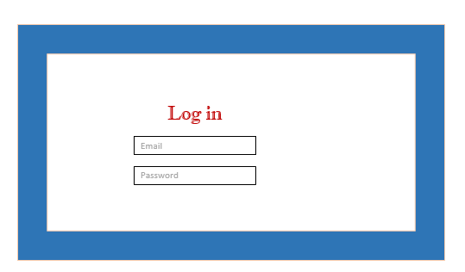
Prototype- 2

Slide 22
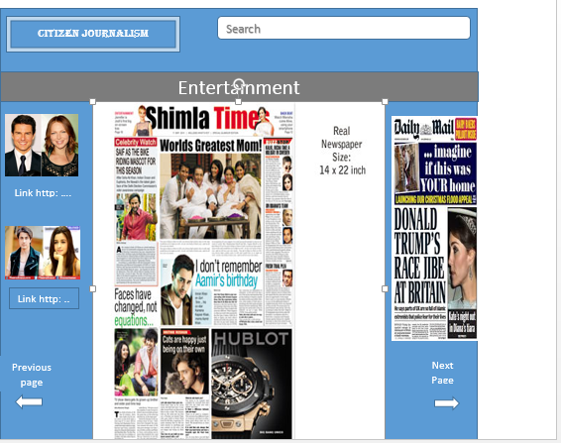

Slide 23
Testing phase
Tested with three users
Tested with same people whom we interview
Tested at their work place
Were happy to see low fidelity after interviews

Slide 24
Things that work
Like news presented in graphs
They like personalized news’s part in prototype
Make no errors almost while using mockups
Create log in easily using mockups

Slide 25
Things Didn’t work
Were not much comfortable with heavy texts
Want concise form of news extracted from those tweet

Slide 26

Questions

