Slide 1
Presented by: Zeeshan Muzammal BSCS13010 Ayesha Asghar BSCS13033 Arslan Ahmad BSCS13023 Abdul Monam BSCS13039
Presented To:
Dr. Zubair Malik

Slide 2
Introduction
Problem Domain
We are providing a platform for Citizen Journalism.
We are restricted to Pakistan’s data only
Motivation
Now a days, we get news and all information through news channels, newspapers or from social media. That information could be biased because a single person, news channels cannot represent public point of view on specific issue.

Slide 3
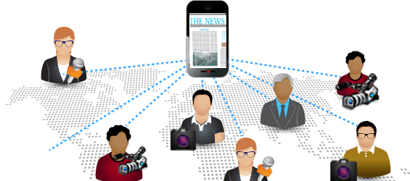
Citizen Journalism
In Citizen journalism People without professional journalism training use tools of modern technology to express their point of view on activities and news happening around them to considering it as a news.
It is public participatory reporting

Slide 4
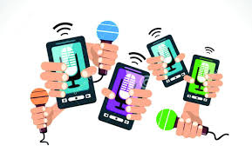
Cont’d
We decided to implement idea of Citizen Journalism through twitter
Decided to get tweet of different news channels
Anchor and general public.

Slide 5
Goal and Objectives
Providing platform for Citizen Journalism
It would be a central information (news) based platform(website)
Providing unbiased news
Trying to fill the gap between T.V news and public news
Informing about local issues of Pakistan

Slide 6
Need finding Methodologies
Identifying stake holders
Did interview of 6 people
Make questionnaire before interview
Interview people, age group from 20-28
Mostly people of this group are more active on social sites
Know importance of their point of view
Did random sampling

Slide 7
Need finding Methodologies
Why do we choose these people ?
People from diverse background
Diverse point of view
Professionals have experience based knowledge
Students

Slide 8
Questions
Do you use social media?
(If yes) do you have twitter account? (If No) why not?
(If yes) Do you have account on social sites?
(If yes) what kind of information usually you post?
What social site you prefer while you have something important to post?
How often you prefer twitter over other social media sites?
What kind of information you post usually?
What is the source of information? Or type of information primary/ secondary?
Do you think current media is biased towards some specific political parties?
Do you want unbiased platform?

Slide 9
Questions
Do you think you need a platform where your point of view will get value?
Where do you get news? Is it from Television or newspaper or social media?
What do you think is good media for get news??
What if we provide a news that is majority of people agree or talked about that will you use it?
What if we provide news based on tweets of different people using data science technique will you use it?
Do you follow any website to get news or information?
(If yes) please tell me name?
(if yes) why do you use this specific one ??
What do you think news feed of Facebook is also a kind of news bulletin?
Does news in Facebook’ news feed are trustworthy?
What is your point of view on the news you get from Facebook ?is it beneficial or not?

Slide 10
Name: Luqman Aziz Age: 24 Profession: Student
Interview #1

Slide 11
Empathy Map
Say
Use Social sites
Do not have twitter account
Posts related to travelling etc.
Get news from television and newspapers
Think
Facebook news feed is not trust worthy
Do
Doing software engineering
Should complete this project
Feel
every channels is biased
Do not like twitter much
Will be a fantastic platform
Appreciate effort

Slide 12
Name: Saad Saleem Age: 26 Profession: Lab attendant
Interview #2

Slide 13
Empathy Map
Say
Use Social sites
Do not have twitter account
Posts related to random events.
Secondary information
Get news from siasat.pk
Think
He thinks news I get from Facebook are beneficial to some extent
News channels are biased
Do
Lab Attendant
Get news from multiple social sites
Feel
Use multiple social sites is a wastage of time

Slide 14
Name: Ahmed Ajmal Age: 21 Profession: CS Student
Interview #3

Slide 15
Empathy Map
Say
Use Social sites
have twitter account
Post on Facebook and twitter both
2nd preference is twitter
Think
Thinks media is biased towards specific political parties
Do
CS student
Watch TV news and political shows
Feel
Do not like to post on social sites
Much
Consider it a good and will be beneficial
Tv news are biased

Slide 16
Name: Rana Usman Age: 22 Profession: CS Student
Interview #4

Slide 17
Empathy Map
Say
Use Social sites
have twitter account
Source of information are urdu point and express tribune
Think
Facebook news feed present scattered news
Do
CS student
Source of information are social sites
Feel
Facebook news feed is not trust worthy
Facebook is not a good platform for news

Slide 18
Name: Faiza Age: 28 Profession: Microbiologist
Interview #5

Slide 19
Empathy Map
Say
Use Social sites
have twitter account
type of information is secondary
Watch TV to get news
Follow Dawn.pk
Think
Thinks social media is biased
News feed of Facebook gives highlights of peoples’ life belongs to you
Do
Microbiologist
News paper and Facebook
Feel
Huge need for unbiased platform
Facebook news feed is not trust worthy

Slide 20
Results of interview
People were excited about our project
Social media was the source of information
Facebook and twitter
Type of information they post is secondary

Slide 21
Result Cont’d
Our assumption gone wrong
Consider news biased towards specific party, person etc
Follow news channels through their social web pages
Post information related to technology, politics and personal affairs on social sites

Slide 22
Analysis
They were very critical against the behavior of current news channels
During question related to TV channels they get hyper against politician
Their behavior was friendly
There environment looks good. They look as new technology user
They were using laptop and mobile.
They said their day passed happily
We infer they want un-biased news from some source

Slide 23
Summary
Aim is to provide platform on concept know as Citizen Journalism
Available sources of information can be biased
Information related to categories like:
Politics
Technology
Entertainment
People appreciate this platform and excited about this
Personalize news is interesting thing for people

