Slide 1
Online News
Presented by:
Zeeshan Muzammal BSCS13010
Ayesha Asghar BSCS13033
Arslan Ahmad BSCS13023
Abdul Monam BSCS13039
Presented To:
Dr. Zubair Malik

Slide 2
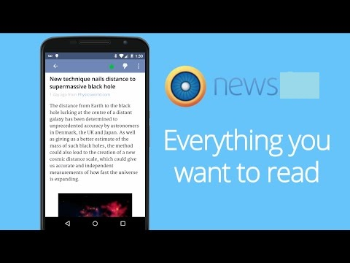
Value Proposition
“All unbiased news along with Personalized News”

Slide 3
Problem/Solution
Most of the people get news that are biased toward specific people or society. All available sources of news provide separate news about same topic that confuses people. Some people want to see news only related to their interests.

Slide 4
Selected Interface

Slide 5
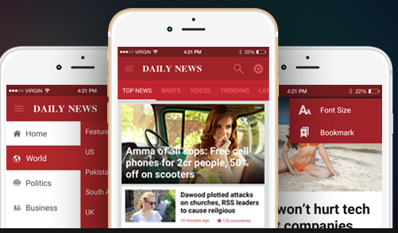
Selected Interface
Mobile Application:
Everyone carries it
Simple familiar UI
Socially connected

Slide 6
Low-Fi Prototype

Slide 7
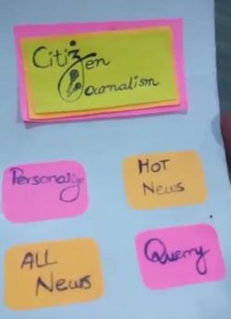
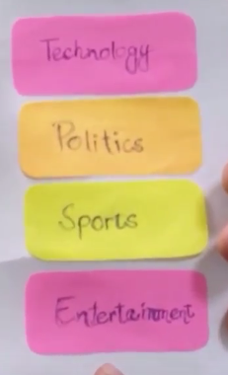
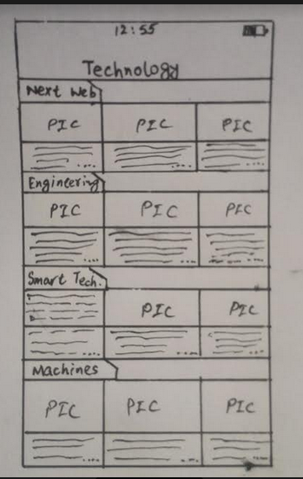
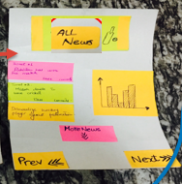
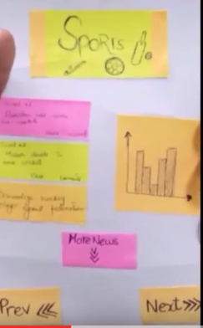

Slide 8
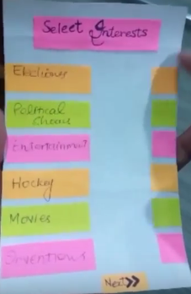
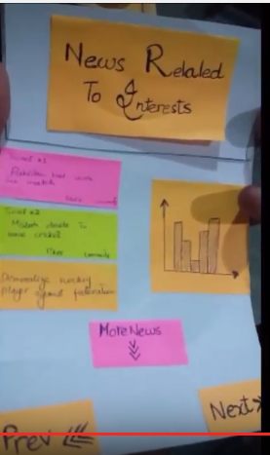

Slide 9
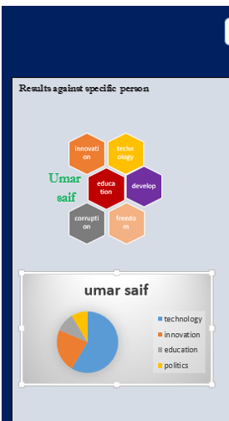
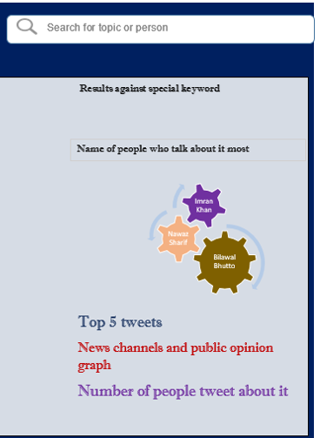
Keyword

Slide 10
Methods

Slide 11
Methods
Place:
ITU, Street, and a Hotel
Three Diverse News Interested persons
Our Role:
Observer, Helper, Note maker
Quick Demo:
Our Project
Assign Tasks:
Hot news, Personalize news etc.
Testing Measures:
pauses, strange clicks

Slide 12
Results

Slide 13
Three Tasks
Simple
A user wants to see all news of the days.
Medium
A user want to see hot news of specific time.
Complex
A user want to see news related to his interests.

Slide 14
Results(From Simple Task)
The Good:
Enthusiasm
Novelty
The Bad :
Swiping(May be due to card board)

Slide 15
Results(From Moderate Task)
The Good:
Save time
Nice to see irrelevant things way
The Bad :
Text a lot.

Slide 16
Results(From Complex Task)
The Good:
Details Screen
Filters
The Bad :
Lack of Picture reduce Interest

Slide 17
UI Changes

Slide 18
UI Changes
Making swiping more intuitive
Distinguish name of Buttons
Trying to make it more graphically
Making Text less approach

Slide 19
Summary
Key Insights
Tasks are clear
Users enjoy browsing
Future Action
Make asking easier
Bring out the bias bar

Slide 20

Questions

