Slide 1
Exp 4: forward slope against 1 at each level, and between levels
Forward slope (report on true colour), experience instruction, 50 participants. Slope 1 = the report follows the colour exactly; below 1 = reports pulled toward the middle (regression to the mean).
Level | Mean slope [95% CI] | People below 1 | vs 1: t (df), p (Holm) | Model slope [95% CI], p vs 1
SD 3 | 1.10 [1.03, 1.17] | 20 of 50 | 2.8 (49), p = .016 | 1.09 [1.01, 1.18], p = .017
SD 5 | 0.97 [0.90, 1.03] | 25 of 50 | −1.1 (49), p = .29 | 0.96 [0.88, 1.05], p = .29
SD 7 | 0.85 [0.78, 0.93] | 32 of 50 | −4.0 (49), p < .001 | 0.86 [0.77, 0.94], p < .001
Between levels (each person's slope) | Difference | t (df) | p (Holm)
SD 5 vs SD 3 | −0.13 | t(49) = −6.00 | p < .001
SD 7 vs SD 3 | −0.25 | t(49) = −7.95 | p < .001
SD 7 vs SD 5 | −0.11 | t(49) = −4.42 | p < .001
Linear trend |  | t(49) = −7.95 | p < .001
Level effect (repeated-measures ANOVA on each person's slope): F(1.74, 85.3) = 43.45, p < .001.
Mean slope and t-test: each person's own OLS slope at that level. Model: linked mixed model (its CIs adjusted for the three levels). Holm across the three levels.

Slide 2
Exps 1–3: forward slope against 1 at every array size (experience)
Experiment | Level | Mean slope [95% CI] | People below 1 | vs 1: t (df), p (Holm) | Model slope [95% CI], p vs 1
Exp 1 | 2 sq. | 0.89 [0.77, 1.02] | 13 of 21 | −1.8 (20), p = .19 | 0.89 [0.71, 1.06], p = .18
 | 6 sq. | 0.84 [0.70, 0.98] | 14 of 21 | −2.3 (20), p = .095 | 0.83 [0.65, 1.00], p = .035
 | 8 sq. | 0.76 [0.63, 0.89] | 19 of 21 | −3.9 (20), p = .003 | 0.76 [0.59, 0.93], p = .003
 | 12 sq. | 0.94 [0.79, 1.10] | 14 of 21 | −0.8 (20), p = .45 | 0.92 [0.73, 1.11], p = .28
Exp 2 | 2 sq. | 0.92 [0.86, 0.98] | 48 of 77 | −2.5 (76), p = .013 | 0.92 [0.84, 1.00], p = .012
 | 10 sq. | 0.83 [0.77, 0.89] | 61 of 77 | −5.8 (76), p < .001 | 0.83 [0.76, 0.90], p < .001
 | 20 sq. | 0.88 [0.82, 0.93] | 54 of 77 | −4.4 (76), p < .001 | 0.87 [0.80, 0.95], p < .001
Exp 3 | 2 sq. | 0.89 [0.80, 0.97] | 26 of 38 | −2.6 (37), p = .025 | 0.88 [0.77, 1.00], p = .026
 | 10 sq. | 0.80 [0.71, 0.88] | 29 of 38 | −4.9 (37), p < .001 | 0.80 [0.69, 0.91], p < .001
 | 20 sq. | 0.88 [0.78, 0.97] | 27 of 38 | −2.6 (37), p = .025 | 0.89 [0.78, 1.00], p = .026
Level effect on each person's slope: Exp 1: F(2.24, 44.9) = 4.99, p = .009; Exp 2: F(1.94, 147.6) = 6.34, p = .003; Exp 3: F(1.92, 71.0) = 3.71, p = .031. Mean slope and t-test: each person's own OLS slope; model: linked mixed model (CIs adjusted for the number of sizes); Holm across sizes.

Slide 3
Exp 4: reverse slope against 1 at each level, and between levels
Reverse slope (true colour on report), experience instruction, 50 participants. Slope 1 = the array behind a report is as extreme as the report; below 1 = arrays less extreme than the reports.
Level | Mean slope [95% CI] | People below 1 | vs 1: t (df), p (Holm) | Model slope [95% CI], p vs 1
SD 3 | 0.63 [0.59, 0.67] | 50 of 50 | −18.1 (49), p < .001 | 0.63 [0.58, 0.68], p < .001
SD 5 | 0.62 [0.58, 0.67] | 50 of 50 | −16.6 (49), p < .001 | 0.62 [0.57, 0.67], p < .001
SD 7 | 0.60 [0.54, 0.65] | 49 of 50 | −14.8 (49), p < .001 | 0.60 [0.54, 0.65], p < .001
Between levels (each person's slope) | Difference | t (df) | p (Holm)
SD 5 vs SD 3 | −0.01 | t(49) = −0.73 | p = .47
SD 7 vs SD 3 | −0.04 | t(49) = −1.68 | p = .30
SD 7 vs SD 5 | −0.03 | t(49) = −1.60 | p = .30
Linear trend |  | t(49) = −1.68 | p = .099
Level effect (repeated-measures ANOVA on each person's slope): F(1.49, 73.3) = 2.33, p = .12.
Mean slope and t-test: each person's own OLS slope at that level. Model: linked mixed model (its CIs adjusted for the three levels). Holm across the three levels.

Slide 4
Exps 1–3: reverse slope against 1 at every array size (experience)
Experiment | Level | Mean slope [95% CI] | People below 1 | vs 1: t (df), p (Holm) | Model slope [95% CI], p vs 1
Exp 1 | 2 sq. | 0.74 [0.66, 0.83] | 19 of 21 | −6.3 (20), p < .001 | 0.70 [0.60, 0.81], p < .001
 | 6 sq. | 0.65 [0.57, 0.72] | 20 of 21 | −9.6 (20), p < .001 | 0.64 [0.54, 0.74], p < .001
 | 8 sq. | 0.64 [0.52, 0.75] | 20 of 21 | −6.7 (20), p < .001 | 0.62 [0.52, 0.73], p < .001
 | 12 sq. | 0.65 [0.58, 0.73] | 21 of 21 | −9.9 (20), p < .001 | 0.63 [0.53, 0.73], p < .001
Exp 2 | 2 sq. | 0.70 [0.65, 0.75] | 71 of 77 | −13.1 (76), p < .001 | 0.67 [0.61, 0.72], p < .001
 | 10 sq. | 0.70 [0.66, 0.75] | 73 of 77 | −12.0 (76), p < .001 | 0.69 [0.64, 0.75], p < .001
 | 20 sq. | 0.70 [0.65, 0.75] | 68 of 77 | −12.6 (76), p < .001 | 0.66 [0.60, 0.71], p < .001
Exp 3 | 2 sq. | 0.71 [0.66, 0.77] | 37 of 38 | −10.7 (37), p < .001 | 0.69 [0.62, 0.77], p < .001
 | 10 sq. | 0.77 [0.69, 0.85] | 33 of 38 | −5.9 (37), p < .001 | 0.75 [0.67, 0.83], p < .001
 | 20 sq. | 0.73 [0.67, 0.79] | 35 of 38 | −8.7 (37), p < .001 | 0.69 [0.62, 0.77], p < .001
Level effect on each person's slope: Exp 1: F(2.20, 44.0) = 3.47, p = .036; Exp 2: F(1.99, 151.5) = 0.07, p = .93; Exp 3: F(1.90, 70.5) = 2.16, p = .13. Mean slope and t-test: each person's own OLS slope; model: linked mixed model (CIs adjusted for the number of sizes); Holm across sizes.

Slide 5
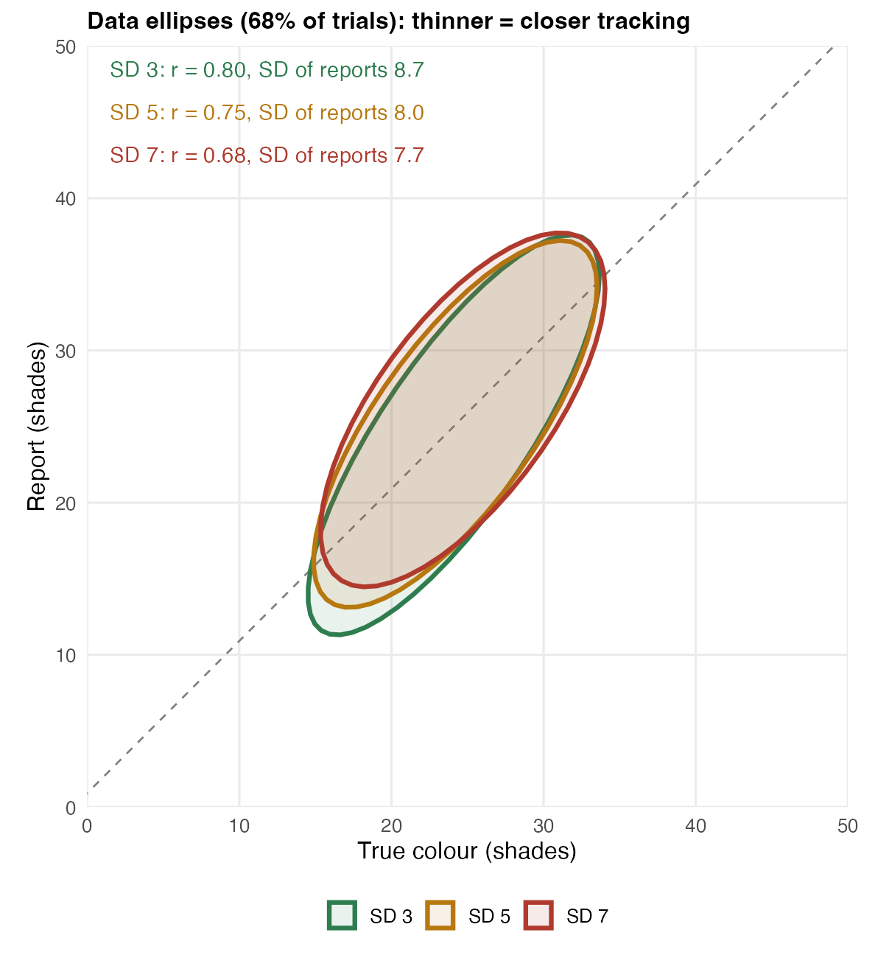
Exp 4: tracking as data ellipses, all levels together (experience)
Each ellipse holds about 68% of a level's trials. Thinner = closer tracking (r); shorter = reports less spread out. Slopes and r on the figure: one regression over all trials, each person centred (overall across participants).

Slide 6
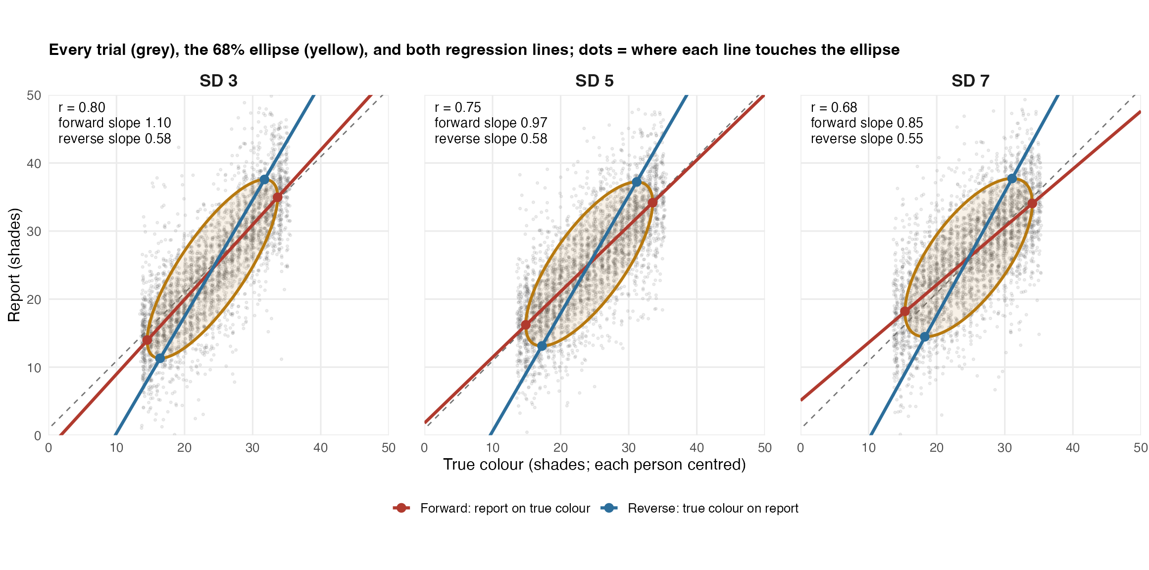
Exp 4: each level, with both regression lines (experience)
Grey: every trial. Yellow: 68% ellipse. Red: forward line (report on true colour), through the leftmost and rightmost points. Blue: reverse line, through the lowest and highest points. Slopes and r on the figure: one regression over all trials, each person centred (overall across participants). The tested values are each person's own: forward 1.10 / 0.97 / 0.85, reverse 0.63 / 0.62 / 0.60.

Slide 7
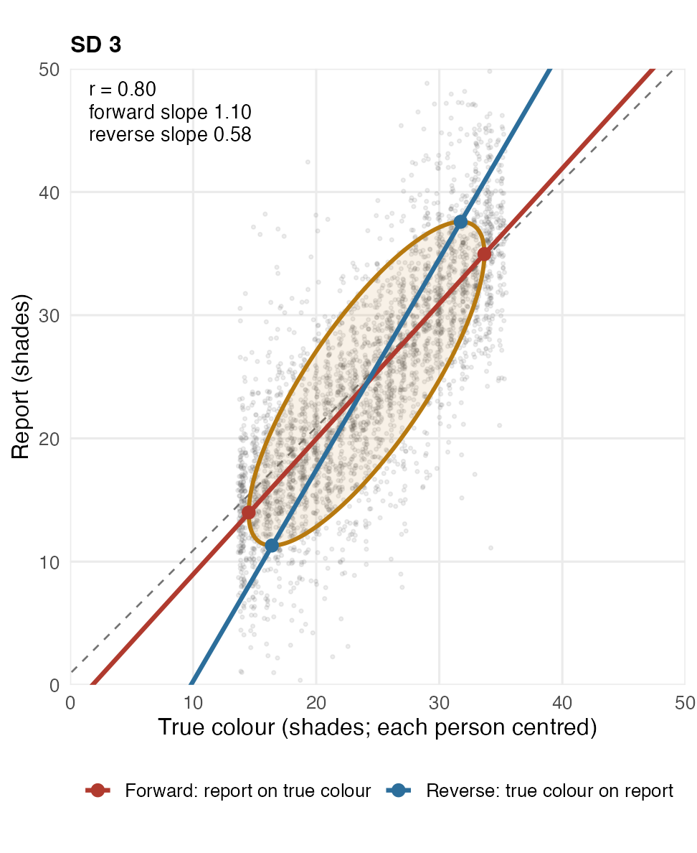
Exp 4, SD 3: trials, ellipse and both regression lines (experience)
Slopes and r on the figure: one regression over all trials, each person centred (overall across participants). The tested values are each person's own: forward 1.10 / 0.97 / 0.85, reverse 0.63 / 0.62 / 0.60.

Slide 8
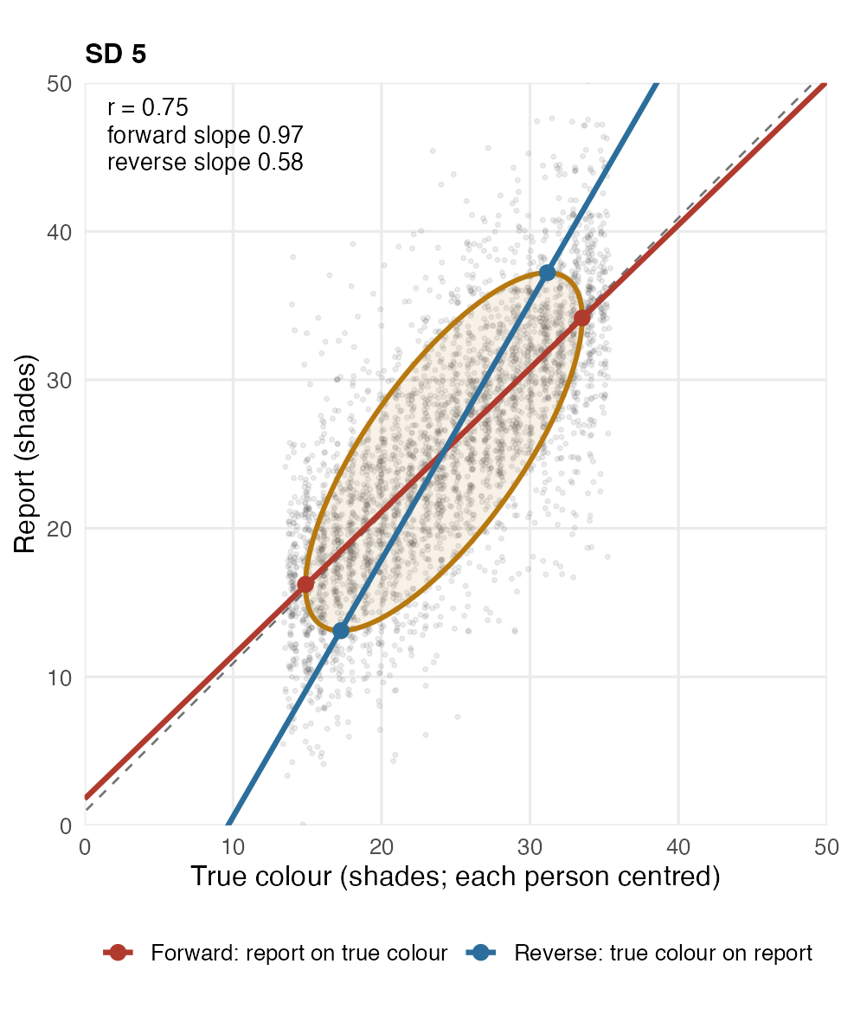
Exp 4, SD 5: trials, ellipse and both regression lines (experience)
Slopes and r on the figure: one regression over all trials, each person centred (overall across participants). The tested values are each person's own: forward 1.10 / 0.97 / 0.85, reverse 0.63 / 0.62 / 0.60.

Slide 9
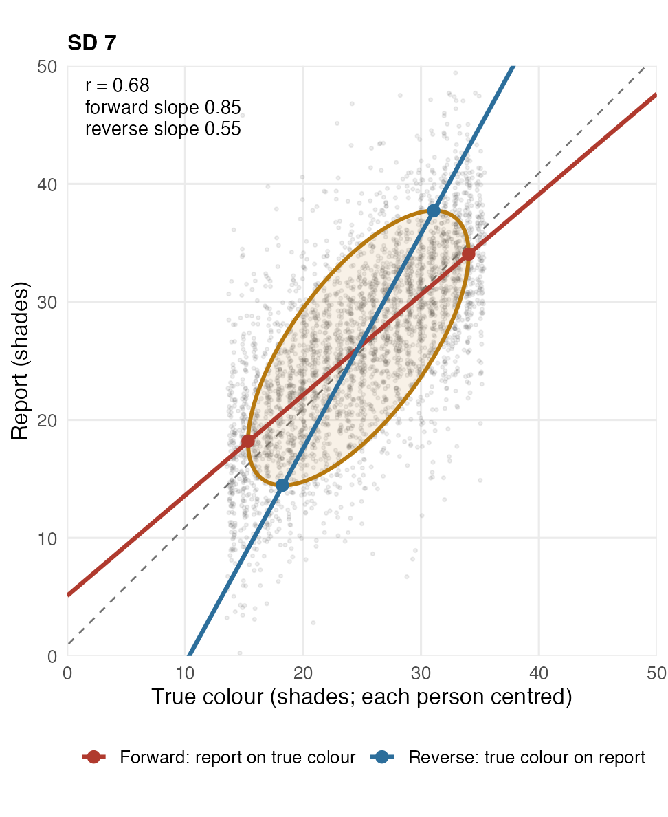
Exp 4, SD 7: trials, ellipse and both regression lines (experience)
Slopes and r on the figure: one regression over all trials, each person centred (overall across participants). The tested values are each person's own: forward 1.10 / 0.97 / 0.85, reverse 0.63 / 0.62 / 0.60.

Slide 10
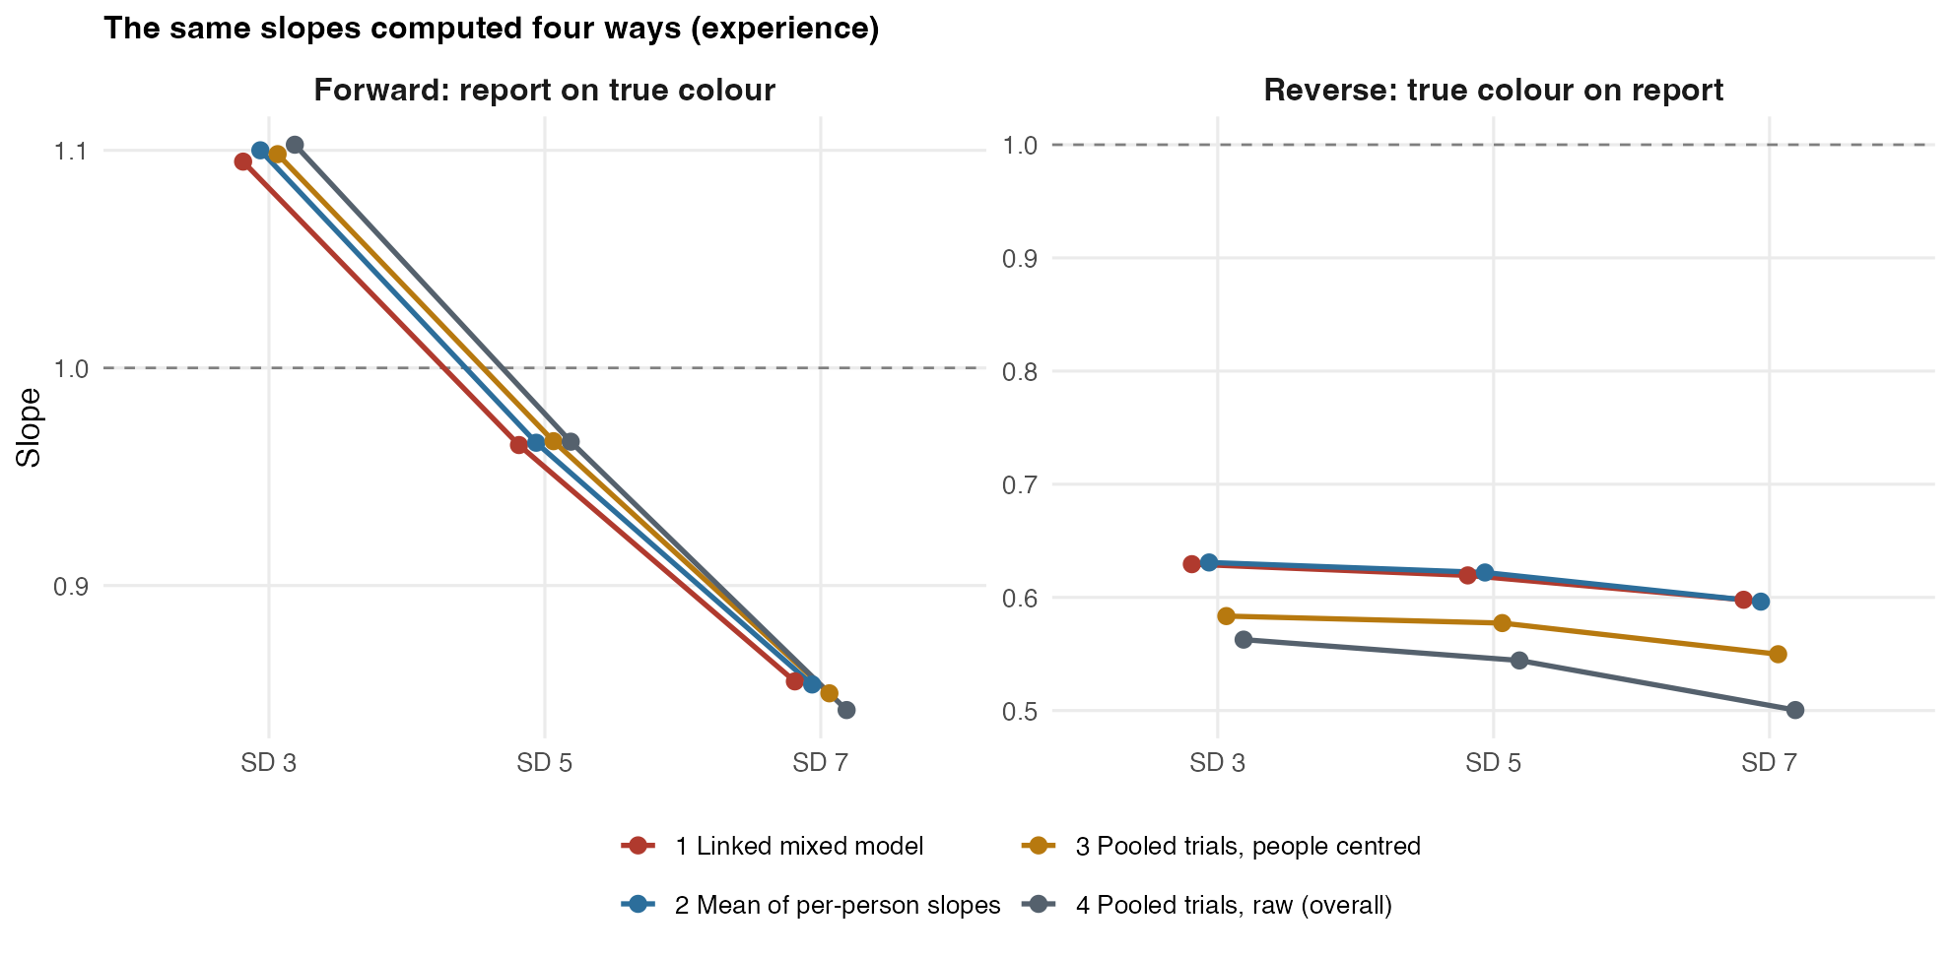
Exp 4: the same slopes computed four ways (experience)
Forward: all four agree. Reverse: pooling trials across people lowers the slope (differences between people inflate the spread of the reports); the model and the per-person slopes are the ones to report.

