Slide 1
Data exp (3.8)
Cleaning critria:
200ms<=rt<=5000ms
Trials +-2.5 SD from avg respond time where cleard whithin participants
Participants that lost 15% of the trials and more until this point where removed
Removed participants with mean RT outside global +-2.5 SD
Removed participants with correlations lower then 0.3
N = 28 (started at 43)

Slide 2
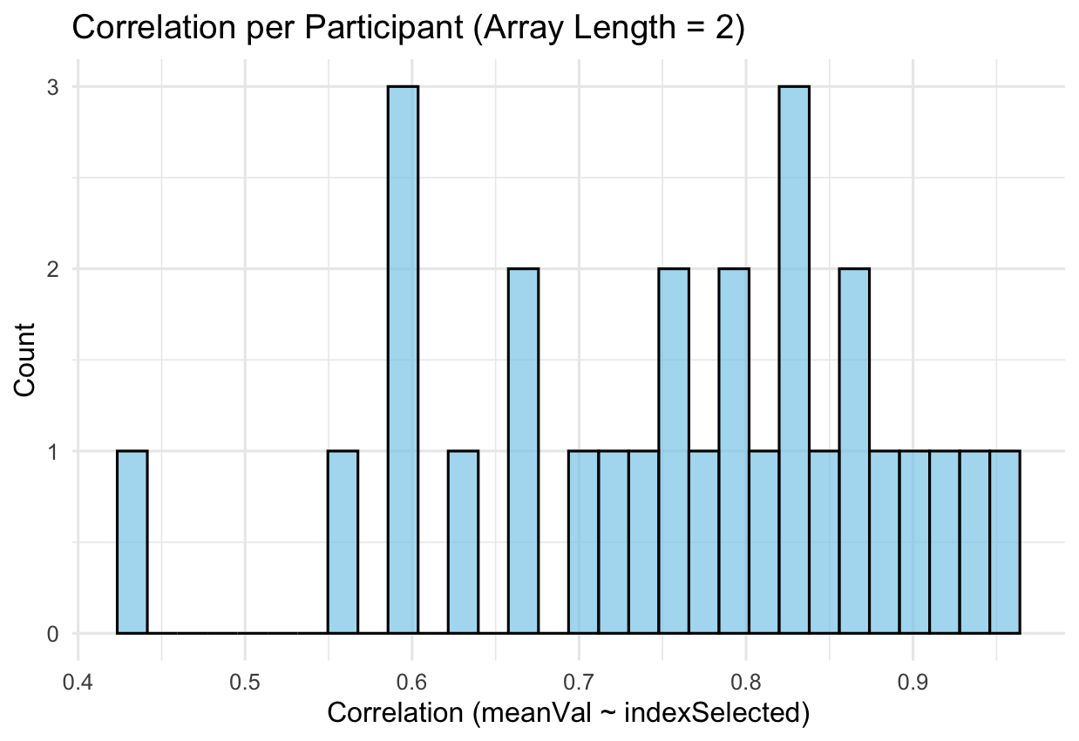

Slide 3
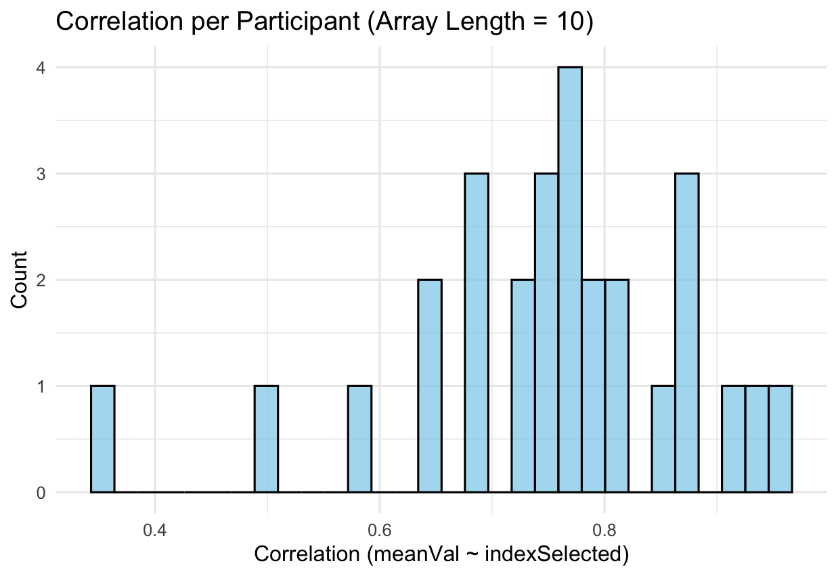

Slide 4
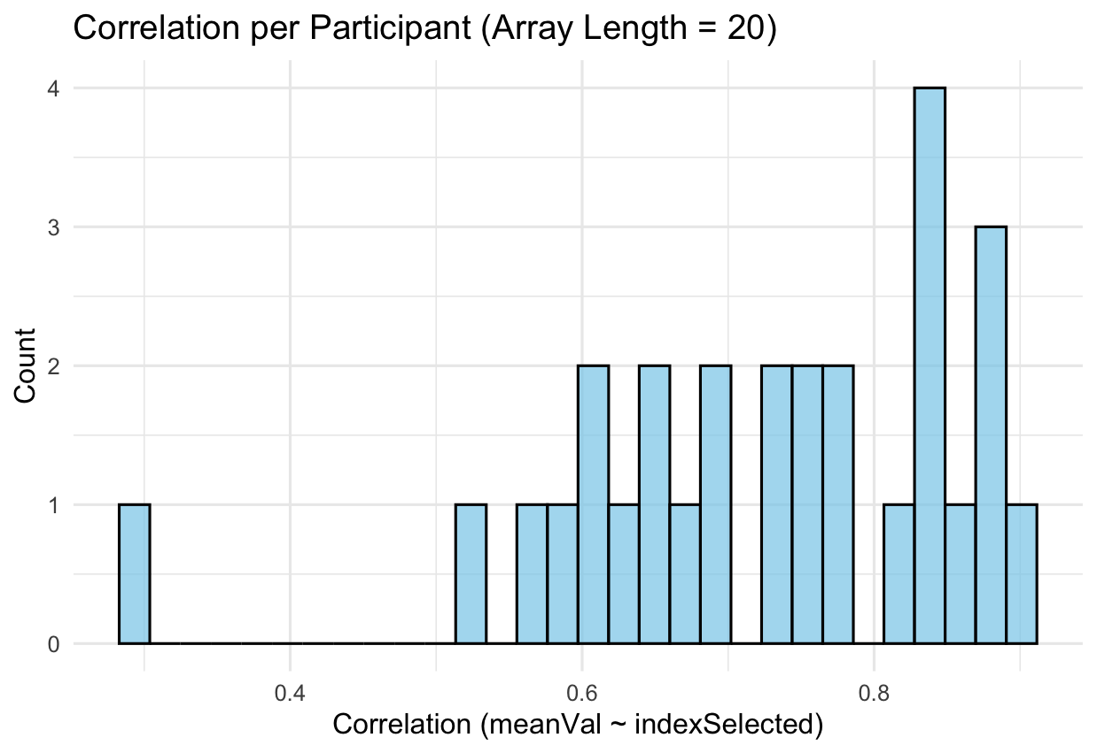

Slide 5
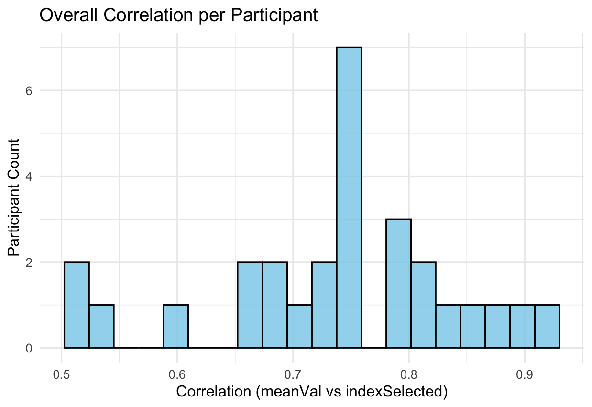

Slide 6
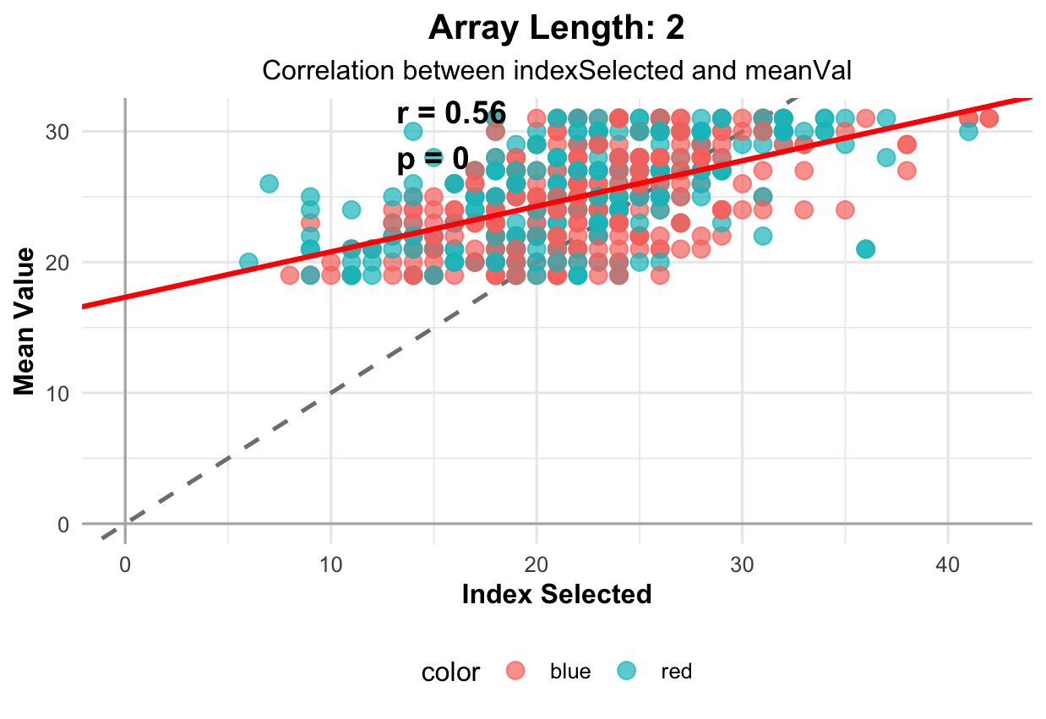

Slide 7
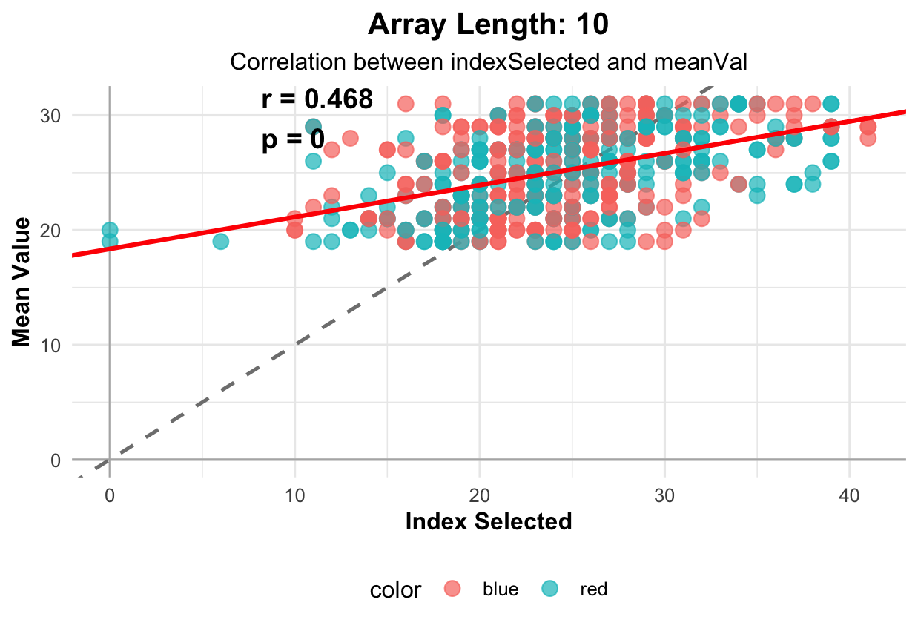

Slide 8
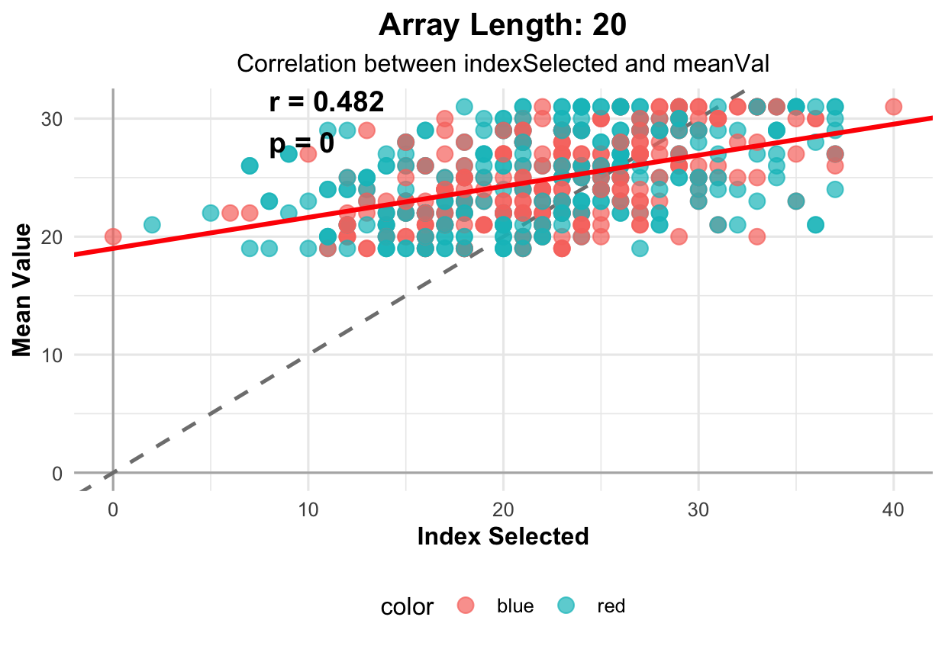

Slide 9
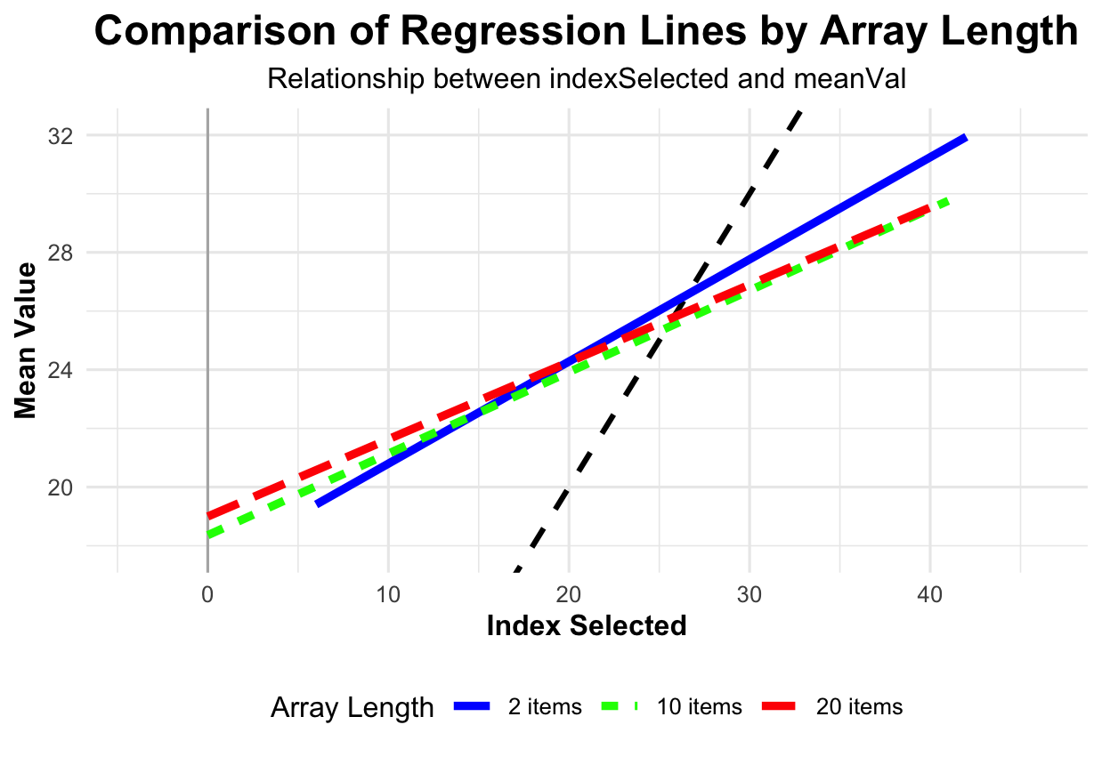

Slide 10
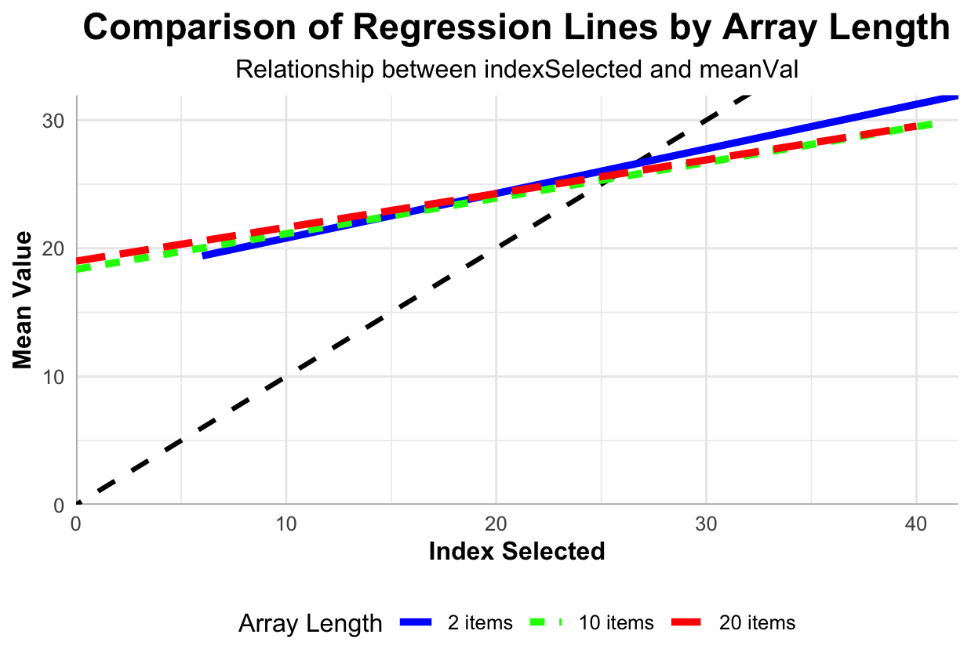

Slide 11
Slope by array length
Slope by array length
2
10
20
6
4
Count
2
0
0.4
0.8
1.2
1.6
0.4
0.8
1.2
1.6
0.50
0.75
1.00
1.25
Slope

Slide 12
Intercept by array length
Intercept by array length
2
10
20
6
4
Count
2
0
-10
-5
0
5
10
15
-10
0
Intercept
10
20
0
5
10
15
20

Slide 13
Overall slope (one model per participant)
Overall slope (one model per participant)
4
3
Count
2
1
0
0.50
0.75
Slope
1.00
1.25

Slide 14
Overall intercept (one model per participant)
Overall intercept (one model per participant)
3
2
Count
1
0
-5
0
5
10
15
Intercept

Slide 15
