Slide 1
Data exp (3.8)
Cleaning critria:
200ms<=rt<=8000ms
Trials +-3 SD from avg respond time where cleard whithin participants
Participants that lost 15% of the trials and more until this point where removed
Removed participants with mean RT outside global +-3 SD
Removed participants with correlations lower then 0.3
N = 32 (started at 43)

Slide 2
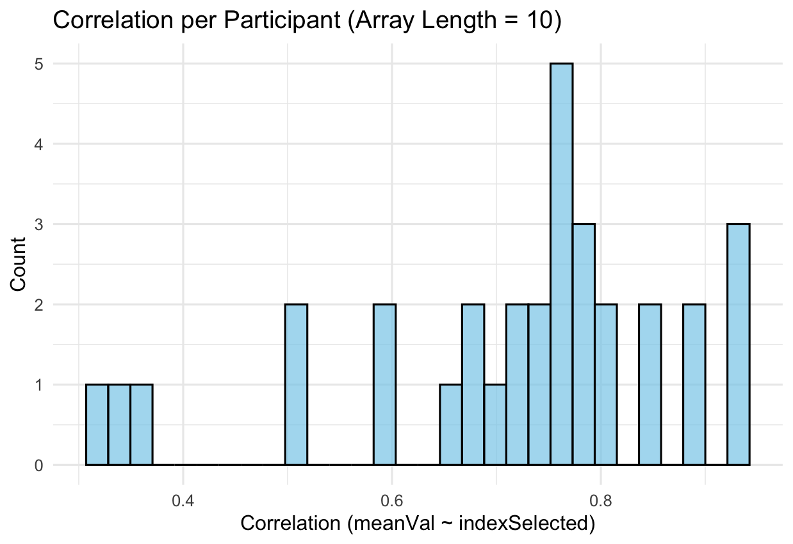

Slide 3
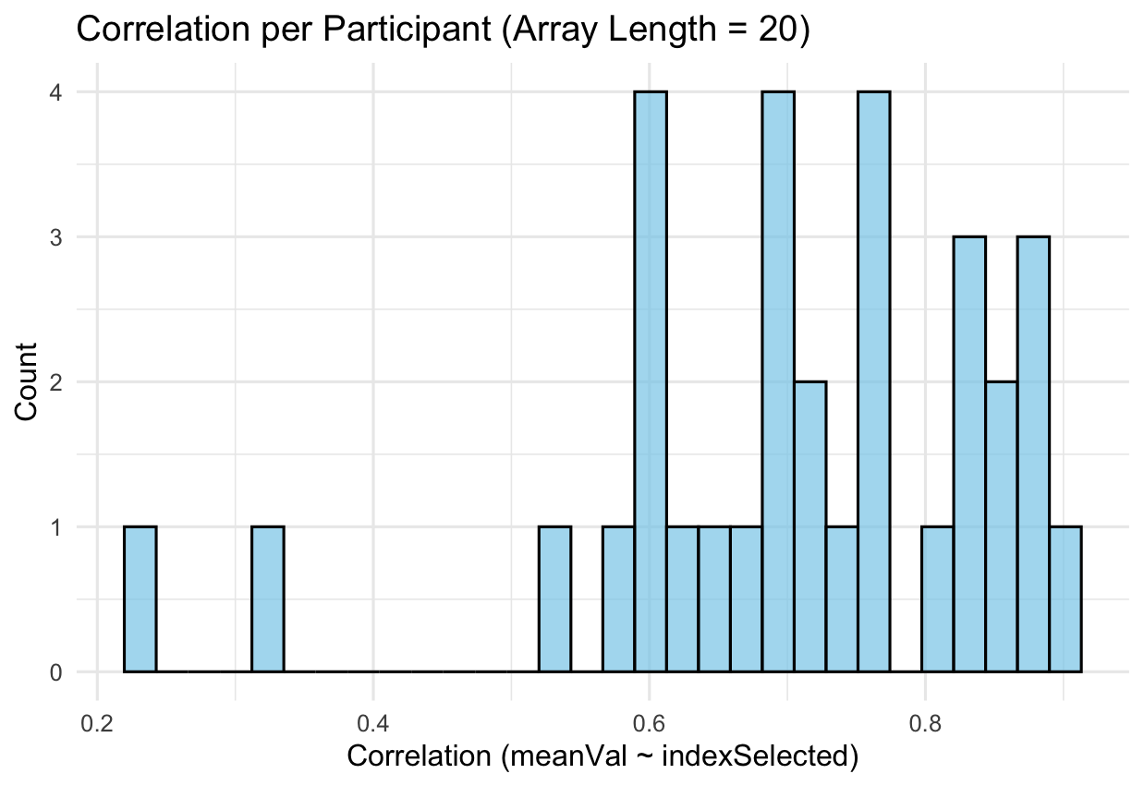

Slide 4
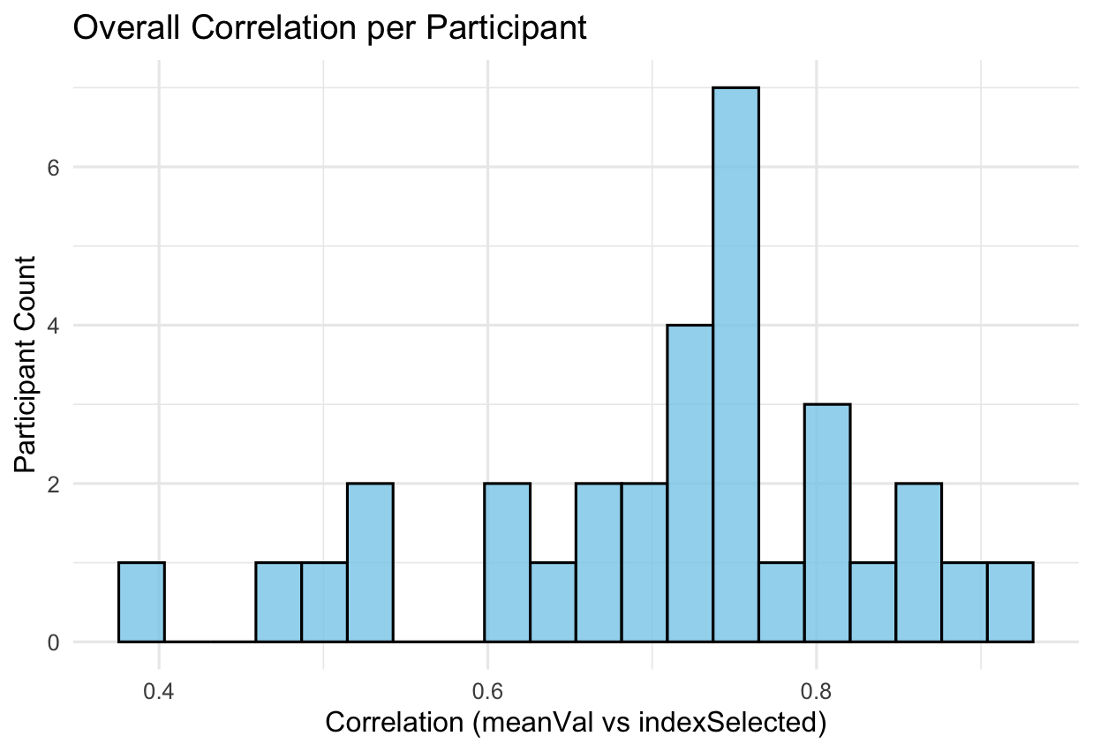

Slide 5
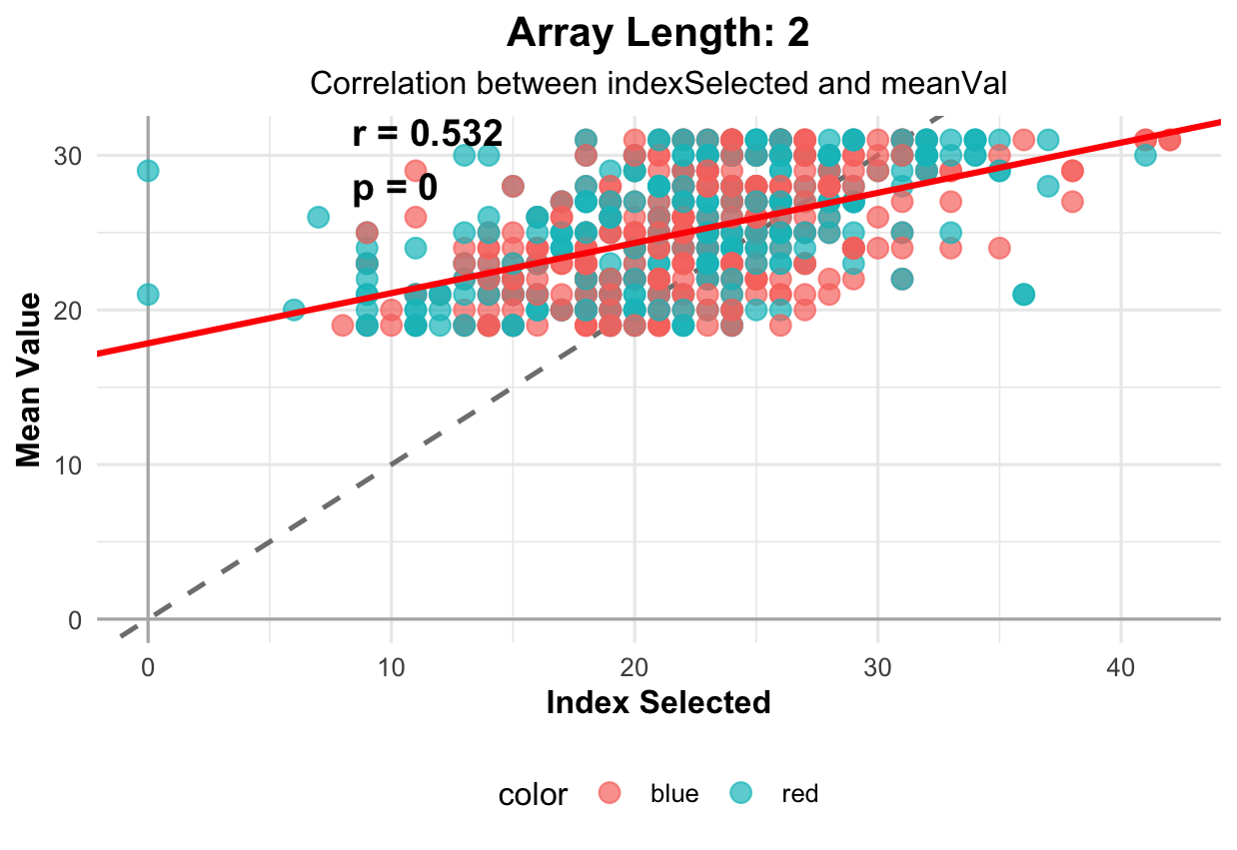

Slide 6
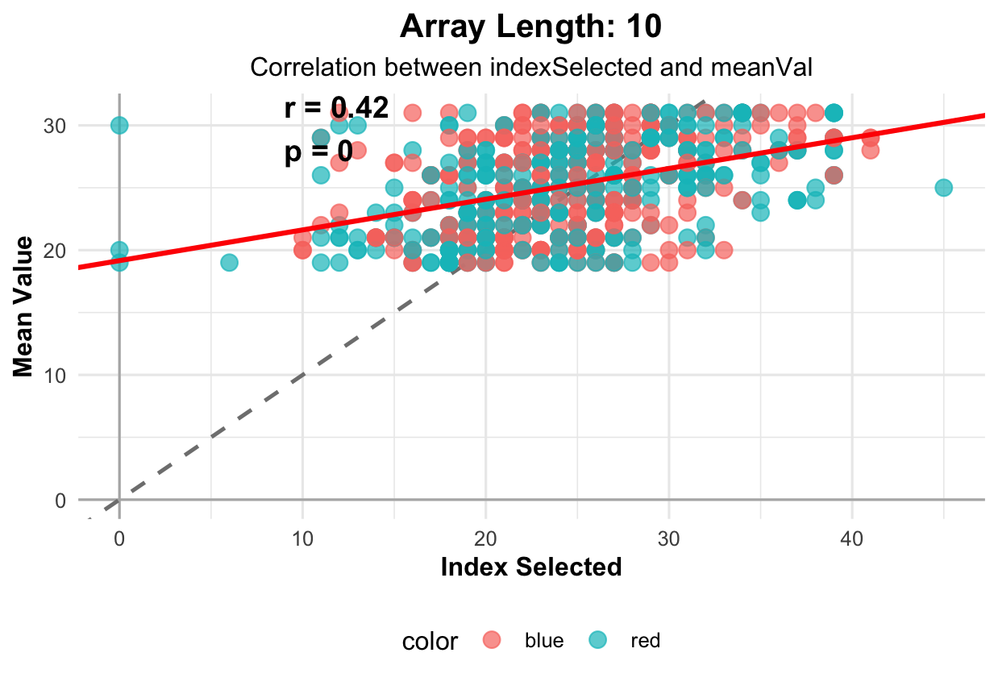

Slide 7
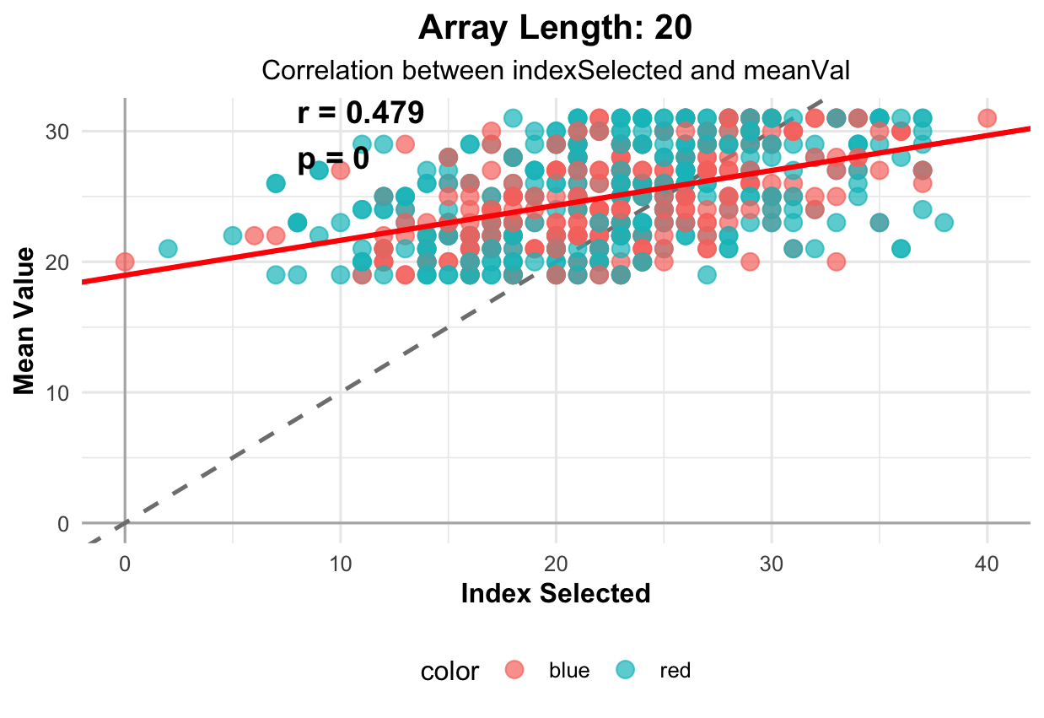

Slide 8
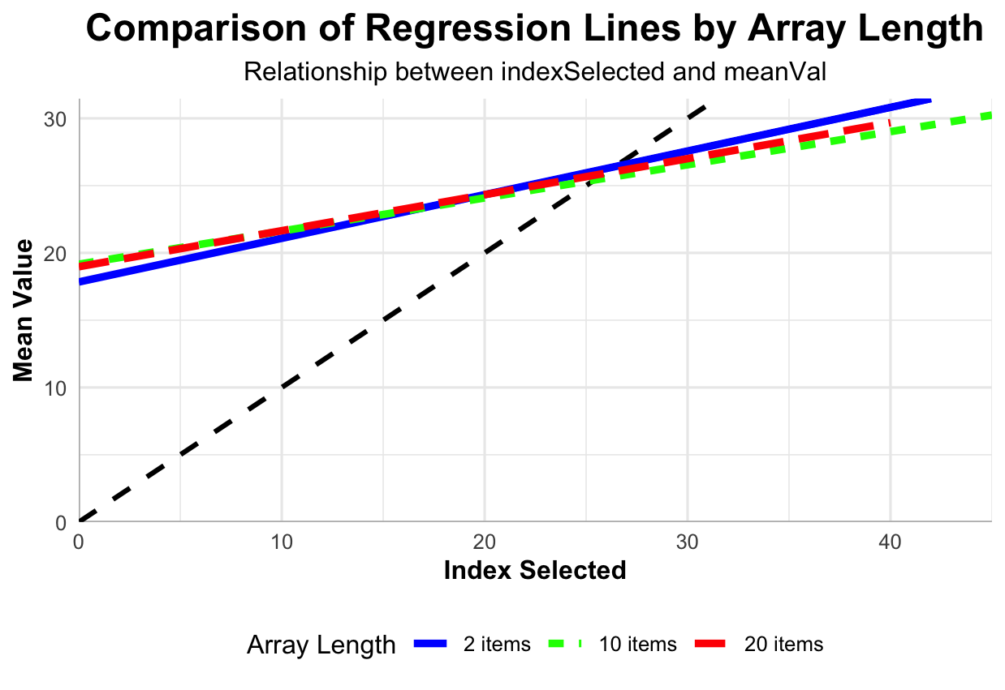

Slide 9
Slope by array length
Slope by array length
2
10
20
6
4
Count
2
0
0.6
0.9
1.2
1.5
0.5
Slope
1.0
1.5
0.25
0.50
0.75
1.00

Slide 10
Intercept by array length
Intercept by array length
2
10
20
5
4
3
Count
2
1
0
-10
0
10
-10
0
Intercept
10
20
0
5
10
15
20

Slide 11
Overall slope (one model per participant)
Overall slope (one model per participant)
5
4
3
Count
2
1
0
0.50
0.75
Slope
1.00
1.25

Slide 12
Overall intercept (one model per participant)
Overall intercept (one model per participant)
4
3
Count
2
1
0
-5
0
5
Intercept
10
15

Slide 13
