Slide 1
Data exp (28.5)
Cleaning critria:
200ms<=rt<=5000ms
Trials +-2.5 SD from avg respond time where cleard whithin participants
Participants that lost 15% of the trials and more until this point where removed
Removed participants with mean RT outside global +-2.5 SD
Removed participants with correlations lower then 0.3
N = 15

Slide 2
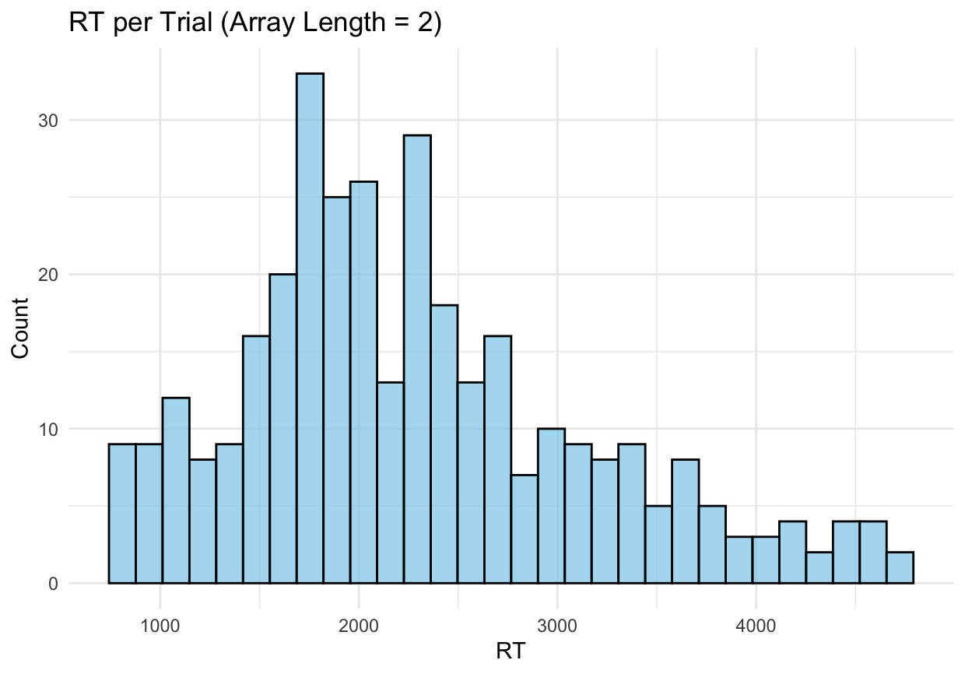

Slide 3
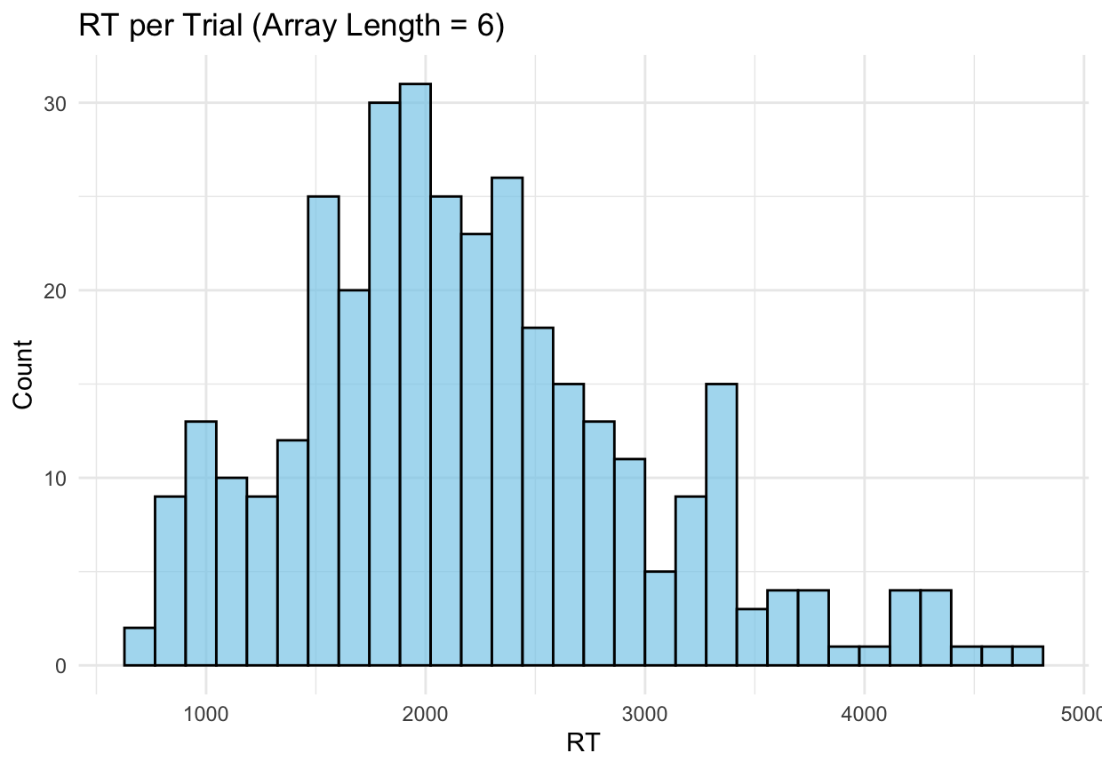

Slide 4
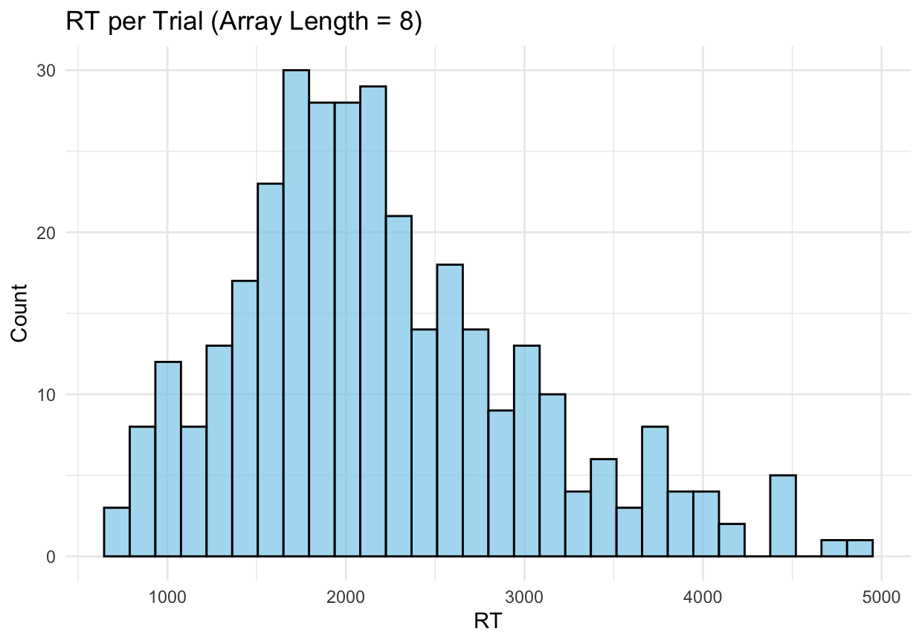

Slide 5
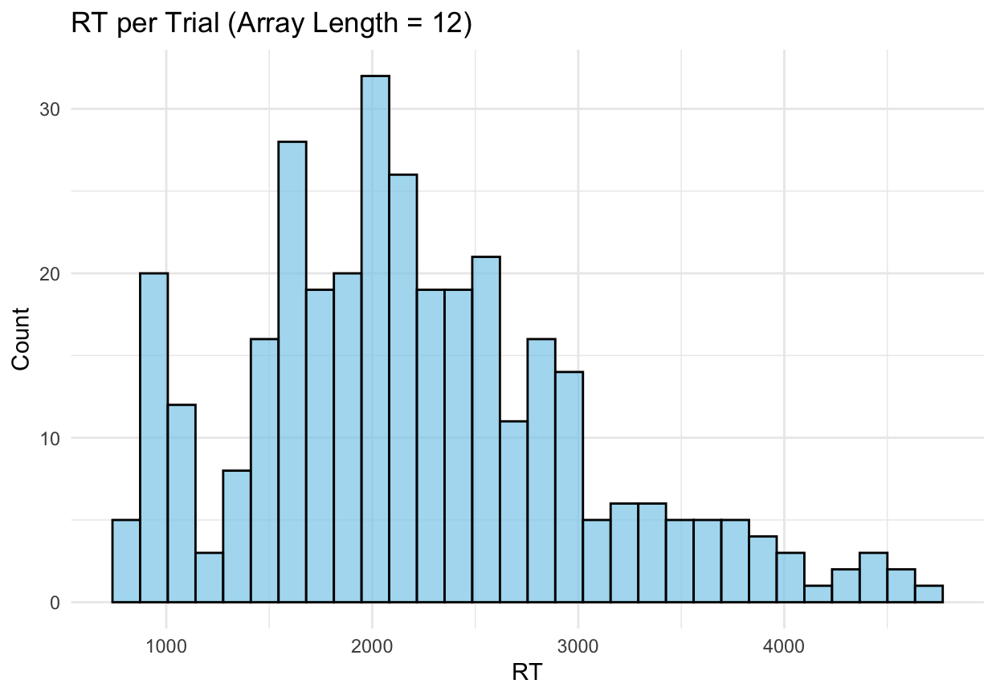

Slide 6
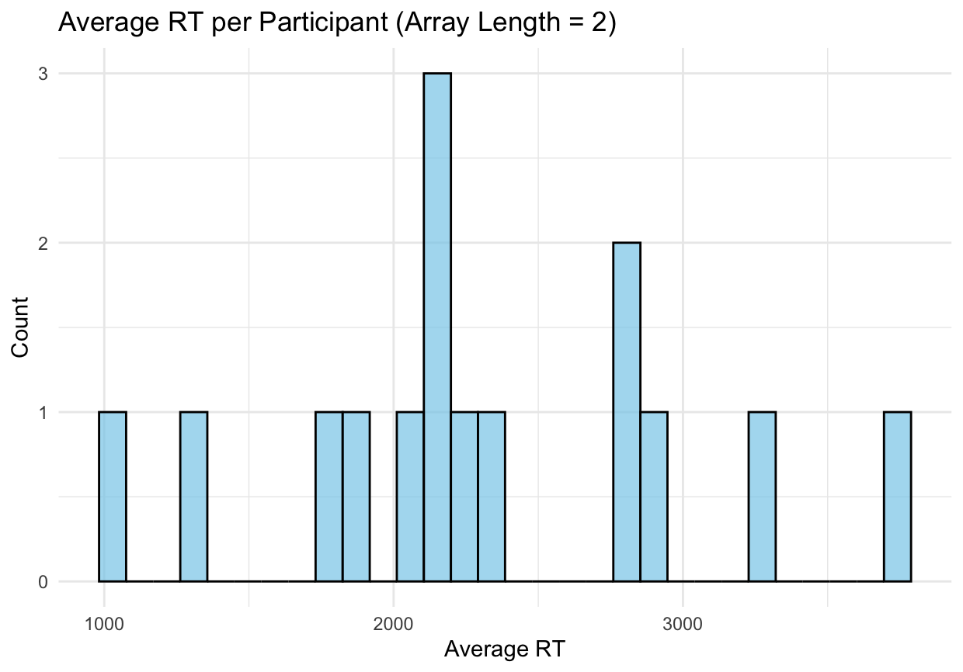

Slide 7
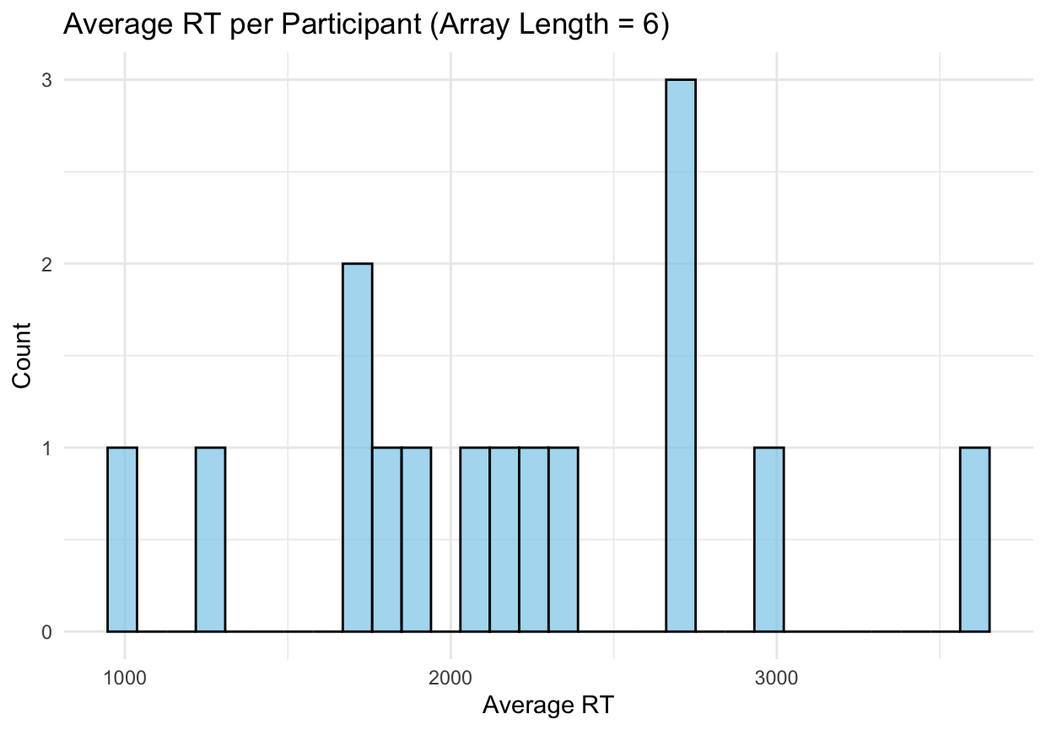

Slide 8
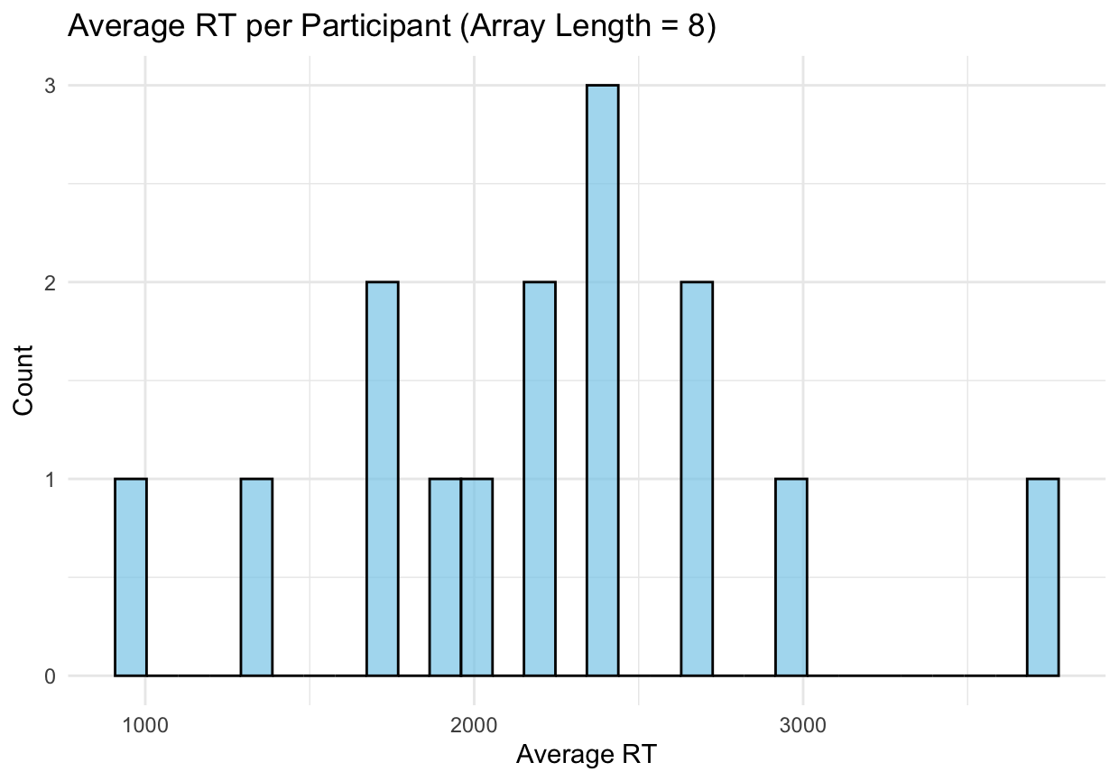

Slide 9
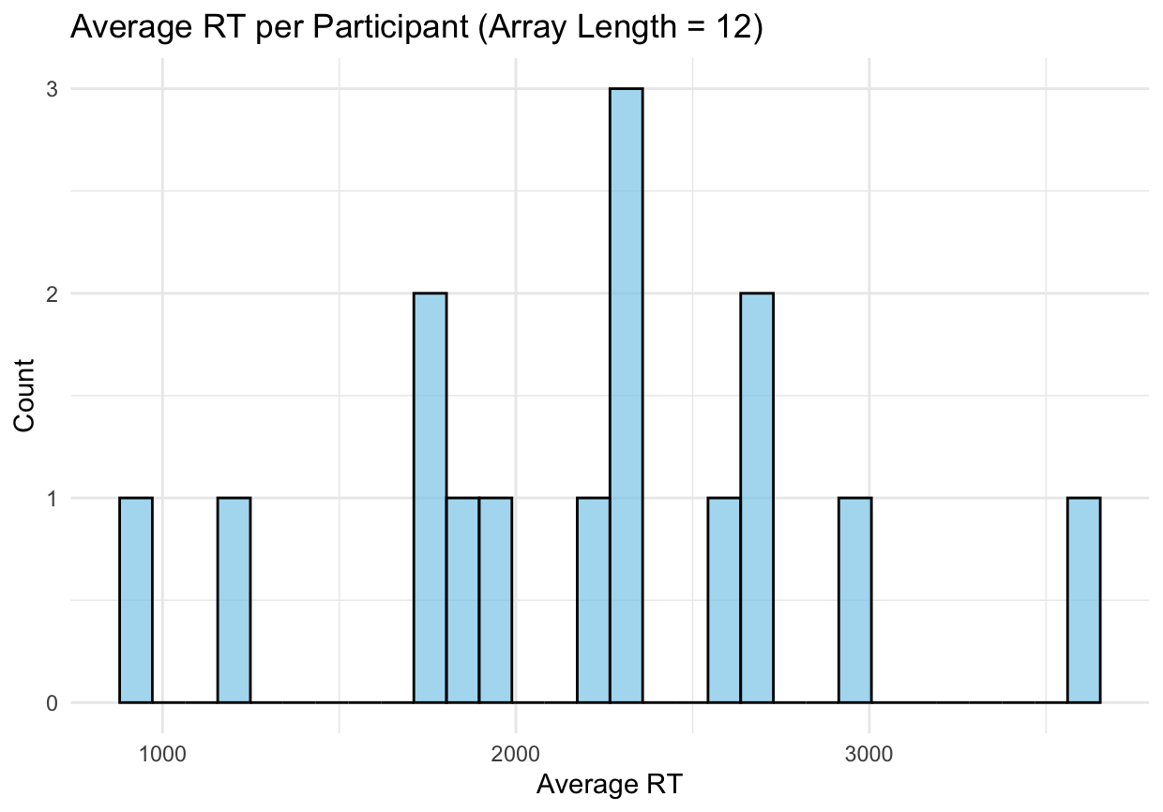

Slide 10
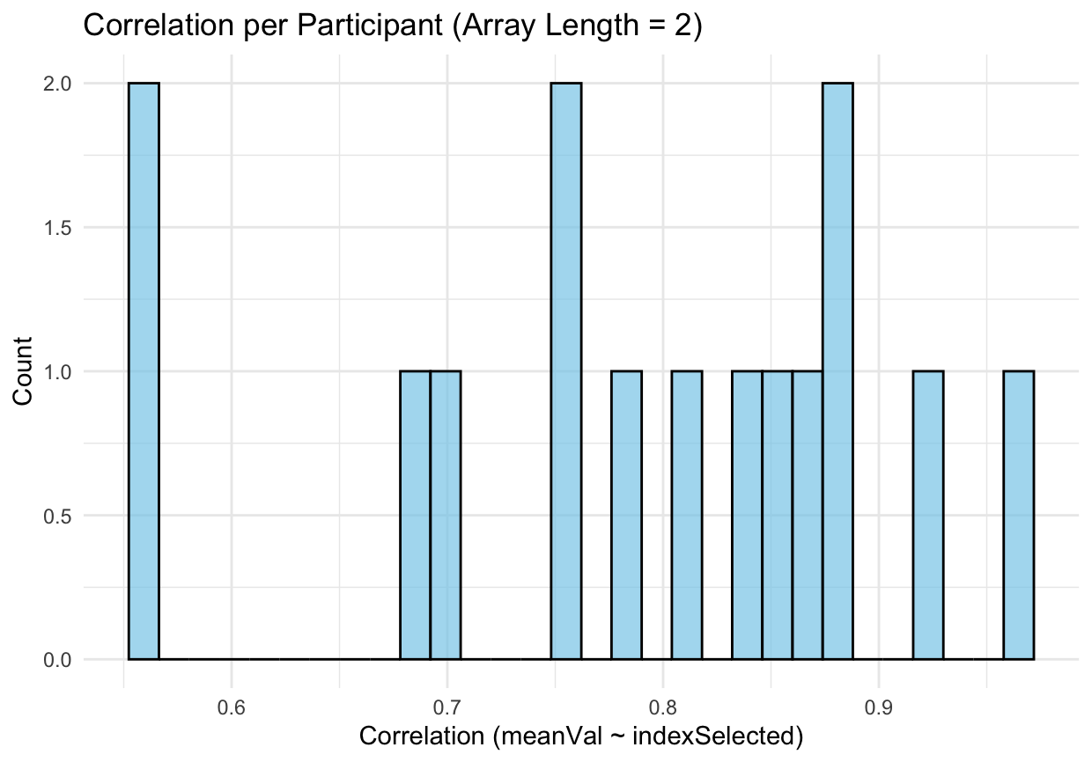

Slide 11
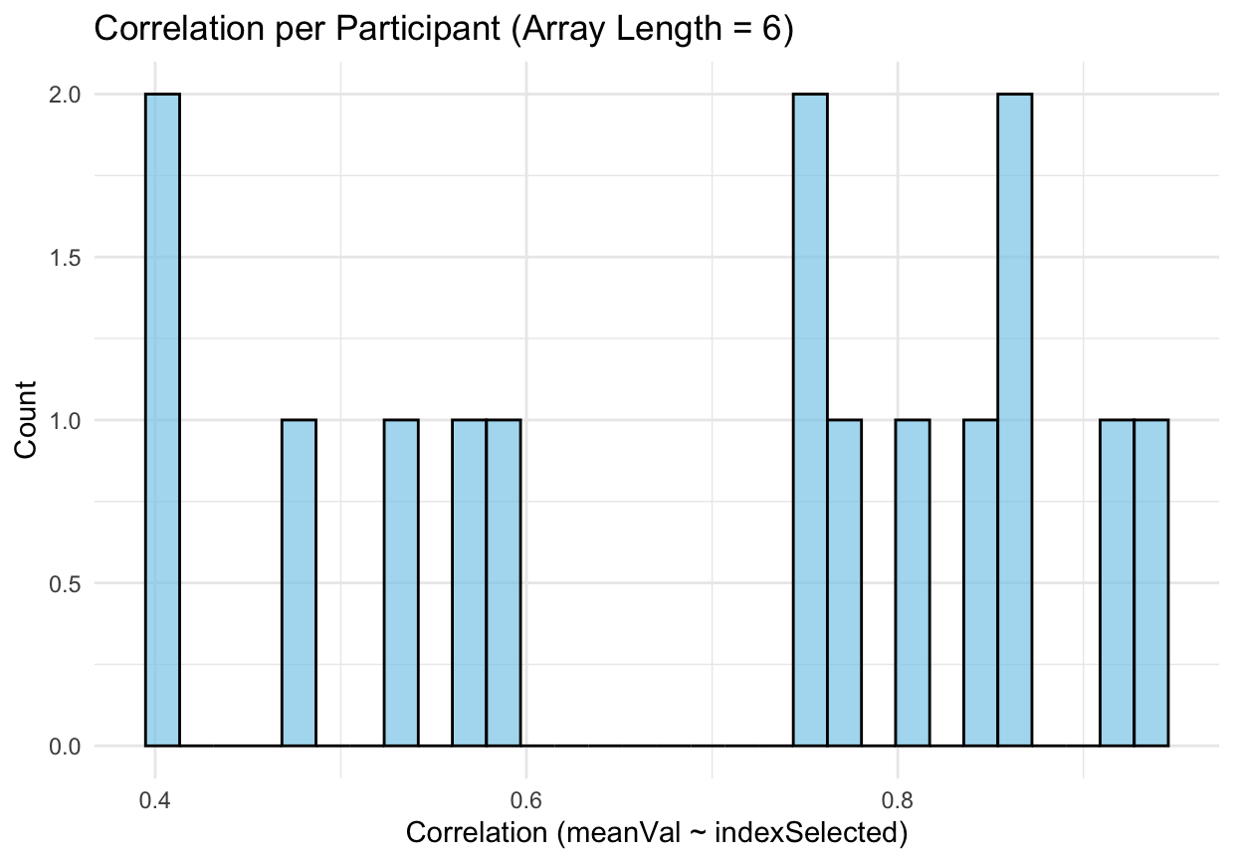

Slide 12
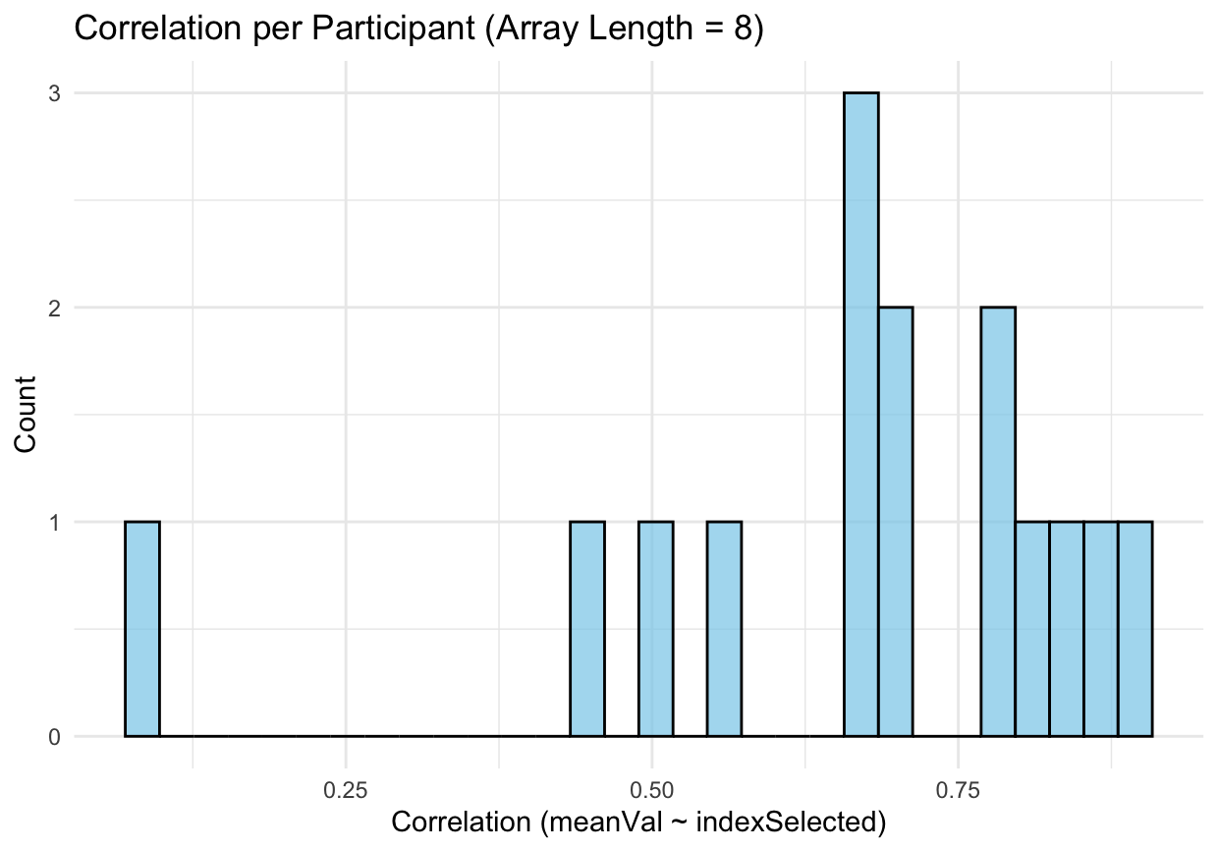

Slide 13
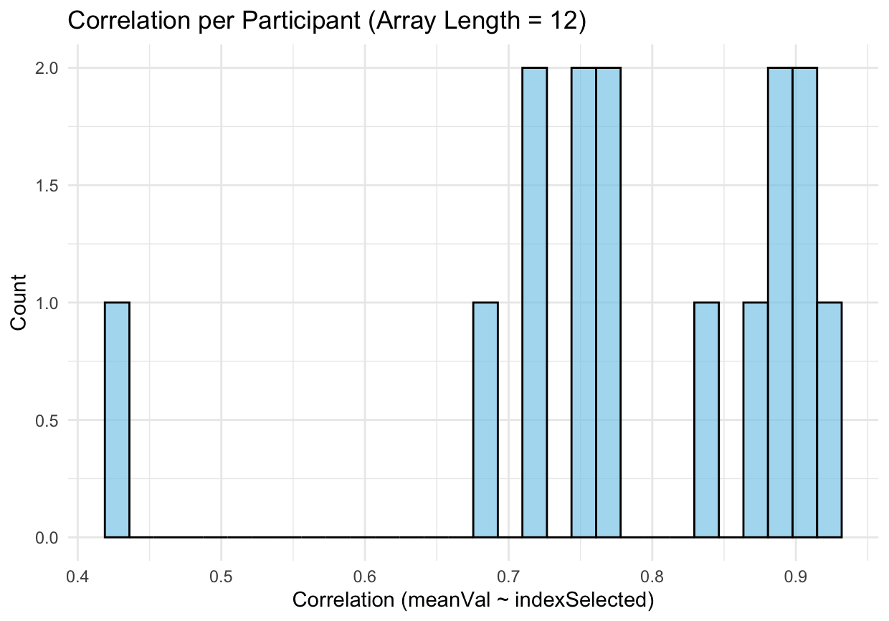

Slide 14
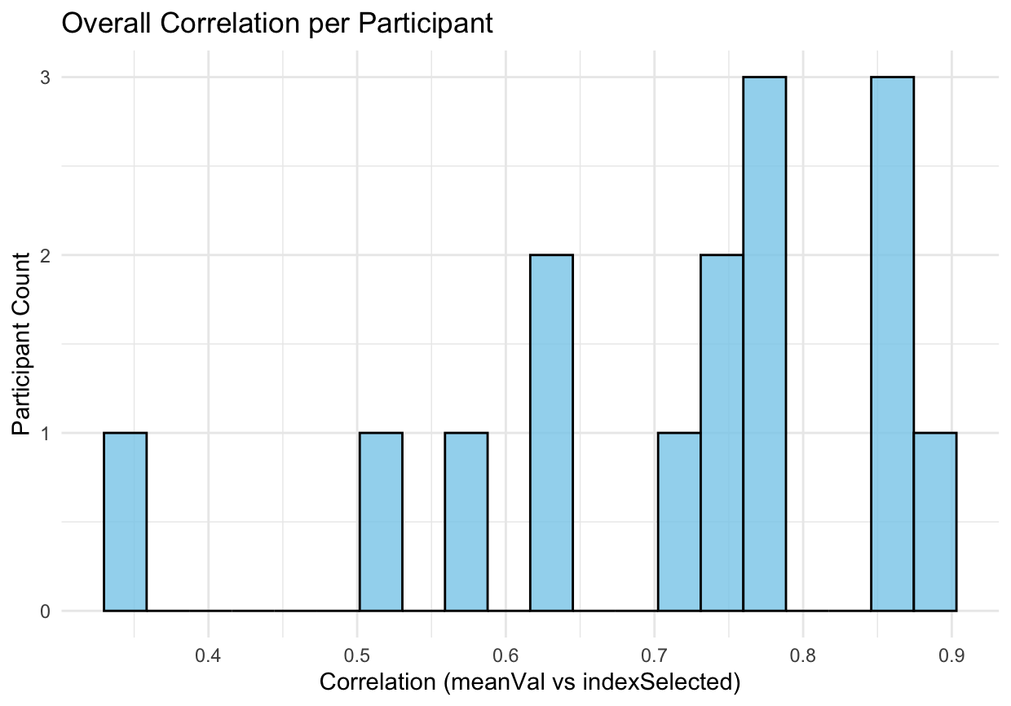

Slide 15
Slope by array length
Slope by array length
2
6
8
12
4
3
Count
2
1
0
0.4
0.6
0.8
1.0
0.4
0.6
0.8
1.0
Slope
0.5
1.0
0.4
0.6
0.8
1.0

Slide 16
Intercept by array length
Intercept by array length
2
6
8
12
3
2
Count
1
0
0
5
10
15
0
5
10
15
20
-10
0
10
20
0
5
10
15
Intercept

Slide 17
Overall slope (one model per participant)
Overall slope (one model per participant)
3
2
Count
1
0
0.4
0.6
Slope
0.8
1.0

Slide 18
Overall intercept (one model per participant)
Overall intercept (one model per participant)
2.0
1.5
Count
1.0
0.5
0.0
0
5
Intercept
10
15

Slide 19
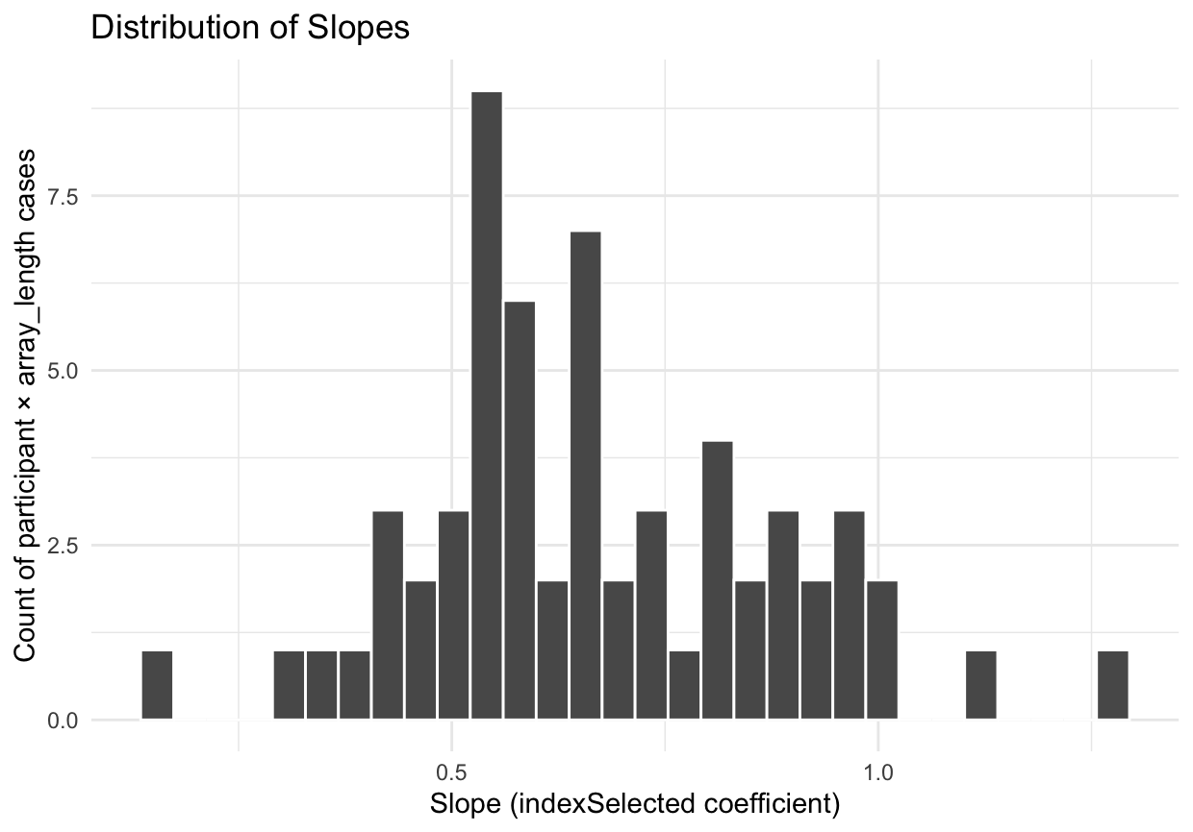

Slide 20
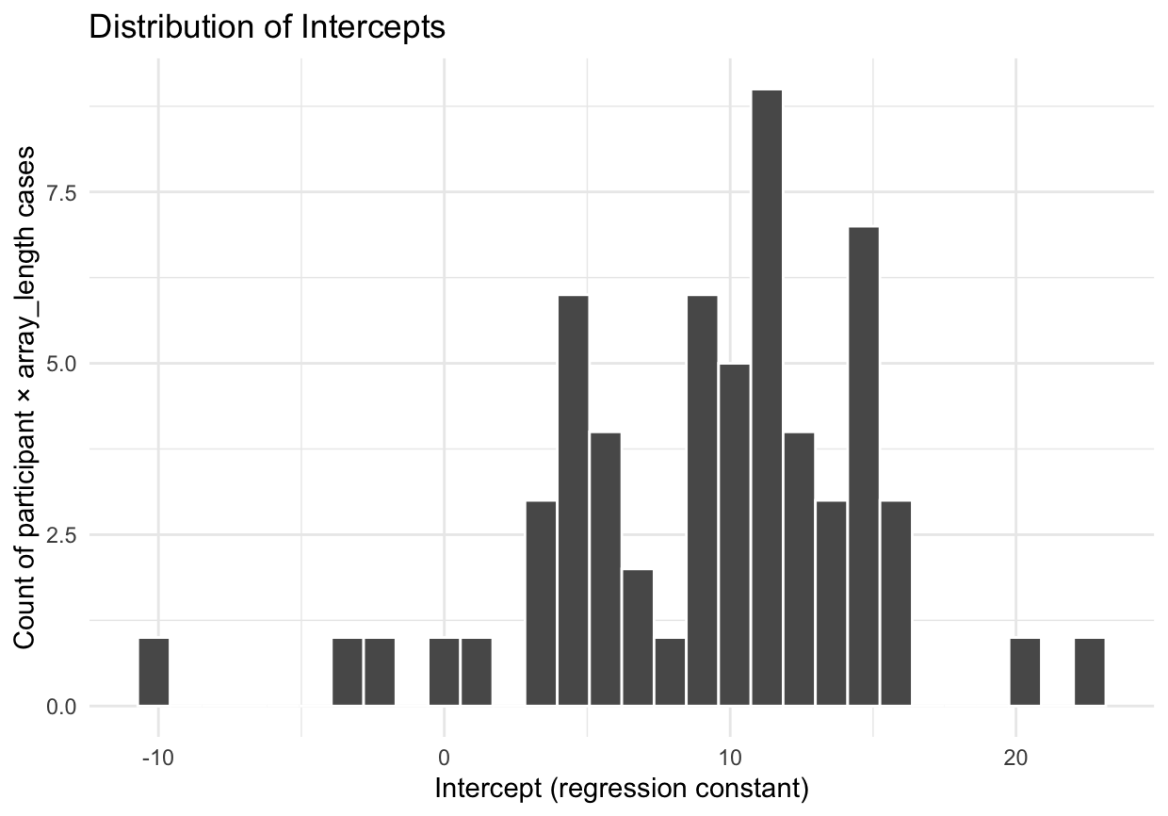

Slide 21
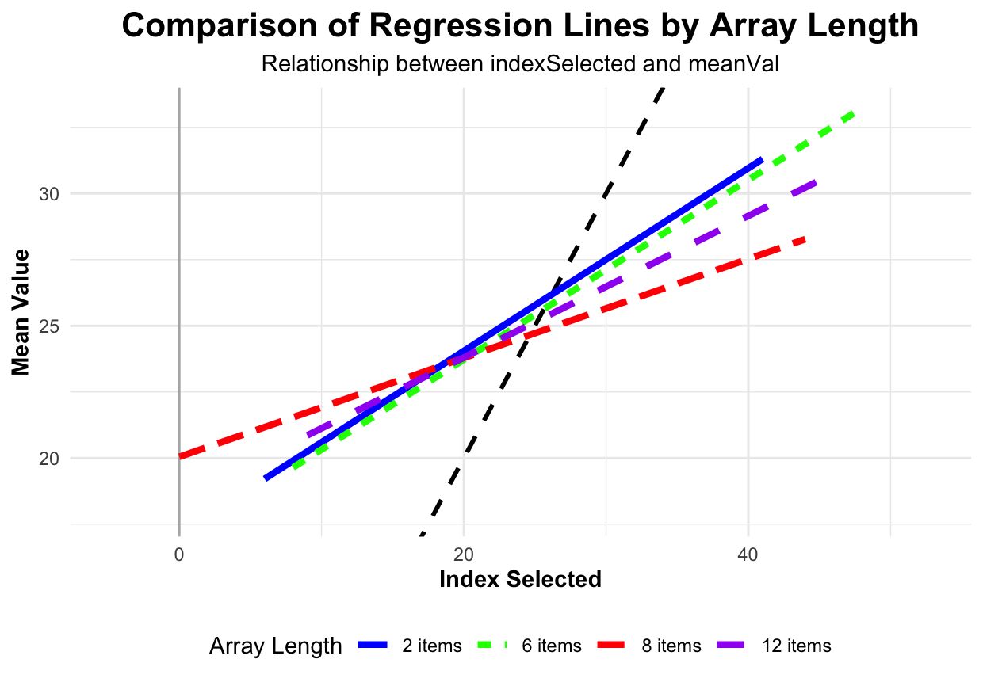

Slide 22
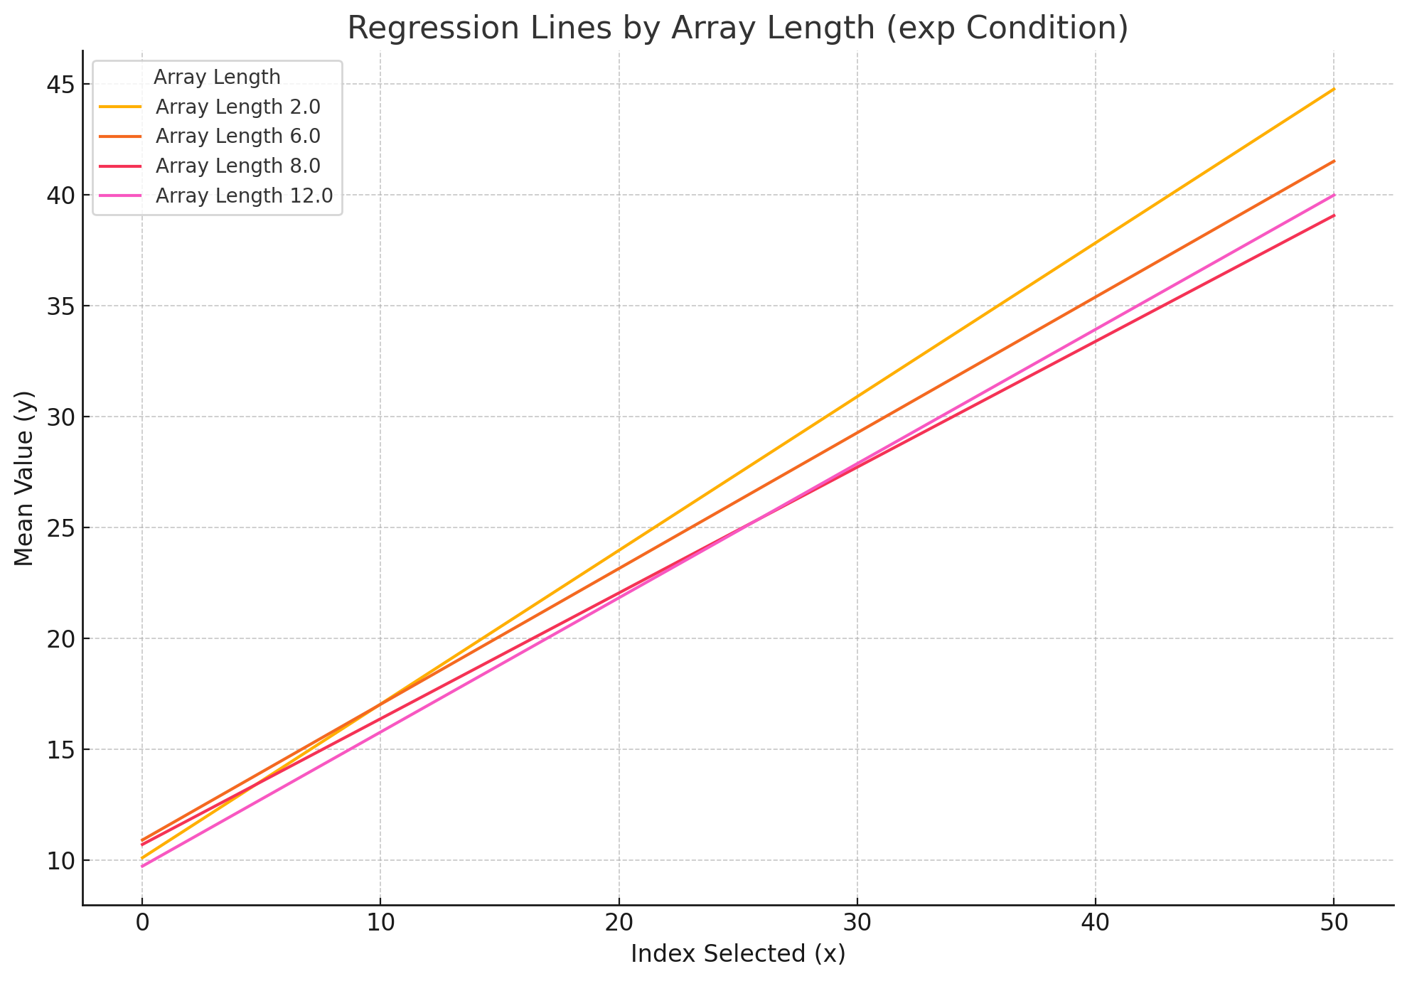
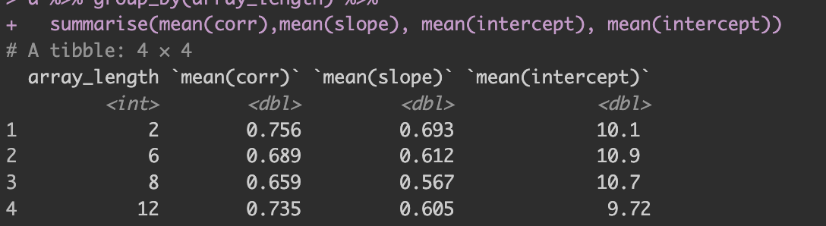

Slide 23
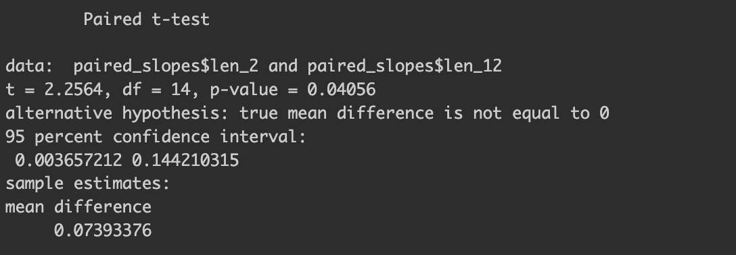
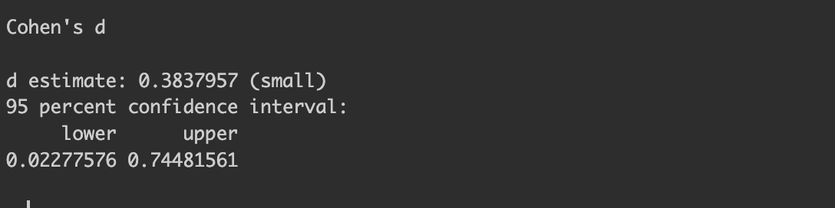
T-test between 12 and 2 (other stuff didn’t work. But I geuss we can’t tell anything because low n)

