Slide 1

Note: The data and information in this document is reflective of a hypothetical situation and client. This document is to be used for KPMG Virtual Internship purposes only.
Sprocket Central Pty Ltd
Data analytics approach
[Division Name] - [Engagement Manager], [Senior Consultant], [Junior Consultant]

Slide 2
Note: The data and information in this document is reflective of a hypothetical situation and client. This document is to be used for KPMG Virtual Internship purposes only.
Agenda
Introduction
Data Exploration
Feature Engineering
Model Development
Interpretation

Slide 3
Note: The data and information in this document is reflective of a hypothetical situation and client. This document is to be used for KPMG Virtual Internship purposes only.
Introduction
Goals: target 1000 new customers to drive the most value
Business goal: Sprocket Central Pty Ltd ‘s marketing team is looking to boost business by analysing their existing customer dataset to determine customer trends and behaviour.

Slide 4
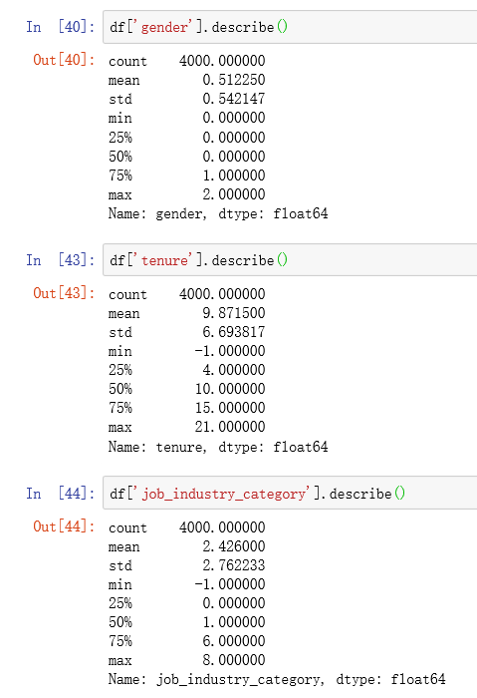
Note: The data and information in this document is reflective of a hypothetical situation and client. This document is to be used for KPMG Virtual Internship purposes only.
Data Exploration
Goals: ensure the split of training and testing dataset more confident
Data concentration
Data dispersion
Data dependency
Before exploring the data, we need to assess and clean the data which is done in Task1.
All features looks good and are not correlated by looking at the above 3 points.

Slide 5
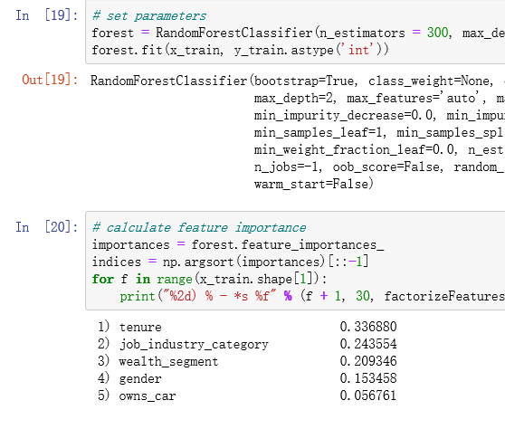
Note: The data and information in this document is reflective of a hypothetical situation and client. This document is to be used for KPMG Virtual Internship purposes only.
Feature Engineering
Goals: find good features to predict bike-related purchases
Tenure, job_industry_category and wealth_segment are good features by using RandomForest tool.

Slide 6
Note: The data and information in this document is reflective of a hypothetical situation and client. This document is to be used for KPMG Virtual Internship purposes only.
Model Development
Goals: build models to target customers.
Strategy:
we can make assumptions based on the good features from feature engineering,
build models like RFM, or LG to verify the assumptions, therefore predict the 1000 new target customers.

Slide 7
Note: The data and information in this document is reflective of a hypothetical situation and client. This document is to be used for KPMG Virtual Internship purposes only.
Interpretation
Goals: visualize the analysis and results
Strategy:
visualizing and interpreting the analysis to make it clearer for our client
Tools: Tableau, Excel, Python
Place any supporting images, graphs, data or extra text here.

Slide 8
Note: The data and information in this document is reflective of a hypothetical situation and client. This document is to be used for KPMG Virtual Internship purposes only.
Appendix

Slide 9
Note: The data and information in this document is reflective of a hypothetical situation and client. This document is to be used for KPMG Virtual Internship purposes only.
Appendix
This is an optional slide where you may place any supporting items.

