Slide 1

How can you get hired ?
Data Scientist Job Market in the U.S
Group 7

Slide 2
Overview & Exploring questions
Data Source: http://www.indeed.com/
Exploring Questions:
What type of talent do employers want concerning tools, degrees, and skills?

Slide 3
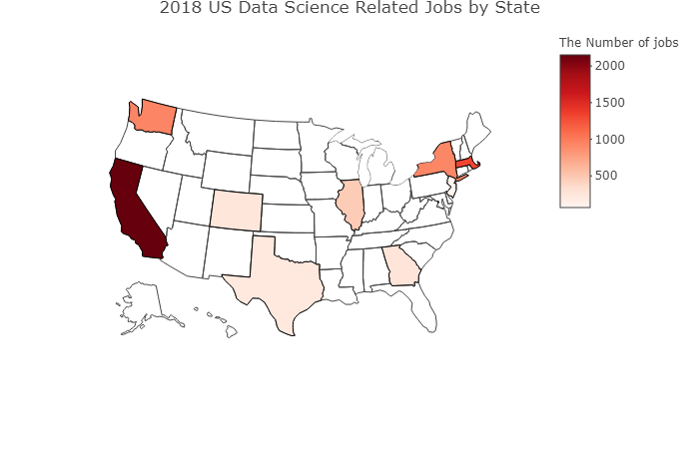
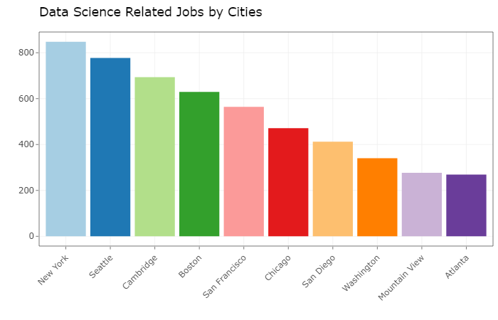
Number of Data Science Related Job in 2018

Slide 4
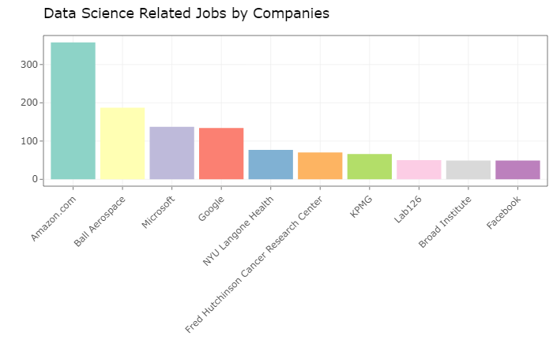
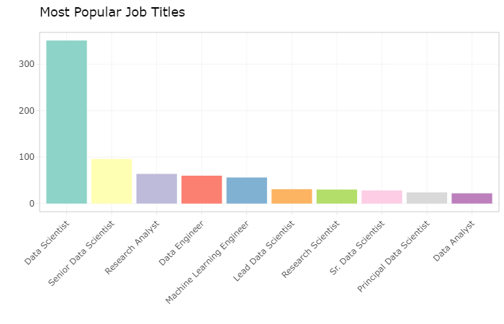
The Job Demand for Companies and Roles

Slide 5
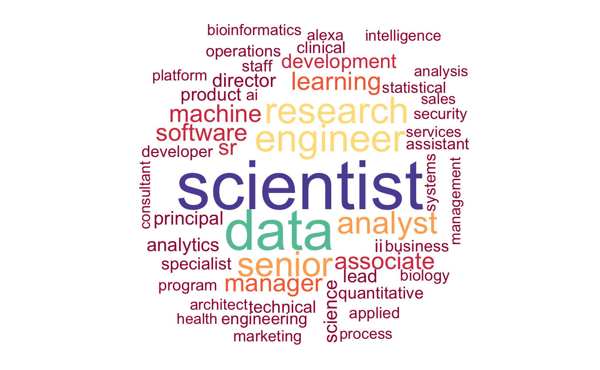
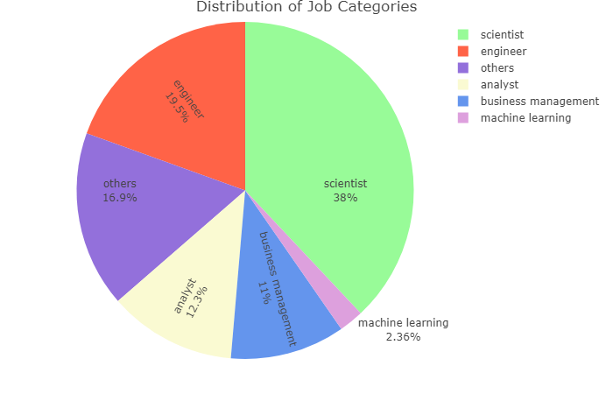
Wordcloud
Top 6 Position Categories

Slide 6
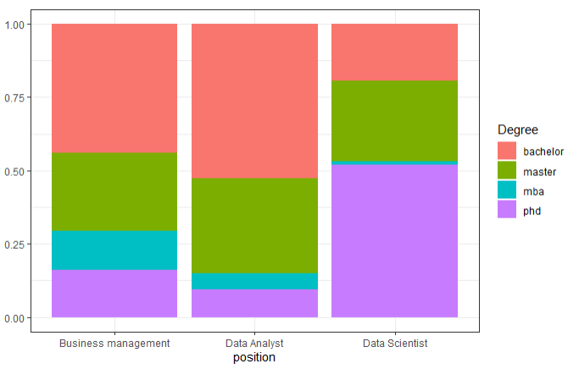
Does the degree matter ?
Data Scientist VS. Data Analyst VS. Business Management Job

Slide 7
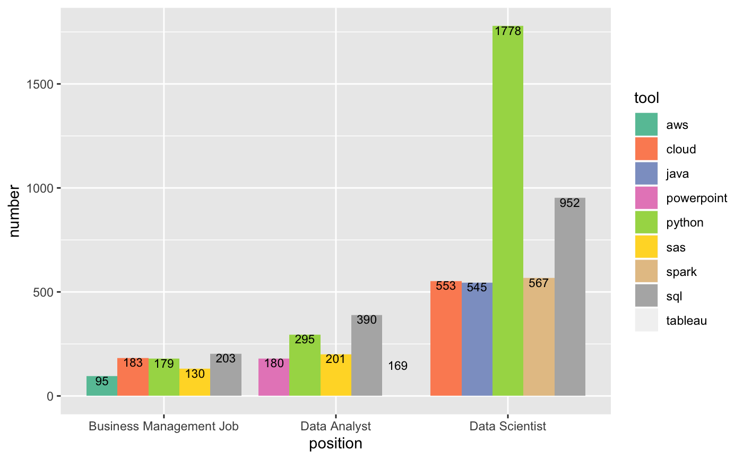
Tools
Data Scientist VS. Data Analyst VS. Business Management Job

Slide 8
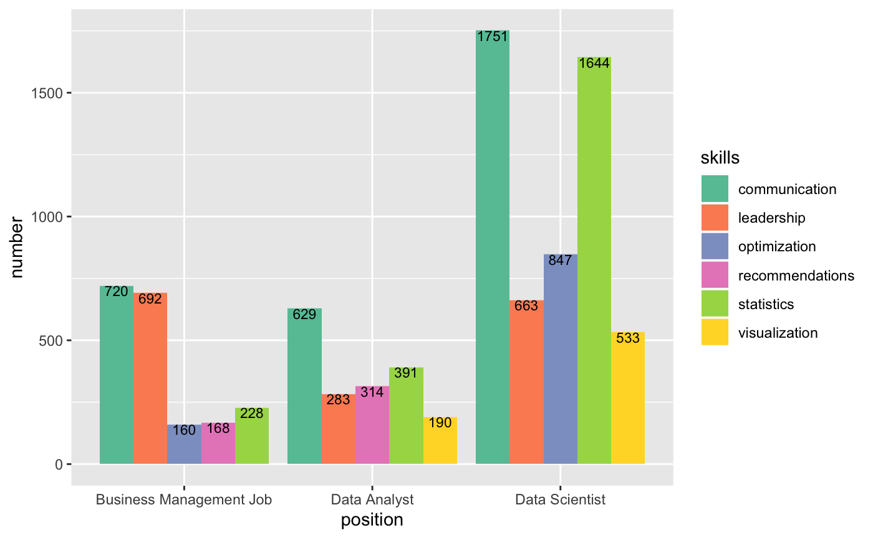
Skills
Data Scientist VS. Data Analyst VS. Business Management Job

Slide 9
Limitations
Customized job postings on indeed may bias the data.
Limited sample size.
Unverified title categorization.
Overcounting several words: “engineer”, “data science”, etc.

Slide 10
Conclusions
To get a job as a data scientist or machine learning professional, you'd better have a PhD, but for other positions a bachelor's degree may be enough.
You need to master Python and SQL, and meet the specific needs of each position, but communication is always important.
Consider California and Washington state for the west coast and Massachusetts and New York state for the east coast.
Pay attention to big tech companies.

