Slide 1
Phase 2 Backend
Database and API

Slide 2
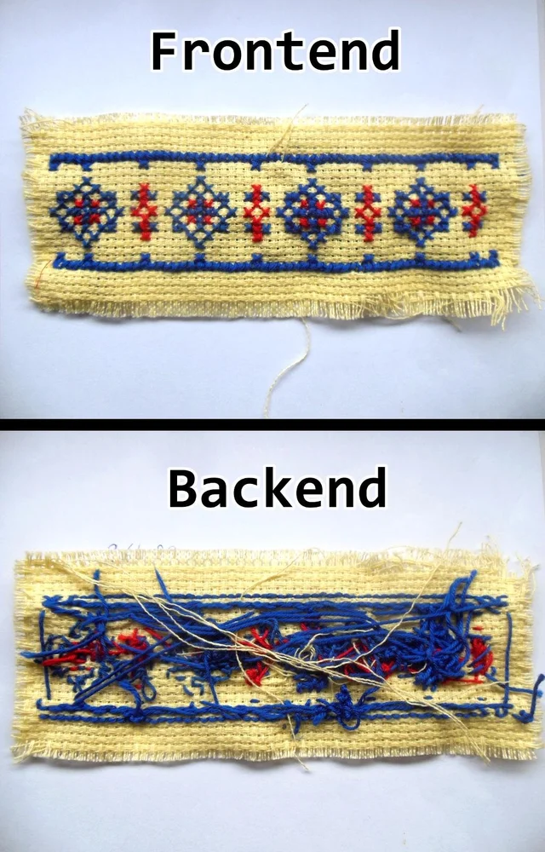
https://scriberapi.azurewebsites.net/
https://www.reddit.com/r/ProgrammerHumor/comments/aiqhsr/frontend_vs_backend/
Notes:
Before I start to talk about the Database and API, I would like to recap what happened earlier today. We've built a very nice Frontend using React with TypeScript. We are able to submit a video and search for transcriptions. But I would like to bring your attention to the link on the right, I am sure you guys are familiar with this link by now as we've copied this link to the Frontend many times, but what's inside this link? How does this link handle all of the requests? After all, the React application just makes a ton of HTTP method calls to this API link.

Slide 3
https://www.reddit.com/r/ProgrammerHumor/comments/aiqhsr/frontend_vs_backend/
Notes:
And behind this link, is the backend, looks like a gigantic mess right? The backend is where the magic happens, the nice thing about the separation between Frontend and backend is that the frontend does not need to understand how the backend works, one simply needs to know how to use it. For all we know, the backend could just be me being a very fast typer, watching every YouTube and type its caption in the database. when the frontend requests something, it could be just me copying and pasting information from the database to return to the frontend. But obviously that's not how this particular API works otherwise I'll be too exhausted to do this presentation. Now, unfortunately, the backend isn't as intuitive as the Frontend and it does take some getting used to. For people who have never been exposed to API and Database, it could look very cryptic. But hopefully we will do a good job of teaching Database and API, after all, you do need to use this content to pass phase two to potentially get a summer placement.

Slide 4



High-level overview of the backend
Scribr Frontend
React with TypeScript
Present the information
Scribr RESTful API
ASP.NET Core
Web API
Handle the requests
SQL Server on Azure
Store the information
Notes:
Before I jump into the nitty gritty, I would like to give a very very high level overview of the content, Our backend consists of two main components, the API and the database. The API’s job, as introduced earlier, is to respond to the request made by the client, in this case, the frontend. It is responsible for handling all requests, for example inserting or getting information into the database. We will be building this API using the Web API framework in ASP.NET Core, note the API doesn’t store any information, the database, as the name suggests, stores all of the information, for example, the video information and the transcriptions. We will be building this database using SQL Server on Azure

Slide 5
Introduction to RESTful API
What is an API? (Application programming Interface)
RESTful API? (REpresentation State Transfer)
HTTP Methods
HTTP Header | Endpoint | Action
GET | /Videos | List of videos
POST | /Videos | Request a new video to be added
PATCH | /Videos/update/{id} | Update information about a video
POST | /Transcriptions | Add a new phrase
Notes:
Let’s take a closer look at what an API is, API stands for Application Programming Interface, this is what enables the separation between backend and frontend. A well designed API does not expose the implementation behind the scenes and only returns information requested by the client. Using Scribr as an example, when we try to search for a word on there, the only information that gets returned to the client is a list of matching videos and transcriptions, all of the processing and searching in the database are done on the API side and the client does not need to know how it works, the client simply needs to know what gets returned. Below the HTTP methods are a couple of the main endpoints that we used this morning and I believe most of you would know what the first three does. We will make these endpoints in the API when we are creating the project in Visual Studio. REST stands for Representation State Transfer, it is a set of architectural constraints such as Code on demand, Statelessness and other attributes that allows our API to be simple, scalable and flexible. We will be talking more about the REST architecture when we are building the API.

Slide 6
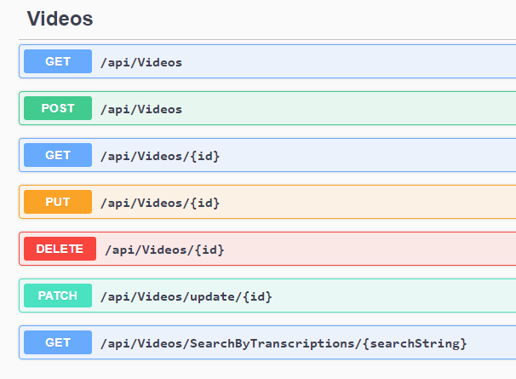
CRUD (Create, Read, Update, Delete)
Four basic functions of persistent storage
HTTP Methods
Create – POST request
Read – GET Request
Update – PUT/PATCH Request
Delete – DELTE Request
Notes:
In order for the API to be considered useful in our application, we need to consider four basic functions, Create, Read, Update and Delete, these are the four fundamental concepts for persistent storage. We will be interacting with our RESTful API via HTTP requests, conveniently, there are HTTP methods that translates to these four basic functions, the most common one is a GET request, which is the read function in the CRUD. When you are visiting a website, the browser usually sends a GET request to the server and the server usually returns HTML code in the response body. We will be doing something similar, but instead of returning HTML code like normal website, our API is going to return information in JSON format, which I will formally introduce in the next slide. Create is normally translated to a HTTP POST request, Update can be either be PUT or PATCH in the HTTP method, and delete is simply a delete HTTP method. Again our API does not store any persistent information, our API will translate these requests into SQL commands to be used in the database.

Slide 7
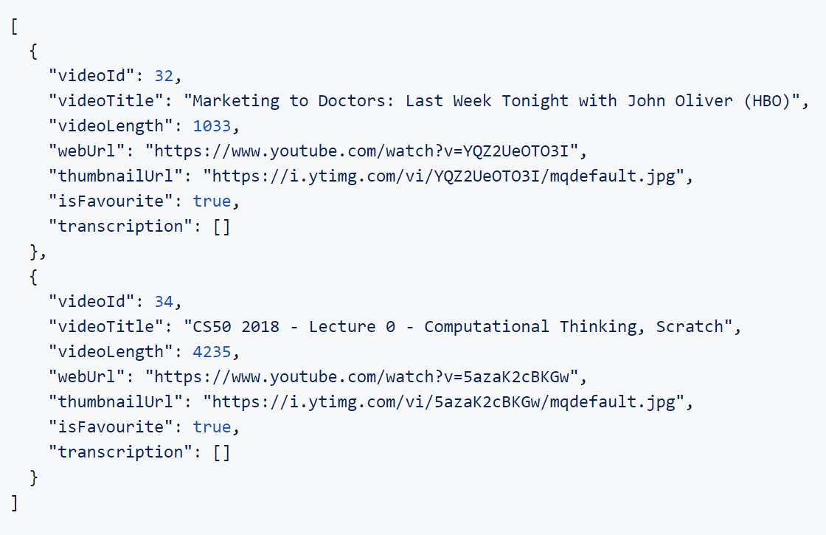
Data Transfer Format
JSON (JavaScript Object Notation)
XML (eXtensible Markup Language)
YAML (YAML Ain’t Markup Language)
…
GET /Videos
Notes:
There are different ways of transferring information from the API to the Client and from the Client to the API, there are JSON, XML and YAML just to name a few. If you guys paid close attention this morning then you should be familiar with JSON data. On the right is an example of the JSON data returned from our Scribr API, This particular endpoint returns a list, each item in the list has a key and a value, for example if I want to know the title of the first video, I would go to the 0th index of the array, go to the key “videoTitle” and get its value. JSON has a lot of advantages over the other two, it is very compact, readable and as a result, very fast which is crucial when it comes to transferring information over the internet.
Note that although JSON stands for JavaScript Object Notation, its use is not limited to JavaScript, in fact JSON has become the norm for most of the programming languages, as a result, there usually is a built-in library to help us to manipulate the data very easily.

Slide 8
Additional Resources for API
https://restfulapi.net/rest-architectural-constraints/
https://swagger.io/docs/specification/api-host-and-base-path/
https://www.restapitutorial.com/
https://www.tutorialspoint.com/rest_api/index.asp
Notes:
That’s about it for the API theory section, here are some additional links if you would like to learn more about REST architecture and APIs. I will put this presentation up tonight at the NZMSA GitHub repo.

Slide 9
Next up: Relational Database theory

