Slide 1
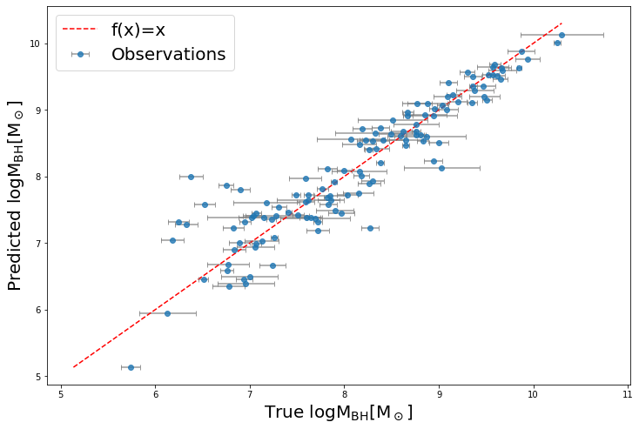

Ultimate black hole mass scaling relations
GFG meeting
Zehao Jin
2023/04/05

Slide 2
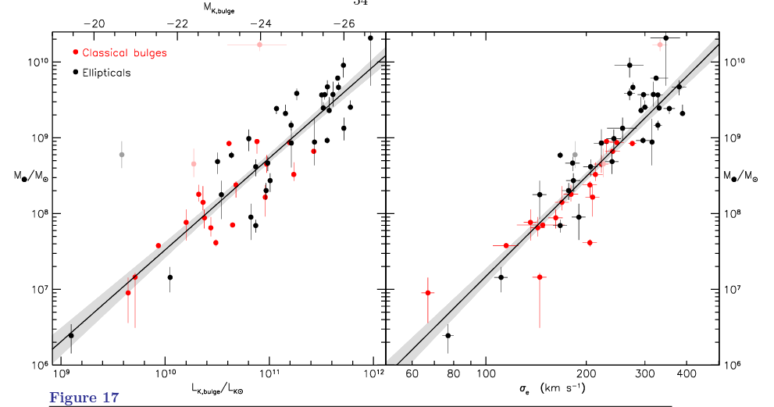
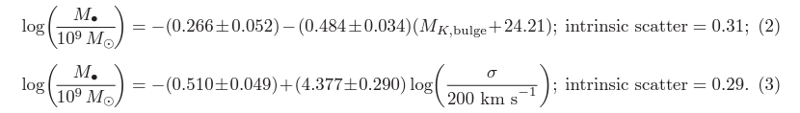
Black hole mass scaling relations
Kormendy, John; Ho, Luis C. (2013)

Slide 3
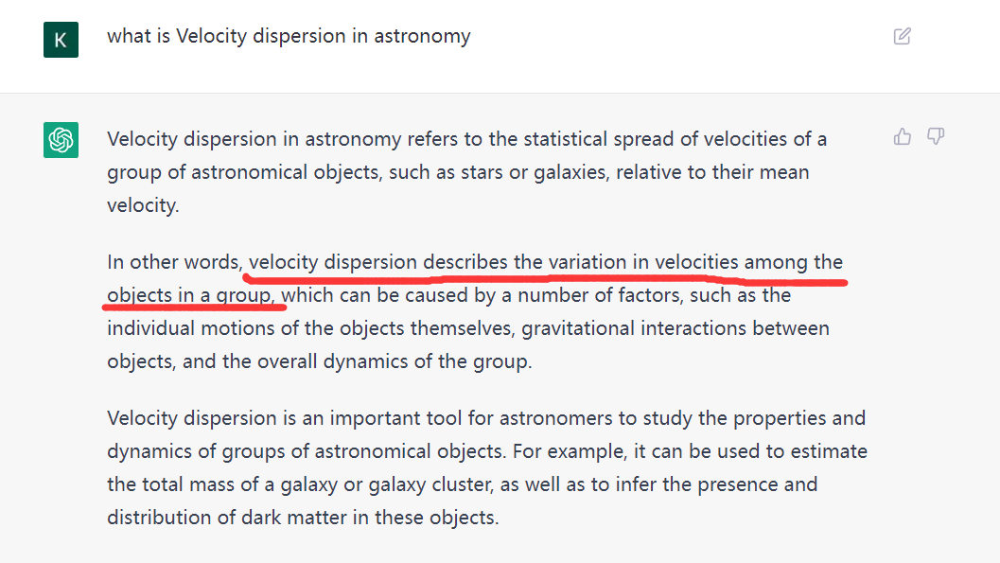
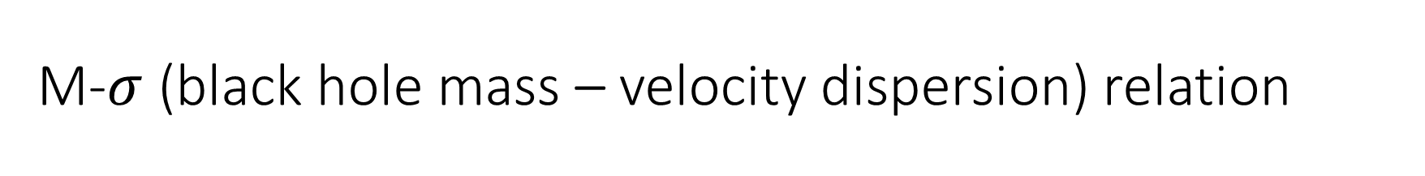
M-$σ$ (black hole mass – velocity dispersion) relation

Slide 4
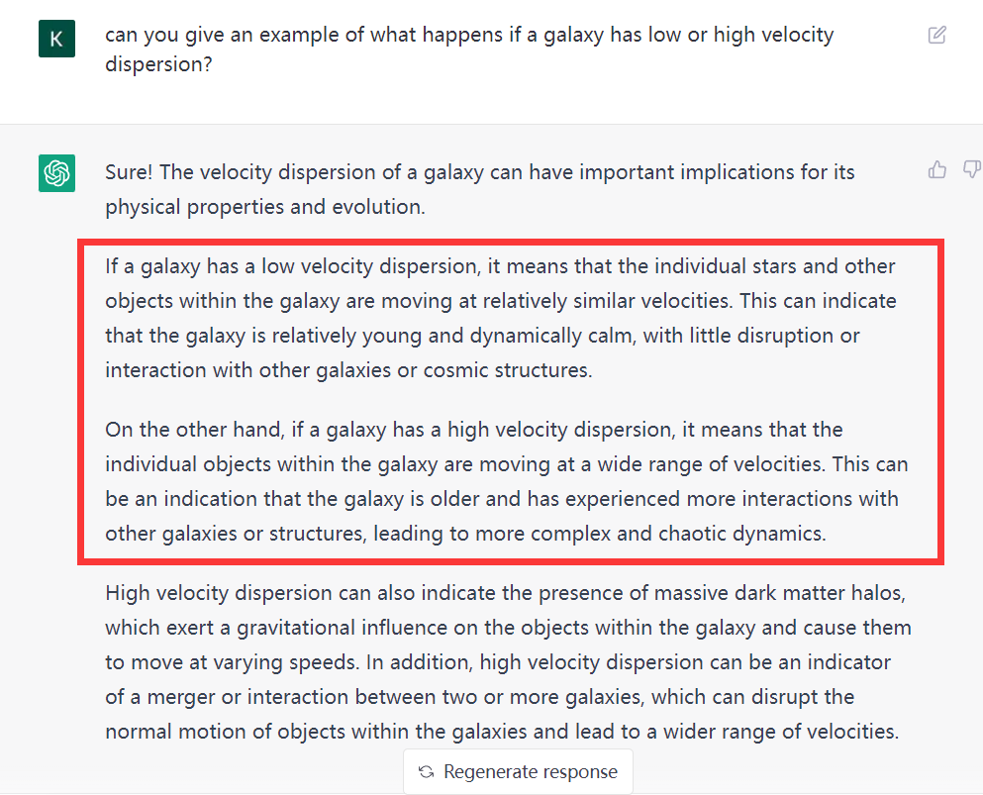
M-$σ$ (black hole mass – velocity dispersion) relation

Slide 5
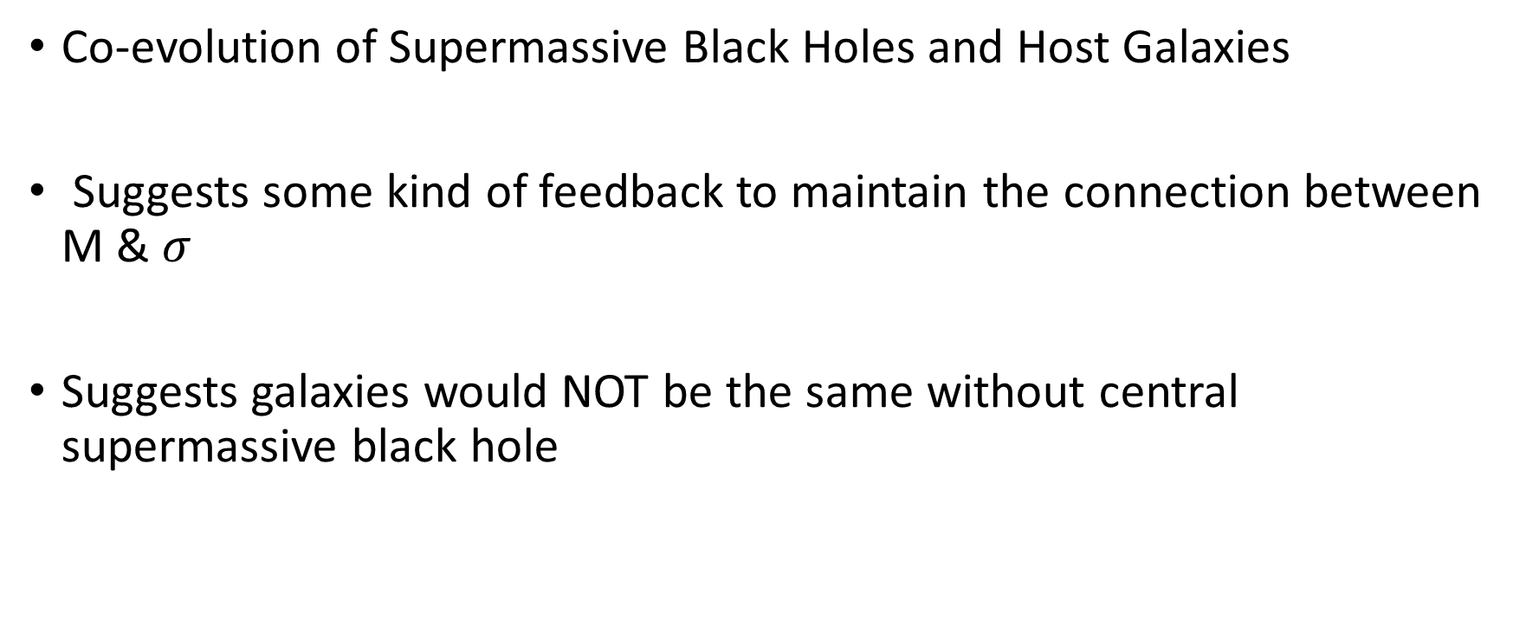
M-$σ$ (black hole mass – velocity dispersion) relation
Co-evolution of Supermassive Black Holes and Host Galaxies
Suggests some kind of feedback to maintain the connection between M & $σ$
Suggests galaxies would NOT be the same without central supermassive black hole

Slide 6
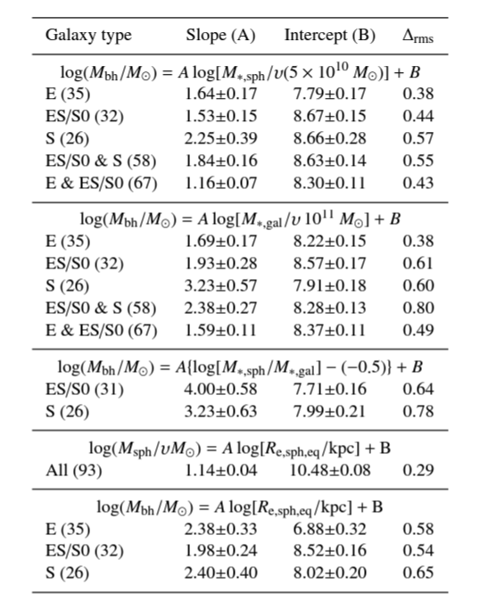
Lots of Black hole mass scaling relations
M*_sph: Stellar mass of bulge
M*_gal: Stellar mass of whole galaxy
R_e: effective half-light radius of bulge
Graham & Sahu (2022)

Slide 7
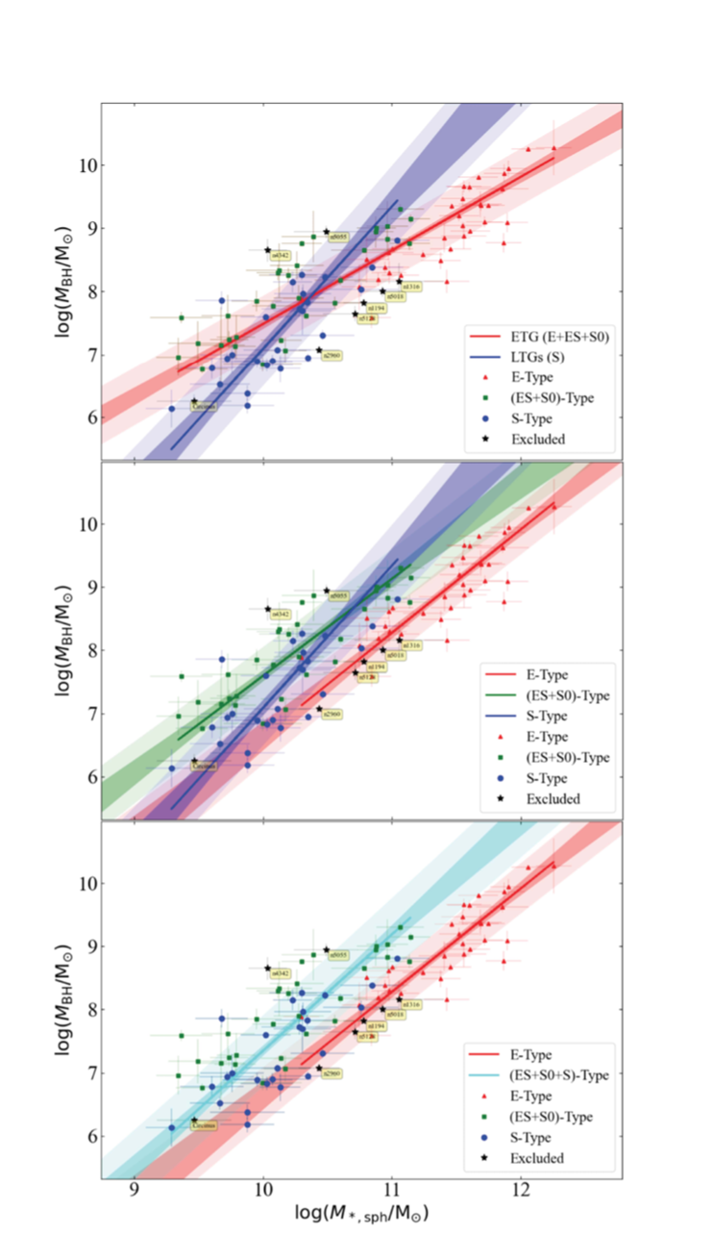
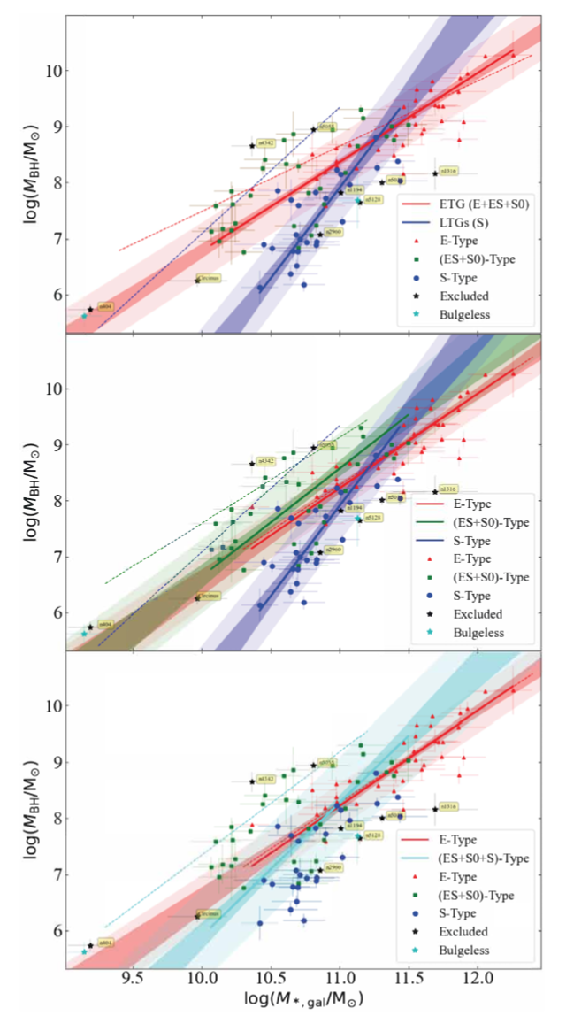
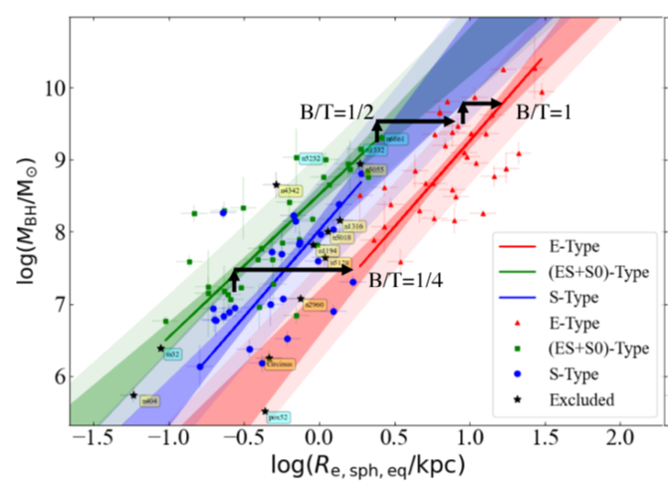
Graham & Sahu (2022)

Slide 8
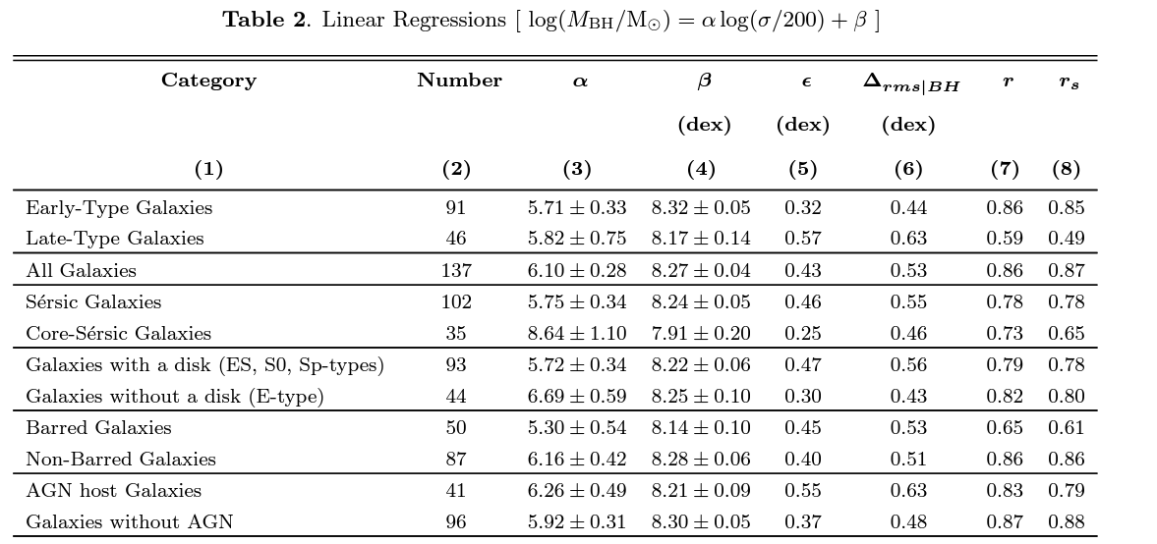
Lots of Black hole mass scaling relations
Sahu et al. (2019)

Slide 9
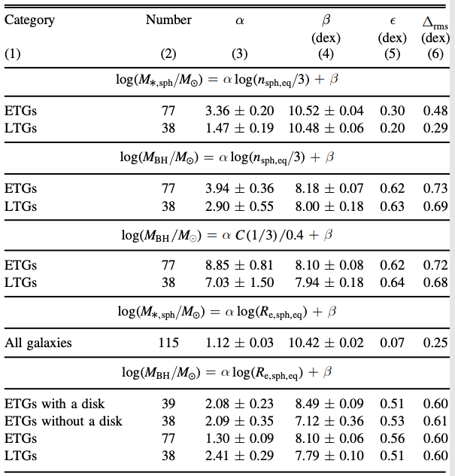
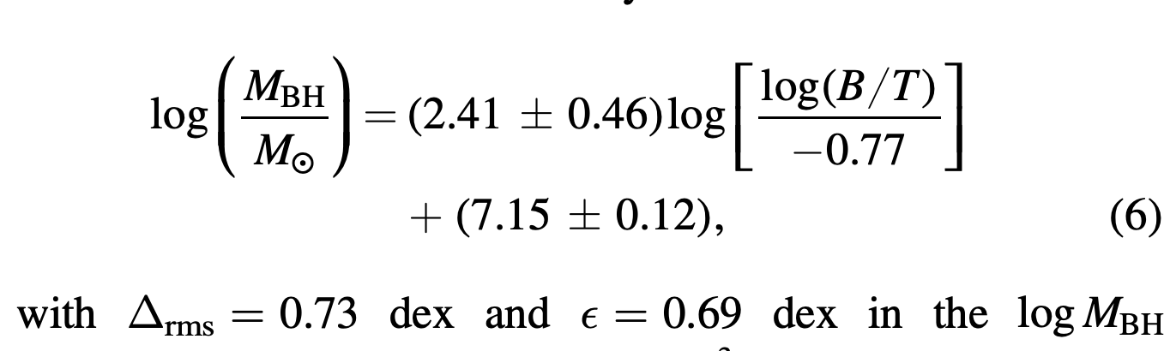
Lots of Black hole mass scaling relations
Davis et al. (2018)
And many more…
Sahu et al. (2020)

Slide 10
Blackhole mass – galaxy property dataset
Black hole mass
Classifications: ETG/LTG, T-type, Bar, Disk, Core, Pseudobulge, …
Velocity dispersion
Stellar mass: M*_sph, M*_gal, B/T (bulge mass/total mass), …
Radius: R_e, R_10, R_90, R_soi, …
Densities: Rho_R_e, Rho_R_10, Rho_R_90, Rho_R_soi, …
Light/color: B-band luminosity, V-band luminosity, B-V
…
Are there relations using multiple properties (N-D scaling relations)?

Slide 11
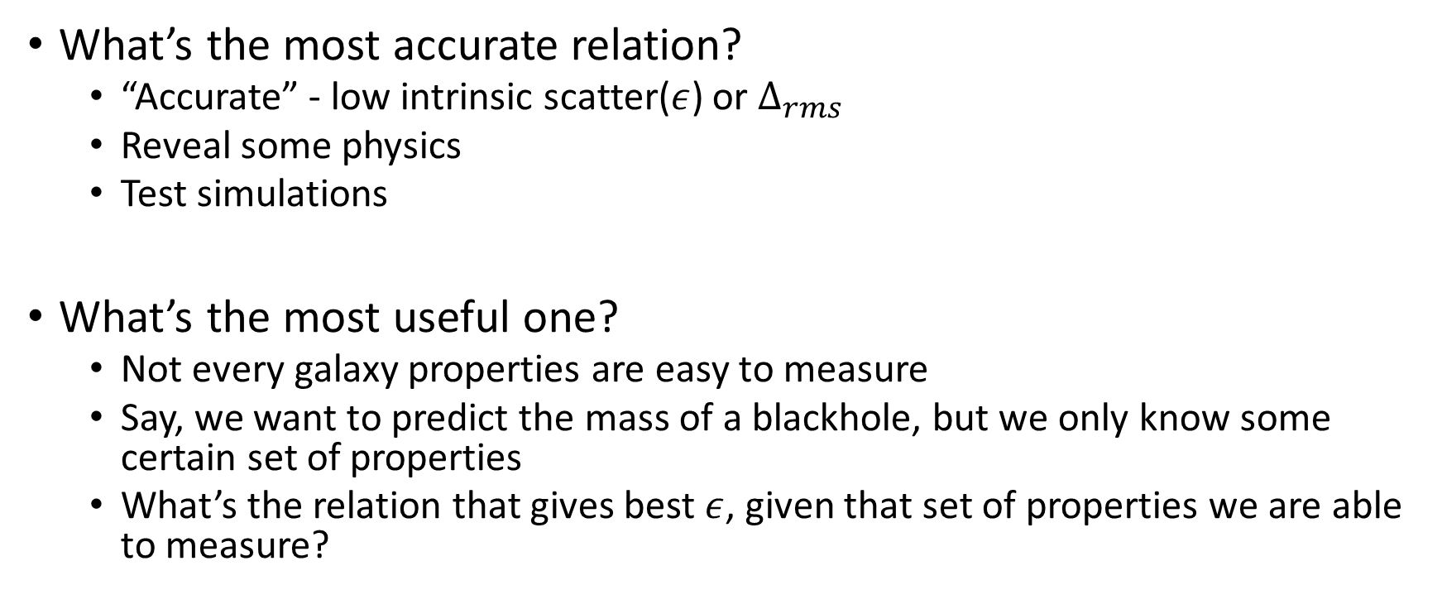
If so, What’s the best one?
What’s the most accurate relation?
“Accurate” - low intrinsic scatter($ε$) or $∆_{rms}$
Reveal some physics
Test simulations
What’s the most useful one?
Not every galaxy properties are easy to measure
Say, we want to predict the mass of a blackhole, but we only know some certain set of properties
What’s the relation that gives best $ε$, given that set of properties we are able to measure?
Notes:
Disclaimer on accurate and precision

Slide 12
It’s simple!
All we need to do is:
List all possible combinations of these properties, blackhole mass, constants, and algorithmic operations
The best relation always lies on the list somewhere
Unfortunately, Ben gives me a table of 183 different properties
-- sounds like the list will be ultra-long

Slide 13
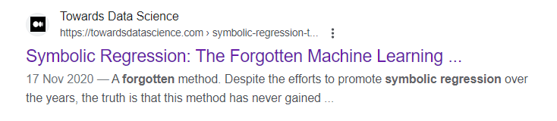
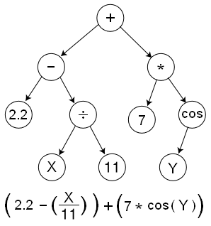
Symbolic Regression(SR)
A subfield of machine learning that aims to find mathematical expressions that best fit a given set of data.
List all possible equations -- Smart brute-force
Most commonly, Genetic coding
Bayesian methods, neural networks, divide and conquer
Pick/Rank the best equations – Occam's razor
Precision: RMSE, L1, L2, Exp, Sigmiod, …
Simplicity: parameters, constants, operators, …
Genetic coding Expression tree
Credit: Wikipedia

Slide 14
PySR
Miles Cranmer (2020)
https://astroautomata.com/PySR/
https://github.com/MilesCranmer/PySR
Video demo: https://streamable.com/ncvqhy
Will come back on SR later

Slide 15
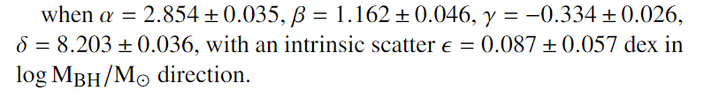
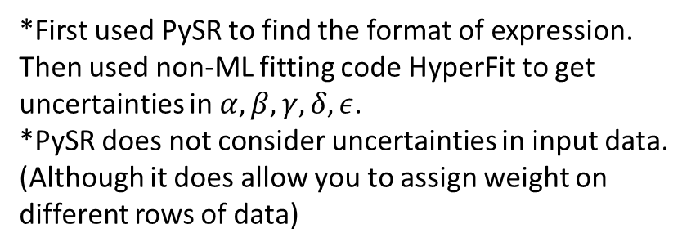
Most precise relations
*First used PySR to find the format of expression.
Then used non-ML fitting code HyperFit to get uncertainties in $α,β,γ,δ,ε$.
*PySR does not consider uncertainties in input data. (Although it does allow you to assign weight on different rows of data)

Slide 16

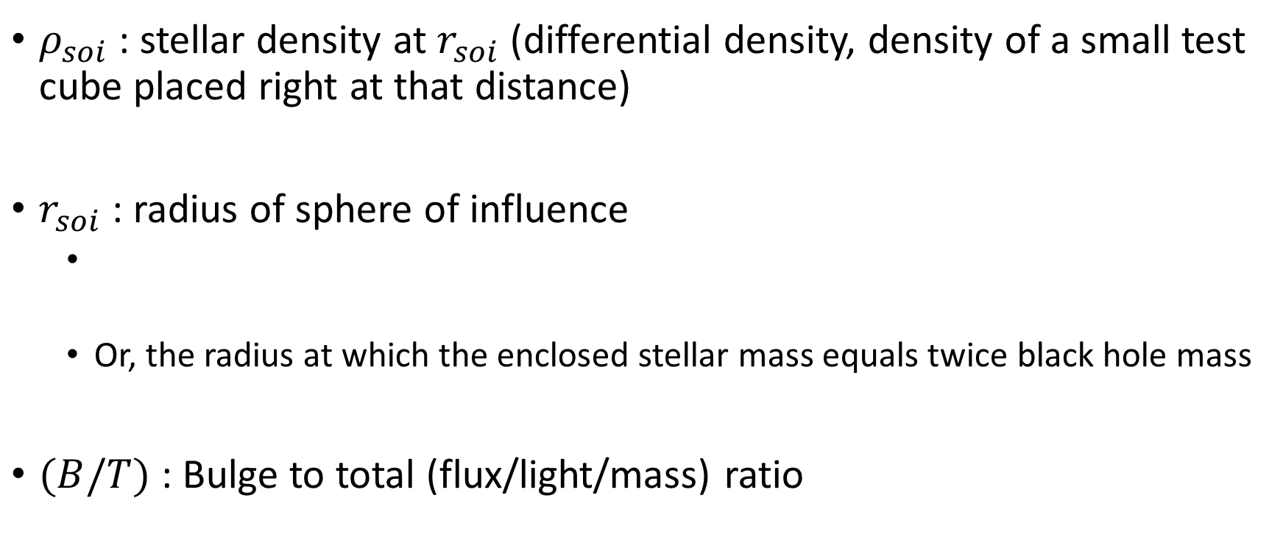
Most precise relations
$ρ_{soi}$ : stellar density at $r_{soi}$ (differential density, density of a small test cube placed right at that distance)
$r_{soi}$ : radius of sphere of influence
Or, the radius at which the enclosed stellar mass equals twice black hole mass
$(B/T)$ : Bulge to total (flux/light/mass) ratio

Slide 17
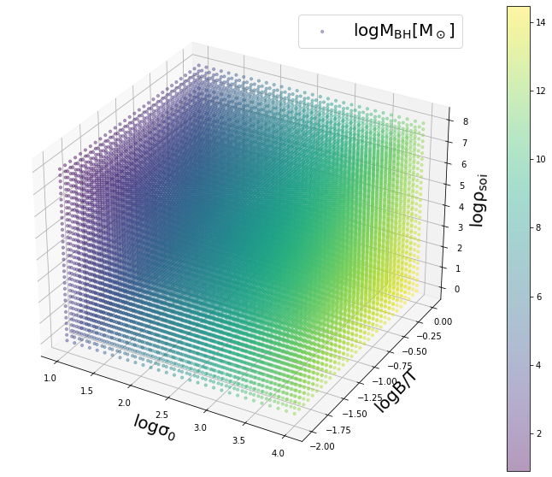

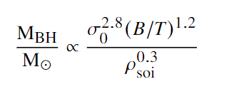
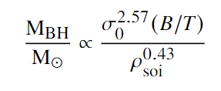
Most precise relations
*PySR score rank 1st
What’s the physics behind it?
Does NIHAO reproduce this?

Slide 18
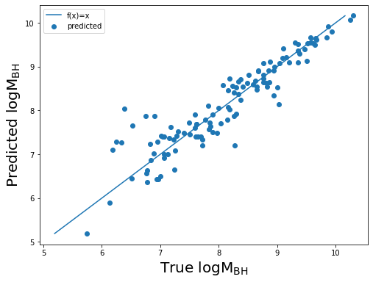
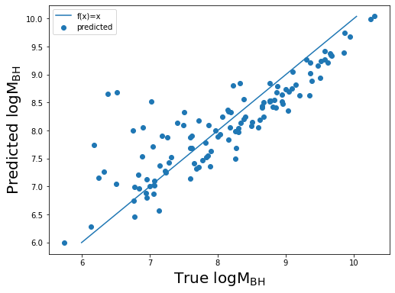





Do we really need $σ,\left(\frac{B}{T}\right)$ , $ρ_{soi}$ ?
$ε$=0.08
$ε$=0.45

Slide 19
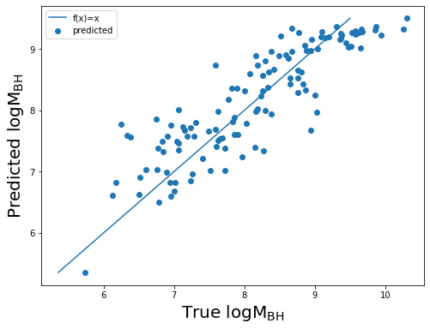


Do we really need $σ,\left(\frac{B}{T}\right)$ , $ρ_{soi}$ ?
$ε$=0.08
$ε$=0.34

Slide 20
Do we really need $σ,\left(\frac{B}{T}\right)$ , $ρ_{soi}$ ?
$ε$=0.08
Kormendy, John; Ho, Luis C. (2013)

Slide 21

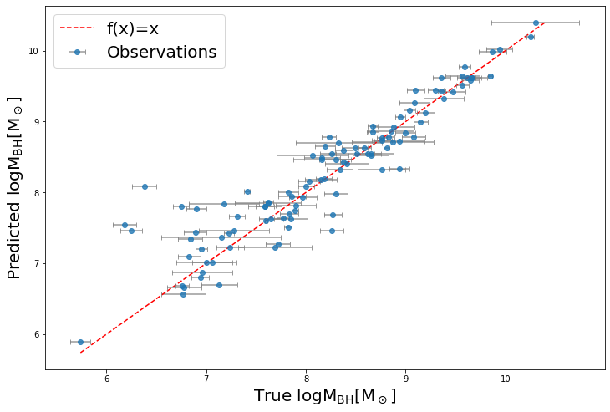
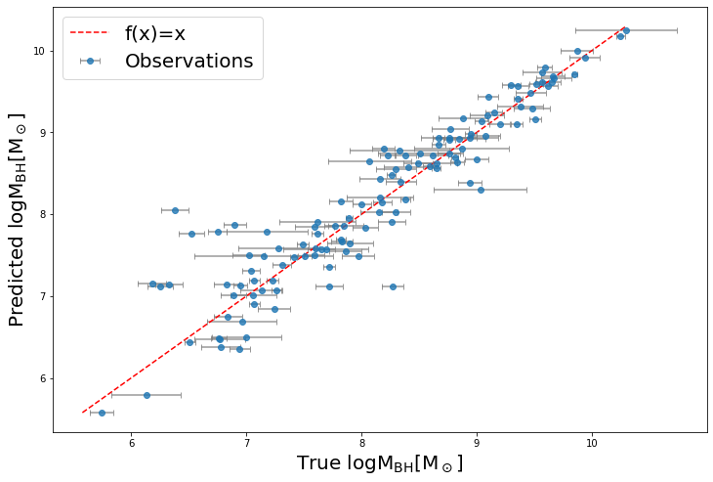


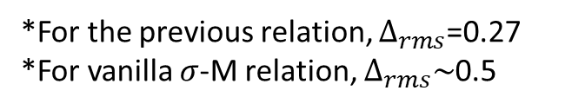
Most precise relations – many more
$∆_{rms}$=0.25
$∆_{rms}$=0.23
*For the previous relation, $∆_{rms}$=0.27
*For vanilla $σ$-M relation, $∆_{rms}\sim$0.5
* For these relations, have not calculated intrinsic scatter yet, since the error in some parameters are unknow, or hard to define

Slide 22


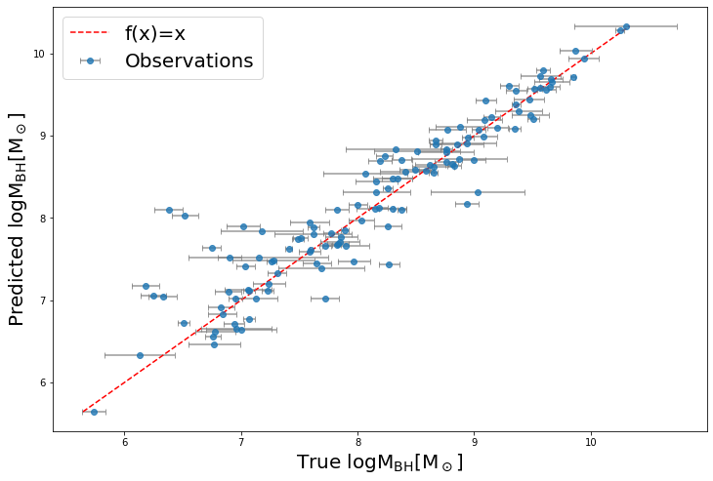
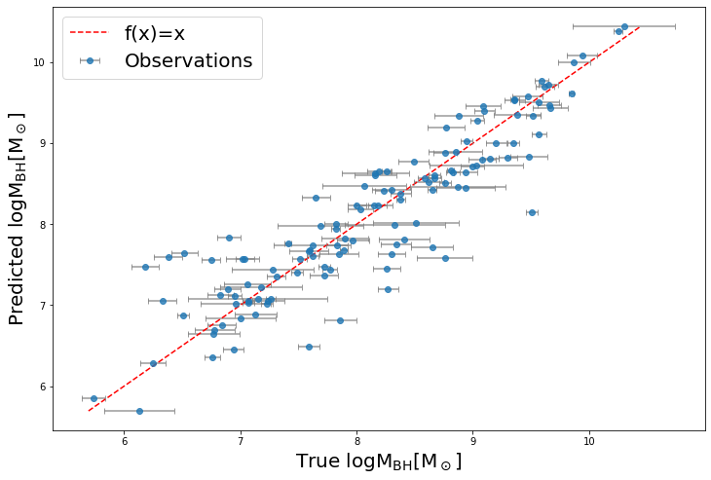




Most precise relations – many more
$∆_{rms}$=0.22
$∆_{rms}$=0.30
* $M_{sph}^{∗}$ only $∆_{rms}\sim$0.5
*$ρ_{soi}$ only $∆_{rms}\sim$0.65

Slide 23

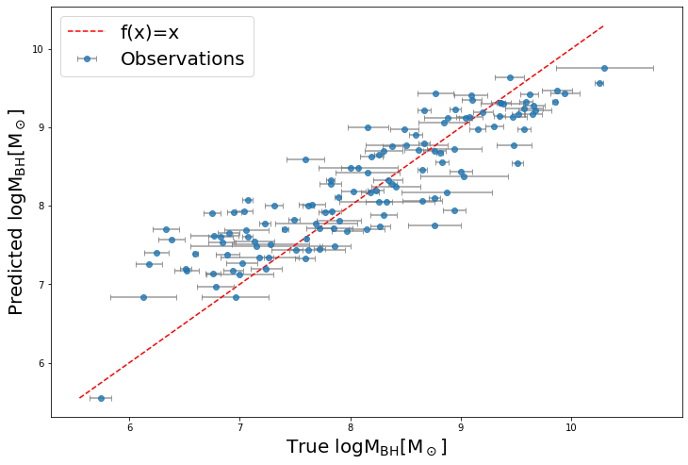


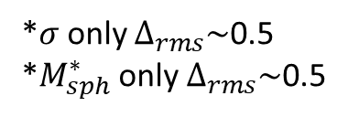
Most precise relations – many more
$∆_{rms}$=0.43
*$σ$only $∆_{rms}\sim$0.5
*$M_{sph}^{∗}$ only $∆_{rms}\sim$0.5
*(B/T) only $∆_{rms}\sim$0.7

Slide 24


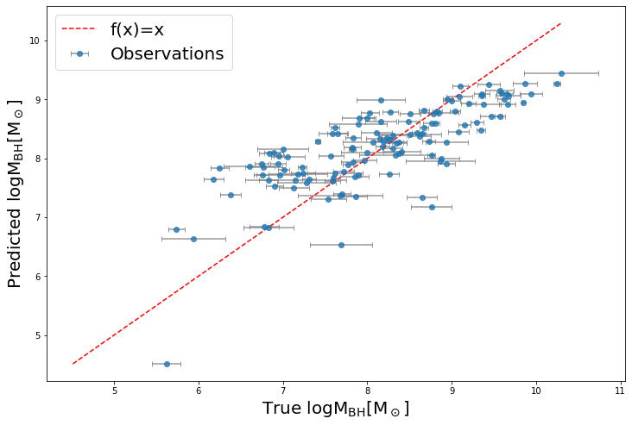
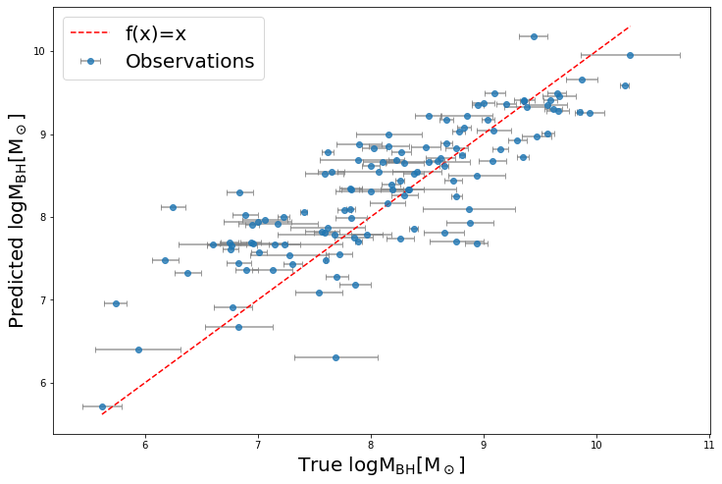


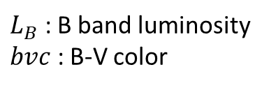

Easy-to-use Relations - Luminosity
$∆_{rms}$=0.52
$∆_{rms}$=0.44
$L_{B}$ : B band luminosity
$bvc$ : B-V color
* $L_{B}$ only $∆_{rms}\sim$0.8

Slide 25


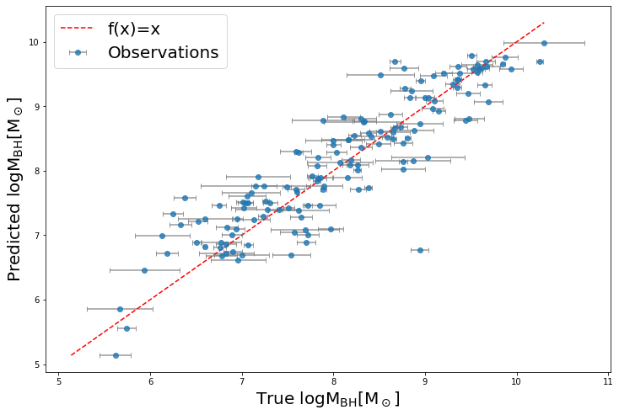
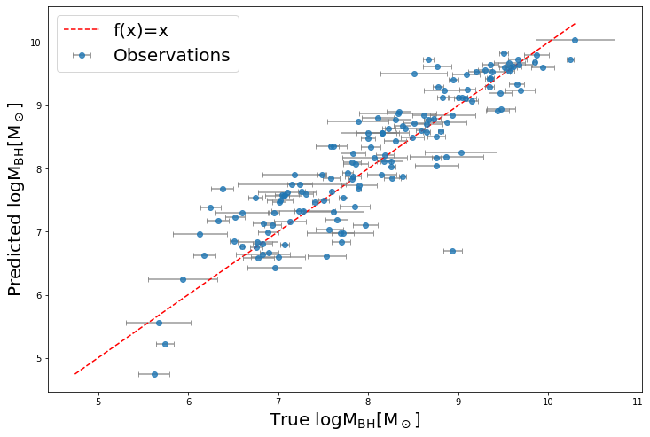




Easy-to-use Relations - $σ$
$∆_{rms}$=0.31
$∆_{rms}$=0.312
*$σ$only $∆_{rms}\sim$0.5

Slide 26


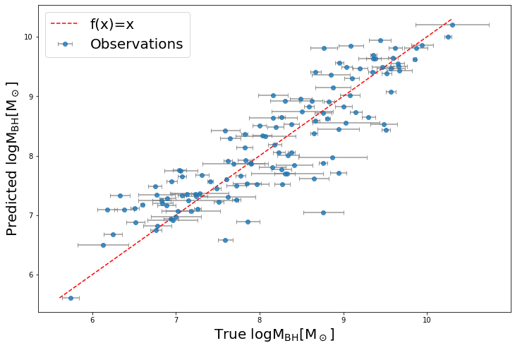
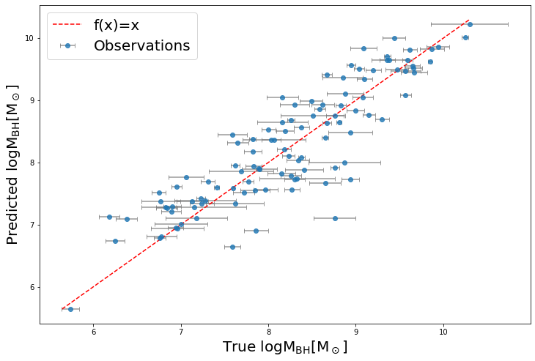



Easy-to-use Relations - Mass
$∆_{rms}$=0.36
$∆_{rms}$=0.31
$M_{sph}^{∗}$ only $∆_{rms}\sim$0.5

Slide 27

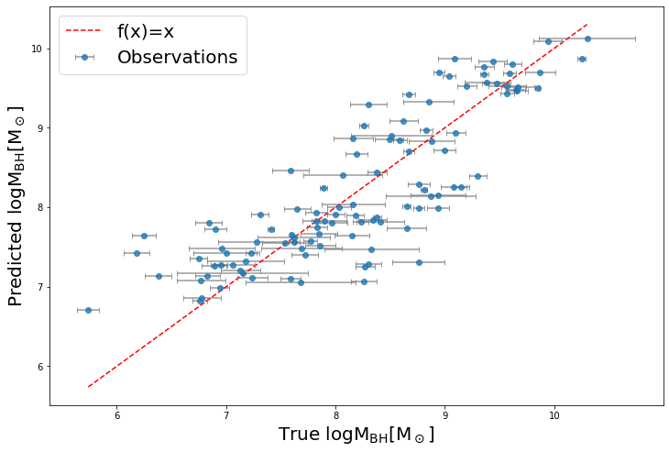


Easy-to-use Relations - Radius
$∆_{rms}$=0.39
* $R_{e}$ only $∆_{rms}\sim$0.6

Slide 28




The collection - precise

Slide 29







The collection - easy-to-use

Slide 30
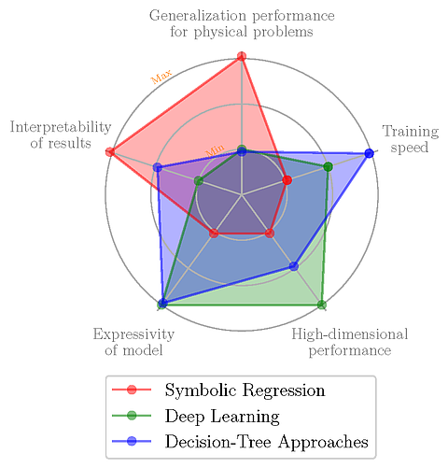
A few words on Symbolic Regression
Blue: Pre-neural network Machine Learning
Model size medium
“black” box
Train on laptop CPU (sec, min,hrs)
Hundreds, thousands data
Accurate results
Green: Deep (Neural network) learning
Model size big
Blacker black box
Train on GPU (days,weeks, months)
Millions data
Very accurate results , even overfitting
Red: Symbolic Regression
Model size small
🧡 EQUATIONS 🧡
Hard to train
Not as accurate (but general) results
Credit: Wadekar et al. 2022

Slide 31

A few words on Symbolic Regression
People besides physicists prefer accurate results
AI video recommendations vs. study everyone’s Psychology
Most AI efforts are on deep learning
CS papers, contesting each other for accuracy
We are getting too good on deep learning
Deep learning algorithm already very mature
SR algorithm plenty of room to improve

Slide 32
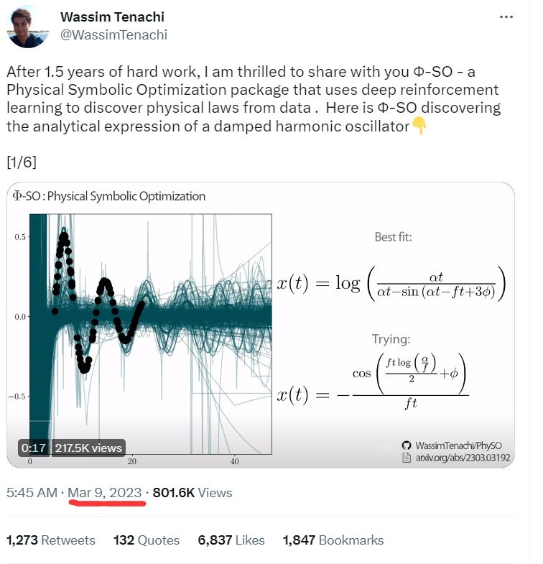

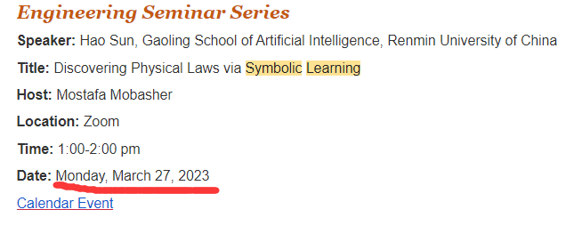
A few words on Symbolic Regression
Recently the SR Field is growing very fast
Physicists are developing Symbolic Regression Algorithms ourselves.

Slide 33
General cases for Symbolic Regression
Current SR algorithms: <10,000 data points, <10 parameters
The nature of your problem sounds like an equation
Scaling relation seems like the best place to use it right now.
Grab any (galaxy/blackhole/star) catalog
Laptop/Falcon, a SR package (PySR, AI Feynman, Φ-SO, …)
Some luck
Find and name your Laws!

Slide 34
Conclusion
Lowest scatter black hole mass scaling relation ever
Reveal Physics, test simulations
Easy-to-use black hole mass scaling relations, with classification corrections
Predict black hole masses. SDSS, JWST, Vera Rubin, …
There are only ~100 direct measurement of blackhole masses, while there are billions of galaxies that have black hole
Many more N-D scaling relations to be found
Symbolic Regression
If you have a good catalog
If you have an equation-finding-like problem
If you want to try some SR
Let me know!

Slide 35
Thank you!

