Slide 1


Emerging Technologies
By: Priyesh Pandya, Hasan Ahmad, Ermin Zeherovic, Punith Agraharavalagerahalli Jayaramu, and Jennifer Sager
Notes:
Priyesh

Slide 2
Emerging technologies, What is it?
It is an e-commerce B2C application which provides end users with the latest and greatest technology products to purchase from.
This with the added benefit of Cybersecurity risk ratings on whether the products are vulnerable or not.
Notes:
Priyesh

Slide 3

Agenda
Features
Team Structure
Technologies used
How they are used
Project Outcomes
Live Demo
Challenges
Questions/Concerns
Next Steps
Notes:
Priyesh

Slide 4
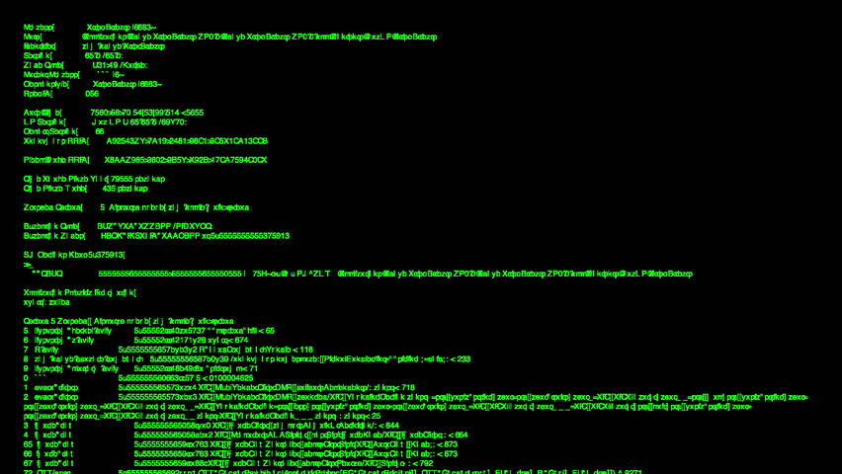
Features
Display Technology products
Indicators for Cybersecurity Risk Ratings
Display user profiles
Display Shopping Cart
Feature to add more than one quantity of the same product
Feature to remove product
Feature to show the prices
Feature to integrate different payment types
Feature to process the order
Feature to download, print and email receipts
Notes:
Priyesh

Slide 5
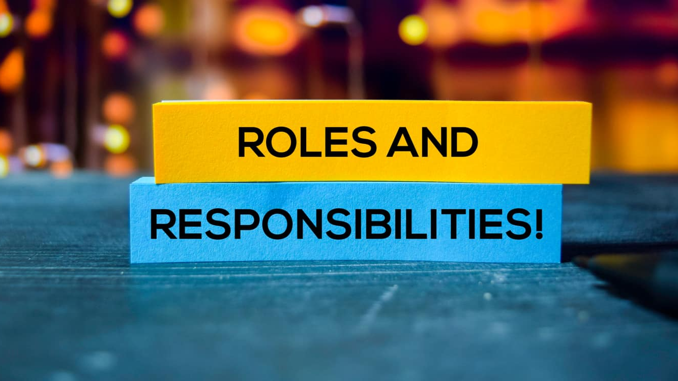
Team Overview
Name | Role
Priyesh Pandya | Technical Product Manager
Punith Agraharavalagerahalli Jayaramu | Software Architect
Hasan Ahmad | Software Engineer
Ermin Zeherovic | Software Engineer
Jennifer Sager | Software Engineer
Notes:
Ermin

Slide 6
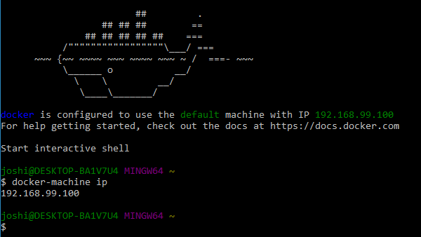
Technologies Used
Docker
Docker Hub
PyCharm
GitHub
Lucido Flowchart / Visio
Trello
Discord
MS Teams
Kubernetes
Notes:
Ermin

Slide 7

Containerization and Orchestration
Docker (containerization)
recreate environment on any machine
Kubernetes (orchestration)
manage all the containers
Jenkins (pipeline)
Ties whole operation together
All this allows for
Smooth development
Minimal downtime
Better allocation of resources
Notes:
Hasan

Slide 8

Project Outcomes and Goals
Bugs captured
Code refactored
Stronger team communication
Better proficiency at new technology
Understanding of microservice architecture
Goals Achieved
Create an application risk free of vulnerabilities
Rapid development of proof of concept
Increased awareness of products
Deliver a lightweight program
Notes:
Hasan

Slide 9
Live Demo
Notes:
Punith

Slide 10
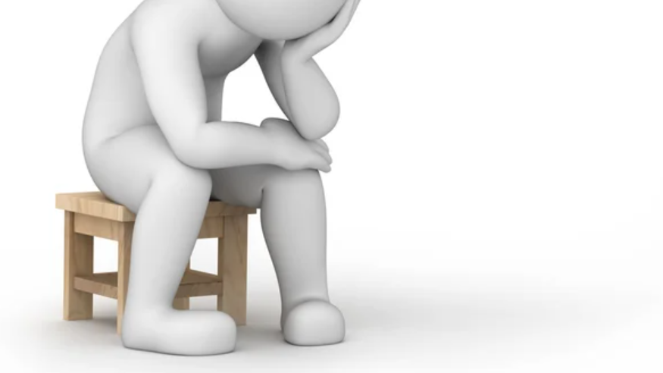
Challenges
It was a challenge getting everything together and working
New technologies have a learning curve that wasted some time
Schedule mismatches lead to a somewhat delayed communication
Different experience levels lead to a gap in ability
Notes:
Jenny

Slide 11
Next Steps
Implement a more user-friendly interface and GUI
Create a bounty program for the community to report vulnerabilities.
Resolve all outstanding bugs by the project deadline.
Notes:
Jenny

Slide 12
Questions?

