Slide 1


Emerging Technologies
By: Priyesh Pandya, Hasan Ahmad, Ermin Zeherovic, Punith Agraharavalagerahalli Jayaramu, and Jennifer Sager

Slide 2

Agenda
Proposal
Flowcharts
Project Outcomes
.
.
.
.
.
Conclusion/Questions

Slide 3
Proposal
An e-commerce B2C application using flask app. Emerging Technologies is an e-commerce B2C application which will provide end customers with the latest and greatest technology products to purchase with Cybersecurity risk ratings on whether the products are vulnerable or not.

Slide 4
Display Technology products
Feature to filter the products based on the area of interest
Indicators for Cybersecurity Risk Ratings
Display user profiles
Display Shopping Cart
Feature to add more than one quantity of the same product
Feature to remove product
Feature to show the prices
Feature to integrate different payment types
Feature to process the order
Feature to download, print and email receipts

Slide 5
Docker
Docker Hub
PyCharm
GitHub
Lucido Flowchart / Visio
Trello
Discord
MS Teams

Slide 6
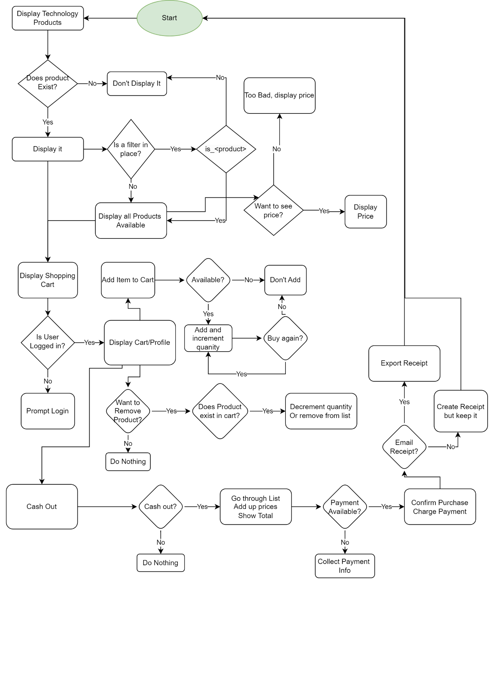

Slide 7
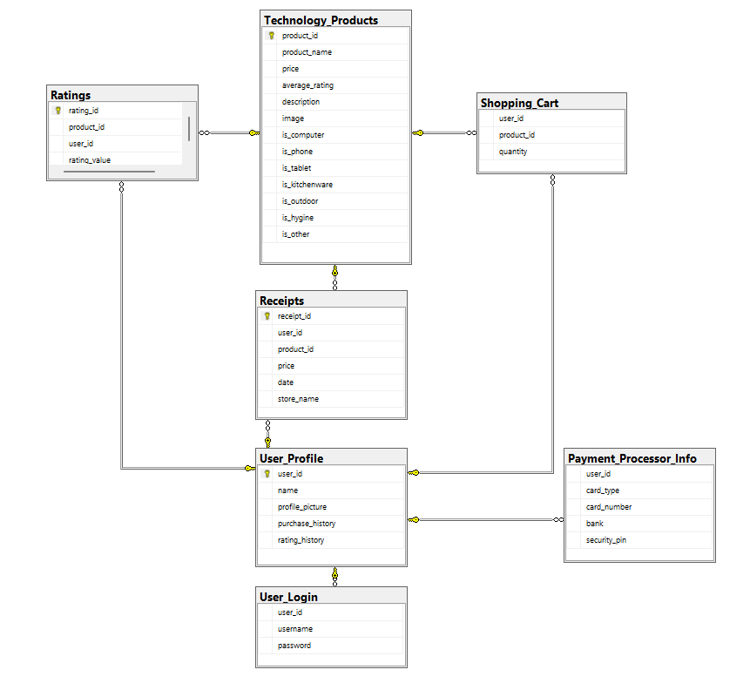

Slide 8
Project Outcomes

Slide 13
Questions?

