Slide 1


Emerging Technologies
By: Priyesh Pandya, Hasan Ahmad, Ermin Zeherovic, Punith Agraharavalagerahalli Jayaramu, and Jennifer Sager

Slide 2
Emerging technologies, What is it?
It is an e-commerce B2C application which provides end users with the latest and greatest technology products to purchase from.
This with the added benefit of Cybersecurity risk ratings on whether the products are vulnerable or not.

Slide 3

Agenda
Features
Team Structure
Technologies used
How they are used
Project Outcomes
Live Demo
Thoughts
Questions/Concerns

Slide 4
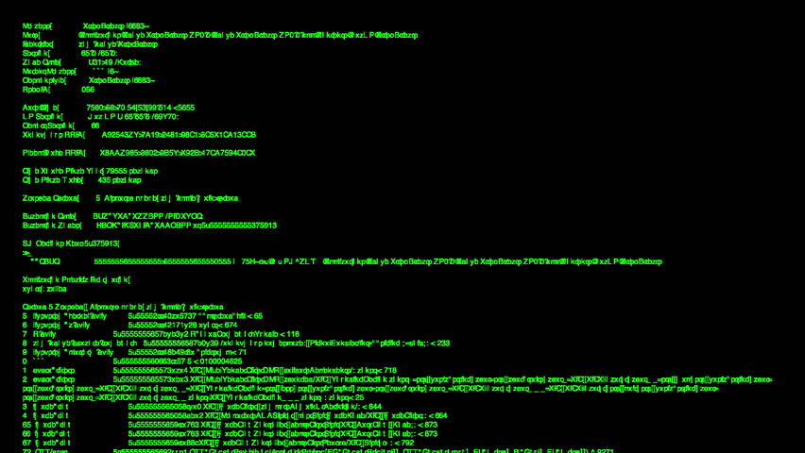
Features
Display Technology products
Indicators for Cybersecurity Risk Ratings
Display user profiles
Display Shopping Cart
Feature to add more than one quantity of the same product
Feature to remove product
Feature to show the prices
Feature to integrate different payment types
Feature to process the order
Feature to download, print and email receipts

Slide 5

Roles
Jennifer Sager
Priyesh Pandya
Punith Agraharavalagerahalli Jayaramu
Ermin Zeherovic
Hasan Ahmad

Slide 6
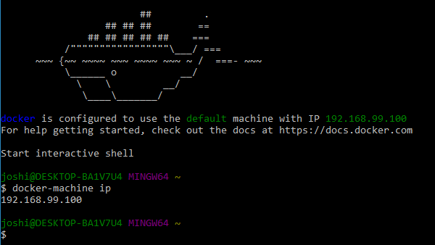
Technologies Used
Docker
Docker Hub
PyCharm
GitHub
Lucido Flowchart / Visio
Trello
Discord
MS Teams
Kubernetes

Slide 7

Containerization and Orchestration
Docker (containerization)
recreate environment on any machine
Kubernetes (orchestration)
manage all the containers
Jenkins (pipeline)
Ties whole operation together
All this allows for
Smooth development
Minimal downtime
Better allocation of resources

Slide 8

Project Outcomes
Bugs captured
Code refactored
Stronger team communication
Better proficiency at new technology
Understanding of microservice architecture

Slide 9
Live Demo

Slide 10

Thoughts
It was a challenge getting everything together and working
New technologies have a learning curve that wasted some time
Schedule mismatches lead to a somewhat delayed communication
Different experience levels lead to a gap in ability

Slide 11
Questions?

