Slide 1
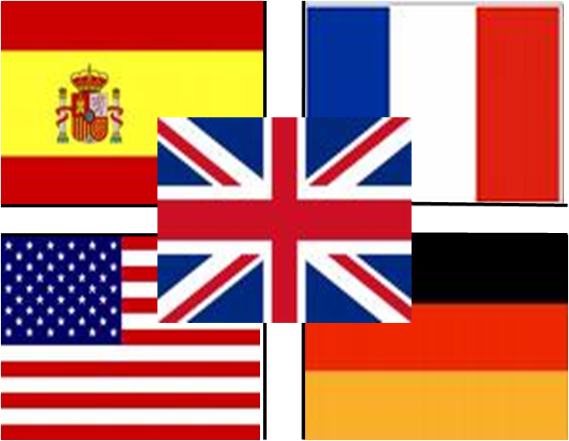
While making my emblem, I had to consider the two main points which were to include a symbol of France, Germany, America and Spain- The places I was inviting the students from. The second point was to include a symbol of London- The place where I was calling the student too. This was because, I had to make sure when someone saw my emblem they understood what my project is about or got an indication of what countries have I considered in using
The Emblem

