Slide 1


AUTOMATIC RAILWAY GATE CONTROL
USING ARDUINO
Submitted by:
AKSHAT GUPTA(2023UEE1168)
ZEHRA BATOOL(2023UEE1126)
NARENDER(2023UEE1157)
KESHAV BATHLA(2023UEE1129)
Submitted to:
Dr. Man Mohan Garg

Slide 2
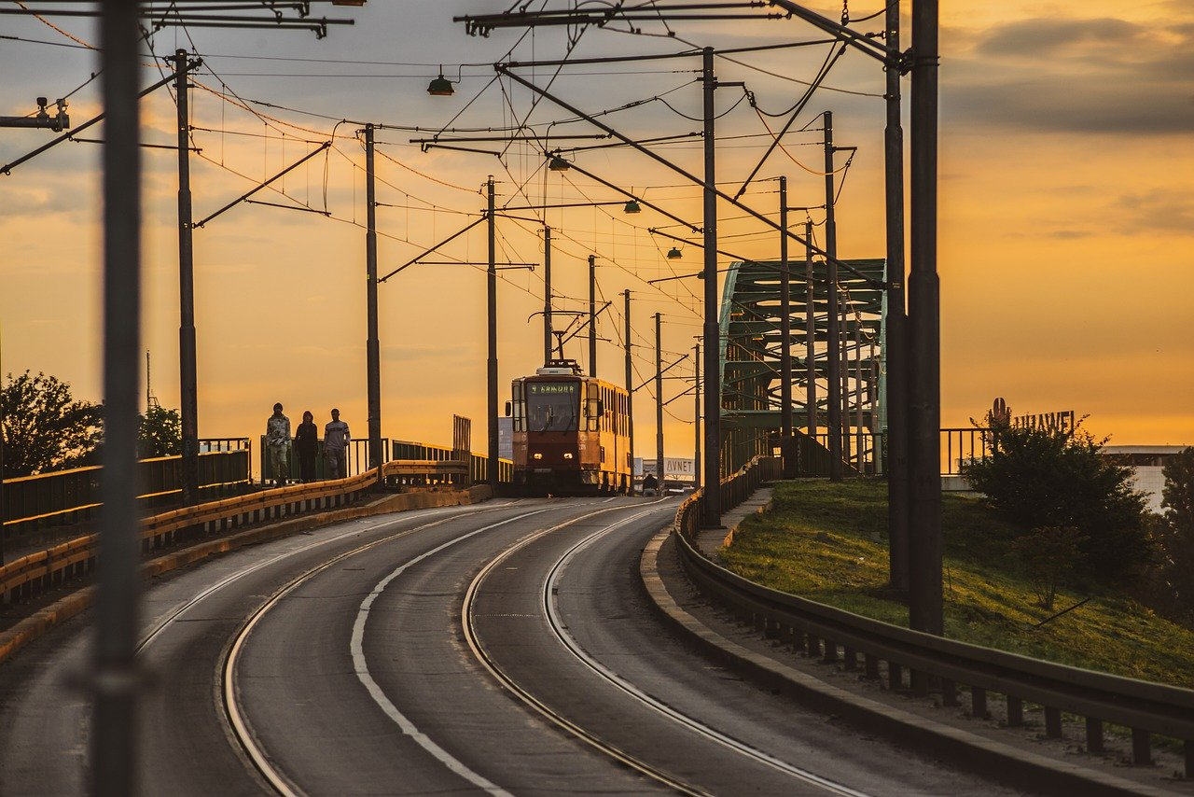
TABLE OF CONTENT
INTRODUCTION
WORKING
COMPONENTS USED
CODE
PROBLEMS
FUTURE SCOPE

Slide 3
INTRODUCTION
In the developing countries like India accidents at the railway crossing are increasing day by day. The main reason of these accidents is negligence of train drivers and gatekeepers. So this system is mostly designed to help railway. This system is also useful for various industries for safety purpose. After all security matters more. It includes opening and closing of gate by the use of Arduino based gate control. Opening and closing of railway level crossing gate involves manpower, which could be often causes incorrect leading to accidents. This system prevents the need of any human involvement at the railway level crossing.To open the gate, a command needs to be sent for the microcontroller to open the gate using motor driver integrated circuit. Both manual and automatically are achieved in this project in case of manual if train arrives and gate open condition IR sensor will detect the train and automatically close the gate. Our system mostly concentrates on the security. The project is designed to achieve control on the railway level crossing gate. Opening and closing of railway level crossing gate involves manpower, which could be often incorrect leading to the accidents. The proposed system prevent any human involvement at the railway level crossing.

Slide 4
INTRODUCTION
The present system attempts to automate the opening and closing of gates at a railway level crossing. In general, level crossing gates are operated manually by a gate keeper. The gate keeper receives the information about the train arrival from a near station. When the train starts to leave the railway station, the station in-charge or gate keeper this information to the closest gatekeeper to get ready for arriving of train. This human act be avoided by automating the process. Situations where the train is late due to some reasons or heavy rain, the gates remain closed for long durations causing dense traffic jam near the gates. This too can be prevented by automation.

Slide 5

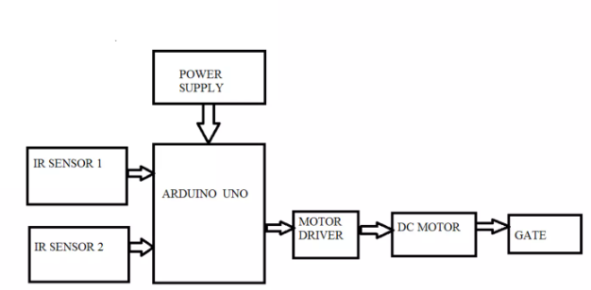



WORKING
In this proposed model we use USB cable to connect the Arduino Uno to the PC that will supply the power Arduino Uno and the sensors are powered by 9v battery. After this Supply is given to ARDUINO the servo motor/DC motor and IR sensor are controlled and interfaced through the ARDUINO. Now the IR sensor senses the arrival/departure of the Train and accordingly closes and opens the crossing gates. Using servo motor to control the gateway system at the crossing itself takes the corresponding action to whether open or close the gateway accordingly.

Slide 6
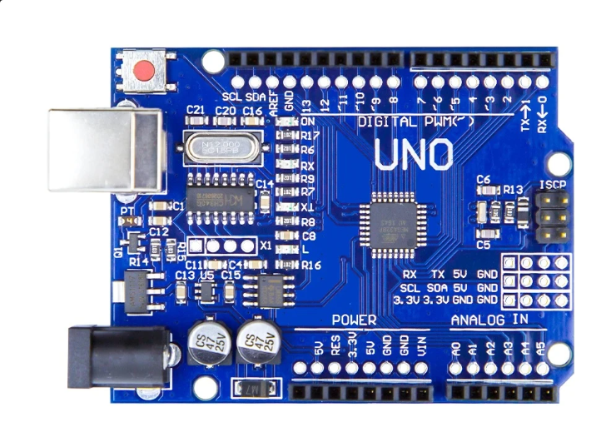
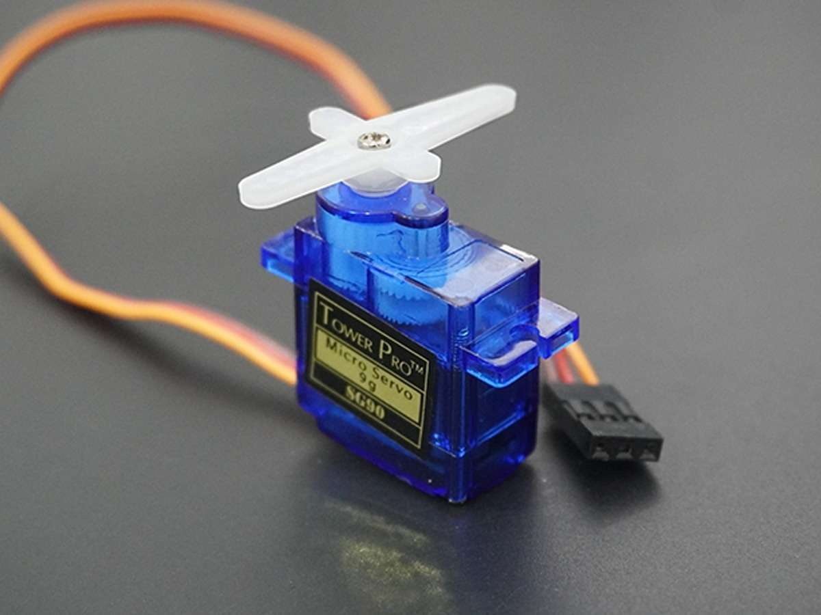
COMPONENTS USED:
Arduino Uno
The Arduino UNO is a widely used open-source microcontroller boardbased on the ATmega328P microcontroller and developed byArduino.cc. The board is equipped with sets of digital and analoginput/output (I/O) pins that may be interfaced to various expansionboards (shields) and other circuits.[1] The board features 14 Digital pinsand 6 Analog pins. It is programmable with the Arduino IDE(Integrated Development
Servo Motor:
A servomotor is a rotary actuator or linear actuator that allows for precise control of angular or linear position, velocity and acceleration. It consists of a suitable motor coupled to a sensor for position feedback. The servo motor is controlled by a signal (data) better known as a pulse-width modulator (PWM).

Slide 7
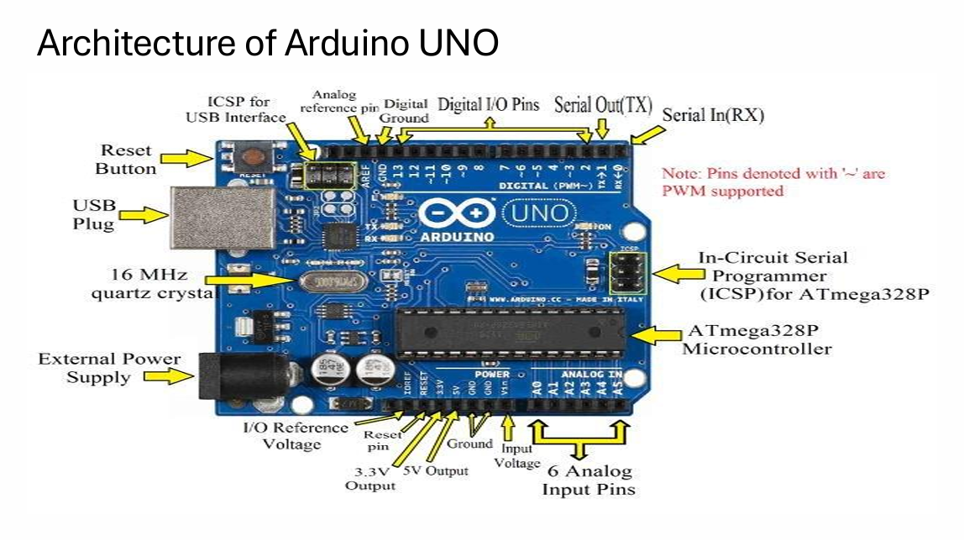

Slide 8
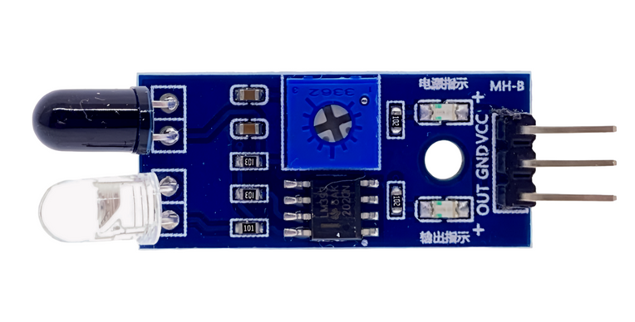
COMPONENTS USED:
IR Sensor:
An infrared sensor is an electronic device, that emits in order to sense some aspects of the surroundings. An IR sensor can measure the heat of an object as well as detects the motion. These types of sensors measures only infrared radiation, rather than emitting it that is called as a passive IR sensor. An infrared sensor is an electronic device, that emits in order to sense some aspects of the surroundings. Usually in the infrared spectrum, all the objects radiate some form of thermal radiations. These types of radiations are invisible to our eyes, but can be detected by an infrared sensor.

Slide 9
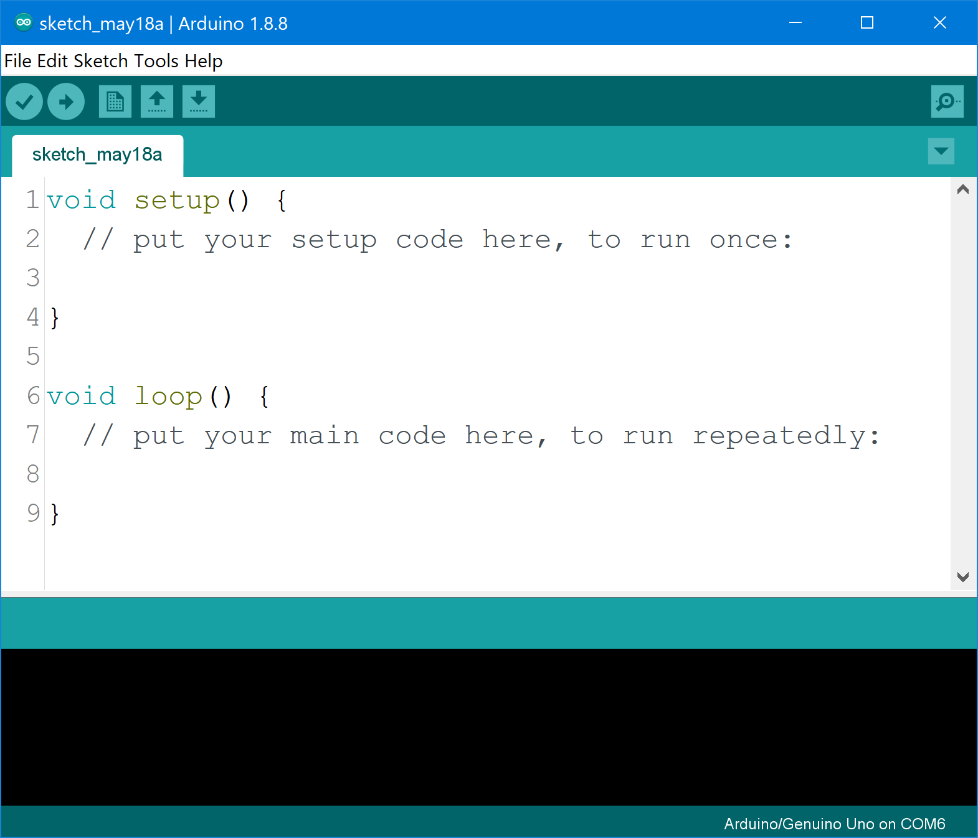
SOFTWARE USED:
ARDUINO IDE:
The Arduino Integrated Development Environment - or Arduino Software (IDE) - contains a text editor for writing code, a message area, a text console, a toolbar with buttons for common functions and a series of menus. It connects to the Arduino and Genuino hardware to upload programs and communicate with them.

Slide 10
CODE:
#include <Servo.h>
Servo serv;
int pinir1=A1;
int pinir2=A2;
int servopin=9;
int signal1=0;
int signal2=0;
void setup() {
serv.attach(servopin);
pinMode(A1,INPUT);
pinMode(A2,INPUT);
}
void loop() {
signal1=analogRead(A1);
signal2=analogRead(A2);
if (signal1>300 && signal2>300){
serv.write(90);
}
else{
serv.write(0);
}
}

Slide 11
PROBLEMS
Though this prototype is simple to build and highly reliable but there're some obstacles too . Rather than a train if an animal or other object is placed in front of the IR sensor and the gate will be closed which is not desirable at all. Also other natural obstacles like fog may arise problems. There're also a scope of alerting the nearest railway station about arrival and departure of the train. The problems indicated above can be overcome by adding some extra modules .Like we left the GSM module for future scope. After adding this module, upon arrival and departure of train, the GSM module will send an SMS to registered phone number for acknowledgement and safety. Also adding a pair of pressure sensor increases the chance of fault triggering of gate as well as alarm. After adding the pressure sensor, the Arduino closes the gate after receiving both signal from IR sensor as well as pressure sensor.

Slide 12
FUTURE SCOPE
Increased Safety and Reliability
Obstacle Detection: Add ultrasonic or LiDAR sensors to detect any obstacles on the railway tracks or at the gate before closing.
Redundant Systems: Implement redundancy by using multiple IR sensors or backup systems to ensure reliability even in case of sensor failure.
Fail-Safe Mechanism: Design a fail-safe mechanism to keep the gates open during power or system failures.
Integration with Smart Systems
IoT Integration: Use an IoT module (like ESP8266 or ESP32) to connect the system to the internet for real-time monitoring and control.
Centralized Monitoring: Integrate with a central control room for monitoring multiple crossings and remotely handling emergencies.
SMS or App Alerts: Notify nearby vehicles or pedestrians through SMS or a mobile app when the gate is about to close or open.

Slide 13
FUTURE SCOPE
Enhanced Detection Systems
Train Detection: Use GPS or RFID technology to detect the train's position and speed for precise gate operation timing.
Multiple Sensors: Employ a combination of IR, pressure, and acoustic sensors to accurately detect trains and avoid false triggers.
Energy Efficiency
Solar Power: Use solar panels to power the system, making it sustainable and suitable for remote areas without reliable electricity.
Low-Power Devices: Optimize the design with low-power components to reduce energy consumption.
Advanced Communication Protocols
V2X Communication: Implement Vehicle-to-Everything (V2X) communication for early warning signals to approaching vehicles.
Railway Signal Integration: Synchronize with railway signaling systems to improve operational accuracy.

Slide 14
FUTURE SCOPE
Automation and AI
Machine Learning: Train the system to recognize patterns, such as abnormal train delays or unexpected obstacles, for predictive maintenance.
Camera-Based Systems: Add a camera with AI-powered image recognition to detect and classify objects near the crossing.
User-Friendly Features
Audible Alerts: Add sirens or voice alerts for enhanced safety.
LED Indicators: Use LED panels to display messages like "Gate Closing" or "Train Approaching."
Scalability
Multi-Gate Systems: Design a system capable of managing multiple gates for wider crossings or junctions.
Adaptive Systems: Make the system adaptable to different track layouts, speeds, and gate types.

