Slide 1
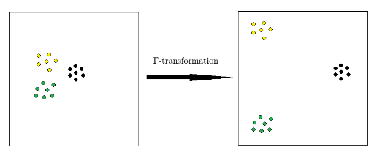
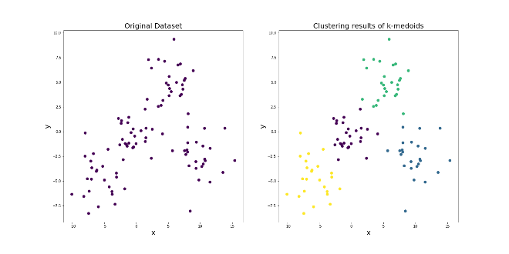

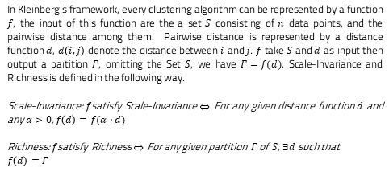

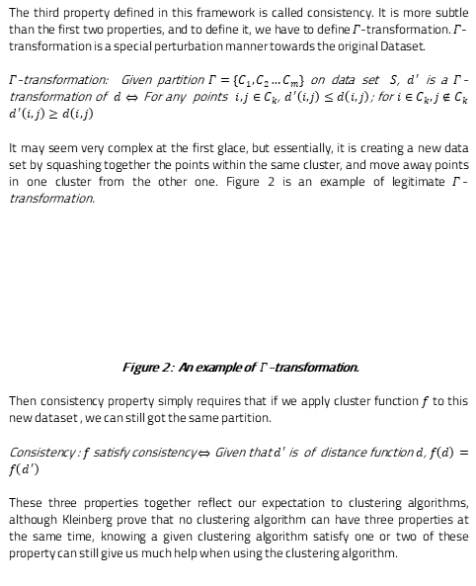

A quantitative approach to Consistency Theorem in clustering
Zehui Li (Data Science) Supervisor: Dr. Yves van Gennip
School of Mathematical Science & Computer Science, University of Nottingham
Introduction
Framework: Scale-Invariance and Richness
Conclusion
Various Clustering Algorithms are usually studied independently, however, in 2003, Kleinberg[1] published an influential paper to build system for studying clustering algorithm as a whole. In that paper, he proposed three properties for clustering: Scale-invariance, Richness and Consistency, and prove that no clustering algorithm can satisfy three of them at the same time. In this project, we continue to study this general system for clustering, we start by reviewing the work of Kleinberg’s work, then focus our study on the consistency property. This paper mainly has four contributions:
Provide the proofs for three of the theorems in Kleinberg’s Paper
Describe the potential problem with consistency property
Show that Clustering Algorithm without Consistency property has “Partial Consistency” under $Γ$–transformation through simulation.
Use Support Vector Machine and other Learning Algorithm to show the use case of Partial Consistency
In Kleinberg’s framework, every clustering algorithm can be represented by a function $f$, the input of this function are the a set $S$ consisting of $n$ data points, and the pairwise distance among them. Pairwise distance is represented by a distance function $d$, $d\left(i,j\right)$ denote the distance between $i$ and $j$. $f$ take $S$ and $d$ as input then output a partition $Γ$, omitting the Set $S$, we have $Γ=f(d)$. Scale-Invariance and Richness is defined in the following way.
Scale-Invariance: $f$satisfy Scale-Invariance $⇔$ For any given distance function $d$ and any $α>0$, $f\left(d\right)=f(α⋅d)$
Richness: $f$satisfy Richness $⇔$ For any given partition $Γ$ of $S$, $∃d$ such that
$$f\left(d\right)=Γ$$
Future study.
Framework: $Γ$-transformation and Consistency
The third property defined in this framework is called consistency. It is more subtle than the first two properties, and to define it, we have to define $Γ$-transformation. $Γ$-transformation is a special perturbation manner towards the original Dataset.
$Γ$-transformation: Given partition $Γ=\{C_{1},C_{2}…C_{m}\}$ on data set $S$, $d^{′}$ is a $Γ$-transformation of $d$ $⇔$ For any points $ⅈ,j∈C_{k}$, $d^{′}\left(ⅈ,j\right)≤ⅆ\left(ⅈ,j\right)$; for $ⅈ∈C_{k},j∉C_{k}$ $d^{′}\left(ⅈ,j\right)≥ⅆ\left(ⅈ,j\right)$
It may seem very complex at the first glace, but essentially, it is creating a new data set by squashing together the points within the same cluster, and move away points in one cluster from the other one. Figure 2 is an example of legitimate $Γ$-transformation.
Figure 2： An example of $Γ$-transformation.
Then consistency property simply requires that if we apply cluster function $f$ to this new dataset , we can still got the same partition.
Consistency : $f$ satisfy consistency $⇔$ Given that $d^{′}$ is of distance function $d$, $f\left(d\right)=f\left(d^{′}\right)$
These three properties together reflect our expectation to clustering algorithms, although Kleinberg prove that no clustering algorithm can have three properties at the same time, knowing a given clustering algorithm satisfy one or two of these property can still give us much help when using the clustering algorithm.
Simulation results: Partial Consistency
Add your informatiographsn, and images to this section.
Clustering Algorithm
Clustering analysis can be defined as a process of segmenting the data points into several subsets, the goal of clustering is to make the data within a cluster to be similar (with small dissimilarity) to each other, while the data points in distinct clusters to be different (with large dissimilarity). Figure 1 shows an example of applying the K-medoid clustering algorithm to a dataset $\{\left(x_{1},y_{1}\right),\left(x_{2}{,y}_{2}\right)…(x_{i},y_{i})\}$.
Figure 1: K-medoid on real clustering algorithm
K-medoid will seek to minimize the “within cluster distance”. Suppose we have $k$ clusters $\left\{C_{1},C_{2}…C_{k}\right\}$ in the final results, then within cluster distance $w$ is defined as the following
$$w=\frac{1}{2}\sum_{i=1}^{k}{\sum_{n∈c_{i}}{\sum_{m∈C_{i}}{{\left(x_{m}−x_{n}\right)}^{2}+{\left(y_{m}−y_{n}\right)}^{2}}}}$$
Clustering algorithm fall into three categories[2]: combinatorial algorithms, mixture modelling, and model seeking, the algorithms in each category follows different underlying principal. K-medoid algorithm we discussed above belongs to combinatorial algorithms. One thing good about Kleinberg’s framework is that it can be applied to all the clustering algorithms regardless of these principal.
References
[1] Jon M Kleinberg. An impossibility theorem for clustering. In Advances in neural
information processing systems, pages 463{470, 2003.
[2] Jerome Friedman, Trevor Hastie, and Robert Tibshirani. The elements of statistical
learning, volume 1. Springer series in statistics New York, NY, USA:, 2001..
Rand Index
Rand Index measure the difference between two partition on the same data set. Given a dataset $S=\{1,2…n\}$ containing $n$ points, and two partition of $S$ $Γ=\left\{C_{1},C_{2}…\right\}$ and $Γ^{′}=$

