Slide 1
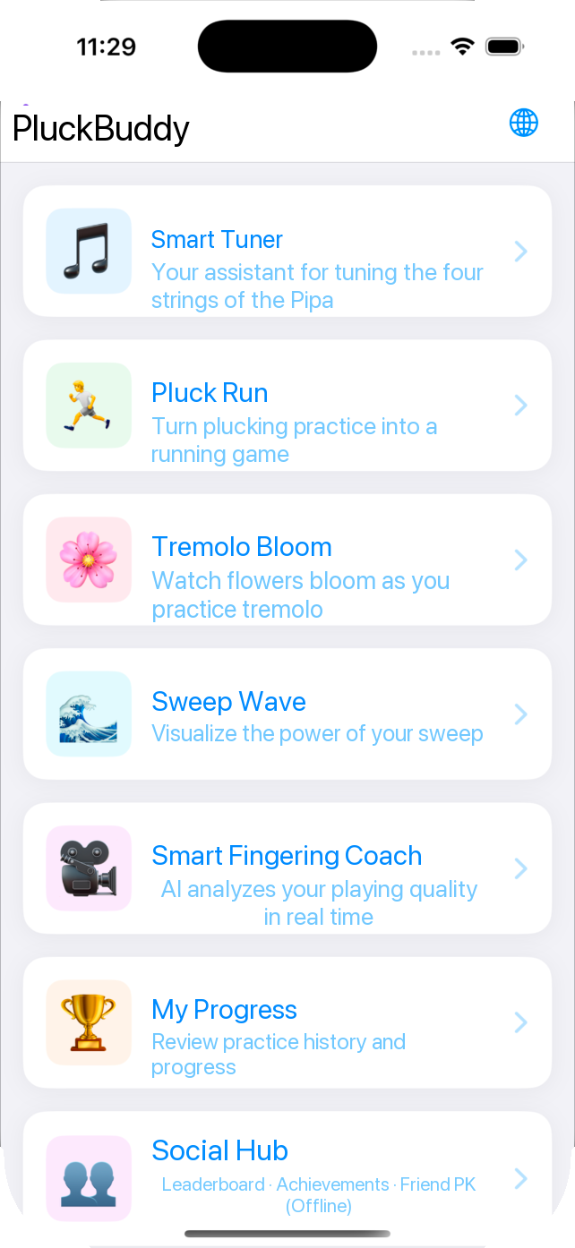
AI PIPA PRACTICE COMPANION
PluckBuddy
Turn tedious drills into progress you can see
No extra hardware · Fully offline · Bilingual · Real-time audio and hand analysis
Version 2.0 | iOS 17.6+ | Oct 2026
Notes:
Opening: PluckBuddy is a smart practice assistant for Pipa learners. One line to remember — turning tedious drills into visible, measurable progress. Everything runs offline using only the phone's built-in microphone and camera.

Slide 2
WHY
Three things that stall everyday practice
01
02
03
It gets boring
No one corrects you
Progress is invisible
Pluck, Tremolo, Sweep — the same motion thousands of times. With no immediate reward, students rarely keep going on their own.
You see a teacher once a week; the other six days are guesswork, and mistakes harden into habit.
After a month you still cannot say what improved. Without data there is no sense of achievement and no direction.
PluckBuddy solves all three at once with real-time audio analysis, game-like feedback and a growing practice record
Notes:
Start with the problem, then the product. These three pains are common to all instrumental fundamentals, and parents and teachers will recognise them.

Slide 3
CORE CAPABILITIES
Five capabilities, one complete practice loop
🎤
Real-time audio analysis
🎼
Built-in metronome
The microphone captures your playing, detecting note onsets and rhythm — no extra hardware or sensors.
Four metronome sounds, tempo synced to your practice goal — nothing to set up.
In one line
Turn your phone
into a coach
students reach for
every single day
🎮
Gamified practice
🏆
Progress tracking
Running, blooming, rippling — abstract technique metrics become scenes you can play with.
Every session is saved automatically; trends, personal bests and achievements in one view.
📊
Live metrics
Speed, stability, evenness and strength appear live, so you know how you played on the spot.
Notes:
The five capabilities form one loop: capture → practise → feedback → calibrate → store. Stress "no extra hardware" — that is what lowers the barrier to use.

Slide 4
PRODUCT AT A GLANCE
Seven modules, from warm-up to review
🎵
Smart Tuner
🏃
Pluck Run
A tuning assistant for all four Pipa strings
Rhythm practice becomes a running game
🌸
Tremolo Bloom
🌊
Sweep Wave
Watch a flower bloom as you tremolo
See the strength of every sweep
🎥
Smart Fingering Coach
🏆
My Progress
AI reads your hand shape in real time
Review your history and progress
👥
Social Hub
Leaderboards · Achievements · Friend challenges
Notes:
The home screen is the navigation. Six modules follow the order of a practice session: tune first, then three technique drills, then the Fingering Coach for posture, and finally My Progress for the record.

Slide 5
NEW IN 2.0
Bilingual · one app, two languages
Tap the globe icon on the home screen to switch between Simplified Chinese, Traditional Chinese and English. Every label and the logo follow your choice — no reinstall needed.
1
One tap, instant switch
The globe icon opens Language settings: Follow System, Simplified Chinese, Traditional Chinese or English. The interface rebuilds in place.
🌐 Language
○ Follow System
2
All 407 strings translated
Labels across Pluck Run, Tremolo Bloom and Sweep Wave are fully translated; missing entries fall back cleanly instead of mixing languages.
● Simplified Chinese
○ Traditional Chinese
3
Three editions, one codebase
○ English
The Chinese, international and bilingual editions share one codebase with separate bundle IDs, so all three can stay on one phone.
Takes effect instantly, no restart needed
Best for students using overseas method books, and for presenting the project in English
Language settings · instant switching
Notes:
Tuning is the step before every practice. Emphasise the written instructions — the biggest difference from an ordinary tuner, which only shows a needle and leaves beginners unsure which way to turn the peg.

Slide 6
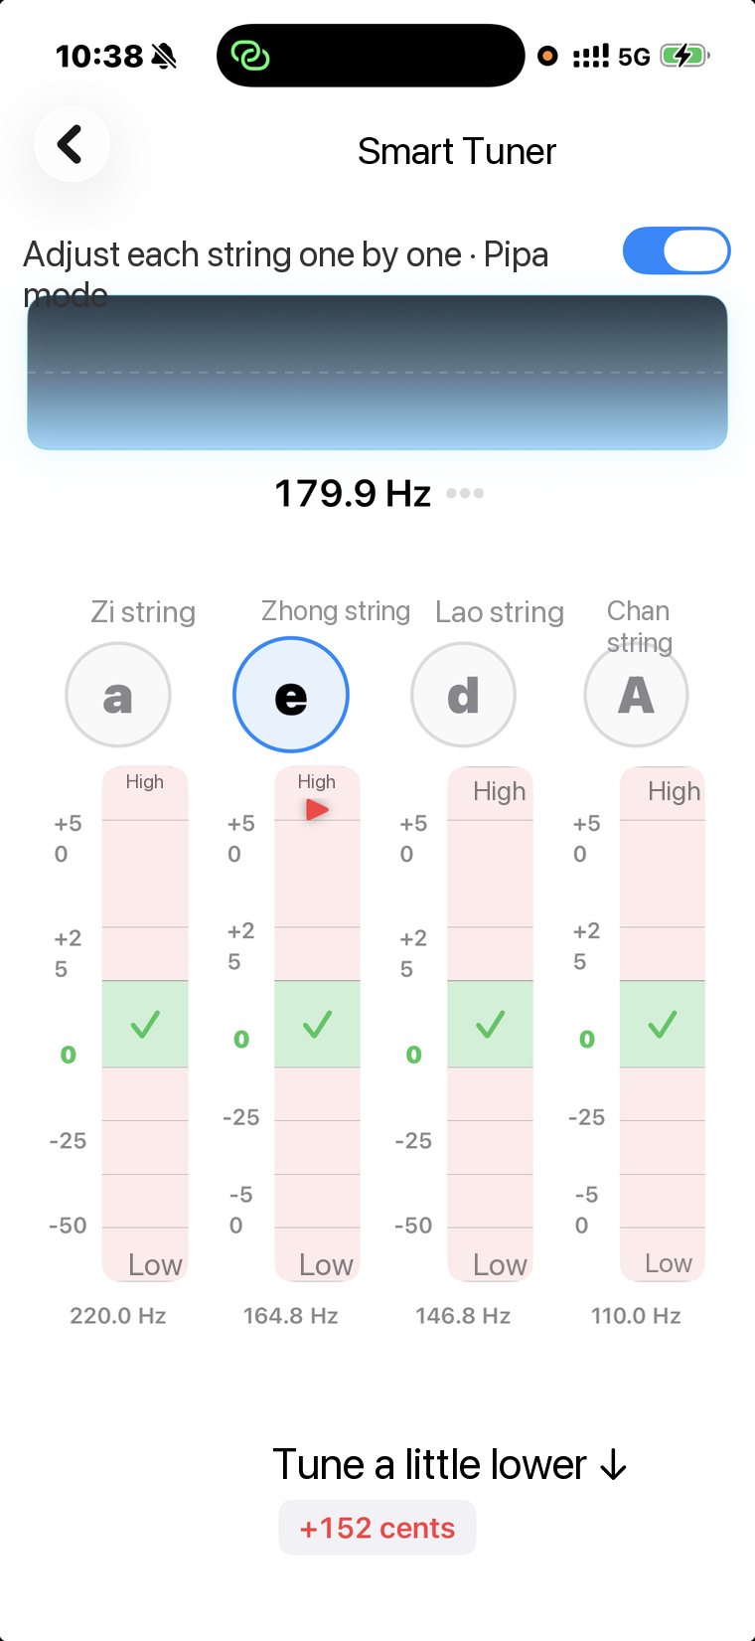
MODULE 01
Smart Tuner · the first step before you play
A four-string Pipa tuning assistant. An on-device model first separates Pipa sound from room noise, then measures each string, replacing guesswork with a clear scale.
1
All four strings, one screen
Zi, Zhong, Lao and Chan — the four Pipa strings sit side by side with the active one highlighted. No switching back and forth.
2
Cents-level precision
Live frequency and cents deviation; the green band means in tune, so sharp or flat is obvious at a glance.
3
Instructions in plain words
A direct prompt such as "Turn it down a little ↓" appears at the bottom, so complete beginners never turn the peg the wrong way.
For complete beginners with no tuning experience, and teachers who need a quick pitch check
Smart Tuner · four-string calibration view
Notes:
Tuning is the step before every practice. Emphasise the written instructions — the biggest difference from an ordinary tuner, which only shows a needle and leaves beginners unsure which way to turn the peg.

Slide 7
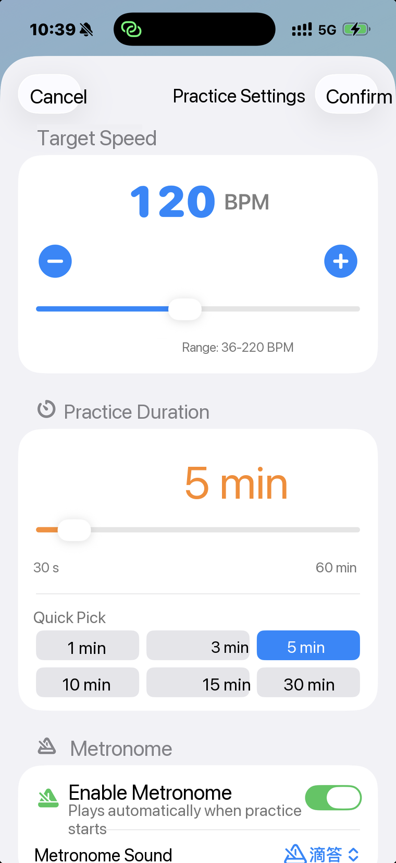
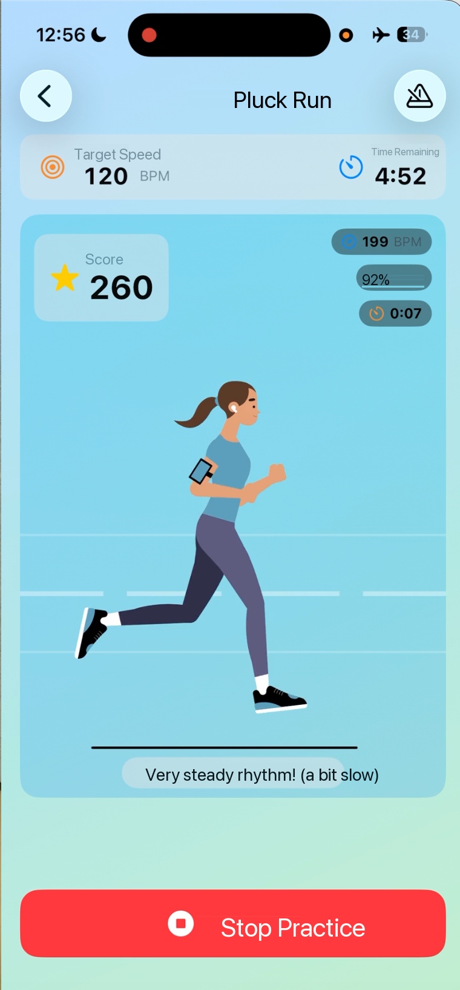
MODULE 02
Pluck Run · turn rhythm practice into a race
Focused training for alternating Pluck strokes: thumb down, index up. The steadier you play, the smoother the runner moves.
1
Your playing drives the scene
The track scrolls with your playing speed and the runner follows live BPM; lose the beat and the animation stutters at once.
2
Three live metrics on screen
Current tempo (BPM), rhythm stability (%) and elapsed time share one screen; stability shifts from green to orange to red.
3
Practice becomes distance
Each valid pluck advances the runner one metre: 300 plucks, 300 metres. An abstract count becomes something you can see.
Configurable: target 36–220 BPM · session 30 s–60 min · four metronome sounds
Session settings
Session in progress
Notes:
This is the page that wins over parents. Demonstrate live: a few plucks and the runner starts moving; play deliberately unevenly and the stability number drops and turns red.

Slide 8
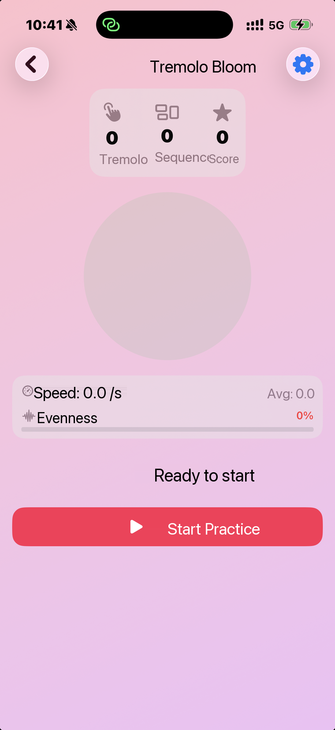
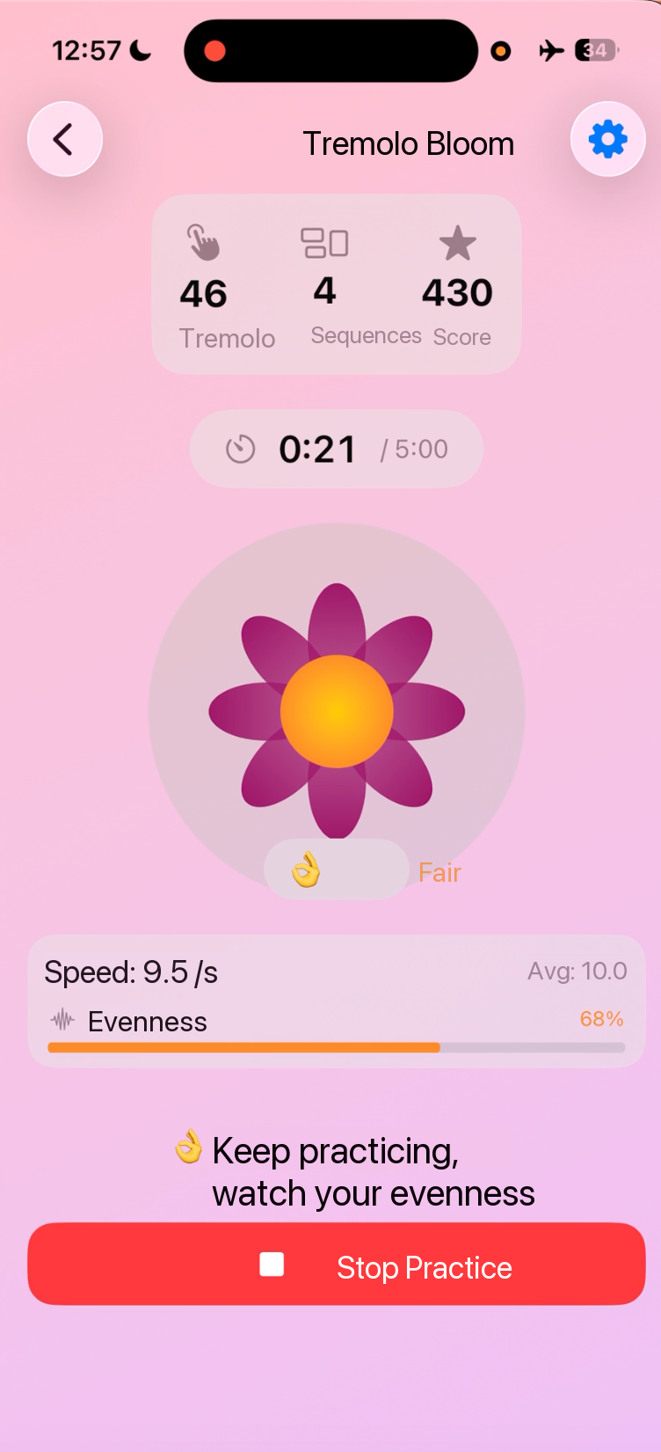
MODULE 03
Tremolo Bloom · let evenness blossom
Focused training for Tremolo, the continuous cycle of Pi, Tiao, Mo and Gou. The shape of a growing flower mirrors how even your four fingers are.
1
The flower is your scorecard
Petals grow with every Tremolo cycle (one per five, up to eight); brightness maps to speed and symmetry maps to evenness.
2
A grade for every cycle
Each four-finger cycle is graded instantly: Excellent 90+ / Good 75–89 / Fair 60–74 / Needs work below 60.
3
Evenness as a percentage
Consistency of the four finger intervals becomes a percentage: above 80% is steady, below 50% prompts you to slow down and repeat.
Score breakdown: evenness 40% + tempo stability 30% + continuity 30%
Ready to practise
Tremolo detection running
Notes:
Tremolo is the hardest Pipa fundamental. The key selling point here is evenness as a metric — once only a teacher could hear it, now it is a percentage you can compare day by day.

Slide 9
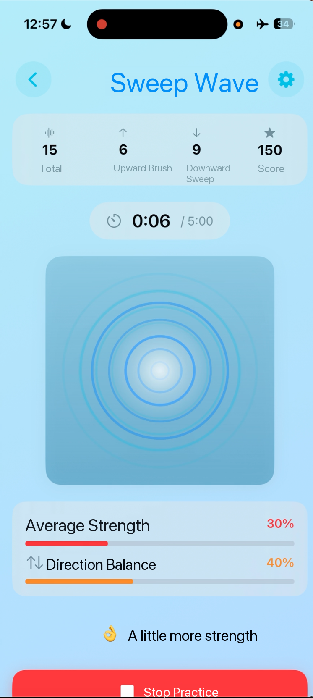
MODULE 04
Sweep Wave · make strength visible
Strength control and up/down balance are the hardest things to judge on your own. Every sweep becomes an expanding ripple; a stronger sweep makes a stronger wave.
1
Up and down counted separately
Up-sweeps and down-sweeps are counted separately, so students cannot practise only the comfortable direction.
2
Average strength visualised
Strength appears as a percentage with prompts like "A little more power", correcting both a weak and an over-forceful sweep.
3
Direction balance metric
Balance between up and down, in count and strength, is scored live — a key measure of mature Sweep technique.
Best introduced once Pluck and Tremolo are steady, as a complementary module
Sweep Wave · strength and direction balance
Notes:
You can move faster through this page. The focus is direction balance — most students sweep down harder than up, but performance needs both to be even.

Slide 10
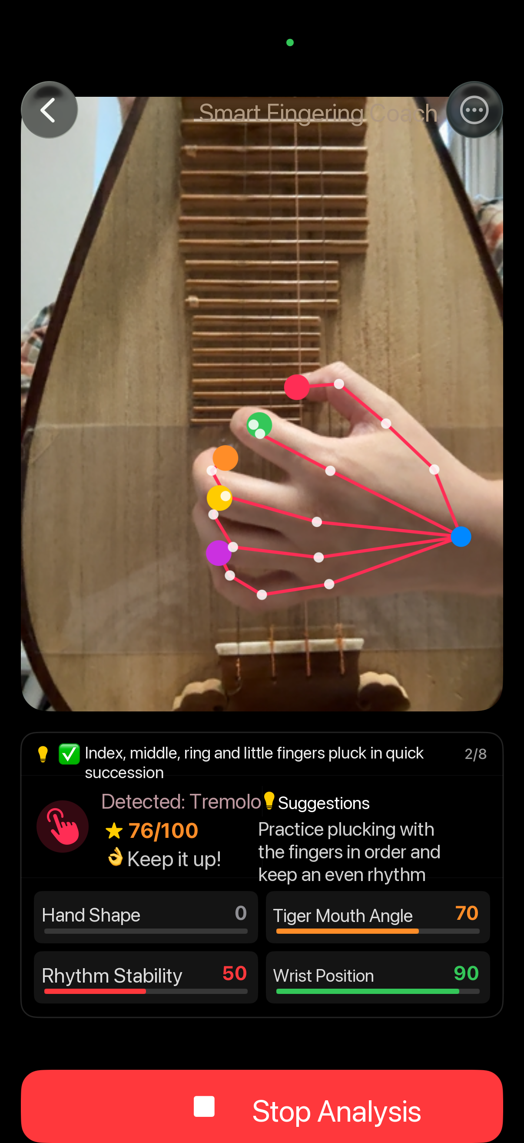
MODULE 05
Smart Fingering Coach · a posture teacher in your pocket
The front camera tracks 21 landmarks on each hand in real time, watching hand shape, tiger-mouth angle and wrist position on the six days a teacher is not there.
1
Live landmarks on both hands
Each hand is detected separately; all 21 landmarks are marked and connected, so coordination is visible on screen.
2
Four-dimension posture score
Hand shape, tiger-mouth angle, rhythm stability and wrist position are scored separately: 30–50° at the tiger mouth earns full marks, plus a 0–100 overall score.
3
Advice in plain words
The app identifies the technique and gives right-hand advice, such as "Pluck the fingers in sequence and keep an even rhythm."
Privacy: camera frames are used only for live posture analysis — never saved, never uploaded
Hand landmark tracking and the four-dimension score
Notes:
This page is the technical high point and the one where privacy matters most — frames are never written to disk or uploaded; everything happens on the device.

Slide 11
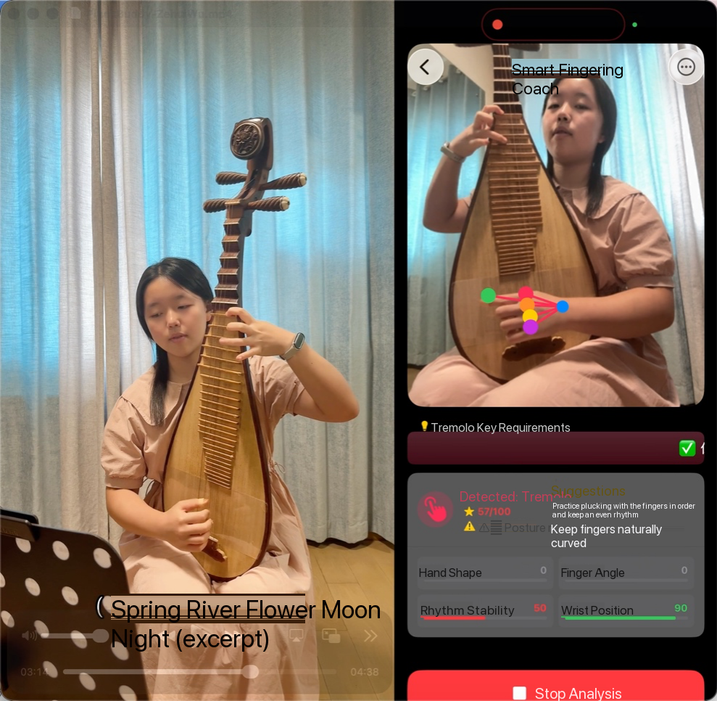
MODULE 05 · LIVE DEMO
Live on a real device · posture problems surface immediately
Filmed in a real practice room. On the left, genuine playing; on the right, the app's reading of that same moment — landmarks, scores and advice, all computed on the device.
1
A real practice room, nothing staged
Prop the phone beside the Pipa and it works — classroom, studio or at home. No sensors, no special hardware, no special room.
2
The picture is the annotation
Twenty-one landmarks on the right hand are marked and connected live; the app identifies Tremolo and shows its core requirements at the top.
3
The score is low, and the reason is clear
An overall 57/100 is flagged in red for posture, with specific advice: "Pluck the fingers in sequence and keep an even rhythm" and "Keep the fingers naturally curved."
Filmed in a practice room · Smart Fingering Coach running
Recorded alongside the demo video: a real room, a real instrument, a real student, scored as soon as practice ends. Fully offline; camera frames are never saved or uploaded.
Reading the image: the right panel is the app on a real phone, identifying Tremolo with an overall 57/100 — hand shape 0, finger angle 0, rhythm stability 50, wrist position 90.
Notes:
These are frames from a demo video shot in a real practice room. On the left, me playing an excerpt of Spring River Flower Moon Night; on the right, the Smart Fingering Coach live: 21 landmarks on the right hand marked and connected, Tremolo identified, an overall 57/100 with a posture warning, and advice to pluck the fingers in sequence with an even rhythm and keep them naturally curved. Stress two things: this is a real session, and it all runs offline.

Slide 12
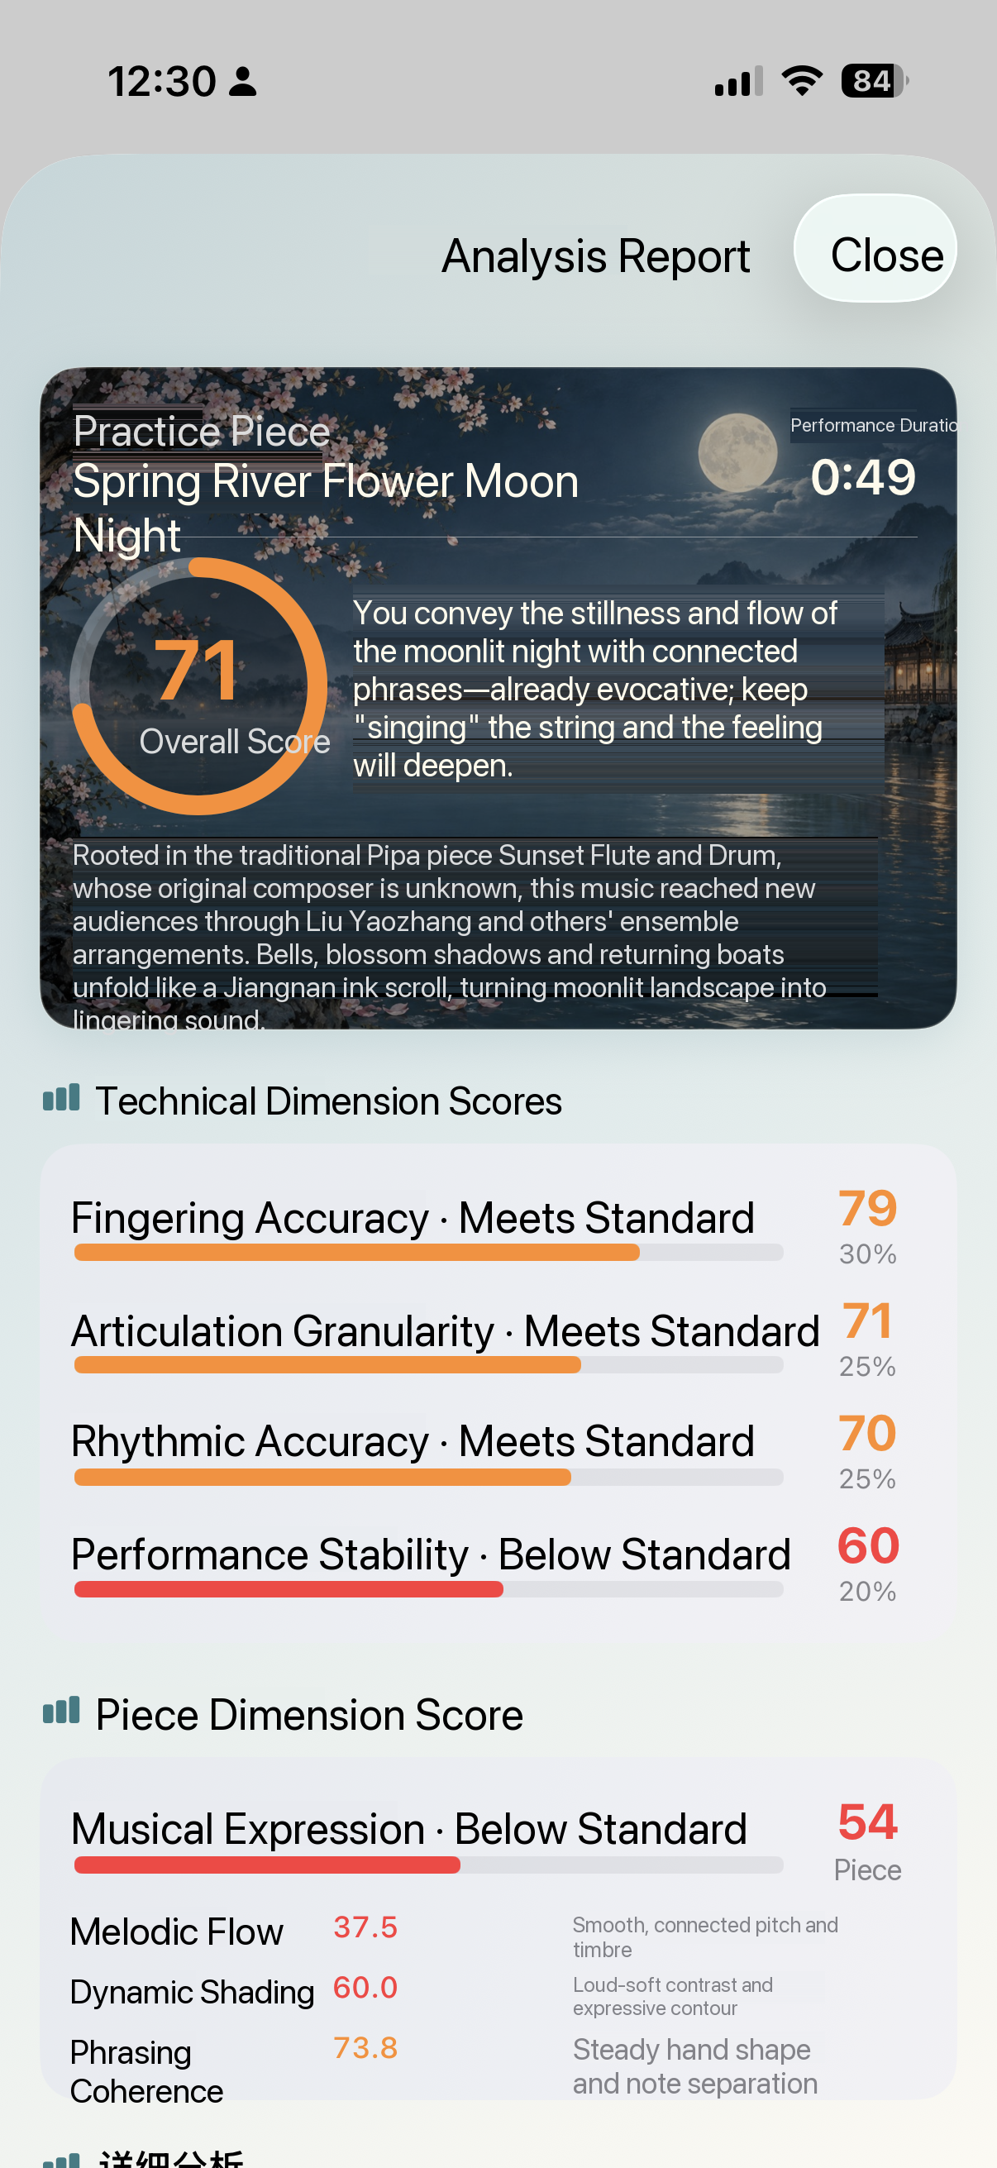
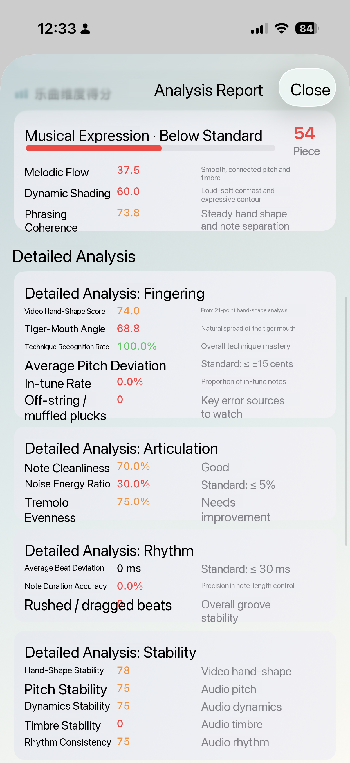
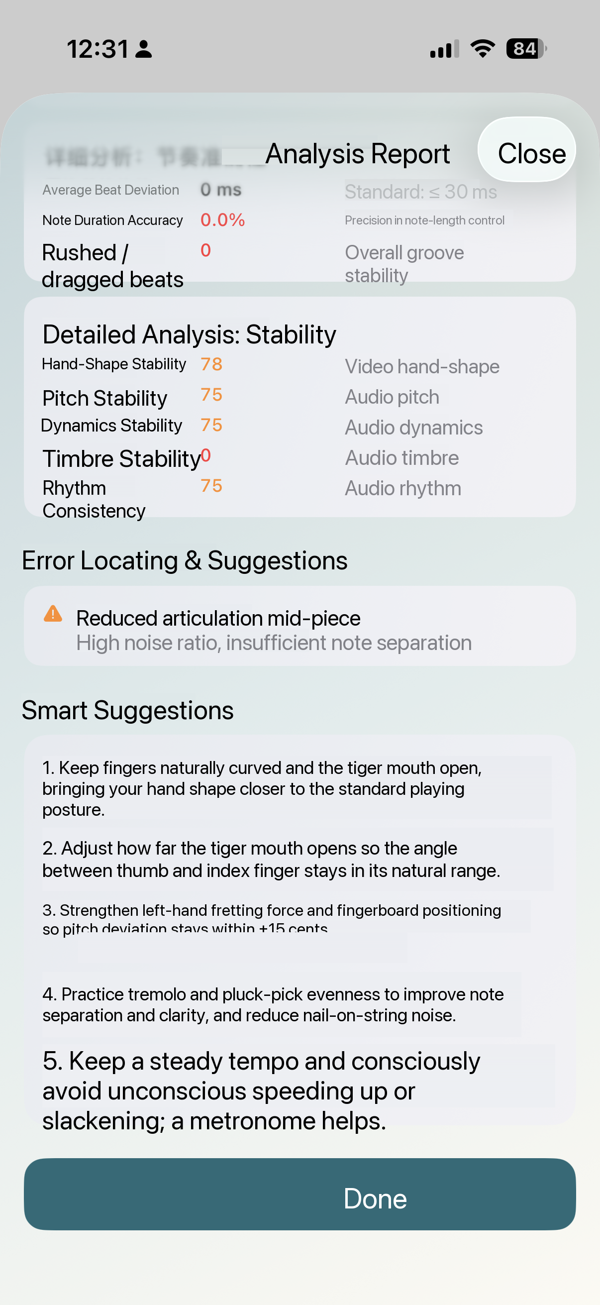
MODULE 05
Smart Fingering Coach · reports written automatically
After every session the app writes a report: an overall score for level, four dimensions for weak spots, and item-by-item analysis with advice.
1
Overall score
A 0–100 total with a one-line summary
2
Four-dimension breakdown
Technique accuracy, articulation, rhythmic accuracy and playing stability
3
Errors and advice
Typical errors marked one by one, each with concrete advice
Every report is archived, so progress is always there to revisit

Slide 13
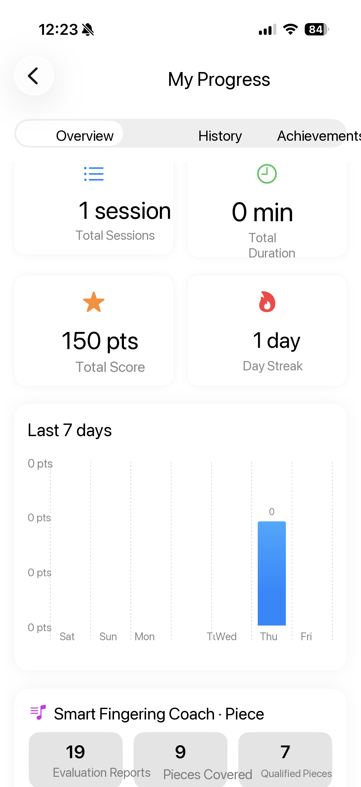
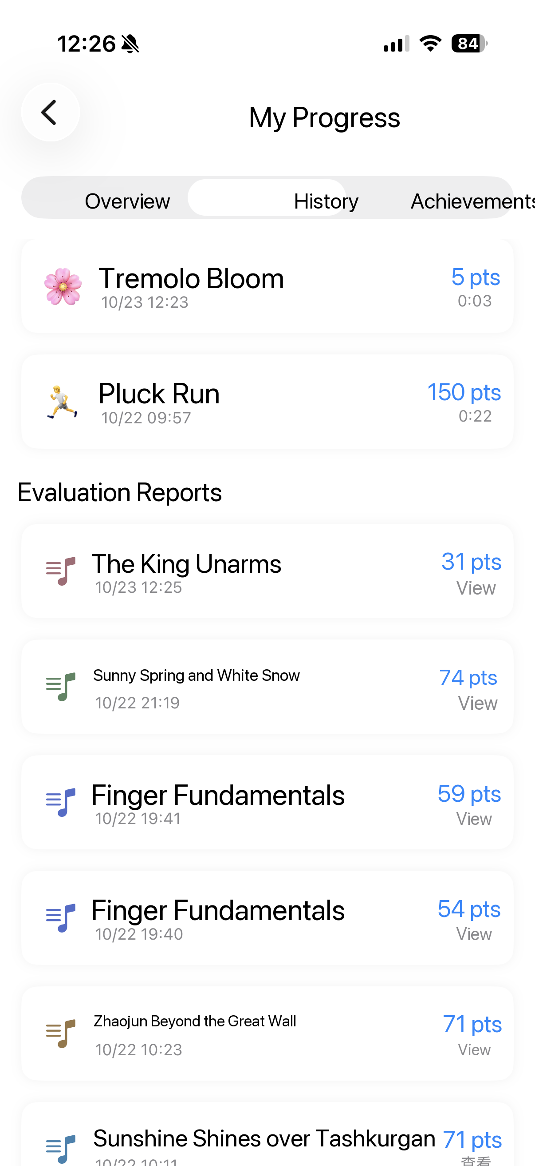
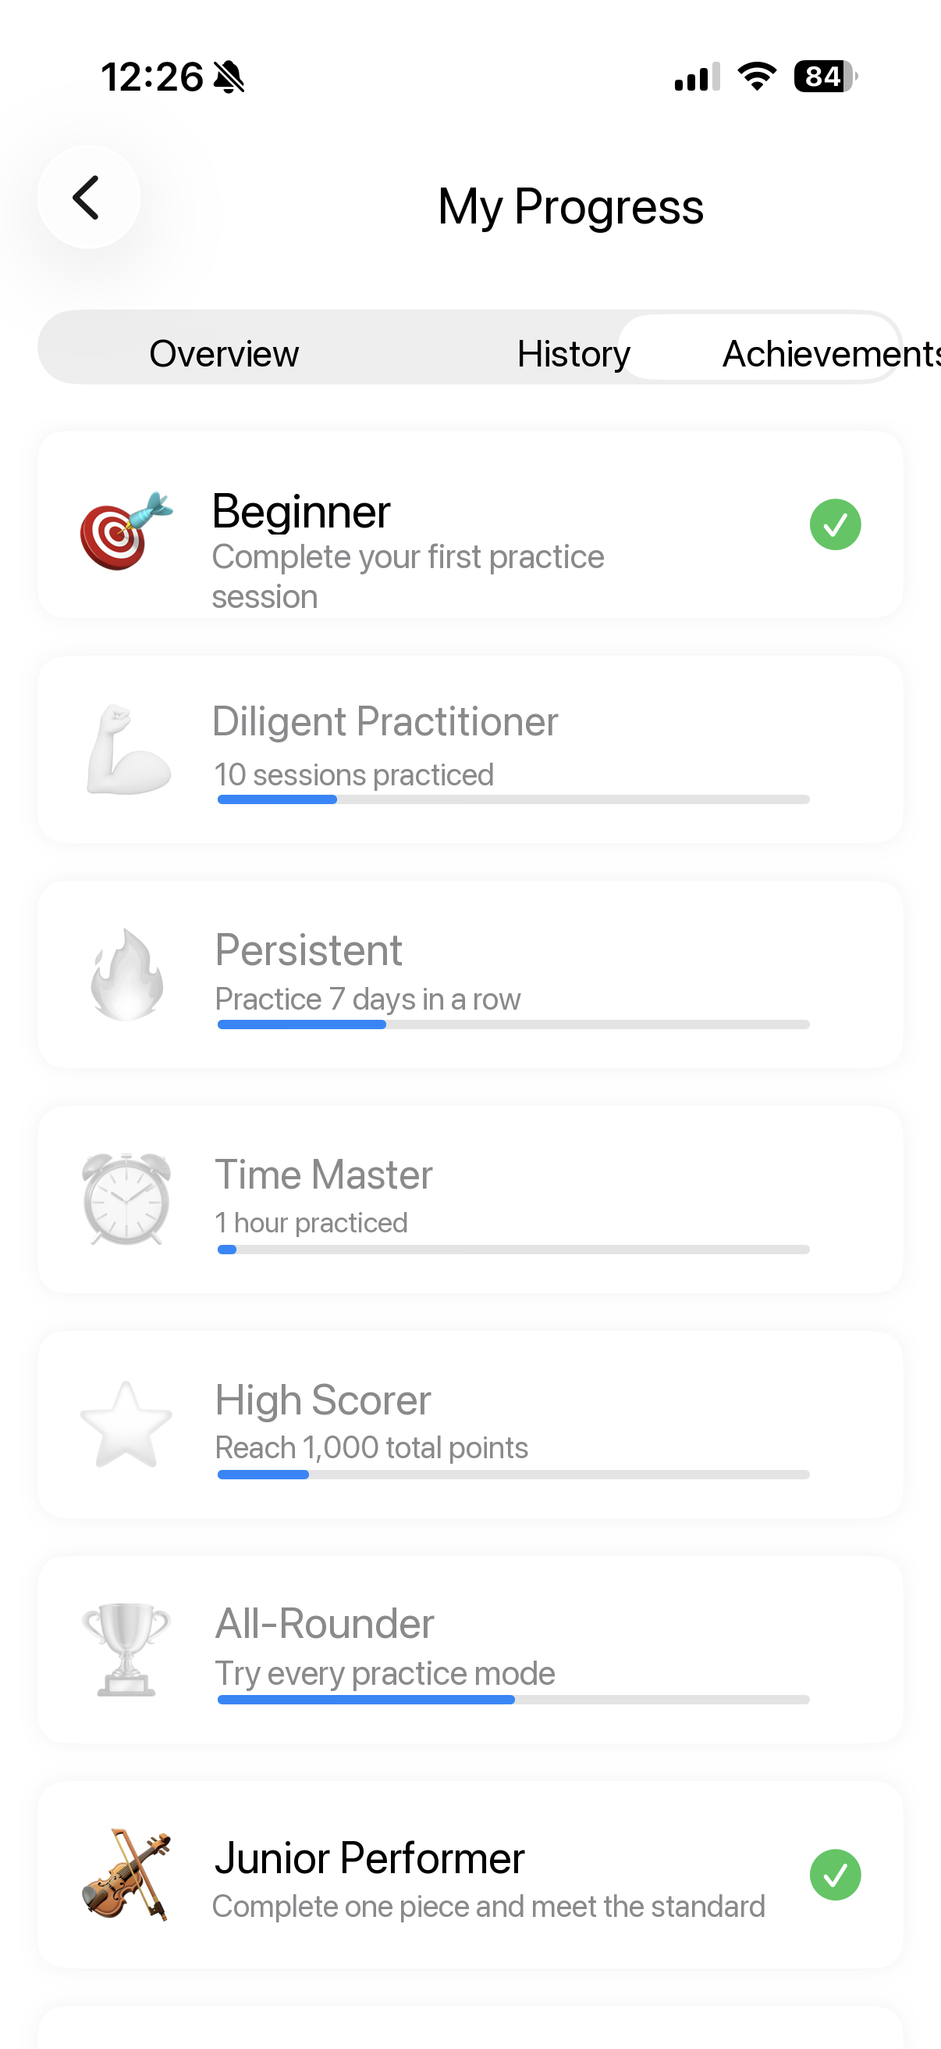
MODULE 06
My Progress · let daily effort add up
Sessions save themselves — no manual logging. Overview, history and achievements answer "how much did I practise, and where did I improve?"
1
Four core statistics
Total sessions, total time, cumulative score and a daily streak, plus a bar chart of the last seven days.
2
Full history and trends
Each session logs tempo, stability / evenness, score and duration, so you can compare long-term trends and personal bests.
3
Achievements that keep you coming back
First Steps, Diligent Practiser, Never Give Up, Time Master, High Scorer and All-Rounder — stepped goals with progress bars.
The daily streak (🔥 Streak) is the key metric behind repeat opens and lasting practice habits
Overview
History & trends
Achievements
Notes:
For parents this is the most convincing page: whether the child practised, for how long, and whether they improved — all on one screen, with no need to watch over them.

Slide 14
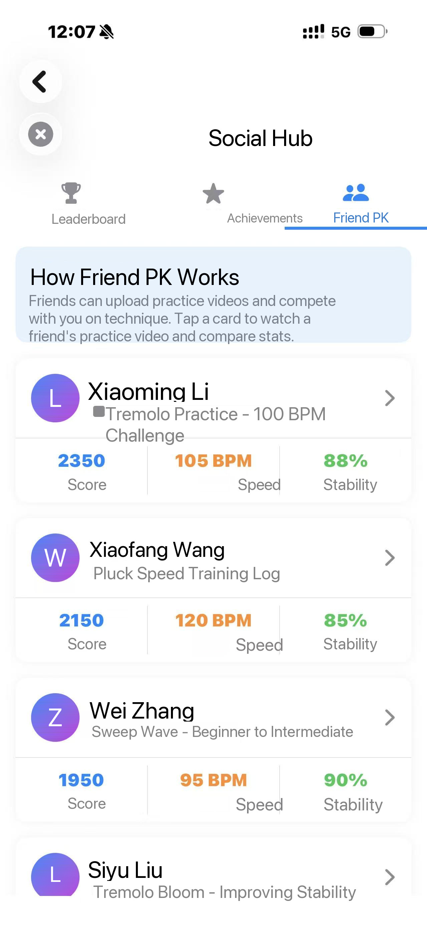
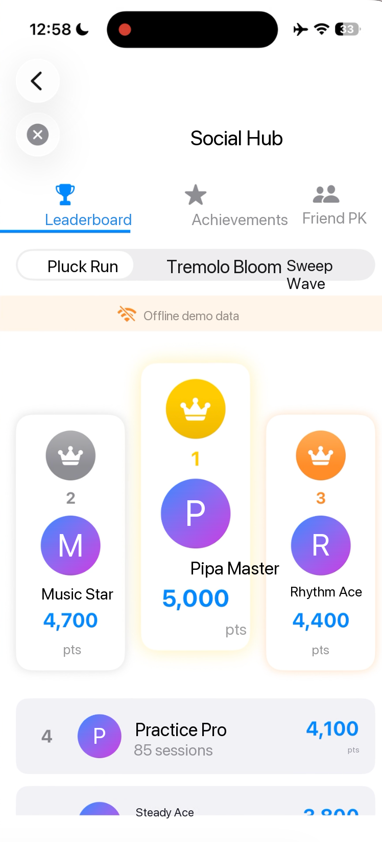
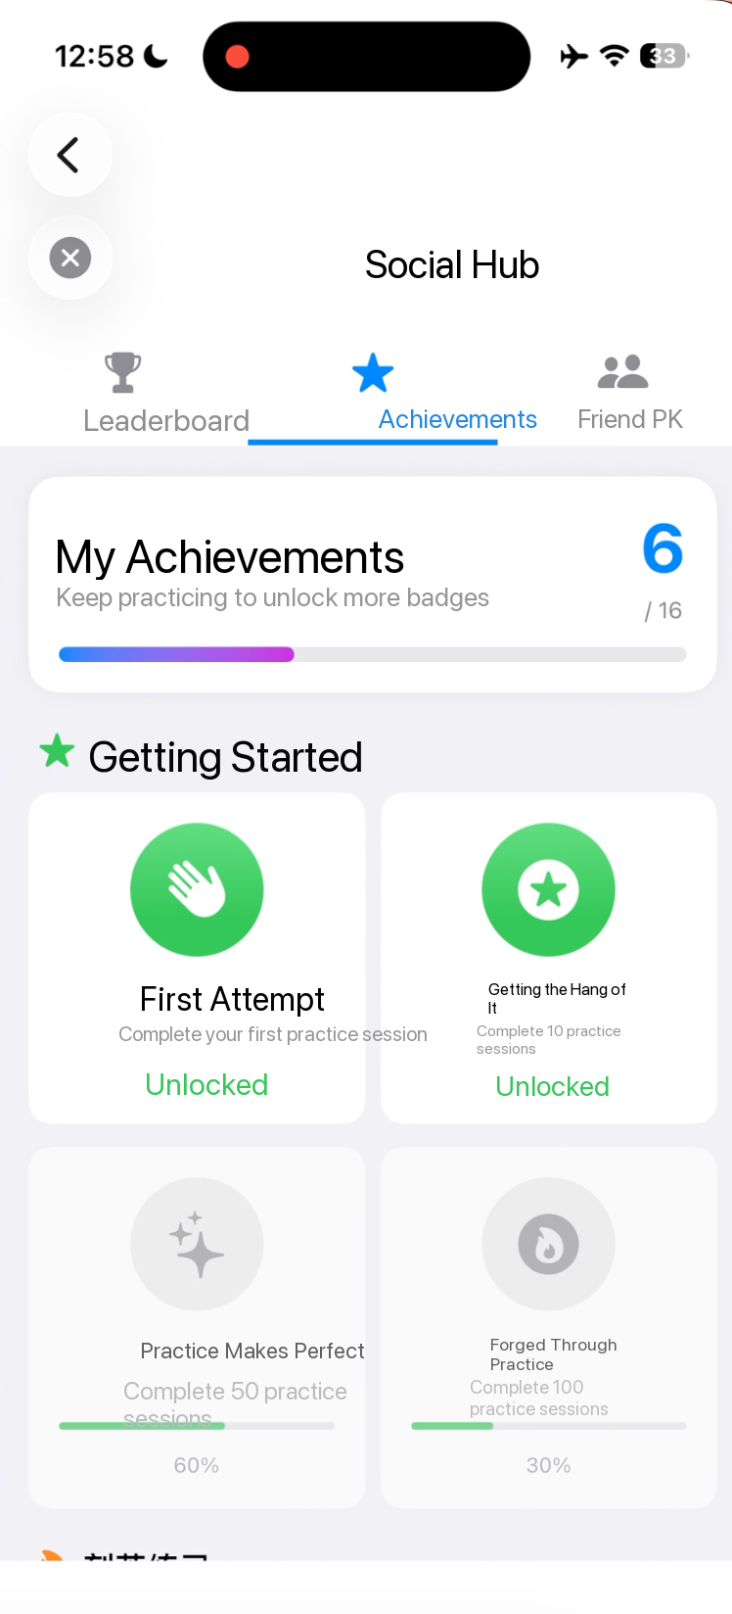
MODULE 07
Social Hub (offline demo)
Turn practice results into something social: compare scores on the same piece, challenge a friend on technique, and let the badge wall record consistency. Practising alone still feels shared.
1
Same-piece leaderboard
See your rank against friends, piece by piece
2
Friend challenge
Friends upload practice clips; scores and tempo compared item by item
3
Badges and achievements
Milestones unlock automatically, with progress always visible
In this offline demo, leaderboard and friend data are sample entries
Friend challenge
Leaderboard
My badges

Slide 15
HOW IT WORKS
From one pluck to a growth curve
1
2
3
4
5
Capture
›
Detect
›
Compute
›
Present
›
Store
Microphone / camera
Onset detection and parsing
Metric evaluation
Gamified visuals
On-device practice archive
Uses the hardware
already in the phone
Locates the attack of each
pluck, then rebuilds rhythm and technique
Intervals between plucks give
speed, stability, evenness and strength
Live metrics drive the runner,
the bloom and the ripples
Sessions are saved locally,
building trends and achievements
Stability algorithm: take the intervals between recent plucks as the sample; stability = 1 − (standard deviation ÷ mean). The smaller the variation, the higher the stability — the shared quantitative basis for every rhythm module.
Notes:
Expand on this page for a school or a music studio's technical lead; for parents, one line is enough — everything happens on the phone, no internet.

Slide 16
SCORING SYSTEM
Metrics, not impressions
Three measurable core metrics give "how well did I play" one consistent meaning
Tremolo score breakdown
Evenness
Tremolo Bloom
Consistency of the four finger intervals
≥ 80% is steady
Stability
Pluck Run
Rhythm variation: 1 − (SD ÷ mean)
≥ 80% is excellent
Strength & balance
Sweep Wave
Evenness carries the most weight: Pipa fundamentals are about steady and even, not fast.
Sweep strength and up/down balance
Two dimensions: strength and direction
Notes:
A consistent standard is the keyword here. Teachers disagree on what "steady" means; once it is measured, the benchmark stays the same across teachers and institutions.

Slide 17
TRAINING PATH
A built-in path that grows with you
Beginner
Intermediate
Advanced
0 – 3 months
3 – 12 months
1 year and beyond
Pluck Run 60 → 80 BPM
3–5 min, twice a day
Goal: stability > 75%
Add Tremolo Bloom from week 4
Pluck 100–120 BPM
Tremolo 80–100 BPM
10 min, once or twice a day
Goal: stability > 85%, evenness > 80%
Pluck 140–180 BPM
Tremolo 120–150 BPM
Sessions of 15–30 min
Goal: stay stable throughout
Practice principles: slow and accurate beats fast and sloppy · short and focused beats one long session · 10–15 minutes a day beats two hours once a week
Notes:
The product is more than a tool — it has a teaching method built in. For studios and institutions, this path can drop straight into their own curriculum.

Slide 18
TECHNICAL SPECIFICATIONS
Lightweight, offline, no data collection
100%
0
17.6+
50 MB
Fully offline
Data uploads
iOS version
App size
Every feature works without a network
Audio and video never written to disk
Universal on iPhone and iPad
The built-in mic is all you need
PERMISSIONS & PRIVACY
Microphone
Live audio analysis only; nothing recorded, nothing uploaded
Camera
Live posture analysis for the Fingering Coach only; nothing saved, nothing uploaded
Local storage
Practice data only, deletable at any time
Network
Every feature runs offline, with no network dependency
Notes:
Privacy is a mandatory question for a product used by minors. Read the four permission lines one by one, especially the camera: nothing saved, nothing uploaded.

Slide 19

Two Core Technologies
Your AI Pipa companion · a phone that sees your hands and hears your instrument
Zehui Wu · Personal exploration project

Slide 20
This app is a little teacher for your Pipa practice
Phone
Camera reads your hands
1
21 hand landmarks identify Pluck, Tremolo or Sweep
= A coach
Microphone hears the sound
2
Checks for a Pipa first, then pitch and rhythm
Hand the camera and mic to AI,
and it sits beside you like a teacher,
watching, listening, giving feedback.
AI scoring and feedback
3
A teacher-like report on what to improve
PluckBuddy
01

Slide 21
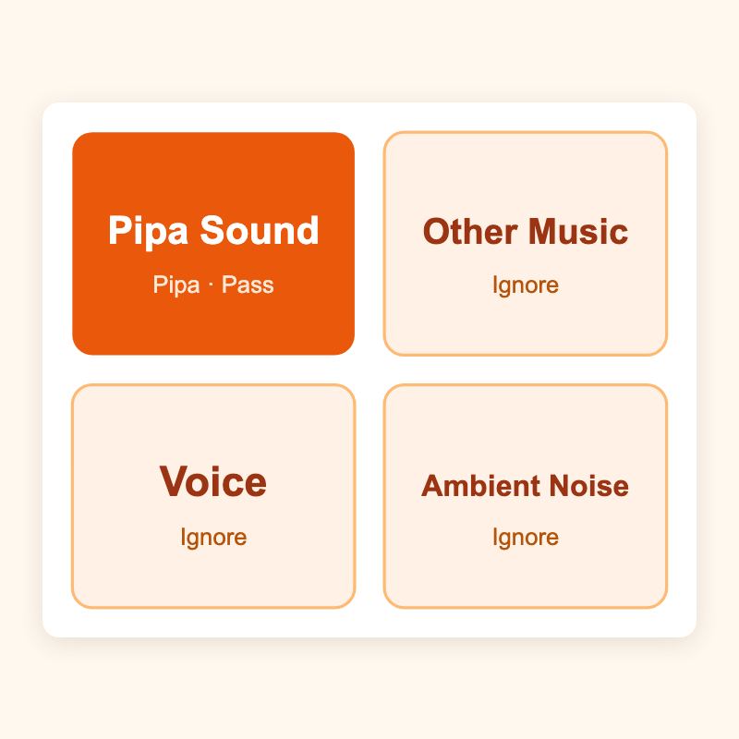
Core technology ①: teaching the phone to hear the Pipa
Inside the phone is a gatekeeper: is what we hear a Pipa at all? Only then does it analyse technique and pitch.
A four-class gate sorts each one-second window:
· Pipa sound? → Let it through to the next stage
· Speech / another instrument / room noise? → Ignore
Why? Rooms have AC noise and voices. Filtering first keeps analysis on track.
PluckBuddy
02

Slide 22
Where did the training data come from? A dataset I recorded myself
Four classes, all from real recordings. Other instruments were hardest — I play several myself, and AI filled in the guzheng pieces.
Pipa sound
Other instruments
My own Pipa playing across techniques, plus pieces I performed on stage.
The hardest class! Drums, guitar, zhongruan and piano that I played, and my own singing. I do not play the guzheng, so three AI-generated guzheng pieces were added to avoid copyright issues.
Speech
My own classroom and debate speeches, to contrast with the Pipa's timbre.
Background noise
The air conditioner at home, traffic on the street — real ambient sound captured as it came.
How raw audio becomes model input — the sampling pipeline
① Record at the device sample rate (usually 48 kHz), mixed to mono → ② Resample to 16 kHz → ③ Slice into 15,600-sample windows (~0.975 s), 50% overlap → ④ Feed the raw waveform, not a spectrogram, into the model.
The dataset: 34 clips, ~520 MB (10 with video), open-sourced under CC BY 4.0.
PluckBuddy
03

Slide 23
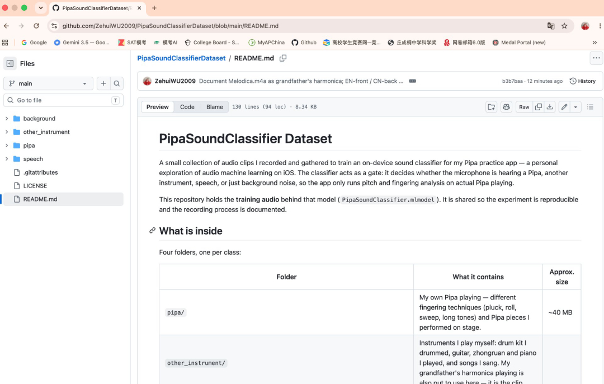
PipaSoundClassifier: how AI and I built it together
Me (student developer)
AI assistant
Came up with the idea, wrote the Swift code, collected and labelled the data, decided the product direction.
Read my code, explained the theory in plain words, debugged with me, checked the results.
Problem · simple DSP kept misfiring
My first version used crest factor and zero-crossing rate to detect a Pipa, but guzheng, guitar and speech all triggered it. AI suggested training a Pipa sound classifier that distinguishes by timbre rather than waveform, and showed me how to build the dataset.
Building the model together
I recorded and labelled over 50 clips of Pipa and interference myself: different techniques, pieces I played, drums / guitar / zhongruan / piano, my grandfather's harmonica, classroom and debate speeches, the air conditioner and street traffic. AI wrote the detector and its integration into the app. Together we trained the on-device Core ML four-class model PipaSoundClassifier, raising Pipa detection accuracy from about 60–70% to 85–95%.
↑ The dataset we collected and labelled together (open-sourced on GitHub)
PluckBuddy
04

Slide 24
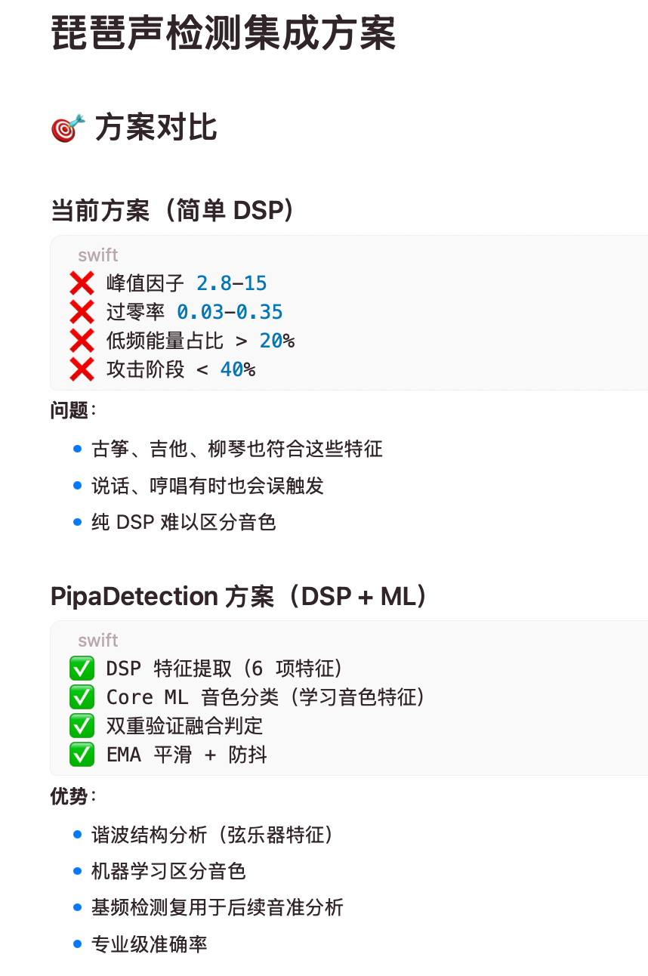
PipaSoundClassifier: how AI and I built it together
Me (student developer)
AI assistant
Came up with the idea, wrote the Swift code, collected and labelled the data, decided the product direction.
Read my code, explained the theory in plain words, debugged with me, checked the results.
Problem · simple DSP kept misfiring
My first version used crest factor and zero-crossing rate to detect a Pipa, but guzheng, guitar and speech all triggered it. AI suggested training a Pipa sound classifier that distinguishes by timbre rather than waveform, and showed me how to build the dataset.
Building the model together
I recorded and labelled over 50 clips of Pipa and interference myself: different techniques, pieces I played, drums / guitar / zhongruan / piano, my grandfather's harmonica, classroom and debate speeches, the air conditioner and street traffic. AI wrote the detector and its integration into the app. Together we trained the on-device Core ML four-class model PipaSoundClassifier, raising Pipa detection accuracy from about 60–70% to 85–95%.
PluckBuddy
↑ The approach we revised together
05

Slide 25
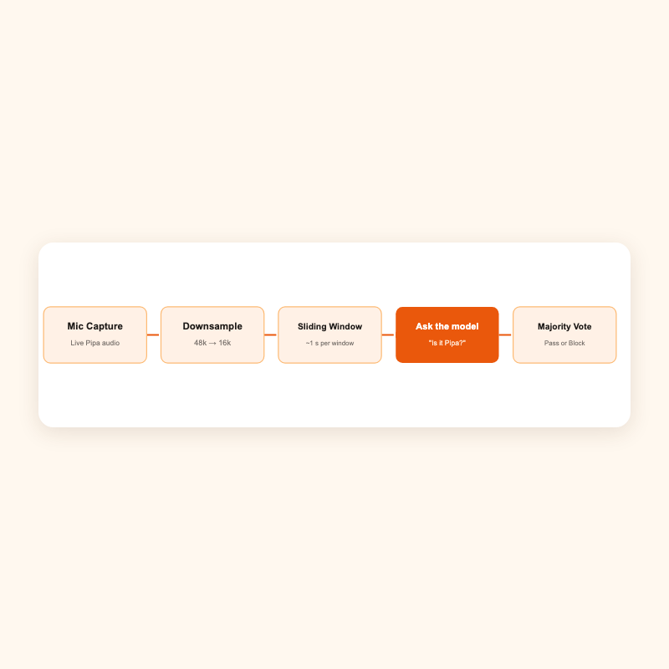
How does it actually work?
Low-energy windows are treated as background and skip the model; after smoothing across windows, analysis only proceeds when the Pipa probability is ≥ 0.35.
PluckBuddy
06

Slide 26
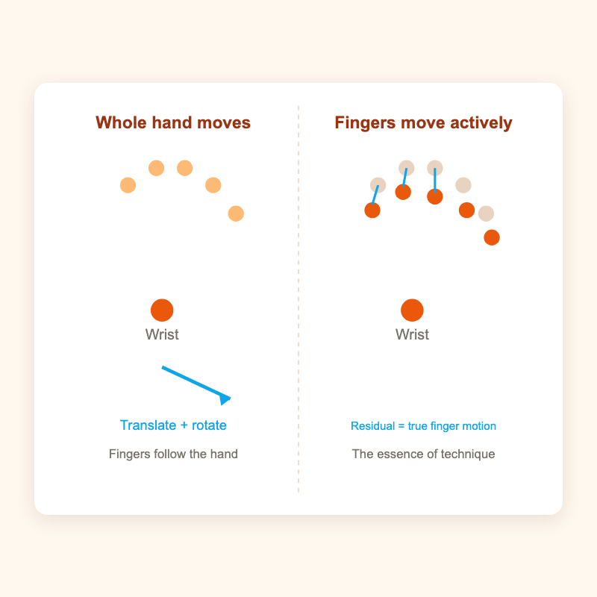
Core technology ②: teaching the phone to see fingering
Apple Vision gives 21 hand landmarks per frame.
Hard part: the hand moves too. Is it the finger or the hand?
Key trick: rigid decomposition. Predict where the fingers "should" be from the wrist's translation and rotation, then compute "actual − predicted = residual". The residual is what the fingers truly did.
PluckBuddy
07

Slide 27
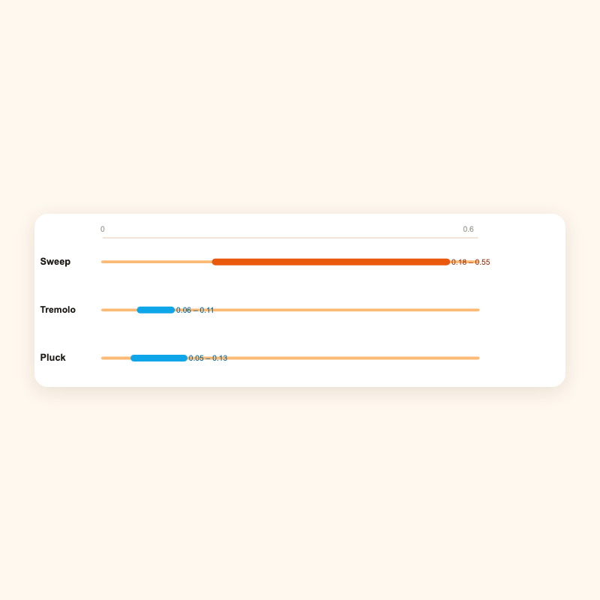
Telling Pluck, Tremolo and Sweep apart
Their fingerprint is how fast the wrist translates.
· Sweep: the whole hand sweeps across, fastest
· Pluck / Tremolo: the wrist barely moves; the fingers do the work
Add the finger residual and the technique becomes clear.
This idea came from this conversation between AI and me:
workbuddy.link/p/HqCmSEpUj2Pij7aASS5Opc
PluckBuddy
08

Slide 28
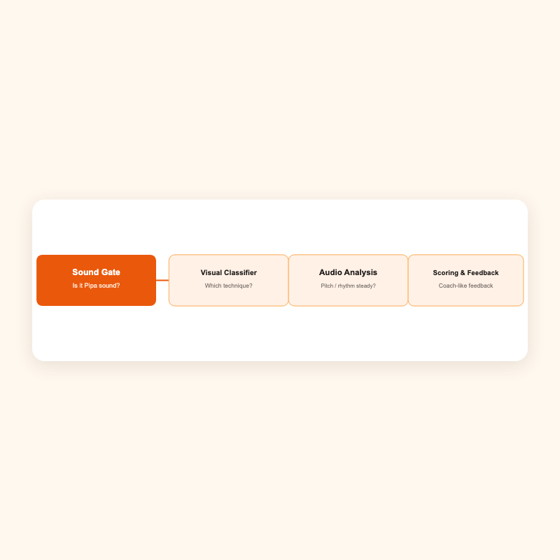
How do the two technologies work together?
The sound gate is the goalkeeper: it confirms the source is a Pipa before vision and audio analysis begin. Two checks, each with one job, never interfering.
PluckBuddy
09

Slide 29

Smart Fingering Coach: how AI and I built it together
Me (student developer)
AI assistant
Came up with the idea, wrote the Swift code, collected and labelled the data, decided the product direction.
Read my code, explained the theory in plain words, debugged with me, checked the results.
Example 1 · teaching the app to read fingering
I explained that Pluck, Tremolo and Sweep are separated by wrist translation speed and finger residuals. AI turned that into the rigid-decomposition algorithm and made technique recognition work.
Link:
workbuddy.link/p/HqCmSEpUj2Pij7aASS5Opc
Example 2 · fixing the score report
The report scores were strangely low. AI and I read the source together and found a bug in the strength-stability algorithm; once fixed, the scores returned to a sensible range.
Link:
workbuddy.link/p/UVEiD28kFBqPflETNrYc6F
PluckBuddy
10

Slide 30
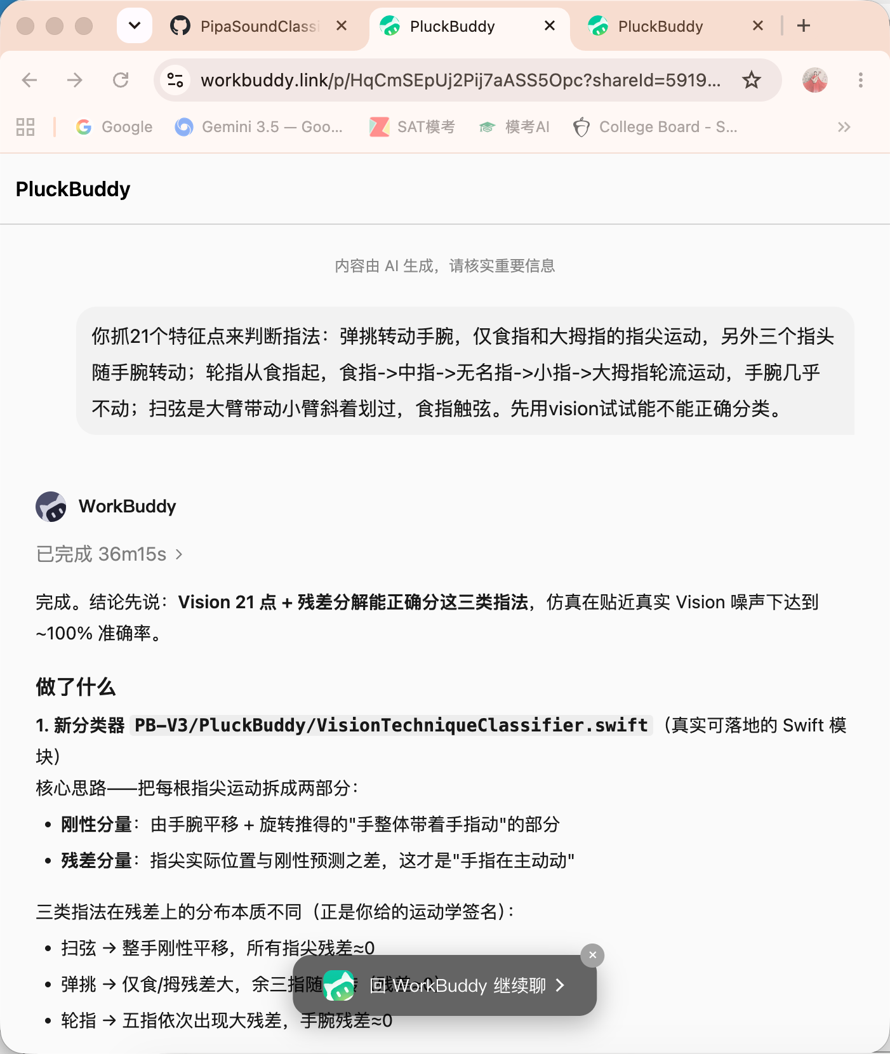
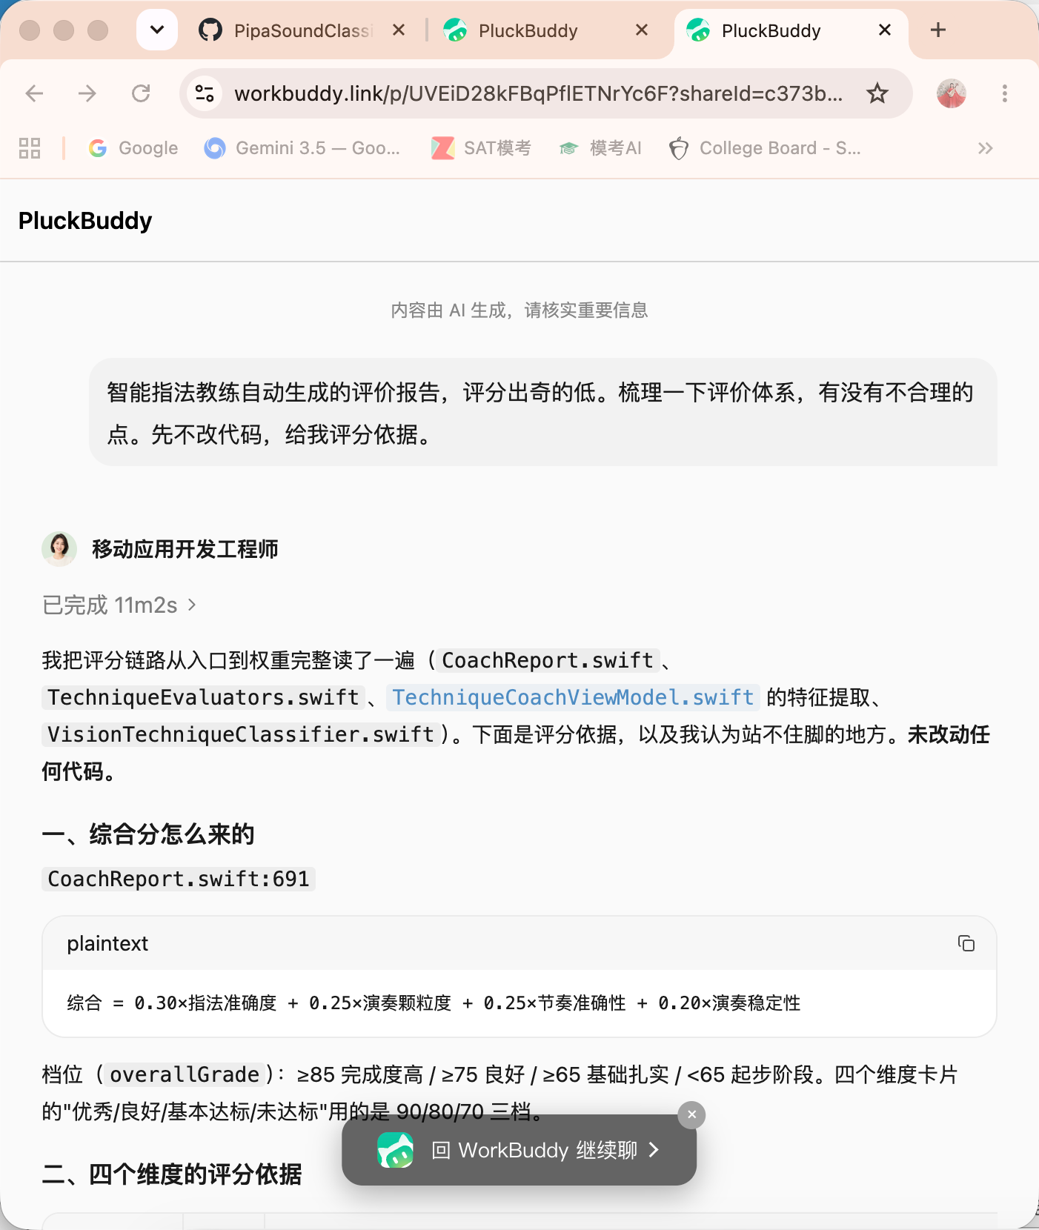
Smart Fingering Coach: how AI and I built it together
PluckBuddy
11

Slide 31
From an idea to a practice companion
A personal exploration: the instrument I love, the AI I wrote, one screen.
Logs:
p/HqCmSEpUj2Pij7aASS5Opc
·
p/UVEiD28kFBqPflETNrYc6F
Zehui Wu · Personal exploration project
PluckBuddy
12

Slide 32
Learning an instrument is a marathon
Consistency · Quality · Feedback
Consistency
Quality
Feedback
10–15 minutes a day beats two hours once a week
Slow and accurate beats fast and sloppy
Know yourself through data, then improve with focus
PluckBuddy
Version 2.0 | October 2026 | Zehui Wu · Wuhan Cogdel Cranleigh High School · Advisor: Jian Lu
Notes:
Close by returning to the three keywords. Then suggest a next step: arrange a student trial, or discuss a data dashboard for institutions.

