Slide 1
Word Statistical
表达数据骤降
Plummet
The proportion of part time students in the higher education systems plummeted from 40% to 20%. 高等教育系统中非全日制学生的比例从40%骤降到20%。
Plunge大幅下跌v,
Slump
The paper's circulation has slumped to 90,000. 此报纸的发行量骤降至9万份。
Take a dive
They feared that the stock prices could take a dive after its first day of trading. 他们担心这只股票在第一个交易日后会暴跌。
Decline/decrease/drop/fall+ sharply/abruptly/dramatically/drastically
Insects numbers have fallen abruptly by half in some parts of the world due to climate change. 由于气候变暖，世界部分地区的昆虫数量骤降了一半。
表达數据最低点
Trough 谷底;最低点
The index shows an approximate 20% decrease from peak to trough from 2007 until 2012.
该指数显示，从 2007 年到2012 年，从高峰到低谷大约下降了20%
Bottom out at 触底
The White House projected the deficit to bottom out at $496 billion in 2018, then start ticking back up to $593 billion in 2022. 白宫预计赤字将在 2018 年触底至 4960 亿美元，然后在 2022年开始回升至 5930 亿美元。
Reach the lowest point (at ）到达最低点
Potential home buyers are still hesitant, waiting for the house prices to reach the lowest point. 潜在购房者仍然犹豫不决，等待房价触底。
表达數据峰值
Hump / Peak 峰值；最高点
Reach a peak / the highest point at 达到峰值
Unimodal / Bimodal / Multimodal 单峰的；双峰的；多峰的
A histogram is unimodal if there is one peak, bimodal if there are two
表达数据激增
Proliferation/Explosion
With the proliferation/explosion of data volume, the network on which the data is stored and all associated programs tend to slow down. 随着数据量的激增，存储数据的网络和所有相关的程序都会趋于変慢。
Grow at an exponential rate/exponentially
Data is growing at an exponential rate with 90% of the world's data being generated in the last two years alone. 数据正以指数速度增长，仅在过去两年中就产生了全球 90%的数据。
Surge/Soar
The global data volume has surged/soared and will reach 163ZB in 2025. 全球数据量飙升，2025年将达到163ZB.
Increase sharply/dramatically/significantly
Many companies said that the volume of data is already increasing dramatically than their ability to keep up with. 许多公司表示，数据量的增长已经超过了他们跟上数拓的能力。
表达数据平稳
Level out/off 趋于平稳；保持平稳
As COVD-19 cases level off, 随着 COV1D-19 病例数量趋于平稳
Moderate/stabilize 趋于平稳；保持平稳
Global food prices start to moderate after hitting all time high.
全球食品价格在创下历史新高后开始趋于平稳。
Remain/keep/maintain + steady/constant/stable 保持平稳
Reach a plateau 达到平台期（达到顶峰后保持平稳）
Many people reach a weight loss plateau after several months of diet and exercise.
许多人在节食和锻炼几个月后达到减肥的平台期。
表达数据波动
Fluctuate (v.)/Fluctuation (n.)
The GDP data has fluctuated throughout the years but overall, it shows an upward trend.
GDP数据多年来一直在波动，但总体上呈上升趋势。
相关短语：
Abnormal fluctuations 异常波动
Fluctuate between .. and…在..与…之间波动
Upward/downward fluctuation 波动上升/下降
Go up and down (不规律irregularly)
Volatile (adj.)/Volatility (n.)
Oil prices are highly volatile based on a number of socioeconomic factors, so it is hard to predict. 基于许多社会经济因素，油价波动很大，因此很难预测
表达数据超过
Outnumber
Men still outnumber women in the paid workforce. 在上班挣钱的人口中，男性的数量仍多于女性。
Surpass
Daily COVID-19 deaths during omicron have surpassed its peak in delta wave.
新冠在奥密克戎期间每日的死亡人数超过了德尔塔时期的峰 值。
Exceed
By 2023, international arrivals are expected to exceed 1.5 billion people.
到 2023年，预计国际人境人数将超过15亿人。
Outstrip
Not once since 1984 has annual economic growth outstripped population increase.
自1984 年以来，每年的经济增长都没有超过人口增长。

Slide 8

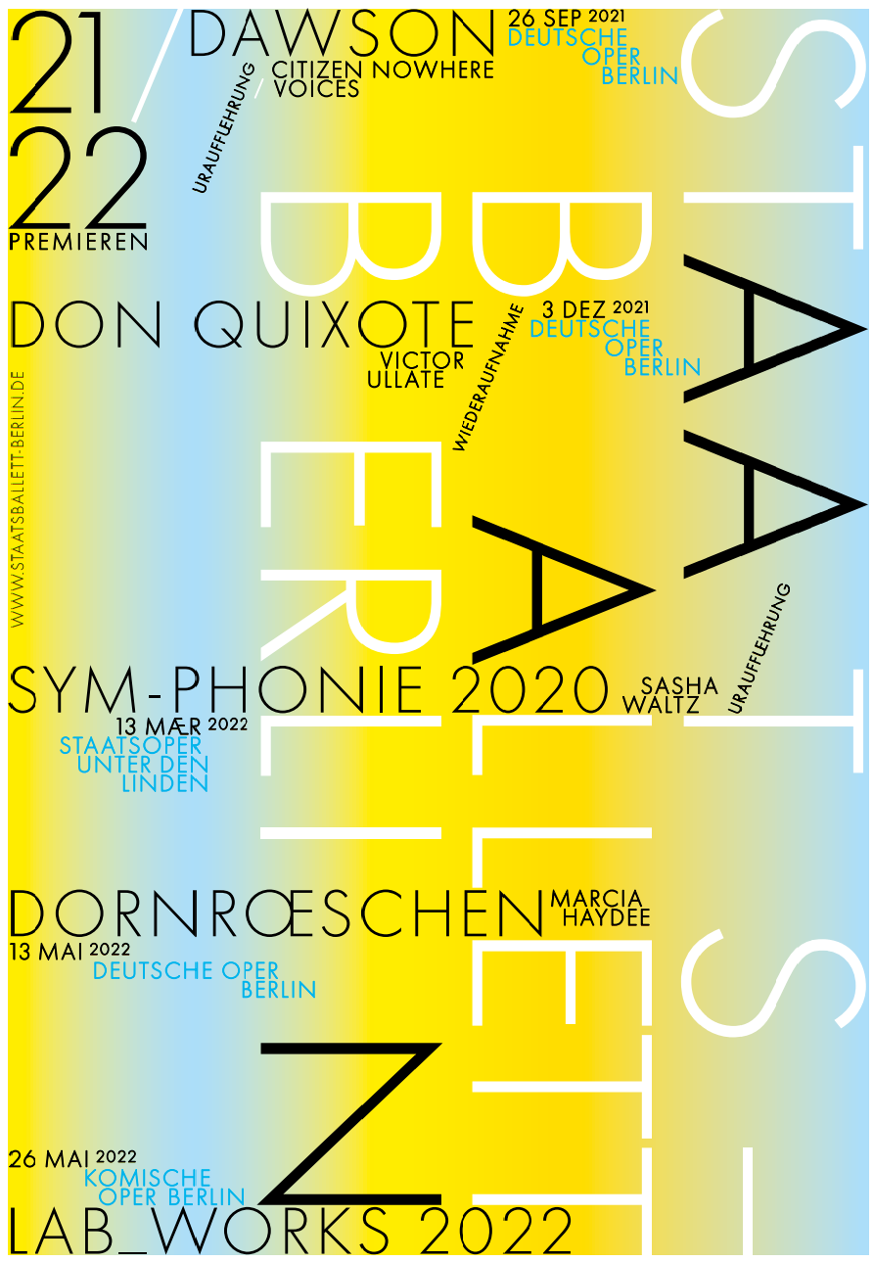



Slide 9
