Slide 1


Slide 2















































Slide 3
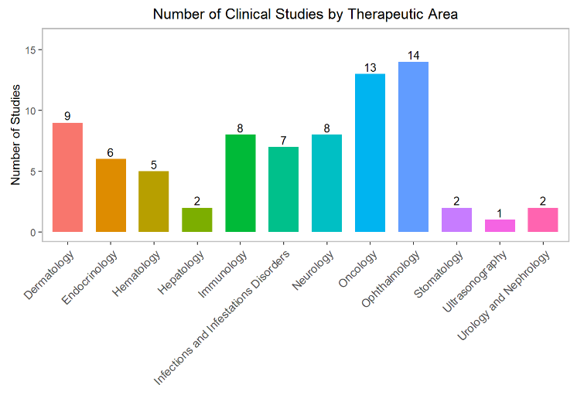
Therapeutic Area Experience

Slide 4

Study Design
Phase I
Phase II
Phase III
Phase IV
Medical Device
Complex Design
Safety Assessment
Tolerability
Pharmacokinetics (PK)
Phase IIa: Proof-of-Concept
Phase IIb: Dose-Finding
Superiority
Non-inferiority
Equivalence
Post-Marketing Surveillance
Pre-Market Approval
Post-Market Clinical Follow-up
Adaptive Design
Complex Sequential
Externally Controlled Trials

Slide 5
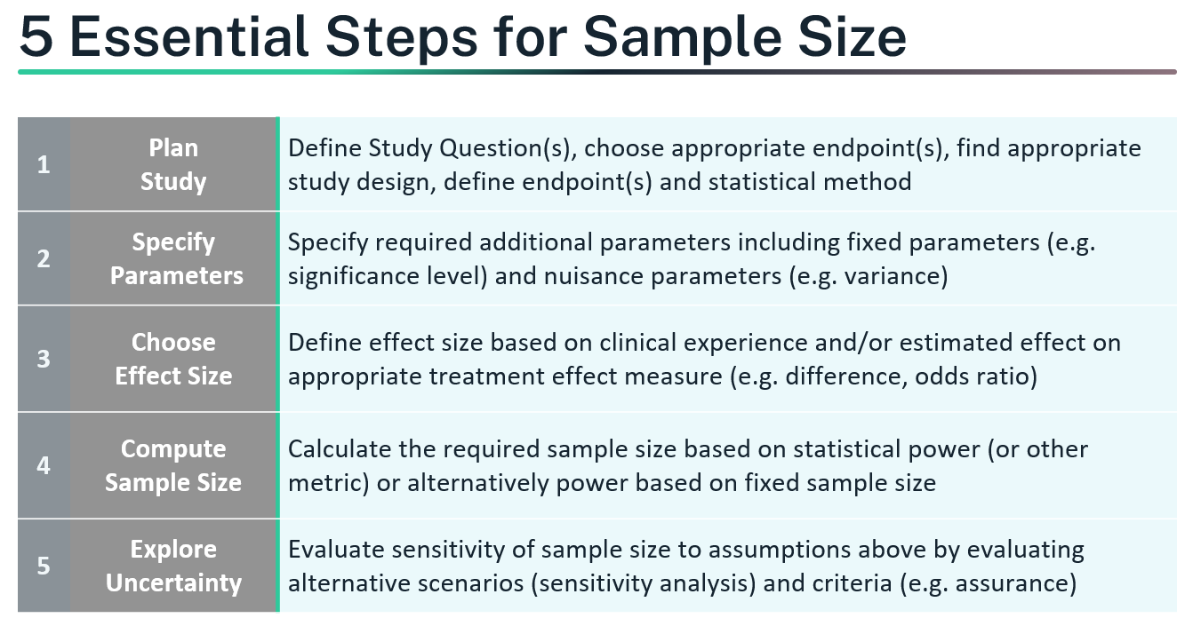
Sample Size Calculation

Slide 6
Statistical Analysis
Logistic Regression
Mixed
Model
Survival
Analysis
Other
Analysis
Machine
Learning
ROC and cutoff analysis
Mixed Models for Repeated Measures
Kaplan-Meier/Nelson-Aalen Estimator
ANOVA and Multiple Test
Ridge/Lasso Regression, Elastic Net Regularization
Logit Model, Probit Model
Complementary log-log-model
Generalized Estimating Equation (GEE)
Exponential/Weibull Regression Model
Non-Parametric Test/Nonparametric Regression
Decision Tree Model, Random Forest
Principal component analysis
Meta Analysis
Ordinal cumulative logit model
Hierarchical (Nested) Model
Cox Proportional Hazards Model
Multiple Imputation Bayes' Theorem
Support vector machine, K-nearest neighbors
Time Series Analysis
Logistic regression for clustered data
Generalized linear mixed model
Time-Dependent Covariates/Competing Risk
SEM and Factor Analysis
Hierarchical clustering, K-means clustering

