Slide 1
Multivariate Pattern Analysis (MVPA)

Slide 2
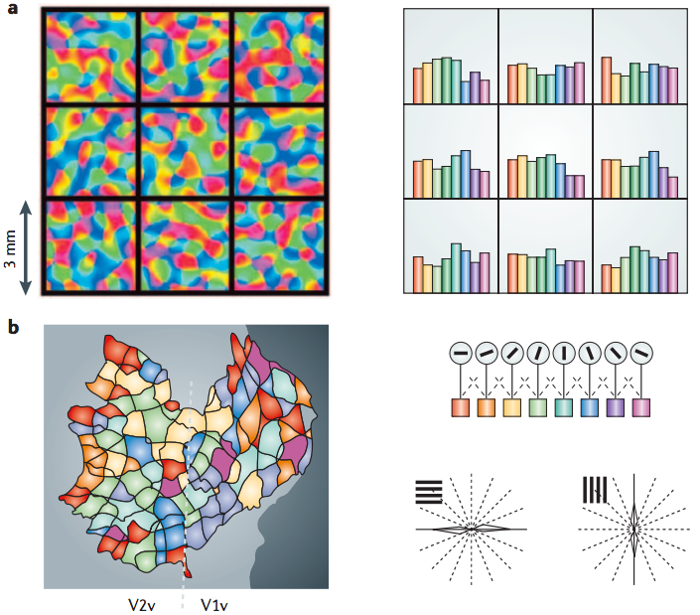
Univariate versus Multivariate
Univariate:
Single voxel statistics
Preprocessing -> voxel-wise subject-level GLM -> voxel-wise group-level modeling.
Activated in one voxel, nearby voxel should also activated. -> the “significance” represent general difference in that cluster (more “activation”).
Multivariate:
Multi-voxel decoding
Preprocessing -> feature selection ->
decoding method -> group-level
Fine-grained patterns.
the “significance” represent decoding
efficacy (more “information”).

Slide 3
Multi-variate pattern analysis
Feature selection
Which voxels (N_{vox})?
ROI
Peak voxel from univariate results
Searchlight
What features?
FIR GLM -> peak HRF response
HRF GLM -> beta estimates
HRF GLM -> t statistic (normalized beta estimates)
How many features (N_{fea})?
Per feature per trial
Per feature per condition
Label of feature
By condition

Slide 4
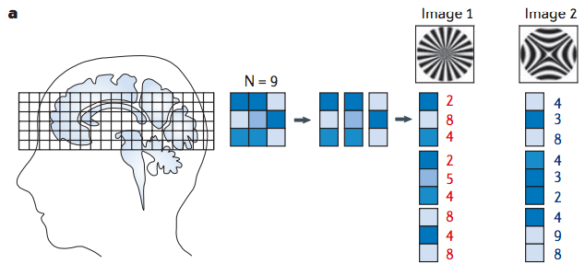
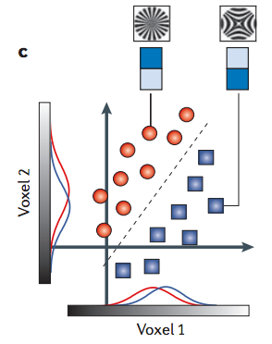
Multi-variate pattern analysis
Decoding method
Machine learning:
Classifier: SVM, LDA, Naive Bayes
N-fold Cross-validation
Estimate efficacy of machine learning: accuracy, distance, correlation.

Slide 5
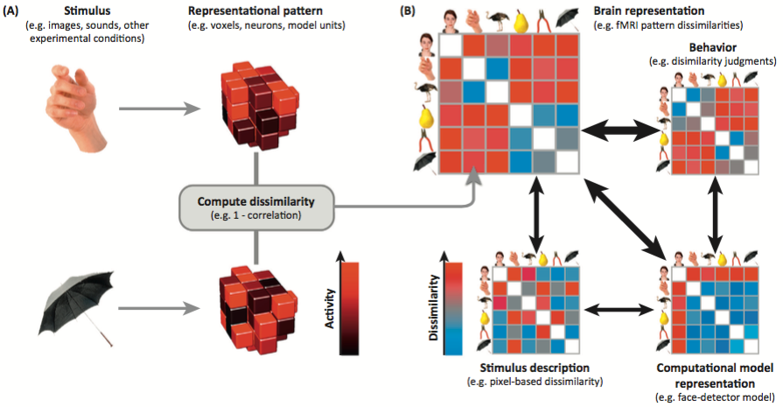
Multi-variate pattern analysis
Decoding method
Representational similarity analysis:
Similarity (correlation) / Dissimilarity (distance): Pearson, Spearman, Kendal correlation; Euclidan, Mahalanobis distance; cross-validated Euclidan, Mahalanobis distance.
Examine relationship to model: glmfit, correlation.

Slide 6
Multi-variate pattern analysis
Group-level statistics
Searchlight: transform multivariate statistic to z value
Transform correlation coefficient to Z value (Fisher’s).
Monte-Carlo permutation to estimate Z value.
Smooth after MVPA in subject level.
ROI:
Average across group.
Mixed model.

Slide 7
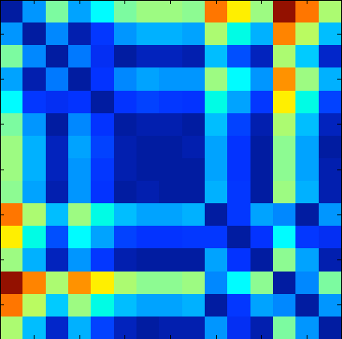
catMVPA
Preprocessing: keep fine-grained pattern
Feature selection
FIR, HRF, GLM Modeling: do it yourself
Create a structure array called “imgsample”
Searchlight:
Searchlight_Mat=get_searchlight(radius, mask_file, imgsample)
Decoding method
ML:
imgsample = get_image_zscore_mat(Searchlight_Mat, imgsample)
[img_corr, img_acc] = MVPA_nfoldcrossval(imgsample, Searchlight_Mat, svmcost)
RSA:
dsm_mat=get_rdm(imgsample, Searchlight_Mat, corr_measure)
dsm_glm_b=MVPA_dsm_glmfit(dsm_mat, dsm_target)
Others methods also provided: correaltion and fiser’s Z transformation, Monte-Carlo permutation
Group-level
Resample to 3d
dsmimg_vol = dsm_resampleto3dvol(imgsample, dsm_glm_b, Searchlight_Mat)
Smooth
spm_smooth(inputfilename, outputfilename, FWHM)

Slide 8
Group-level statistics
SPM build-in Second-level analysis
SnPM

