Slide 1


Remote Work Salary Analysis
Project 1 Milestone 3 Presentation – Trevor Zeiger
Bellevue University | DSC 680

Slide 2
Project Overview
• Project analyzes trends in remote work salaries using datasets from multiple global sources.
• Focus areas: salary distribution, job title, experience level, employment type, and location.
• Results offer actionable insight for HR, hiring managers, and job seekers.

Slide 3
Data Sources
1. Kaggle – Contains global remote job listings with structured salary data (USD).
2. Glassdoor – U.S.-focused data with job titles and salary estimates.
3. Indeed – Salary data focused on India, particularly software roles.
• Data was selected for diversity and geographic coverage.

Slide 4
Methodology
• Datasets were cleaned and standardized using Pandas.
• Visuals created with Seaborn and Matplotlib for trend analysis.
• Missing or inconsistent fields (job titles, salaries) were handled.
• Combined data allowed for comparison across experience levels and countries.

Slide 5
Challenges & Ethical Considerations
• Job title inconsistency and salary formatting were major challenges.
• Self-reported salaries introduced potential biases.
• No PII was included – all datasets are publicly accessible.
• Ethics guided the use of aggregated, de-identified data.

Slide 6

Key Findings: Employment Type & Location
• Contract: $184,575 | Highest pay but least common (1%).
• Full-Time: $113,468 | 97% of listings.
• Freelance: $48,000 | Part-Time: $33,070.
• U.S. jobs offer top salaries; India lags with ~$28,582 average.

Slide 7
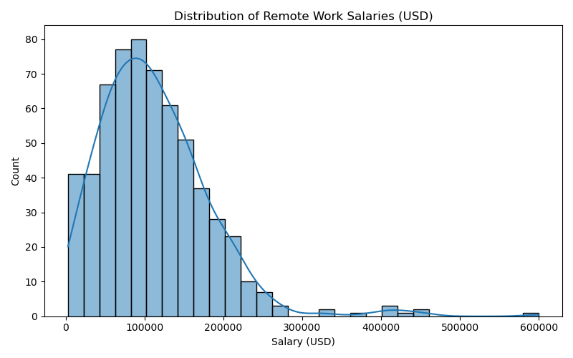
Distribution of Remote Work Salaries (USD)

Slide 8
Key Findings: Salary Distributions
• Salary range clusters between $60K–$140K.
• Outliers observed beyond $300K for niche and senior roles.
• Mode salary: $100,000 across 15 listings.
• Right-skewed distribution shows higher concentration in mid-salary range.

Slide 9
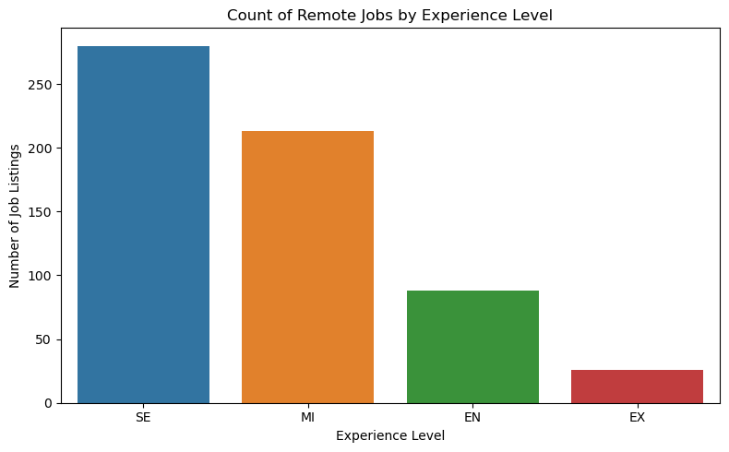
Experience Level

Slide 10
Key Findings: Experience & Role
• Executive average salary: $199,392 | 4% of roles.
• Senior: $138,617 | 46%, Mid-Level: $87,996 | 35%.
• Entry-Level: $61,643 | 14% – limited remote opportunities.
• High-paying roles include: Data Analytics Lead, Principal Data Engineer.
Suggests a desperate need for more experience analysts

Slide 11
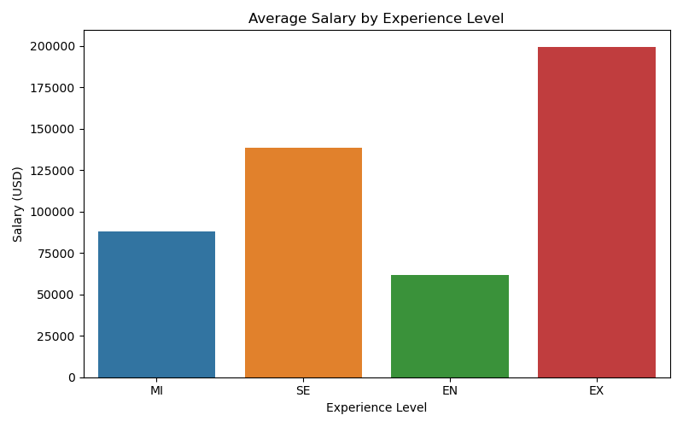
Average Salary by Experience Level

Slide 12
Salary by Experience Level
• Executive: $199,392 (4% of roles)
• Senior: $138,617 (46%)
• Mid-Level: $87,996 (35%)
• Entry-Level: $61,643 (14%)

Slide 13
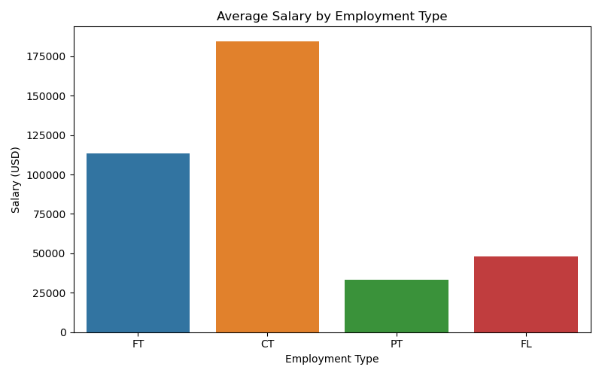
Average Salary by Employment Type

Slide 14
Salary by Employment Type
• Contract: $184,575 (1%)
• Full-time: $113,468 (97%)
• Freelance: $48,000 (1%)
• Part-time: $33,070 (2%)

Slide 15
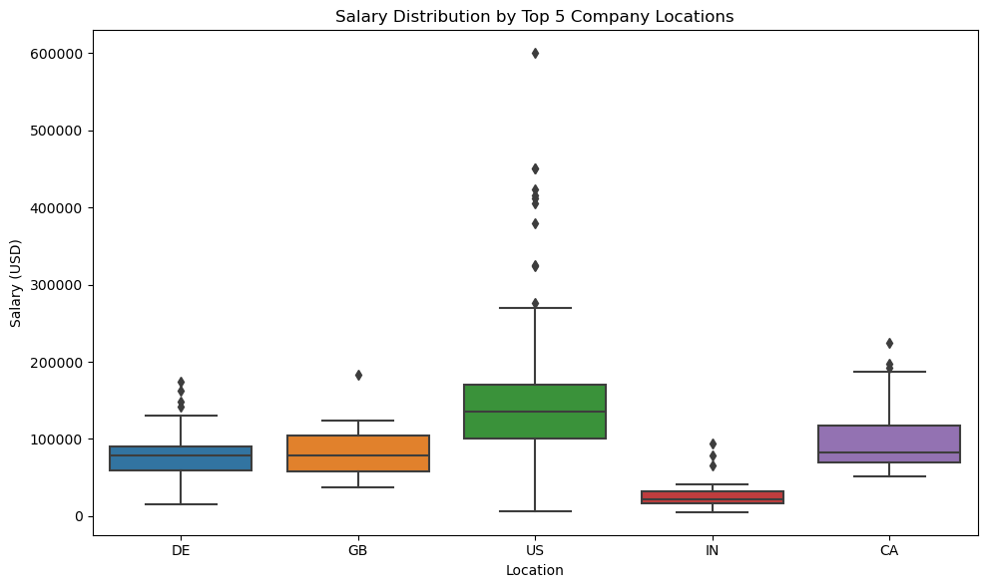
Salary By Location

Slide 16
Top 5 Locations: Salary Summary
• US: Avg $144,055 | Median $135,000 | Max $600,000
• CA: Avg $99,824 | Median $81,896 | Max $225,000
• DE: Avg $81,887 | Median $78,015 | Max $173,762
• GB: Avg $81,583 | Median $78,526 | Max $183,228
• IN: Avg $28,582 | Median $22,124 | Max $94,665

Slide 17
Strategic Implications
HR and hiring managers can use this data to benchmark remote compensation more effectively.
Remote job seekers should focus on Senior and niche roles for top earnings.
Contract work may offer premium pay but comes with trade-offs (e.g., no benefits).
Geographic pay differences should inform global hiring strategies.

Slide 18

Audience Questions
Q1: How current is the data, and what is the timeframe?
A1: The datasets primarily span 2020–2023, reflecting recent remote job trends.
Q2: Are salaries adjusted for cost of living by region?
A2: No, salaries are reported as-is. Cost of living varies and was not normalized.
Q3: How were salaries normalized across currencies?
A3: USD salaries were analyzed; INR salaries were kept separate for clarity.
Q4: What industries were most represented in the datasets?
A4: Tech and data roles were most common, including analysts, engineers, and scientists.
Q5: Are there any visible gender or diversity-related trends?
A5: The datasets lacked demographic identifiers, so this was not analyzed.

Slide 19

Audience Questions (Continued)
Q6: How frequently is this kind of analysis recommended?
A6: Ideally, quarterly or semi-annually to track market shifts in remote work.
Q7: Can this approach be turned into a live dashboard?
A7: Yes, the pipeline supports extension into dashboards with tools like Tableau or Power BI.
Q8: How do contract vs. full-time roles affect company costs?
A8: Contracts often cost more short-term but avoid long-term benefits obligations.
Q9: Is salary the most effective measure of job quality?
A9: No, benefits, flexibility, and career growth also matter greatly.
Q10: How do outliers affect the interpretation of results?
A10: Outliers skew the mean but were acknowledged and visualized for transparency.

Slide 20
References
Glassdoor. (n.d.). Glassdoor salary API. Glassdoor. https://www.glassdoor.com/developer/index.htm
Harvard Business Review. (n.d.). Remote work compensation trends. Harvard Business Review. https://hbr.org/
Indeed. (n.d.). Indeed job postings API. Indeed. https://www.indeed.com/hire/apis
Kaggle. (n.d.). Remote job salaries dataset. Kaggle. https://www.kaggle.com/
McKinsey & Company. (n.d.). Remote job market trends. McKinsey & Company. https://www.mckinsey.com/
U.S. Bureau of Labor Statistics. (n.d.). Employment and wage data. U.S. Department of Labor. https://www.bls.gov/data/

