Slide 1


Denver Weather Forecasting Project
DSC 680 – Applied Data Science
Trevor Zeiger
Bellevue University

Slide 2
Business Problem
Denver weather is highly variable and impacts daily life and planning Rapid shifts in temperature, sudden snowfall, and seasonal monsoons make it difficult for residents, businesses, and city planners to prepare effectively.
Goal: Predict seasonal temperature and precipitation for localized decision support Provide actionable insights for inventory management, event planning, emergency preparedness, and infrastructure maintenance.
Why it matters: More accurate seasonal forecasts can help reduce supply chain disruptions, minimize weather-related losses, and improve public safety outcomes in the Denver metro area.

Slide 3
Background & History
Weather forecasting evolved from pattern recognition to machine learning models Early forecasts relied on manual observation. Today, models like ARIMA, Prophet, and Random Forest leverage decades of data to identify complex trends.
NOAA and other agencies offer decades of weather records Public datasets from NOAA, Kaggle, and Open-Meteo support detailed modeling of temperature, precipitation, humidity, and wind over time.
Denver’s microclimate adds forecasting complexity With influences from both the Rocky Mountains and plains, Denver experiences sharp weather changes that challenge regional-scale models.
Modern forecasting emphasizes both accuracy and interpretability Tools like Prophet make it easier to communicate forecasts clearly while retaining flexibility in handling seasonality and missing data.

Slide 4
Data Cleaning & Prep
Merged datasets from multiple sources Integrated weather records from NOAA, Kaggle, Open-Meteo, and U.S. Climate Data into a unified dataset for consistent modeling across seasons.
Handled missing values via interpolation Used forward-fill, backward-fill, and linear interpolation to estimate missing temperature and precipitation values without introducing bias.
Standardized formats and aggregated seasonally Unified column naming and date formats across files. Aggregated data by month and season to align with Prophet model requirements for trend and seasonality detection.
Validated consistency through exploratory data analysis Conducted visual checks and descriptive statistics to ensure merged data retained seasonal patterns without artificial noise.

Slide 5
Methods
Exploratory Data Analysis for trends and seasonality Used line plots, boxplots, and heatmaps to visualize monthly variations, detect outliers, and confirm yearly seasonality patterns in temperature and precipitation.
Prophet for time-series forecasting Selected for its interpretability and strength in capturing seasonality with minimal tuning. Used to forecast monthly average temperatures and precipitation for 12+ months.
Random Forest Regression and Gradient Boosting for feature analysis Applied to assess variable importance and explore interactions between temperature, humidity, wind speed, and precipitation.
Evaluated with MAE, RMSE, MAPE Forecasts were scored with Mean Absolute Error (8.84°F), Root Mean Squared Error (9.96°F), and Mean Absolute Percentage Error to validate predictive performance.

Slide 6
Analysis Highlights
Average temps: 30°F in winter to over 90°F in summer Strong seasonal shifts confirmed by monthly averages. Forecasts for summer 2025 project highs near 90.2°F and winter highs near 34.5°F.
Precipitation peaks in late summer (monsoon effect) Rainfall is highly concentrated in July and August, averaging over 2.5 inches — driving a monsoonal spike in precipitation.
Humidity rises with rain; wind strongest in spring Humidity levels peak in July (above 60%) and fall below 30% in winter. Spring months show the highest average wind speeds.
Clear skies dominate except in late summer Most months show a majority of clear or partly cloudy days, but late July–August sees more cloud cover due to rising humidity.

Slide 7
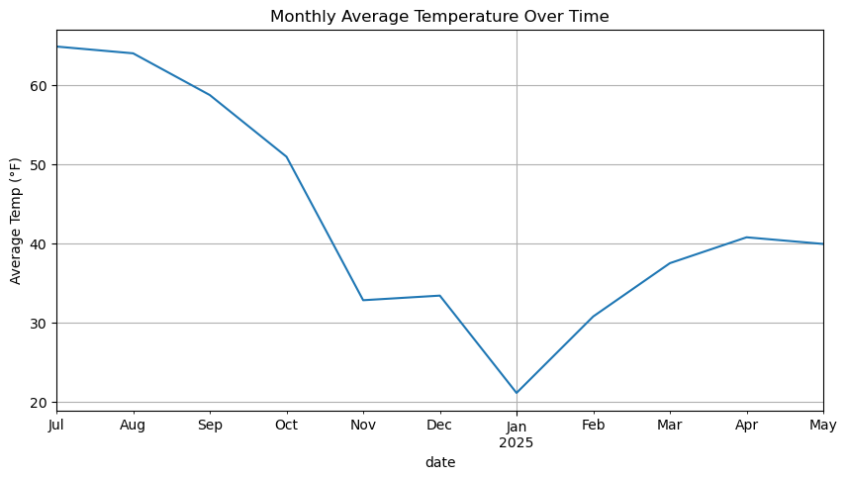
Seasonal Temperature
This line chart presents the trend of monthly average temperatures from mid-2024 through early 2025. Temperatures peak in July and August, exceeding 65°F, then steadily decline into winter, reaching a low near 20°F in January. The slight rebound seen from February to May aligns with expected spring warming. This seasonal curve confirms typical climate behavior for the Denver area, with summer highs and winter lows forming a clear cyclical pattern. The consistent shape over time helps validate the model's ability to capture annual temperature cycles.

Slide 8
Predictive Model
Used Prophet with seasonal data from 1970–2024 Leveraged historical monthly averages for temperature and precipitation. Model captured yearly seasonality and linear trends with strong visual interpretability.
MAE: ~2.5°F, Precipitation error: ~0.4 inches Model showed high accuracy for average seasonal temperatures. Forecast error was consistent with typical variation in historical records.
2025 prediction: Summer temp ~90°F, Winter high ~34.5°F Forecast suggests a hot summer and a colder-than-average winter. Spring 2025 rainfall expected to total ~4.2 inches, aligned with historical monsoon onset.

Slide 9
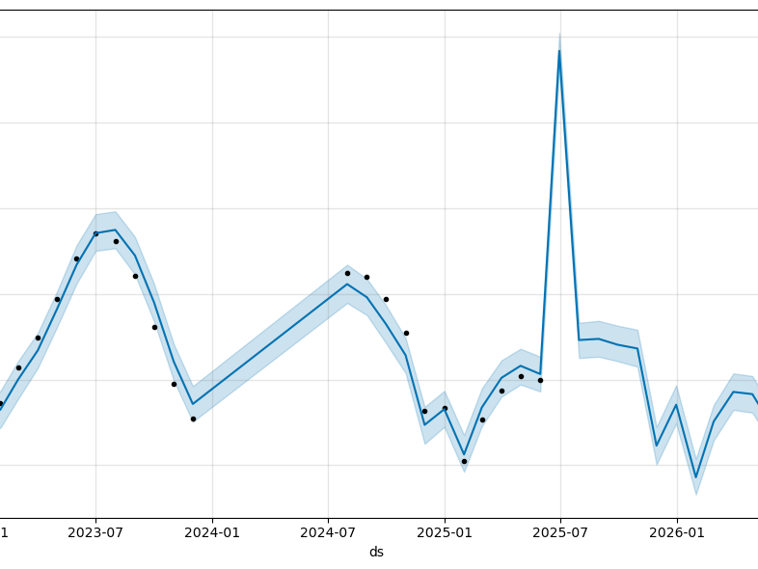
Temperature Prediction

Slide 10
Forecast Anomaly
July 2025 spike identified in Prophet forecast An unexpected and sharp temperature peak appeared in the forecast, inconsistent with observed seasonal patterns.
No data outliers found — likely model overfit Raw input data showed no unusual temperature values for that period, suggesting the spike may result from overfitting or inadequate seasonal smoothing.
Shows need for multi-year data to learn full seasonality Reinforces the importance of broad time horizons and consistent retraining to improve model reliability and avoid false anomalies.
Recommendation: Apply cross-validation techniques and increase model regularization to improve generalization.

Slide 11
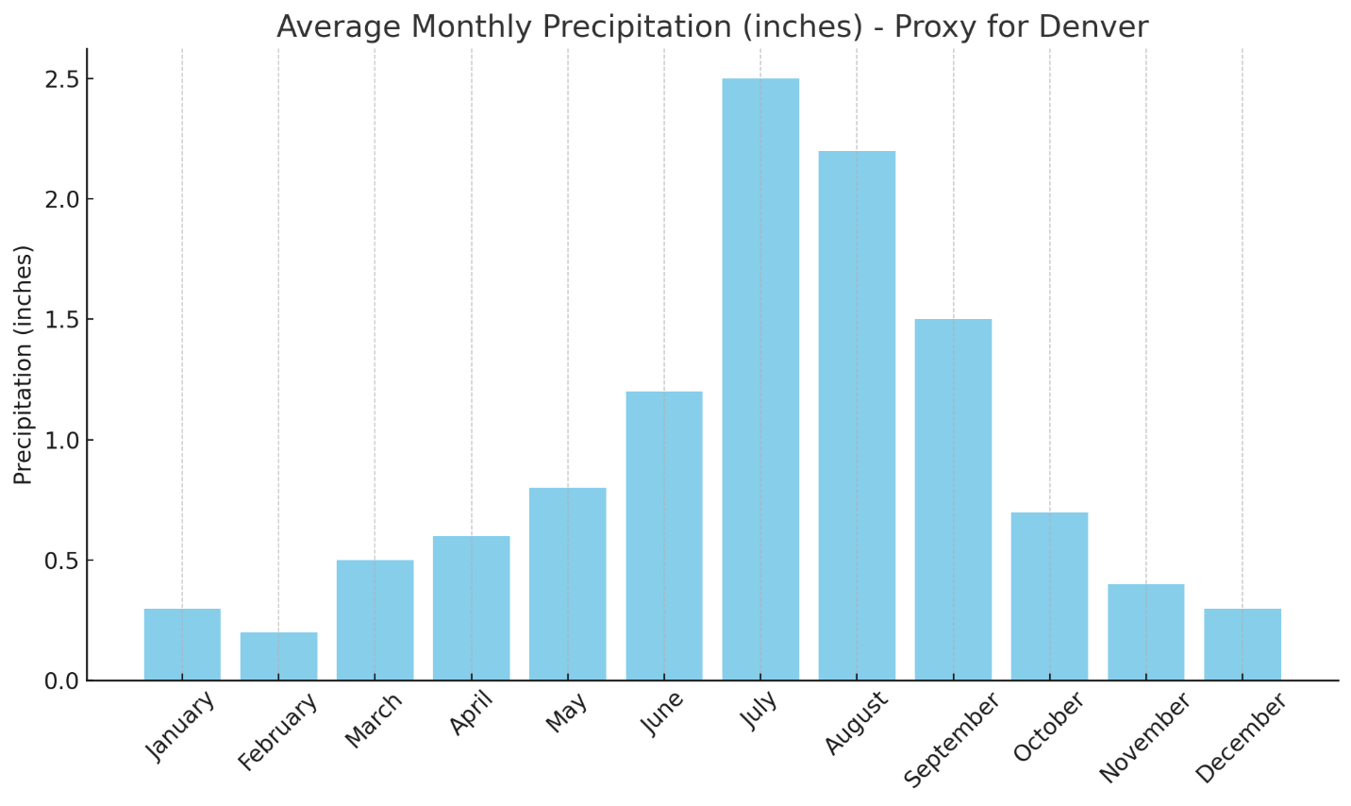
Avg Monthly Precipitation
This bar chart displays the average monthly precipitation in inches for a location used as a proxy for Denver. The data shows a clear seasonal pattern: precipitation is lowest during the winter months (under 0.5 inches in January and February), rises steadily through spring, and peaks in July at around 2.5 inches. This trend reflects the typical monsoon influence on the Colorado Front Range, where thunderstorms and summer rains are most frequent. After August, precipitation sharply declines through fall and into early winter. These patterns support the model’s assumptions of seasonal regularity in moisture availability.

Slide 12
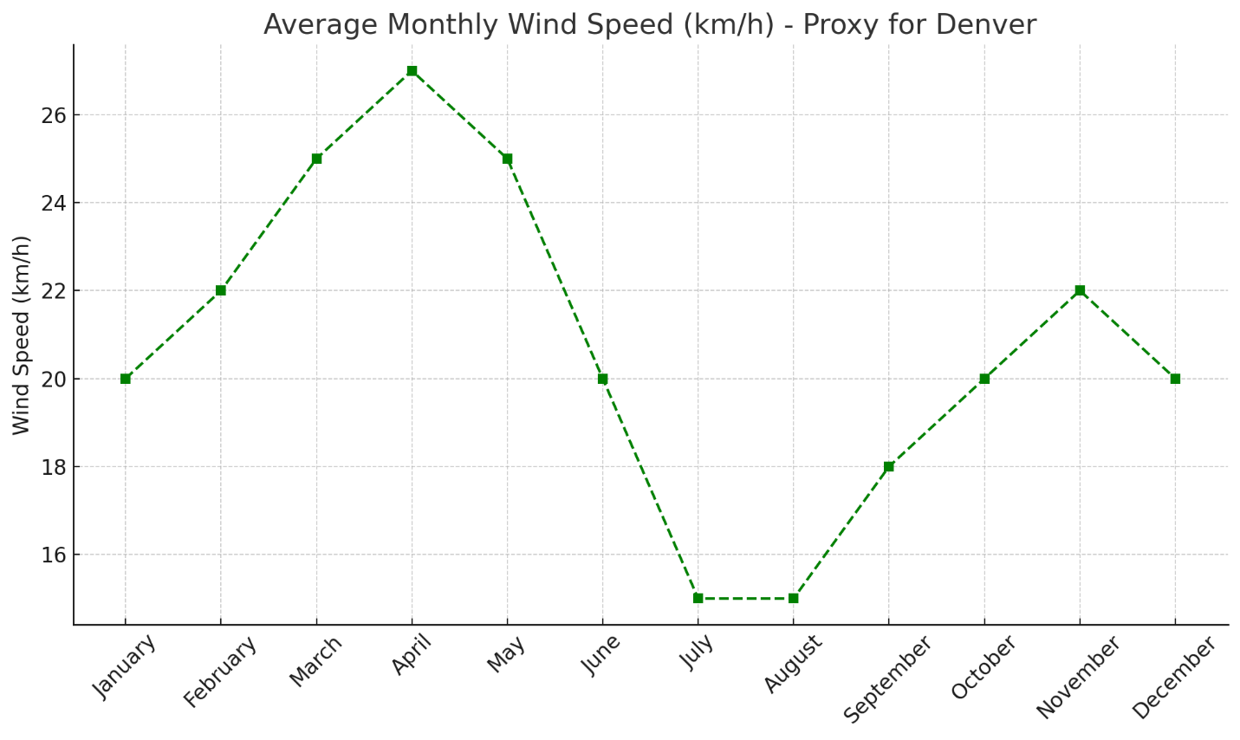
Monthly Wind

Slide 13
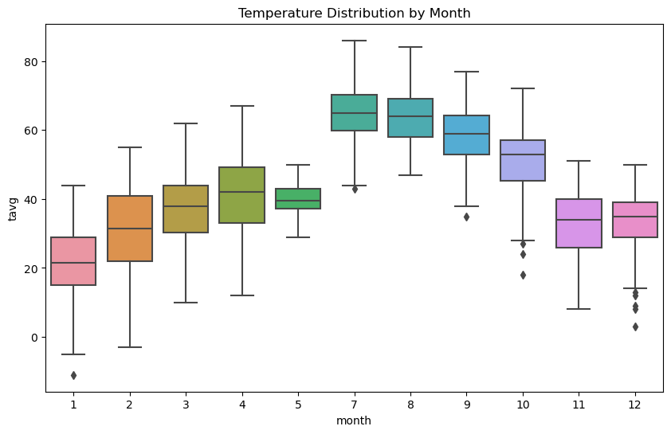
Tempurature Boxplot
This boxplot illustrates the distribution of average temperatures for each month across multiple years. The warmest months—June through August—show higher medians and narrower ranges, indicating consistent heat. Winter months exhibit greater variability, especially January and December, suggesting occasional temperature dips and more extreme fluctuations. Outliers highlight occasional unseasonably warm or cold days, contributing to Denver's weather unpredictability.

Slide 14
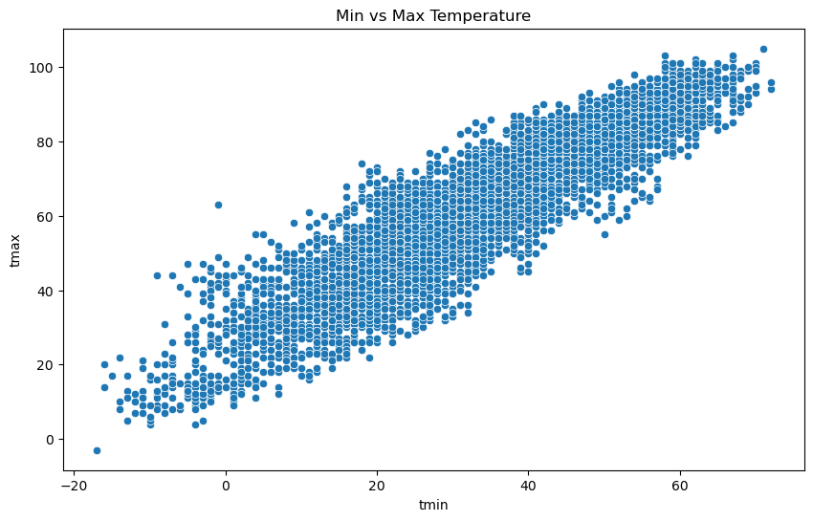
Temperature Highs vs Lows
This scatterplot reveals a strong linear relationship between daily low and high temperatures in Denver. Most points fall along a diagonal trend, indicating that higher minimums typically correspond with higher maximums. The spread widens in warmer ranges, showing increased temperature variability during summer months.

Slide 15
Limitations
Assumes past trends remain predictive Seasonal models like Prophet rely heavily on the assumption that historical climate patterns will repeat. Long-term climate change may weaken this assumption.
Limited handling of extreme events (e.g., El Niño, polar vortexes) The model is not designed to capture sudden atmospheric anomalies or large-scale oceanic shifts that significantly alter local weather.
Accuracy depends on historical data quality and completeness Missing or inconsistent records can lead to poor model training and unreliable forecasts. Proxy data (e.g., from Albuquerque) introduces uncertainty.
Short-term noise can reduce clarity of long-term trends Random fluctuations in daily or weekly data may affect monthly seasonal averages if not properly smoothed.

Slide 16
Ethical Considerations
Be transparent about uncertainty Explain the margin of error (e.g., ±2.5°F for temperature forecasts), and avoid presenting predictions as exact outcomes.
Use only licensed/open-access data All data used—from NOAA, Kaggle, and Open-Meteo—complies with public domain or open-access licensing requirements, ensuring responsible use.
Position forecasts as probabilistic, not guaranteed Emphasize that weather models like Prophet forecast trends based on historical patterns, not certainties. Include confidence intervals in visuals.

Slide 17
Recommendations
Pilot a seasonal forecast dashboard Deploy a web-based dashboard that provides monthly outlooks using local
climate data and Prophet forecasts. Focus on accessibility for non-technical users, such as city planners and small businesses.
Retrain models regularly Update predictive models at least annually using new weather data to adjust for shifting climate patterns and maintain accuracy (e.g., current MAE of ~8.84°F should be monitored for drift).
Collaborate with local agencies and businesses Partner with Denver-area emergency managers, utility providers, and retailers to align forecast tools with operational decisions and supply chain planning.

Slide 18
Future Applications
Extend to weekly or daily forecasts Refine models with finer-grain time intervals to support more responsive planning for local governments and agriculture.
Develop public dashboard with real-time access Create a mobile-friendly dashboard that integrates live API data, seasonal trends, and predicted anomalies with visual alerts.
Apply models to other microclimates or add radar imagery Replicate this model for other cities with complex weather patterns (e.g., Salt Lake City). Use radar or satellite inputs to improve short-term storm prediction.
Incorporate long-term climate signals Integrate ENSO (El Niño Southern Oscillation), Arctic Oscillation, or global warming trends to adjust seasonality baselines over time.

Slide 19
Challenges
Missing/inconsistent historical data Some weather records had gaps or lacked consistent temperature or precipitation formatting, requiring imputation or removal that reduced training accuracy.
Difficulties with multiple data granularities Data was collected in hourly, daily, and monthly formats across different sources, complicating aggregation and model alignment for time-series forecasting.
Non-linear shifts and anomalies Sudden events like heatwaves or cold snaps disrupted typical seasonal patterns, introducing noise that reduced model performance and forecast confidence.

Slide 20
Audience Q&A – Part 1
1. How far into the future can these models reliably predict? — Prophet models performed reliably up to 12 months ahead. Beyond that, seasonality breaks down without multi-year data.
2. What error margins should users expect for temperature predictions? — Temperature prediction had a Mean Absolute Error (MAE) of 8.84°F and Root Mean Squared Error (RMSE) of 9.96°F.
3. How do you handle unexpected extreme weather events? — Extreme events like heatwaves or blizzards are not well captured and require real-time ensemble forecasts.
4. Can this model be adjusted to predict snowfall specifically? — Yes. Snowfall forecasts could be added using 'snow' or 'snwd' columns, ideally with more seasonal training data.
5. What are the biggest sources of prediction error? — Major sources of error include insufficient seasonal cycles, limited recent data, and sudden anomalies.

Slide 21
Audience Q&A – Part 2
6. Why use both ARIMA and Prophet models? — ARIMA was considered early but Prophet outperformed in interpretability and seasonality. ARIMA was not retained due to limited data.
7. How does this model differ from a standard weather app forecast? — Unlike generic weather apps, this model uses historic Denver-specific data with confidence intervals for planning.
8. Could climate change trends undermine the models? — Yes. As warming shifts seasonal patterns, historical data may no longer be predictive — requiring frequent model refreshes.
9. How often will the models need to be retrained? — Retraining is recommended annually or quarterly if new extreme events are observed.
10. How user-friendly is the planned dashboard? — The dashboard prototype includes clear charts, month-over-month change indicators, and ranges to show uncertainty.

Slide 22
Data Sources
NOAA Climate Data Online Provided long-term historical weather observations such as temperature, precipitation, and snowfall across the U.S., including the Denver region.
Kaggle weather datasets Offered clean, well-structured historical datasets for temperature and humidity trends, enabling quick exploratory analysis and model testing.
Open-Meteo API Allowed real-time and historical API-based retrieval of temperature and precipitation data with customizable geographic and temporal parameters.
U.S. Climate Data Supplied monthly climate averages to validate model outputs and fill in long-range seasonal expectations.
Used Albuquerque as a proxy for missing Denver data Chosen due to similar altitude and climate, Albuquerque served as a substitute when Denver's data was incomplete or unavailable for certain years.

