Slide 1


Design and Implementation of a Robotics System for Medical Assistant in Hospitals.
Haider Salamah (12th grade), Zein Mohammad (12th grade)
National Center for the Distinguished
Scientific advisor: Salman Daher, Academic Programs DCA Syria, Robotics and Intelligence Systems Student at Manara University
1

Slide 2
Introduction
2

Slide 3
IDEs and environments
r
ROS
Arduino
Google Colab
Proteus
3

Slide 4
Algorithms
ArUcos Detection
Navigation
Item grabbing
Mask detection
4

Slide 5
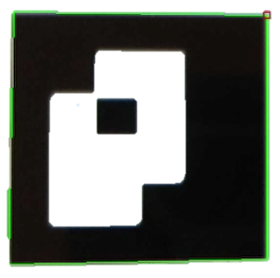
ArUcos Detection Algorithm (Navigation)
sample of a detected ArUco
5

Slide 6
Start
Initialize the requirement variables and turn on the camera
While camera is working
End
No
Move in specific direction depending on the ArUco’s ID
Yes
If the ArUco is close
If the camera detectd an ArUco
Read the ArUco’s ID
Yes
Yes
No
Do not change the direction
No
Move forward
6

Slide 7
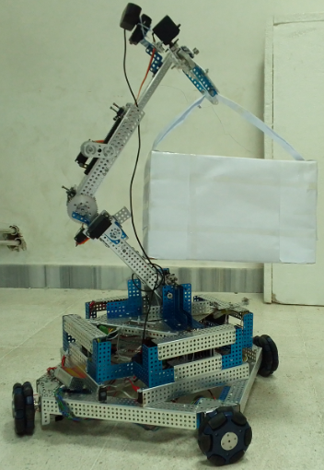
ArUcos Detection Algorithm (Item grabbing)
7

Slide 8
Mask Detection Algorithm
Collect data
Train the neural network
Process the data (convert the images to arrays and perform one hot encoding )
Save the trained model (which is ready to use in video streaming)
8

Slide 9
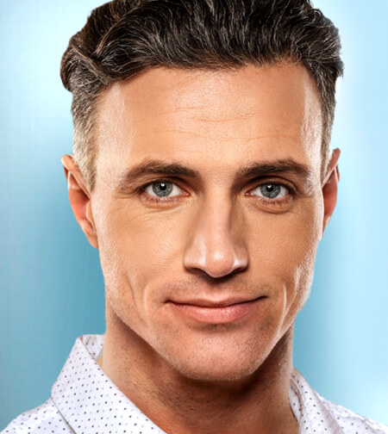
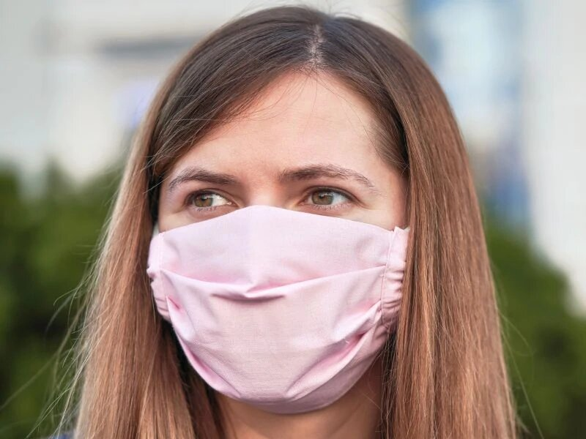
Mask Detection Algorithm
(The first stage)
Sample for no mask
Sample for mask
9

Slide 10
Mask Detection Algorithm
(The second stage)
Before one hot encoding
After one hot encoding
Status | Photo
Mask | Photo 1
No mask | Photo 2
……. | ……..
Mask | Photo m
No mask | mask | Photo
0 | 1 | Photo 1
1 | 0 | Photo 2
……. | ……. | ……..
0 | 1 | Photo m
10

Slide 11
Mask Detection Algorithm
(The third stage)
baseModel = MobileNetV2(weights="imagenet", include_top=False,
input tensor=Input(shape=(224, 224, 3)))
headModel = baseModel.Output
headModel = AveragePooling2D(pool_size=(7, 7))(headModel)
headModel = Flatten(name="flatten")(headModel)
headModel = Dense(128, activation="relu")(headModel)
headModel = Dropout(0.5)(headModel)
headModel = Dense(2, activation="sigmoid")(headModel)
model = Model(inputs=baseModel.input, outputs=headModel)
for layer in baseModel.layers:
layer.trainable = False
opt = tensorflow.keras.optimizers.legacy.Adam(lr=INIT_LR, decay=INIT_LR/EPOCHS)
model.compile(loss="binary_crossentropy", optimizer=opt,
metrics=["accuracy"])
11

Slide 12
Mask Detection Algorithm
(The forth stage)
12

Slide 13
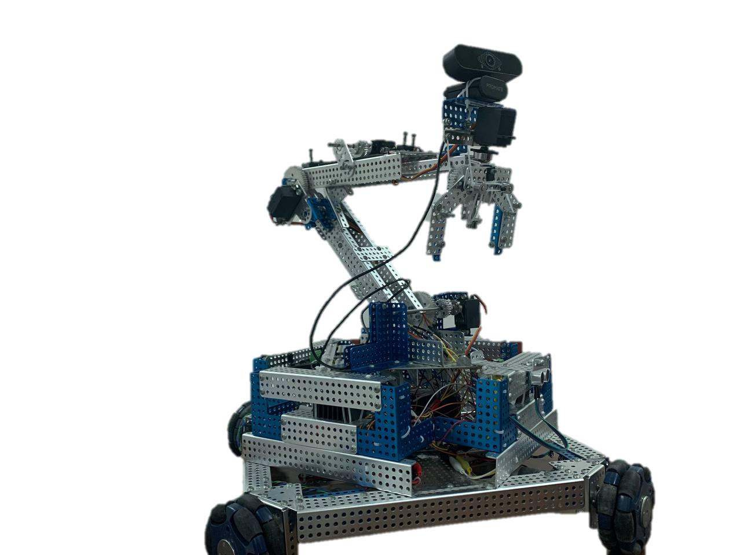
Mechanism design
Photo for the outer structure of the robot
13

Slide 14
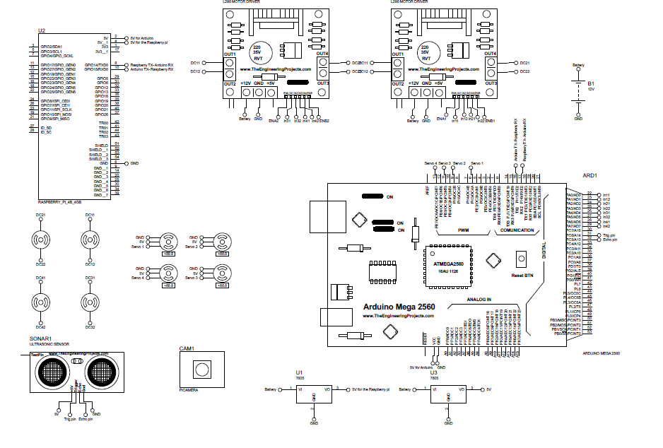
Electrical connections between boards are other parts
14

Slide 15
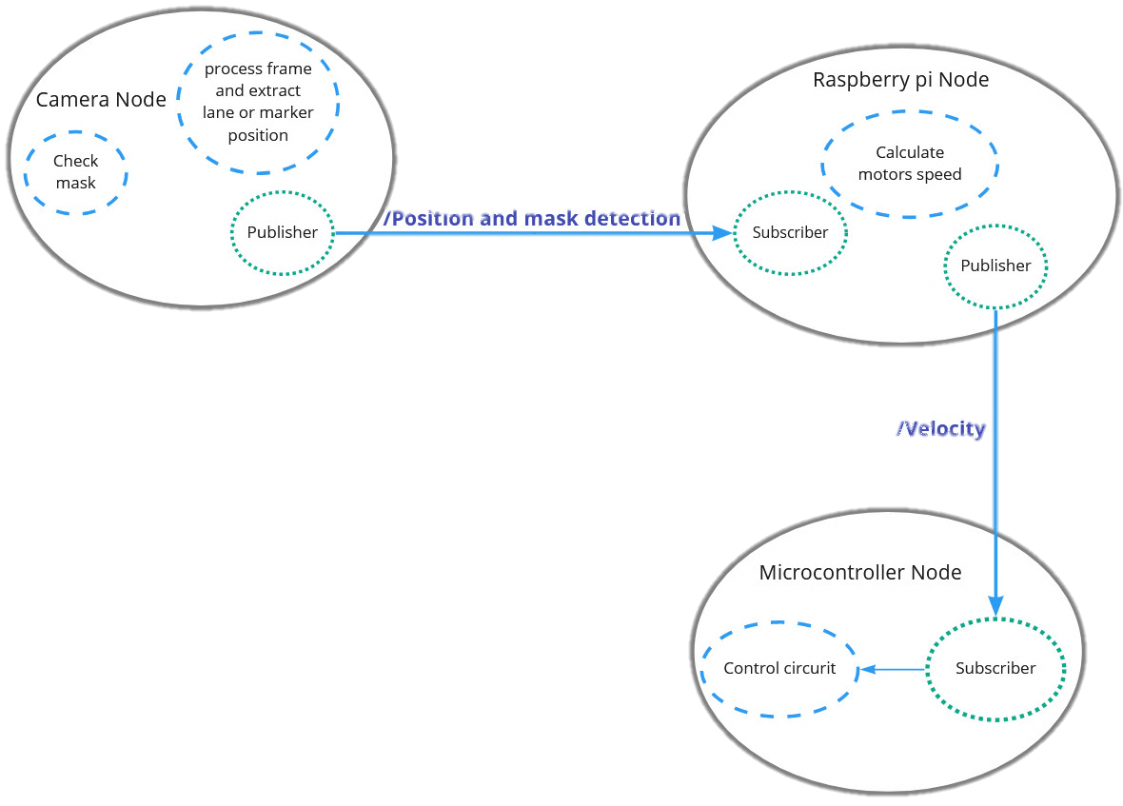
Software connecting between
the boards
15

Slide 16
Business Model Canvas for our project
Customer segments 1.Hospital owners 2.Medical Insurance Companies 3.Companies in the medical field | CUSTOMER REALTIONSHIP Representative from the company that keeps in touch with customers and asks for feedback | VALUE PROPOSTION 1.The Medical Industry 2,.Medical staff | KEY ACTIVITIES 1.Creation 2.Reporting 3.Promotion 4.Optimization | KEY PARTNERS Businesses that import class-one electronic and mechanical components.
 | CHANNELS 1.Word of mouth 2.YouTube 3.Facebook 4.Applying to contests and showrooms | KEY RESOURCES Robotics engineers
 |  | COST STRUCTURE 1.Staff Costs 2.Operating Expenses 3.Marketing Costs (Facebook and Instagram ADS).
REVENUR STREAMS 1.One time purchase of a product 2.Charge Maintenance Fees
16

Slide 17
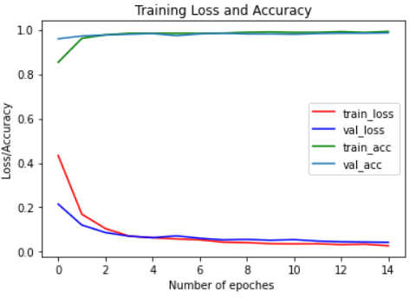
Results
1. Our AI model provides its efficiency in detecting masks, navigation and arm tasks In testing, the CNN model has around 98.58% accuracy
17

Slide 18
Results
2. The mechanism of the robots and the arm mounted on it was satisfying for the tasks mentioned and the navigate shows flexibility even if there are lot of human around.
3. The connection using ROS interrupts when the live video has large number of faces. So using pyserial to initiate the connection between Arduino and Raspberry Pi could be more efficient.
18

Slide 19
Conclusion
19

Slide 20
Future Works
1. Use other navigation teachings and algorithms like lane detection, GPS or SLAM technology.
2. Increase the number of robot tasks and add more robots to make a swarm of healthcare robots (maybe a robot for cleaning).
3. Use alternative energy source to charge the robots batteries like wind energy.
4. Increase the number of the train dataset that contains unique photos comparing to the dataset we used in trained our model.
20

Slide 21
References
 | [1] | "Detection of ArUco Markers," 29 Dec 2022. [Online]. Available: https://docs.opencv.org/4.x/d5/dae/tutorial_aruco_detection.html.
 | [2] | Robotics, Open, "ROS - Robot Operating System," 2021. [Online]. Available: https://www.ros.org/.
 | [3] |  | V. Bhateja, T. A. S. C. Satapathy and M. N. Favorskaya, Smart Intelligent Computing and Applications, Volume 2: Proceedings of Fifth International Conference on Smart Computing and Informatics (SCI 2021), Singapore: Springer Nature Singapore, 2022. https://www.researchgate.net/publication/354009690_Healthcare_Robotics_Key_Factors_that_Impact_Robot_Adoption_in_Healthcare.
 | [4] |  | S. Alla and P. Pazos, Healthcare Robotics: Key Factors that Impact Robot Adoption in Healthcare, Norfolk: ResearchGate, 2021. https://www.google.com/books/edition/Smart_Intelligent_Computing_and_Applicat/Y9xwEAAAQBAJ?hl=ar&gbpv=0.
21

Slide 22
THANKS FOR LISTENING!
22

