Slide 1
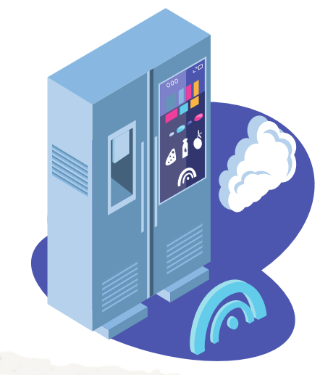
Team #34
ProdFrost
Upgrade your Home, Invest in Your Life.

Slide 2




Situational Overview
Current Situation
The Big Question:
Customers are upgrading from outdated home appliances.
How can
create a flawless launch strategy for their innovative smart fridge?
ProdFrost
Customers want to save money
& be environmentally friendly.
Gen Z and Millennials enjoy
shopping digitally.
Overview
Strategy
Life-Cycle
Risks
Q&A

Slide 3
Pain Points
1
Costs
Users may be deterred by the initial investment required to acquire ProdFrost, potentially hindering adoption among cost-sensitive consumers.
Privacy
2
Concerns regarding the privacy of personal data, especially with features like Automatic Ingredient Reordering, may create apprehension among users.
3
Resistance to Change
User apprehension about data security, particularly with Automatic Ingredient Reordering, poses a potential barrier to full engagement with ProdFrost.
Overview
Strategy
Life-Cycle
Risks
Q&A

Slide 4


How We Capture the Target Market
58% of all food produced in Canada goes to waste.
It's estimated that avoidable food waste costs the average Canadian household over $1,300 per year.
The prevalence of unhealthy eating is notably high, reaching 56.4% among youth, and 63.6% in adults.
The ProdFrost Smart Fridge seeks to reduce food waste, save precious time, and provide realistic healthy recipes.
Busy Bob is always short on time and commutes to UW. His mom Healthy Holly wants to work healthier recipes into their lifestyle, while also reducing food waste.
App Features:
Automatic Ingredient Reordering
Recipe Search Based On Ingredients
Weekly Nutrition Reports Based on Consumption
Overview
Strategy
Life-Cycle
Risks
Q&A

Slide 5


Partnership Opportunities
Fresh food delivery.
Access to large network of grocery stores.
Reaches a larger audience with current customer base.
Delivery of longer lasting products or kitchen equipment.
Integrated reoccurring deliveries for discounts.
Overview
Strategy
Life-Cycle
Risks
Q&A

Slide 6



Marketing Campaign
SEO
Partners
Social Media
Search engine optimization will ensure ProdFrost is seen by customers.
Marketing can be employed through our partners' existing marketing streams.
Reaching a larger audience by consistently posting engaging content.
$120
Overview
Strategy
Life-Cycle
Risks
Q&A
Notes:
make green and add a circle thing
Next payment is due
How much money you have left

Slide 7
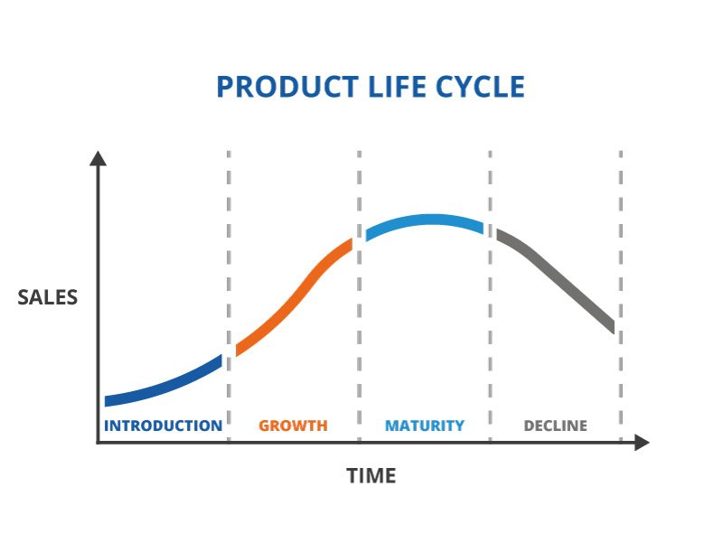
Product Life Cycle
ProdFrost
Overview
Strategy
Life-Cycle
Risks
Q&A

Slide 8
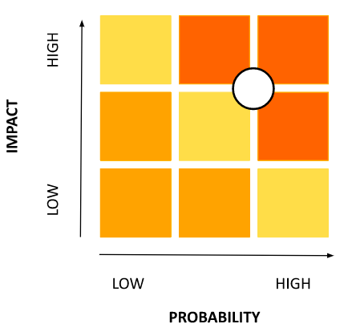
Prevalent Risks
R I S K
Initial Cost (40% more than standard).
M I T I G A T I O N
Monetization strategy with sponsored posts within the app to offset any upfront expenses.
C O N T I N G E N C Y
Implement an extended 3-year warranty program.
Overview
Strategy
Life-Cycle
Risks
Q&A
Notes:
1. Risk of users not paying the subscription/loan - users attempt to take advantage of the no interest loan]
Mitigation:
First missed payment (monthly): The user's account is frozen, they are notified they must pay within the next month. This will impact the credit score.
Second missed payment: the users assets are liquidated. User is notified about the conditions if payments are not paid and continue to be missed. Impacted Credit score.
Contingency: WS condition: After the fourth missed payments, WS can now charge interest on the previous missed payments and payments moving forward. If there were any capital gains, it would be used to cover the missed payments. Continuation of decreasing credit history (score)

Slide 9
Prevalent Risks
R I S K
Privacy
M I T I G A T I O N
Communicate robust privacy measures clearly, conduct third-party audits, and empower users with data control.
C O N T I N G E N C Y
Establish a dedicated support channel for privacy concerns and a crisis communication plan for unforeseen incidents.
Overview
Strategy
Life-Cycle
Risks
Q&A
Notes:
1. Risk of users not paying the subscription/loan - users attempt to take advantage of the no interest loan]
Mitigation:
First missed payment (monthly): The user's account is frozen, they are notified they must pay within the next month. This will impact the credit score.
Second missed payment: the users assets are liquidated. User is notified about the conditions if payments are not paid and continue to be missed. Impacted Credit score.
Contingency: WS condition: After the fourth missed payments, WS can now charge interest on the previous missed payments and payments moving forward. If there were any capital gains, it would be used to cover the missed payments. Continuation of decreasing credit history (score)

Slide 10
Prevalent Risks
R I S K
Resistance To Change
M I T I G A T I O N
Extensive user education campaigns highlighting the user-friendly nature of ProdFrost, emphasizing its seamless integration.
C O N T I N G E N C Y
Continuous user support, including tutorials and responsive customer service.
Overview
Strategy
Life-Cycle
Risks
Q&A
Notes:
1. Risk of users not paying the subscription/loan - users attempt to take advantage of the no interest loan]
Mitigation:
First missed payment (monthly): The user's account is frozen, they are notified they must pay within the next month. This will impact the credit score.
Second missed payment: the users assets are liquidated. User is notified about the conditions if payments are not paid and continue to be missed. Impacted Credit score.
Contingency: WS condition: After the fourth missed payments, WS can now charge interest on the previous missed payments and payments moving forward. If there were any capital gains, it would be used to cover the missed payments. Continuation of decreasing credit history (score)

Slide 11

Conclusion
ProdFrost Innovation:
User-friendly design.
Cutting-edge features
Market Alignment:
Addresses key pain points, strategically aligning with market demands.
Comprehensive Solution:
Transforms kitchens with efficiency, convenience, and a touch of the future.
Overview
Strategy
Life-Cycle
Risks
Q&A

Slide 12
Q&A
Overview
Strategy
Life-Cycle
Risks
Q&A

