Slide 1
Olymic Games
Model for data analysis

Slide 2
INTRODUCTION:
Focus: This presentation examines historical trends in the Olympic Games, offering insights into the evolution of this global sporting event.
Dataset: we explore data across different years, Olympic editions, participating nations, and medal distributions.
Aim: Our objective is to identify patterns and insights that reveal changes in participation, performance, and the overall dynamics of the Olympics.
Importance: The analysis provides a unique lens to view the progression of international sportsmanship, reflecting the changing landscape of global athletic competition.

Slide 3
Dataset Description
Number of Rows: 1781
Number of Columns: 11
Column Names:
year: The year of the Olympic Games
games_type: Type of the Games (Winter or Summer)
host_country: Country where the Games were held
host_city: City where the Games were held
athletes: Number of athletes participating
teams: Number of teams participating
competitions: Number of competitions held
country: Participating country
gold: Number of gold medals won
silver: Number of silver medals won
bronze: Number of bronze medals won

Slide 4
continue
The dataset contains historical data from the Olympic Games, covering various aspects of the games
It includes data on the year, type (Winter/Summer), host details (country and city), and the number of athletes and teams participating.
The dataset also provides information on the number of competitions and medal tallies (gold, silver, bronze) for each participating country.
Total Records: 1781, spanning across multiple Olympic events and years.

Slide 5
Methodology
Data Preprocessing:
Handling missing values and outliers to clean and standardize the dataset.
Feature Engineering to enhance model performance by creating new relevant features from existing data
Plot : histograms, boxplots, and scatter plots

Slide 6
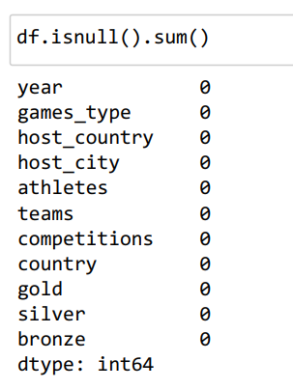
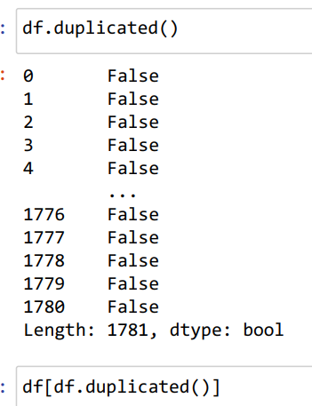
Handle missing values

Slide 7
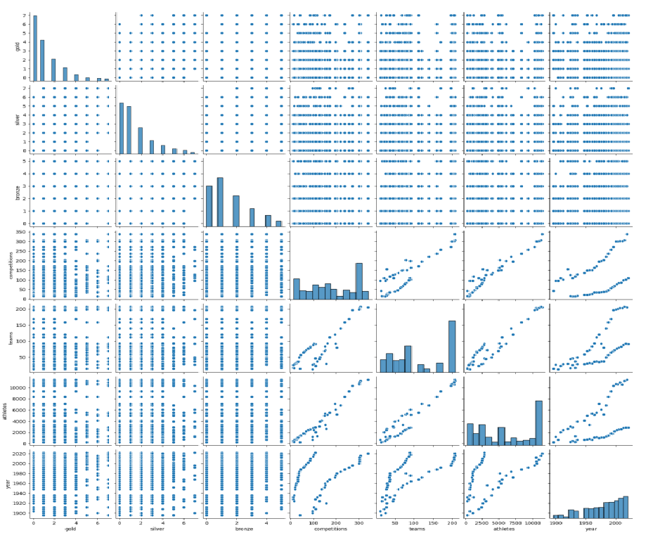
Pair plot

Slide 8
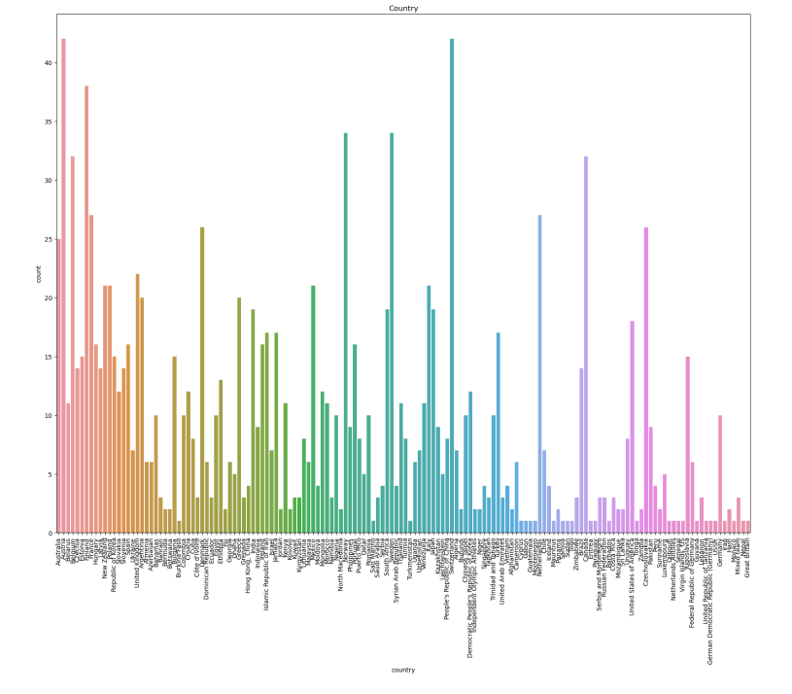
Scatter plot

Slide 9
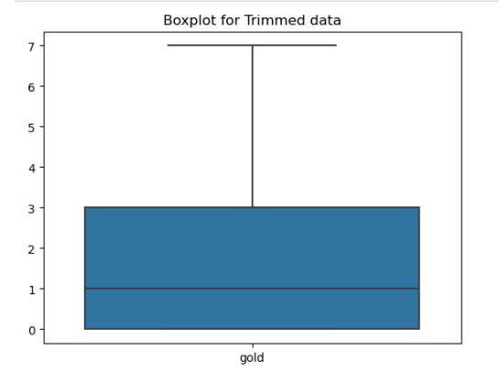
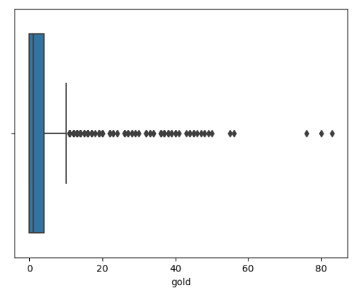
Exploratory Data Analysis (EDA):
Purpose:Utilizing descriptive statistics to summarize data characteristics.Employing visual tools like plots and charts for identifying trends, patterns, and outliers.

Slide 10
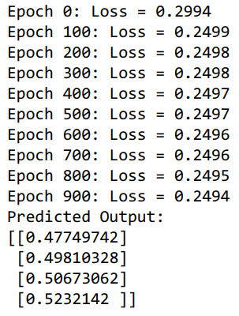
Model Selection and Training:
Choosing suitable machine learning algorithms based on the problem type (classification, regression)
Training the models with a part of the dataset to learn patterns and relationships.
Model Evaluation:

Slide 11
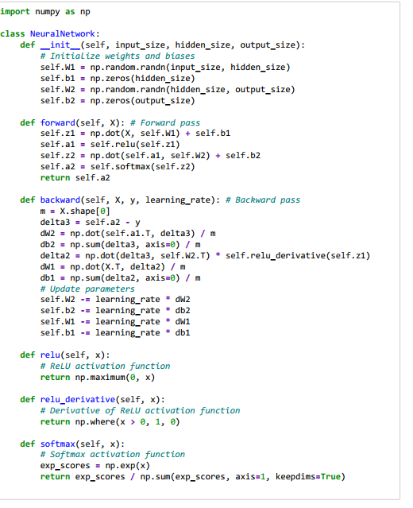
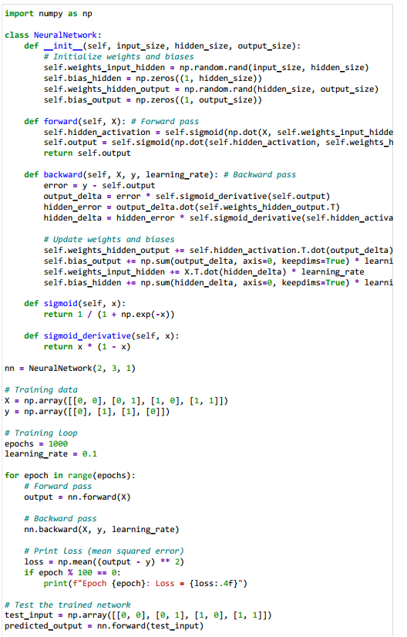

Slide 12
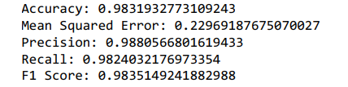
Model Evaluation:
Applying metrics like accuracy, precision, recall, and F1-score for performance assessment.
Using a Confusion Matrix to evaluate classification accuracy and identify prediction errors.

Slide 13
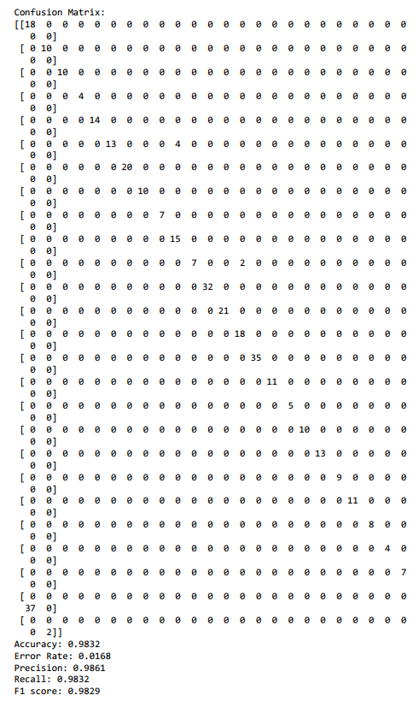
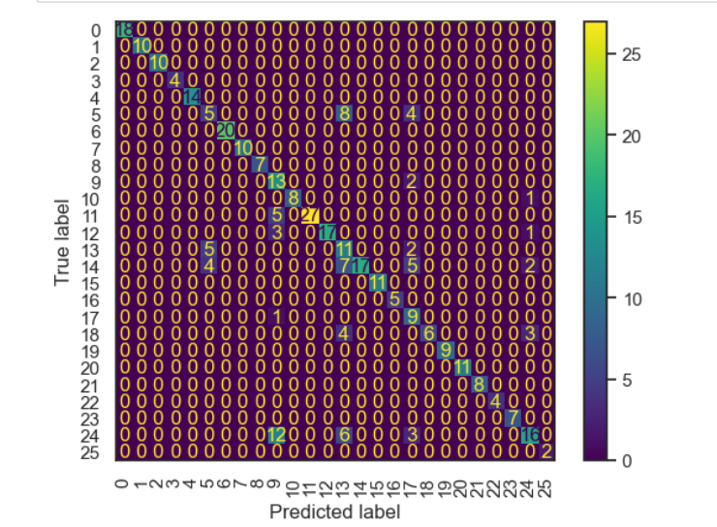
Confusion matrix

Slide 14
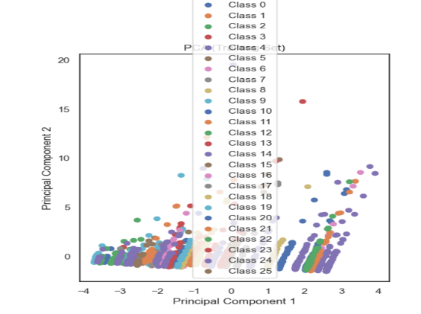
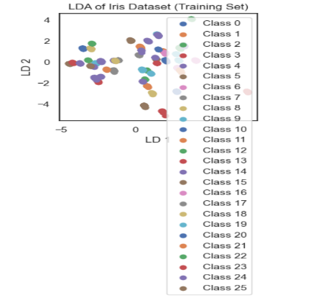
Feature reduction:

Slide 15
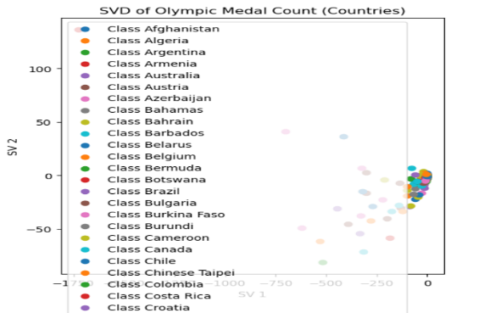
SVD

Slide 16
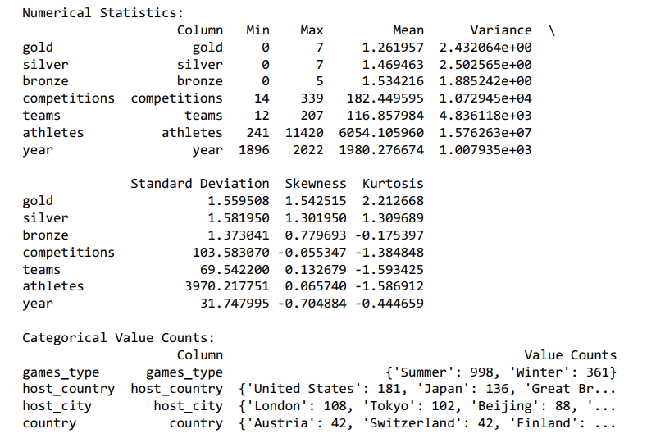
Data Analysis:
Statistical Measures: Computed minimum, maximum, mean, variance, standard deviation, skewness, and kurtosis to understand the central tendency and dispersion of the data.

Slide 17
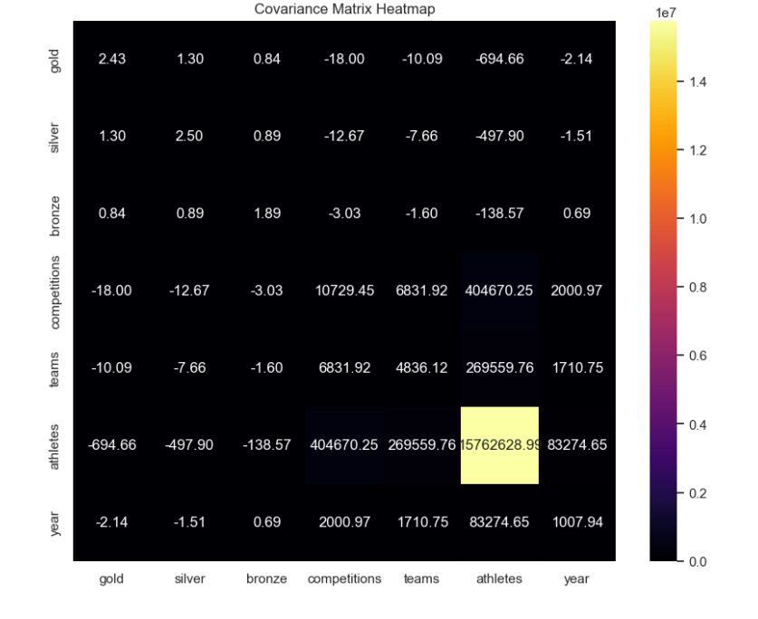
Covariance matrix
Covariance and Correlation Analysis: Examined relationships between variables, likely visualized through a heatmap.

Slide 18
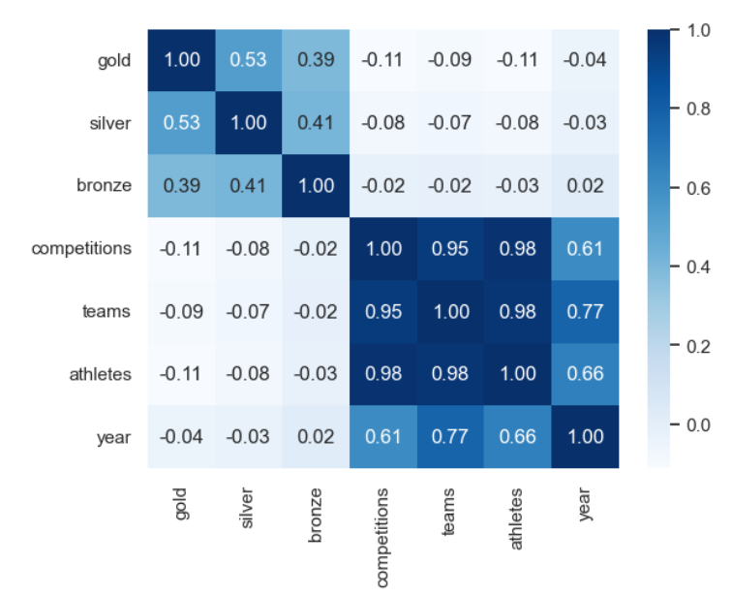
Correlation matrix

Slide 19

Evaluation Metrics:
Dataset Splitting: Data divided into 80% training and 20% testing sets.
K-fold Cross-validation: Employed to validate the performance of the models, with the average accuracy reported for each fold.

Slide 20
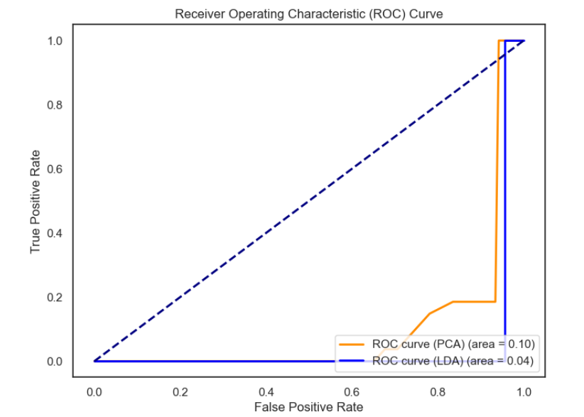
ROC

Slide 21
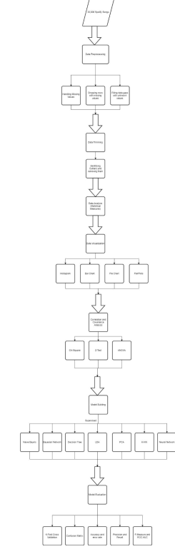
Drawing Model:

Slide 22

Overfitting Check:
A mechanism to detect potential overfitting or underfitting w as implemented by comparing training set accuracy with testing set accuracy.

Slide 23
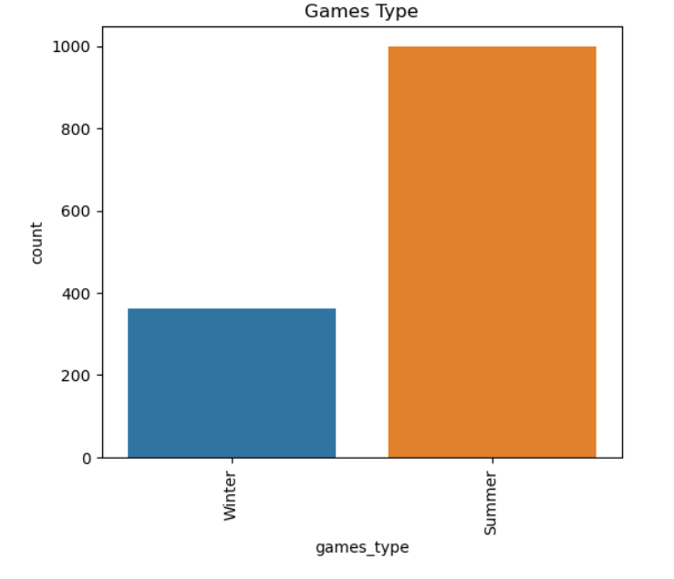
Data Visualization:

Slide 24
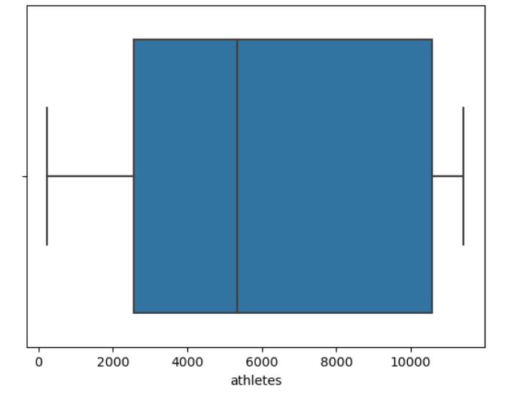
Data visualization:

Slide 25
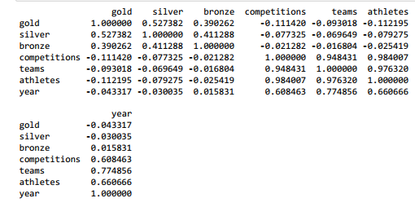
Results:
Correlation matrix:

Slide 26
Covariance matrix:

Slide 27
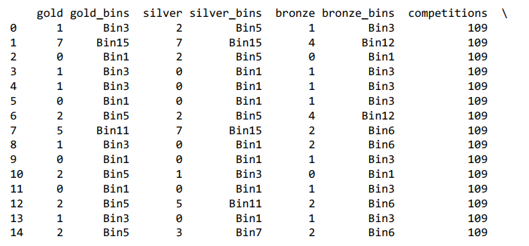
Binning:

Slide 28
Statistical analysis:

Slide 29
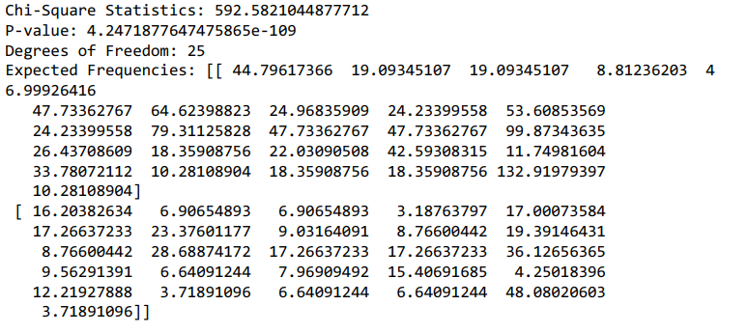
CHI SQUARE TEST

Slide 30
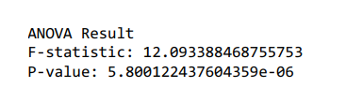

Z Test , ANOVA

Slide 31
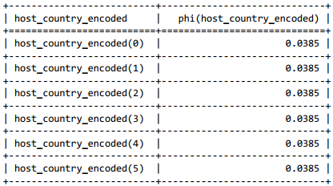
Bayesian belief network

Slide 32
Conclusion:
- Performance Trends: Certain countries consistently exhibited dominance in medal tallies, suggesting factors like economic status, investment in sports, and infrastructure play significant roles.
- Impact of Hosting: The 'host country advantage' was noticeable, with host nations generally performing better in the years they hosted the Games.
- Evolution of the Olympics: A steady increase in athlete participation and the number of competitions over the years highlighted the growing inclusivity and global reach of the Olympics.
- Comparative Analysis: Different methodologies, from statistical tests to machine learning models, were employed, each providing unique perspectives on the dataset.
These findings not only enhance our understanding of the dynamics of the Olympic Games but also provide a foundation for further research in sports analytics and policy-making.

Slide 33
References:
Klausen, A. M. (Ed.). (1999). Olympic games as performance and public event: The case of the XVII Winter Olympic games in Norway (Vol. 94). Berghahn Books.
Foster, L., James, D., & Haake, S. (2011, June). The influence of the Olympic Games on athletic performance. In Proceedings of the 3rd International conference on Mathematics in Sport (pp. 37-43).
Shibli, S., & Bingham, J. (2013). A forecast of the performance of China in the Beijing Olympic Games 2008 and the underlying performance management issues. In Performance Measurement and Leisure Management (pp. 138-158). Routledge.
Noland, M., & Stahler, K. (2016). What goes into a medal: Women's inclusion and success at the Olympic Games. Social Science Quarterly, 97(2), 177-196.
Andreff, W. (2013). Economic development as major determinant of Olympic medal wins: predicting performances of Russian and Chinese teams at Sochi Games. International Journal of Economic Policy in Emerging Economies, 6(4), 314-340.

