Slide 1

Walmart Sales Analysis Dashboard
Data Analysis & Business Insights — Powered by Power BI
PREPARED BY: KEROLOUS · VERINA · ZEINAB

Slide 2
Agenda
A structured walkthrough from raw data to actionable business recommendations.
01
02
Project Overview
Dataset Description
Goals, scope, and analytical approach
Variables, time span, and data structure
03
04
Data Cleaning
Dashboard Analysis
Quality checks and transformations applied
High-level KPIs and trend visualization
05
06
Store Analysis
External Factors
Performance comparison across 45 locations
Economic and environmental variable impact
07
08
Holiday Analysis
Key Insights & Recommendations
Seasonal uplift and key holiday periods
Findings and strategic action items

Slide 3

Project Overview
This project analyzes Walmart's weekly sales data across 45 stores to surface actionable insights for strategic decision-making.
Project Goal
Why Sales Analysis?
Uncover performance trends, seasonal patterns, and the impact of economic factors on weekly revenue across all store locations.
Understanding sales dynamics enables smarter inventory management, targeted promotions, and strategic resource allocation — turning raw data into competitive advantage.
Dashboard Value
Interactive Power BI dashboards provide real-time visibility, allowing decision-makers to drill into KPIs, compare stores, and respond proactively to market shifts.

Slide 4
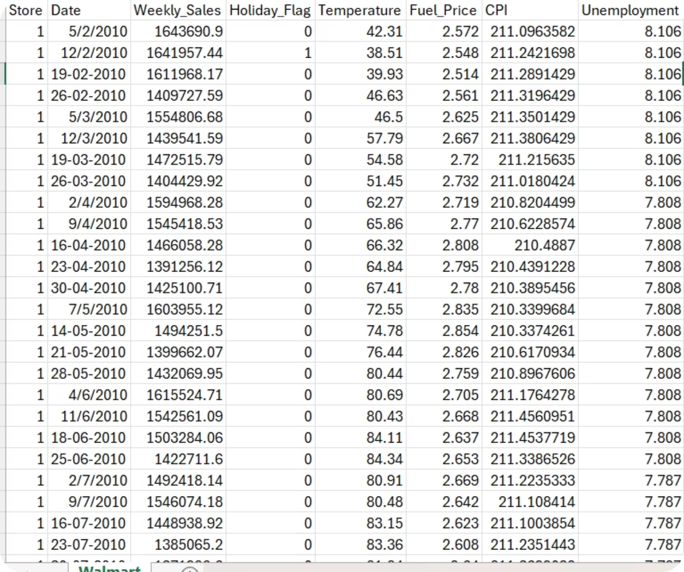
Dataset Description
The Walmart dataset contains historical weekly sales data for 45 stores across multiple departments, spanning 2010–2012. It includes economic and environmental variables to support deeper analysis.
Key Variables
Weekly Sales
Total revenue per week per store
Store
Store identifier (1–45)
Date
Week start date of sales period
Holiday Flag
Marks holiday weeks (0 or 1)
Temperature
Avg regional temperature (°F)
Fuel Price
Cost of fuel in the local region
CPI
Consumer Price Index — inflation indicator
Unemployment
Regional unemployment rate (%)

Slide 5






Data Cleaning Process
Five systematic steps were applied in Power Query Editor to ensure data integrity and analytical readiness.
Remove Duplicates
Check Missing Values
Convert Data Types
Create Date Columns
Ensure Consistency
All transformations were performed in Power Query. Date fields were converted to DateTime format, numeric fields (Sales, CPI, Fuel) were correctly typed, and Year/Month columns were extracted to enable time-based trend filtering. No significant null values were found across the dataset.

Slide 6
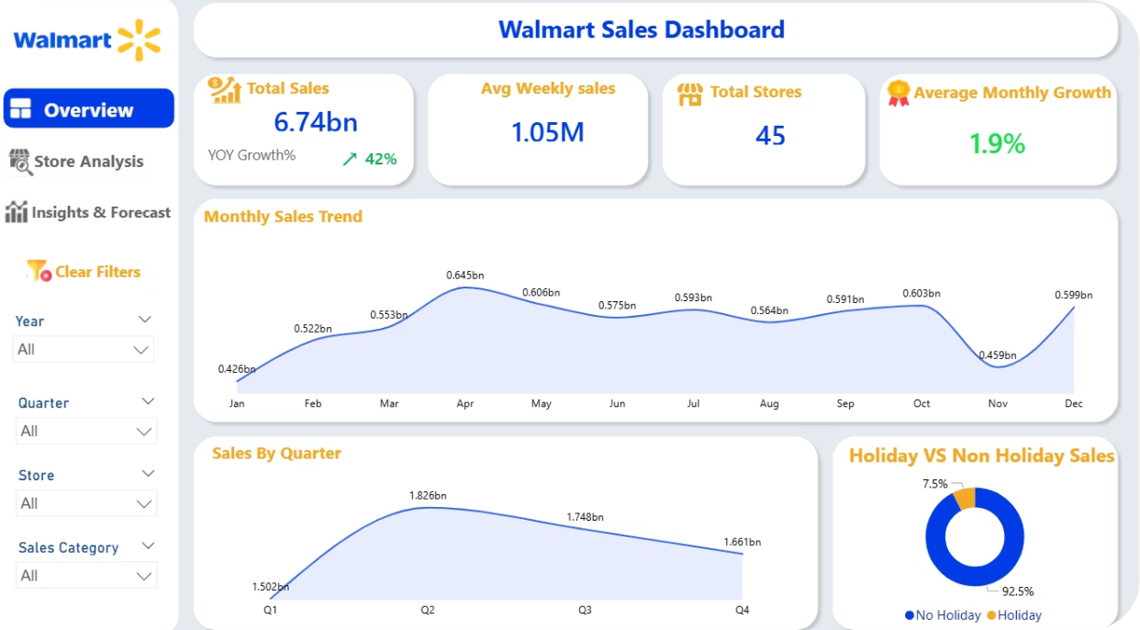
DASHBOARD OVERVIEW
$6.7B+
$1.05M
Total Sales
Avg Weekly Sales
45
+3.2%
Total Stores
Monthly Growth Rate
Dashboard Highlights
Monthly and yearly sales trend lines visualize growth patterns
Interactive slicers allow filtering by store, year, and holiday
Year-over-Year performance tracked across 2010–2012
Top-level KPI cards provide instant performance snapshot

Slide 7
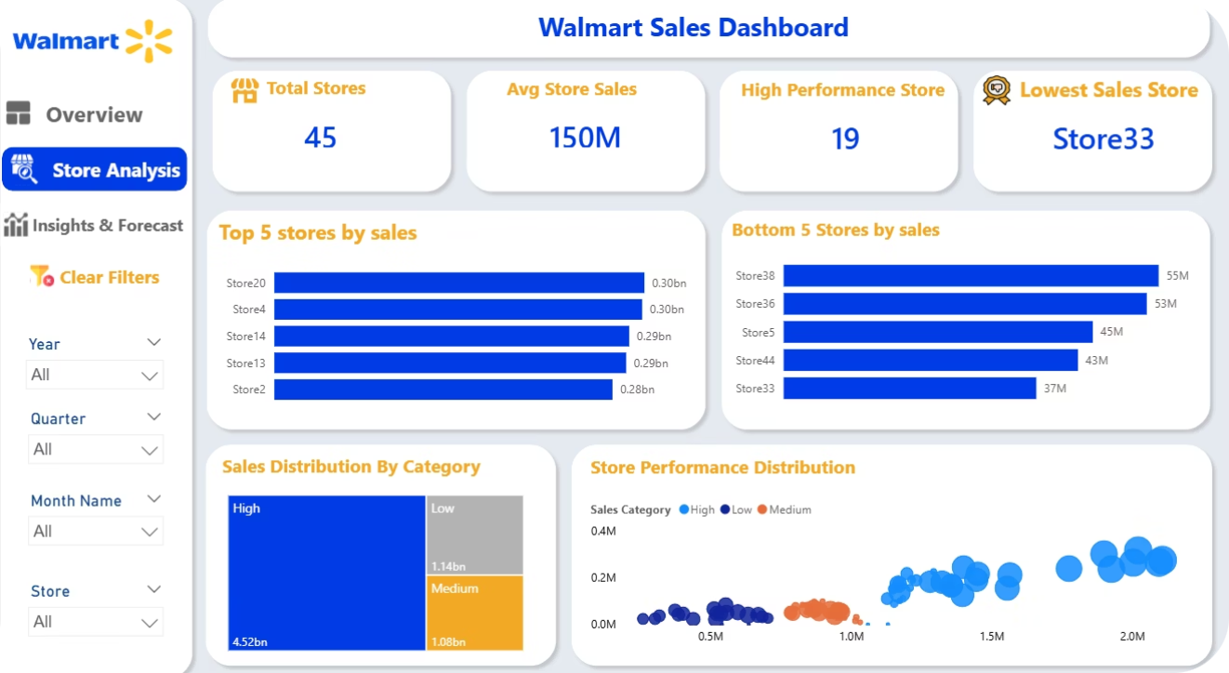
STORE ANALYSIS
Top Performer
Store 20 recorded the highest cumulative sales, consistently outperforming all other locations.
Total Stores
45 unique store locations were analyzed, ranging from small-format to large-format retail outlets.
Avg Sales/Store
Average weekly sales per store showed significant variance, indicating disparity in store performance.
Lowest Stores
Several stores consistently ranked in the bottom tier, presenting clear improvement opportunities.

Slide 8


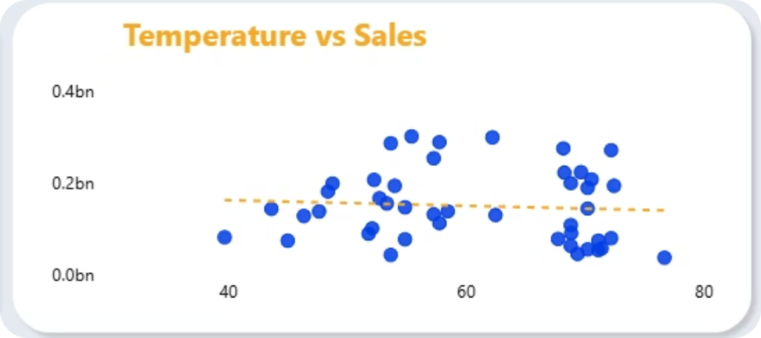
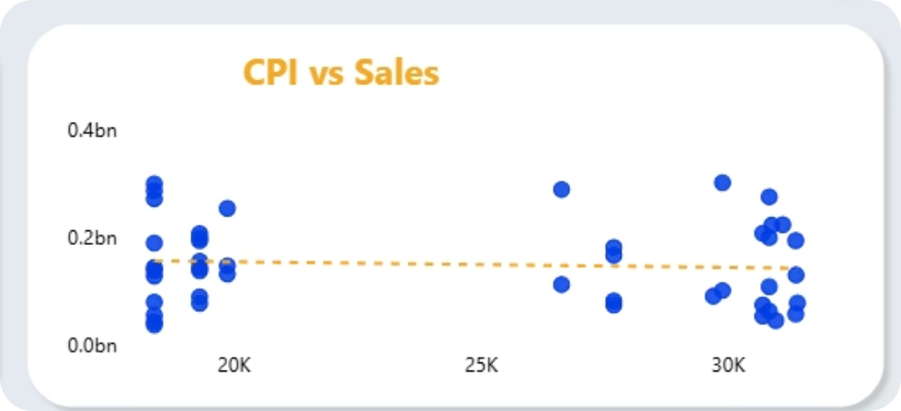


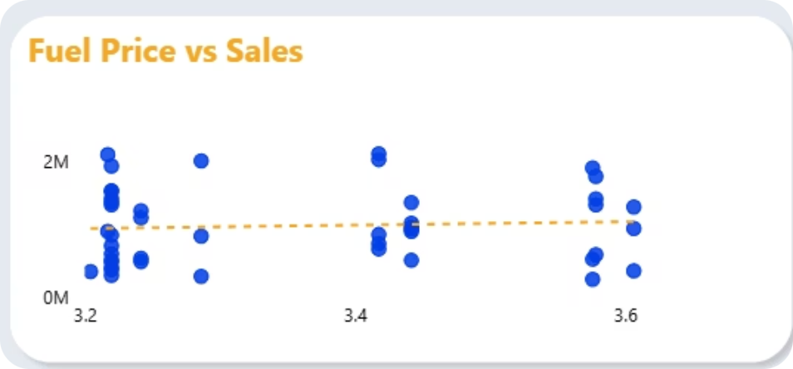
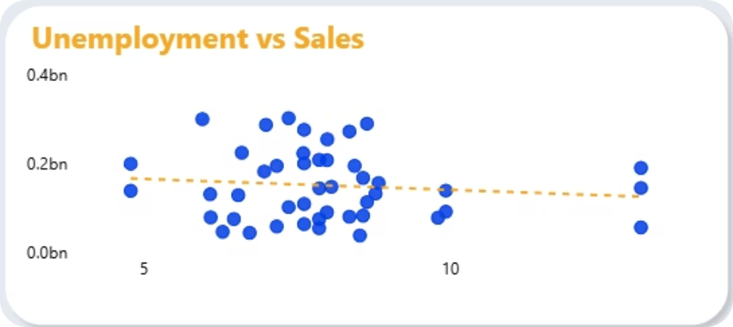
EXTERNAL FACTORS ANALYSIS
Economic & Environmental Variables vs. Weekly Sales
Temperature
CPI
WEAK NEGATIVE
MODERATE
Slight sales decline in extreme heat/cold periods; minimal overall impact on revenue.
Consumer Price Index shows a moderate relationship — inflation influences purchasing behavior.
Fuel Price
Unemployment
WEAK NEGATIVE
WEAK NEGATIVE
Higher fuel prices marginally reduce consumer spending; correlation is not statistically strong.
Higher unemployment associates with slightly lower sales; customers adjust discretionary spending.

Slide 9
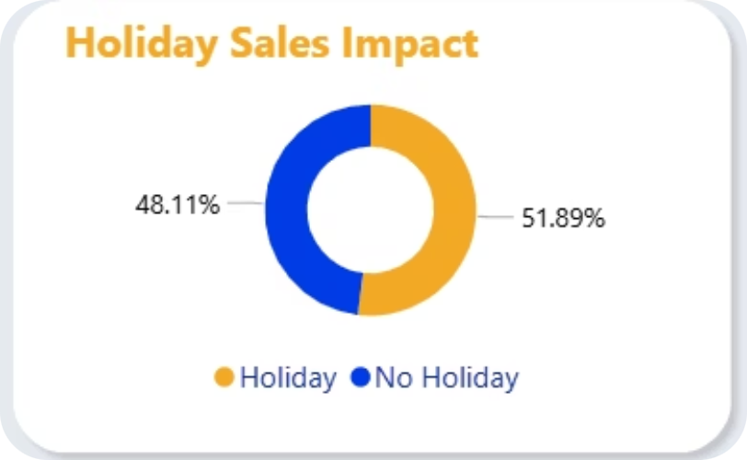
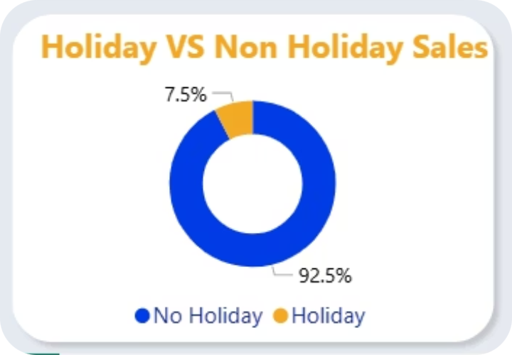
HOLIDAY SALES ANALYSIS
~7%
4
2 Yrs
Avg Sales Uplift
During Holidays
Major Holiday
Periods Analyzed
Historical Data
Covered
Key Findings
Holiday weeks show a measurable but moderate sales increase compared to regular weeks
Super Bowl, Labour Day, Thanksgiving, and Christmas are the four tracked holiday periods
Sales peak most significantly around Thanksgiving and Christmas seasons
Non-holiday weeks make up the majority of annual revenue volume
Stores vary in their response to holiday demand — urban stores see larger spikes

Slide 10
KEY INSIGHTS
01
04
Top-Performing Store
Store Performance Gap
Store 20 achieved the highest total sales, far surpassing average store performance over the analysis period.
Significant performance disparities exist between top and bottom-tier stores, signaling operational inefficiencies.
02
05
Holiday Impact
Stable Growth Trend
Holiday weeks generated a moderate uplift in sales (~7%), confirming seasonal demand spikes around key holidays.
Overall Walmart sales showed consistent growth from 2010–2012, with a positive year-over-year trajectory.
03
06
External Factor Influence
Unemployment Correlation
Temperature, fuel price, and unemployment showed weak-to-moderate correlations with sales, not strong predictors.
Unemployment Index showed the strongest external correlation with sales.

Slide 11




RECOMMENDATIONS
Improve Low-Performing Stores
Maximize Holiday Promotions
HIGH
HIGH
Conduct targeted operational audits for bottom-tier stores. Invest in staff training, layout optimization, and localized marketing strategies.
Increase promotional budgets during Super Bowl, Thanksgiving, and Christmas. Deploy targeted campaigns to capitalize on elevated consumer intent.
Track Demand Trends
Monitor Economic Indicators
MEDIUM
MEDIUM
Implement continuous monitoring of weekly sales KPIs. Use forecasting models to anticipate demand fluctuations and optimize inventory.
Regularly track CPI and unemployment trends at a regional level to adjust pricing strategies and promotional planning proactively.

Slide 12
CONCLUSION
Power of Data Analysis
Power BI as a Business Tool
Value of Dashboard Reporting
This project demonstrates how structured data analysis transforms raw transactional records into actionable business intelligence, enabling evidence-based decision-making at scale.
Power BI's interactive dashboards provided a dynamic, accessible platform for exploring Walmart's sales data — empowering stakeholders to filter, compare, and derive insights without technical expertise.
Centralizing KPIs in a single dashboard ensures consistent reporting, reduces analytical silos, and accelerates strategic response to market changes across the entire store network.

Slide 13

THANK YOU
Questions?
Feel free to reach out or discuss any aspect of this analysis.
Data Analysis Graduate Project
Tools: Power BI | Power Query | Excel

