Slide 1
Smile Eyes x STAAR Surgical: Partnering for Research Excellence
Presented by:
Dr. Martin Bechmann
Dr. Martin Heese
Aziza Guellouz, M.Sc

Slide 2
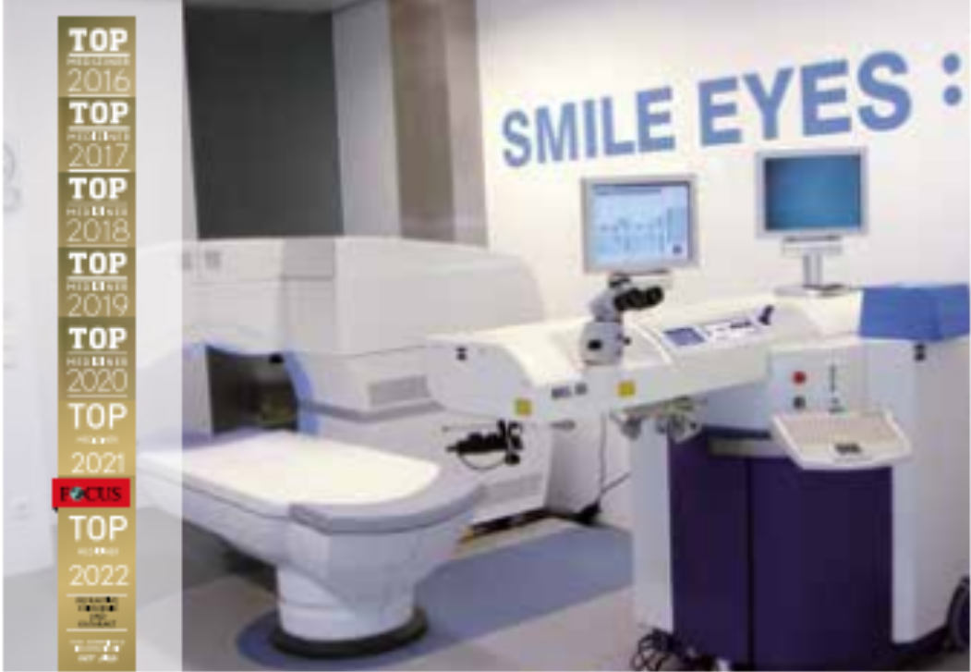
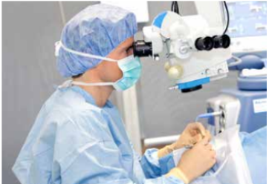
Smile Eyes at a Glance
A Leader in Refractive Surgery in Germany and Austria
Comprehensive eye care expertise
Full range of refractive procedures:
  Laser-based: SMILE, Femto-LASIK, LASEK/PRK/Trans-PRK
  Lens-based: ICL, CLE, Multifocal lenses
Eye health is at the heart of our work
20+ locations
in Germany and Austria
20+ years
of expertise in refractive surgery.
30,000+ operated
refractive procedures
150+ Research Projects
15 Years of Experience with EVO ICL
1,500+ EVO ICL Procedures in 2023

Slide 3
Focused Collaboration
Research as the Cornerstone of Partnership
Objective: Produce high-quality medical publications on EVO ICL performance.
Scope:
  Long-term safety and efficacy studies.
  Comparative analyses with other refractive solutions.
  Insights into demographic-specific outcomes.
Outcome: Establish EVO ICL as the premier refractive surgery option globally.

Slide 4
Our Opportunity
Your Partner in Research Excellence
Expertise: 150+ research projects with proven impact.
Leadership in EVO ICL implementation and patient outcomes.
Access to a diverse patient database and state-of-the-art facilities.

Slide 5
What we offer
Marketing/Consumer awareness

