Slide 1

Fuel Subsidy
IMF Flickr

Slide 2
Lecture outline
  Fuel Subsidy Toolkit
Notes:
In this lecture, we will:
Discuss the different dimensions of gender inequality.
Analyze key trends across countries and over time in gender inequality, incl. the impact of COVID-19.

Slide 3
Fuel Subsidy Tool
A model developed by Stefania Fabrizio and Roland Kpodar extended to include gender
Analyses how fuel price changes within a country affect consumers depending on:
  Income
  Location (rural/urban)
  Gender
The tool provides two levels of analysis:
      Direct Impact: how does a change in the fuel price directly affect consumers?
        Expenditure on fuel varies by consumer so price changes will affect consumers from different income groups, location, and genders differently
        A household expenditure/consumption survey is essential for this analysis.
      Indirect Impact: how does a change in the fuel price indirectly affect consumers?
        Fuel products serve as intermediate inputs – changes in fuel prices impacts the price of other goods. Households will be affected differently based on their expenditure patterns
        A household expenditure/consumption survey and an input-output table is required.

Slide 4
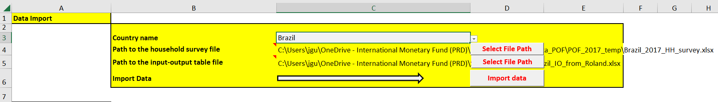
Fuel Subsidy Tool
Step 1a: select country name
Step 1b: fill in data path
Step 1c: click “import data”

Slide 5
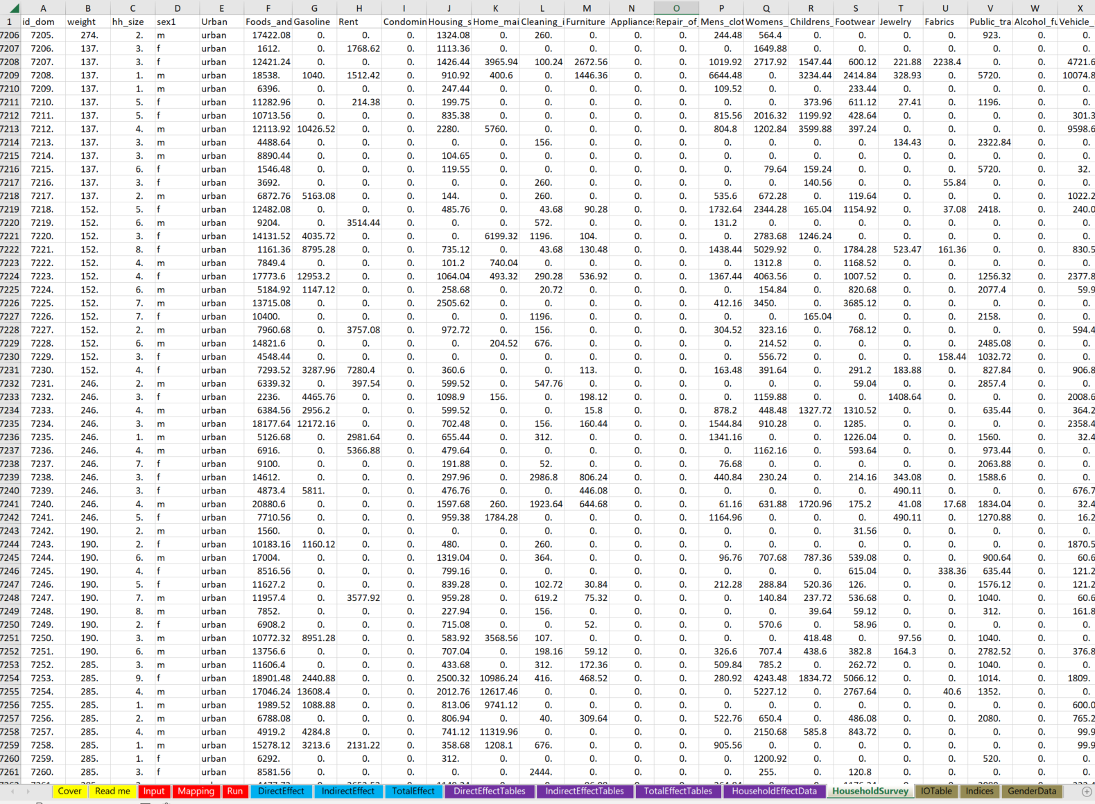
Fuel Subsidy Tool
Household survey data will be imported to the “Household Survey” tab:

Slide 6
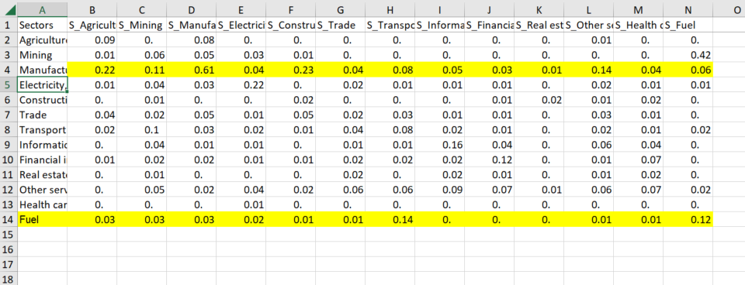
Fuel Subsidy Tool
Import Output Table:

Slide 7
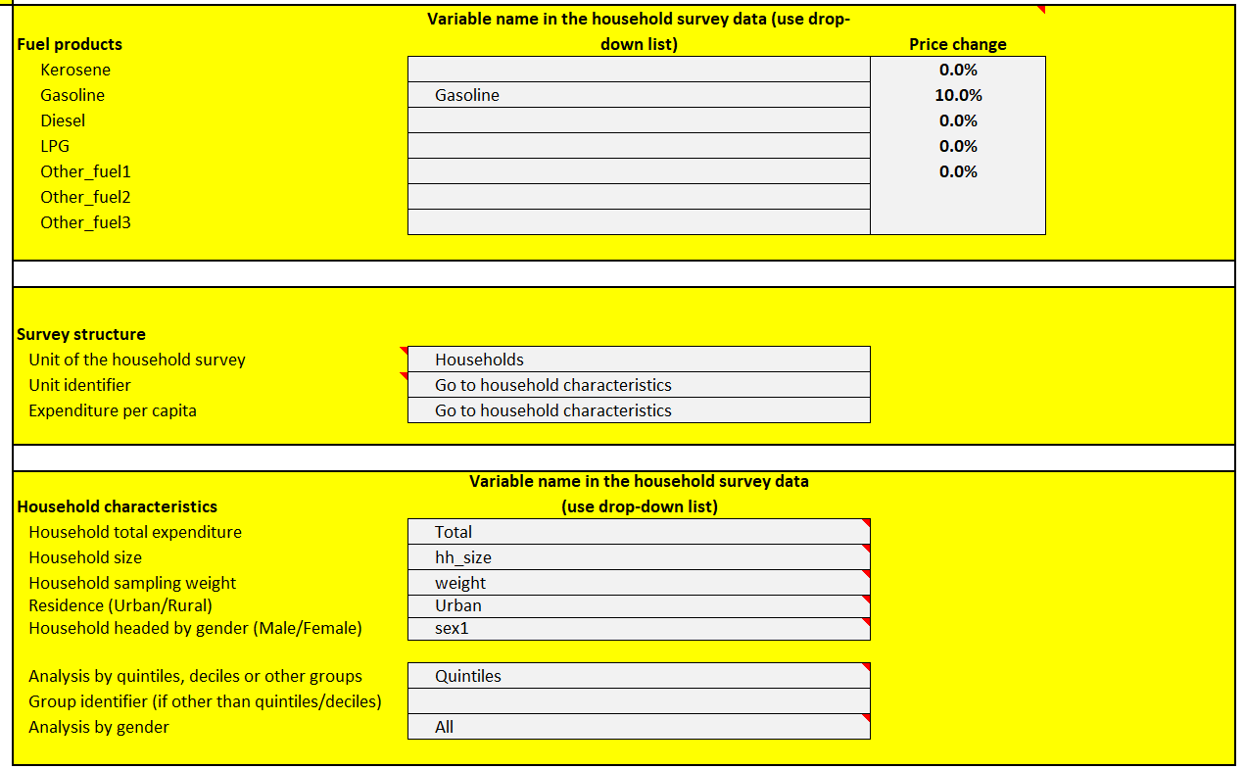
Fuel Subsidy Tool
Step 2a: Determine fuel sector and price change

Slide 8
Fuel Subsidy Tool
Step 2b: unit of observation

Slide 9
Fuel Subsidy Tool
Step 2c: identify variables that contain info in household characteristics

Slide 10
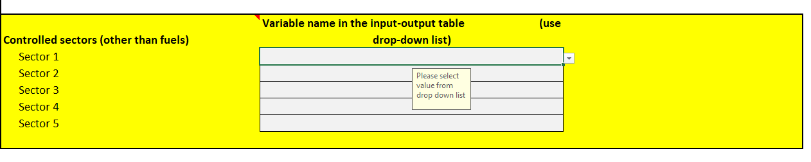
Fuel Subsidy Tool
If want to keep price of certain sectors constant

Slide 11
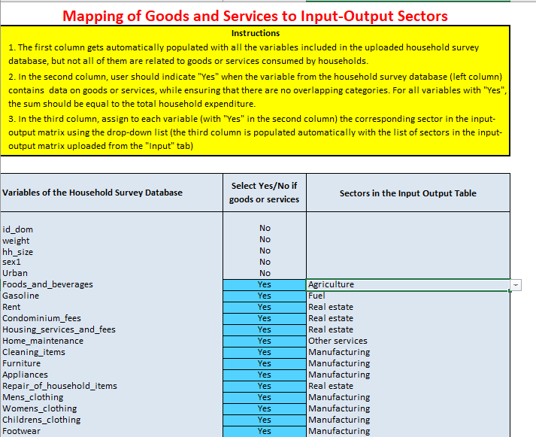
Fuel Subsidy Tool
Step 3: Mapping

Slide 12
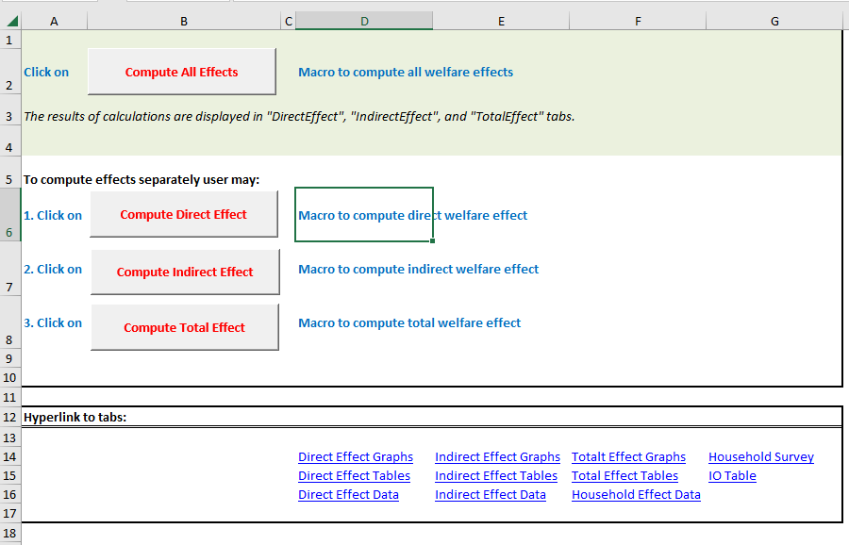
Fuel Subsidy Tool
Step 4: Run!

Slide 13
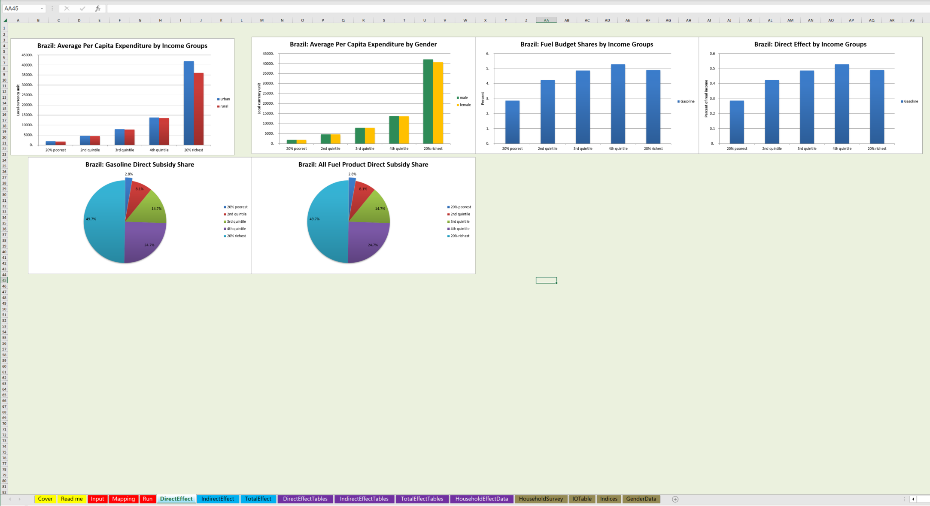
Fuel Subsidy Tool
Results: Direct effect

Slide 14
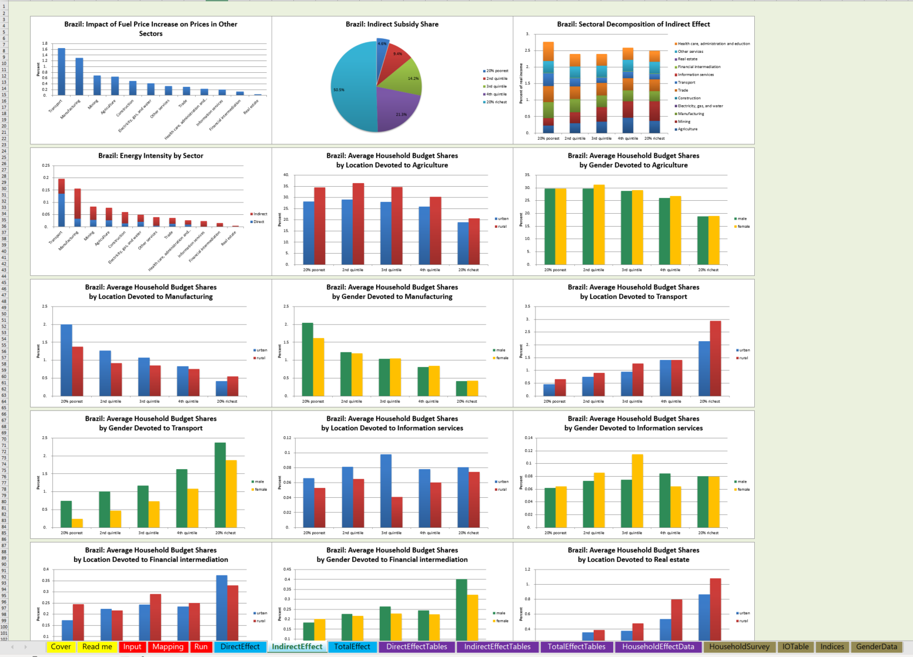
Fuel Subsidy Tool
Results: Indirect effect

Slide 15
Fuel Subsidy Tool
Results: Total effect

Slide 18
Homework
Identify if your country has available consumption expenditure survey (would love to hear from you on this!)
Identify if your country has input-output table available (would love to hear from you on this!)
Apply this tool if they are available
Play around with the toolkit with the already loaded data.
Understand the direct and indirect effects
Understand the graphs and tables
Policy implications?

