Slide 1
The file’s structure dominates its label associations
22,457 rows, 17 columns; source is undocumented.
After removing the ordered block, smoking OR is 1.00.
Interpretation: integrity audit and descriptive analysis only.
Research prototype - not a diagnostic tool 1 / 18
Notes:
Open with the single takeaway. This is a review of one supplied file, not a population study. State that no model was fitted and that the checksum mismatch is explicitly handled.

Slide 2
A smoking checkbox cannot reproduce screening history
USPSTF 2021 [1] uses ages 50–80.
It also requires at least 20 pack-years and a quit-time criterion of 15 years.
This file has no dose, duration, or quit-time fields; no eligibility inference is possible.
Research prototype - not a diagnostic tool 2 / 18
Notes:
Explain the reference criteria and immediately contrast them with the available fields. This is context for limitations, not an assessment of any person.

Slide 3
The objective is to test whether findings survive integrity checks
RQ1: characterize ordering, duplicates, and conflicting records.
RQ2–RQ3: quantify associations and their sensitivity to cleaning.
RQ4–RQ5: describe representativeness limits and justify candidate features.
Success means reproducible checks, transparent uncertainty, and traceable claims—not model accuracy.
Research prototype - not a diagnostic tool 3 / 18
Notes:
State that the project is descriptive and integrity-focused. The five research questions are fully listed in the report; summarize the paired questions here rather than reading them verbatim.

Slide 4
The checksum does not match the project contract
Observed: 22,457 × 17; 0 null cells.
Expected SHA-256 prefix: 4ad2333067fcb0a9.
Observed prefix: 1e0d557990cd7533.
Recorded-label code 1 share: 82.1%; not population prevalence.
Research prototype - not a diagnostic tool 4 / 18
Notes:
Describe the mismatch plainly. The user approved continuing with this current snapshot under an explicit override; the expected checksum was not changed.

Slide 5
Several meanings needed for interpretation are unknown
Dataset source, sampling frame, collection process, and licence: unknown.
Meaning and generation of the recorded label: unknown.
GENDER code mapping: unknown.
The project README only supplied a title; redistribution needs a licence check.
Research prototype - not a diagnostic tool 5 / 18
Notes:
Do not speculate about where the file came from or what the label means. Point to the data card and open questions.

Slide 6
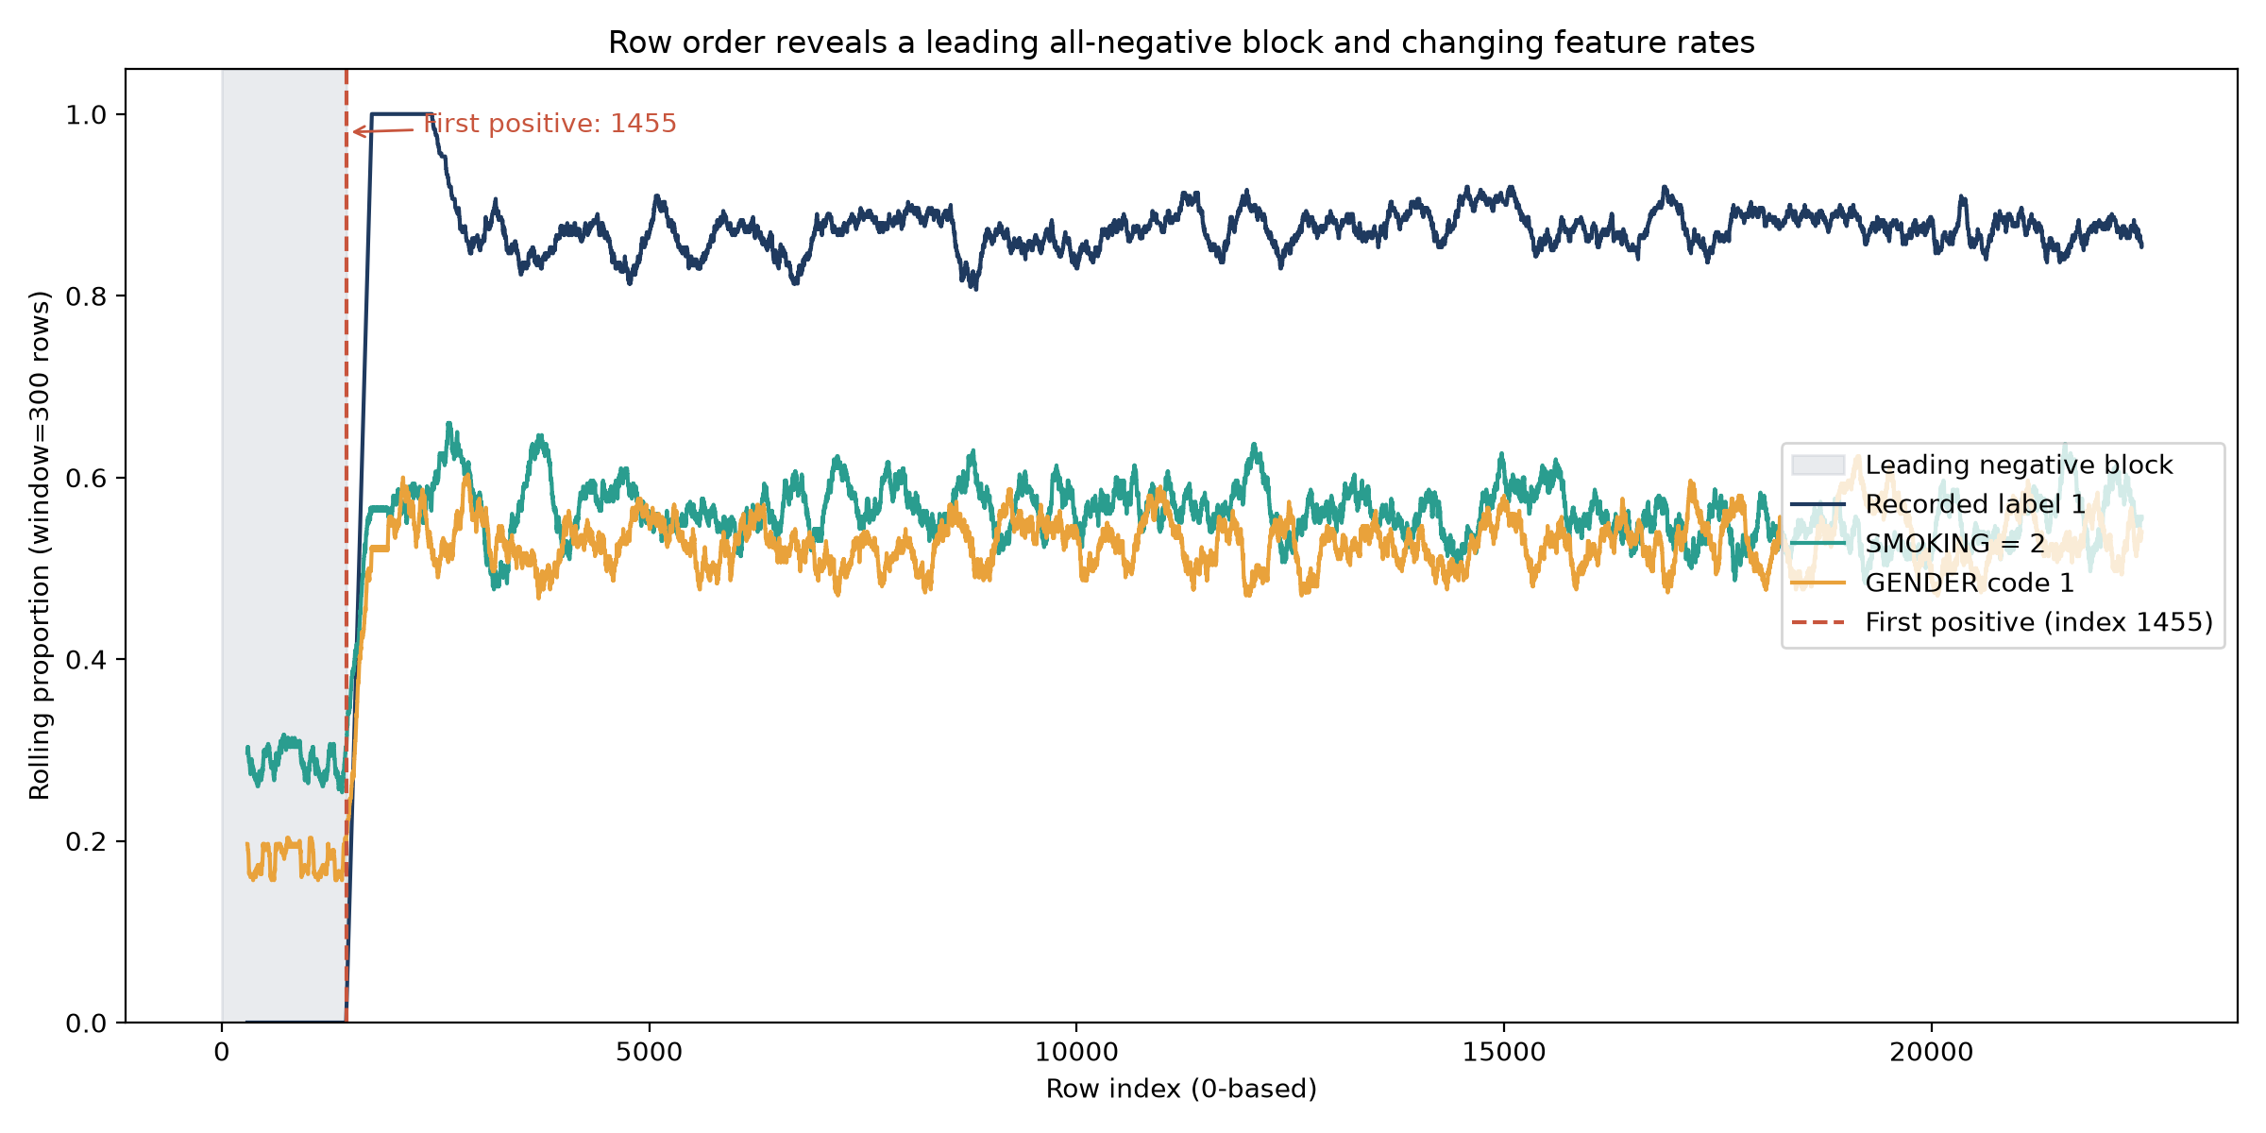
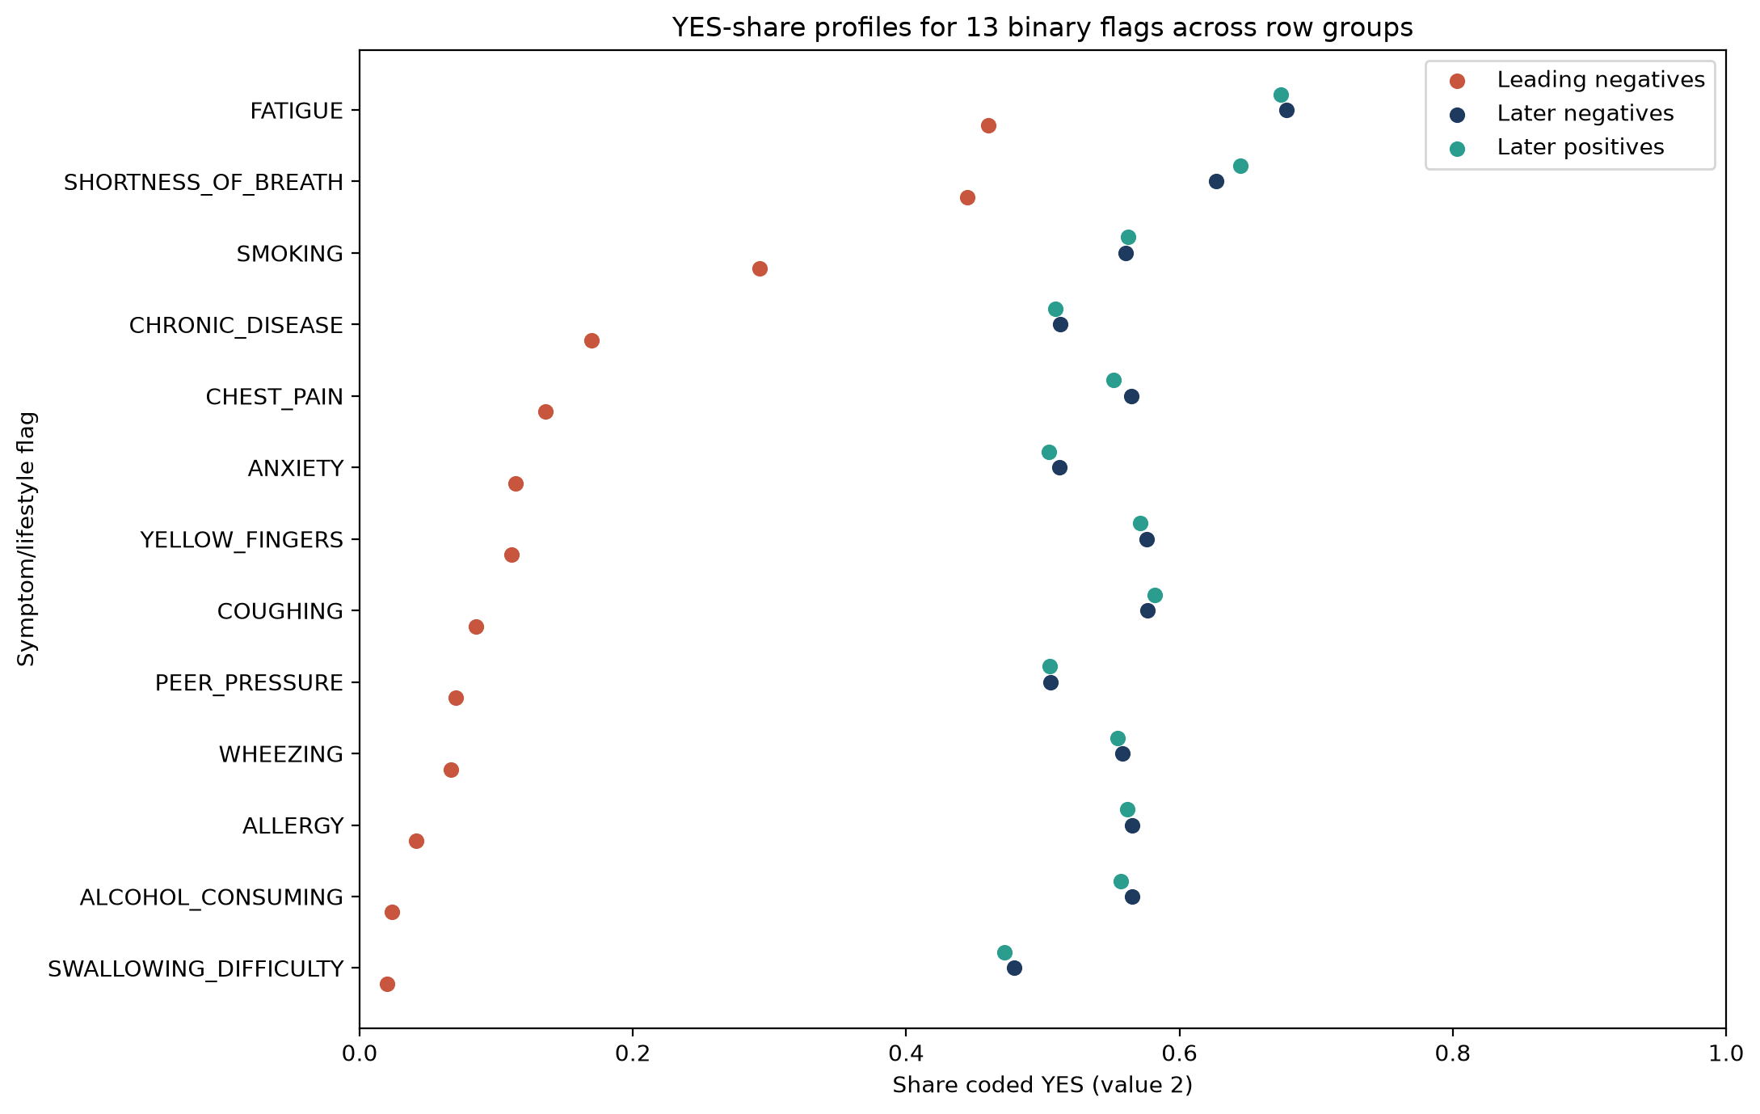
The leading rows form an all-negative block
First 1,455 rows are coded negative.
Smoking YES share: 29.3% in the block vs 56.0% in later negatives. | The plot shows row order, not a documented timeline.
Research prototype - not a diagnostic tool 6 / 18
Notes:
Figure 1: describe row index, rolling positive-label share, and the boundary. Figure 2: compare YES shares across leading negatives, later negatives, and later positives. Both are descriptive; neither establishes provenance.

Slide 7
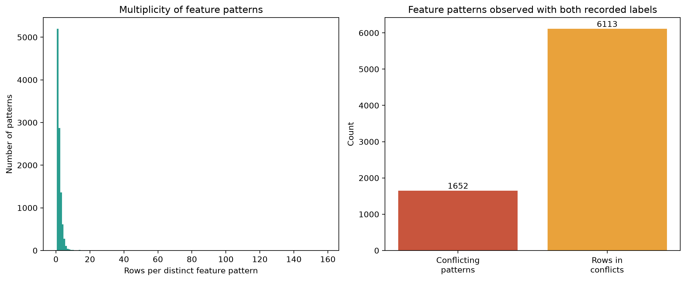
Duplicate patterns and ID order are not harmless
2,573 exact duplicate rows; 133 conflicting feature patterns.
Maximum pattern multiplicity: 86. | ID-only AUC: 0.67 — an audit statistic, not model performance. | The source and record-generation process remain unknown.
Research prototype - not a diagnostic tool 7 / 18
Notes:
Describe the duplicate-multiplicity distribution and conflicting-pattern counts. Explain why duplicate policies are sensitivity analyses. The ID-only AUC is an integrity statistic; patient_id remains excluded from feature sets.

Slide 8
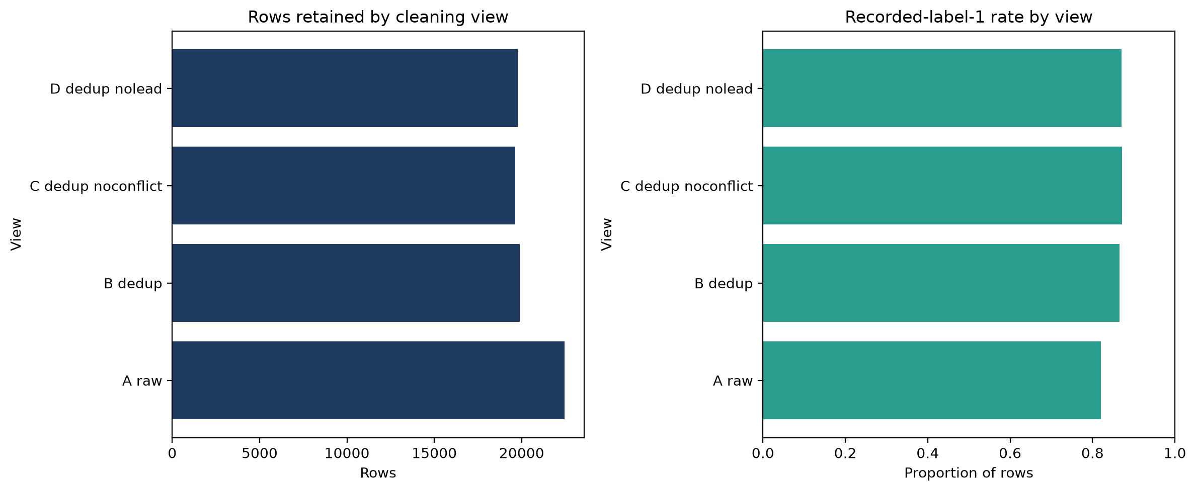
Four cleaning views expose policy sensitivity
A raw: 22,457; B exact-deduplicated: 19,884.
C no conflicts: 19,618; D no leading block: 19,781. | Recorded-positive share ranges from 82.1% to 87.1%. | View D filters B by the original raw row index.
Research prototype - not a diagnostic tool 8 / 18
Notes:
Figure 5 shows retained row counts and recorded-label-1 rates for views A through D. Explain that these are sensitivity policies, not a known ground-truth repair.

Slide 9
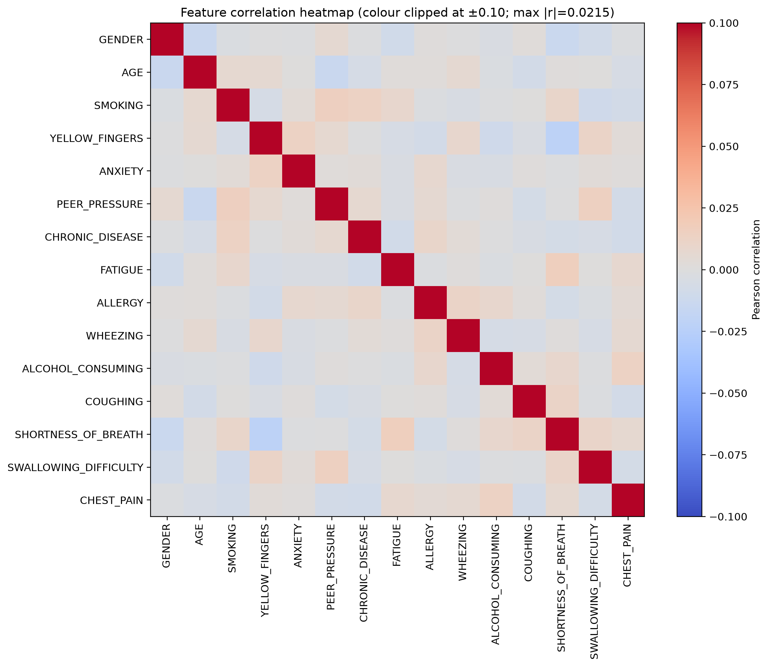
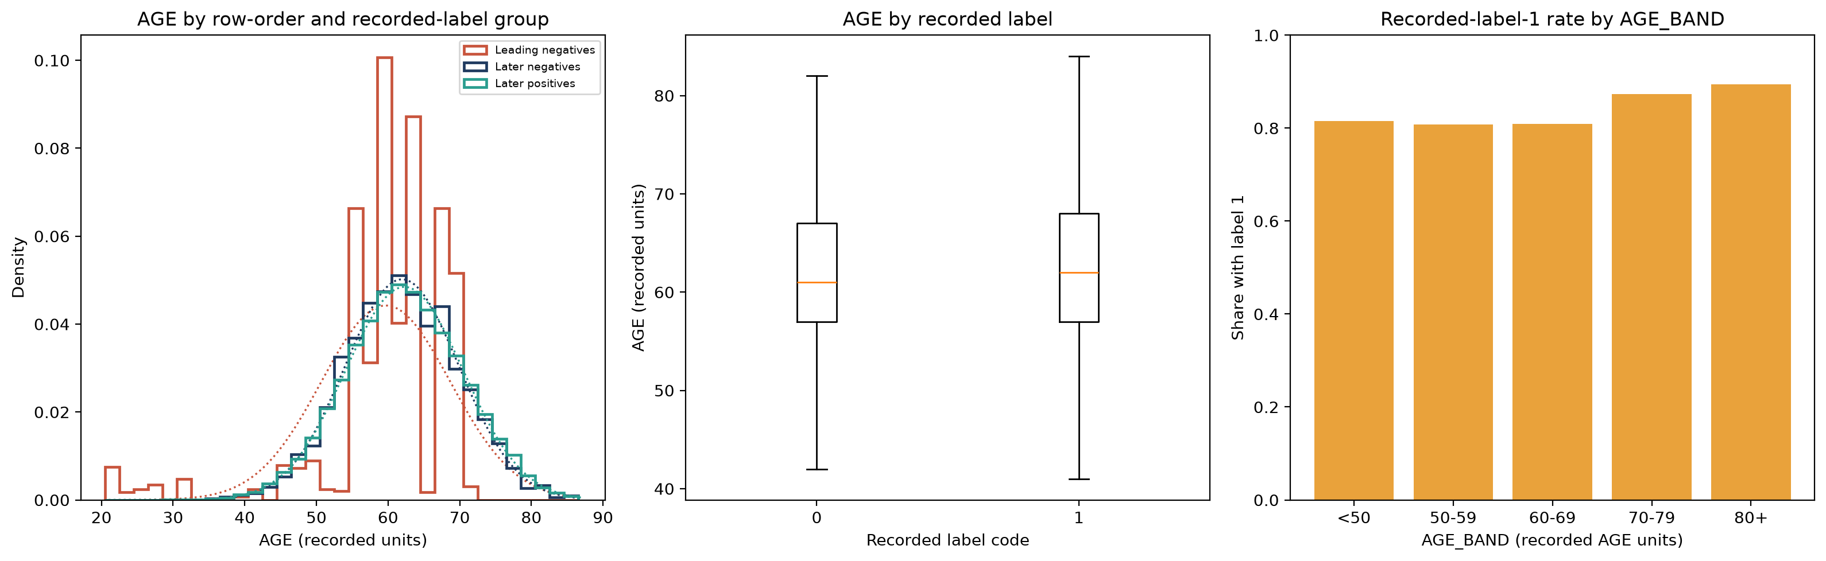
After deduplication, pairwise feature relations are weak
Age: 21–87, mean 62.1.
Maximum absolute pairwise correlation: 0.022. | First PCA component: 7.0%; flat reference: 6.7%. | These are descriptive diagnostics, not proof of independence.
Research prototype - not a diagnostic tool 9 / 18
Notes:
Figure 3: describe the feature-pair axes, correlation colour, and clipped range. Figure 4: compare AGE across the leading block, later negatives, and later positives, and show the label-wise and AGE_BAND summaries. These are descriptive views.

Slide 10
Five pre-specified tests separate effect from significance
H1 smoking: odds ratio, confidence interval, chi-square, permutation check.
H2 age: Mann–Whitney and CLES; H3 symptom count: Spearman rho.
H4 feature family: Benjamini–Hochberg correction; H5: source-shift audit.
View D H4 minimum raw p = 0.033; minimum q = 0.458.
Research prototype - not a diagnostic tool 10 / 18
Notes:
Describe the pre-specified tests and distinguish p-values, effect sizes, and adjusted q-values. The analysis does not test causal hypotheses.

Slide 11
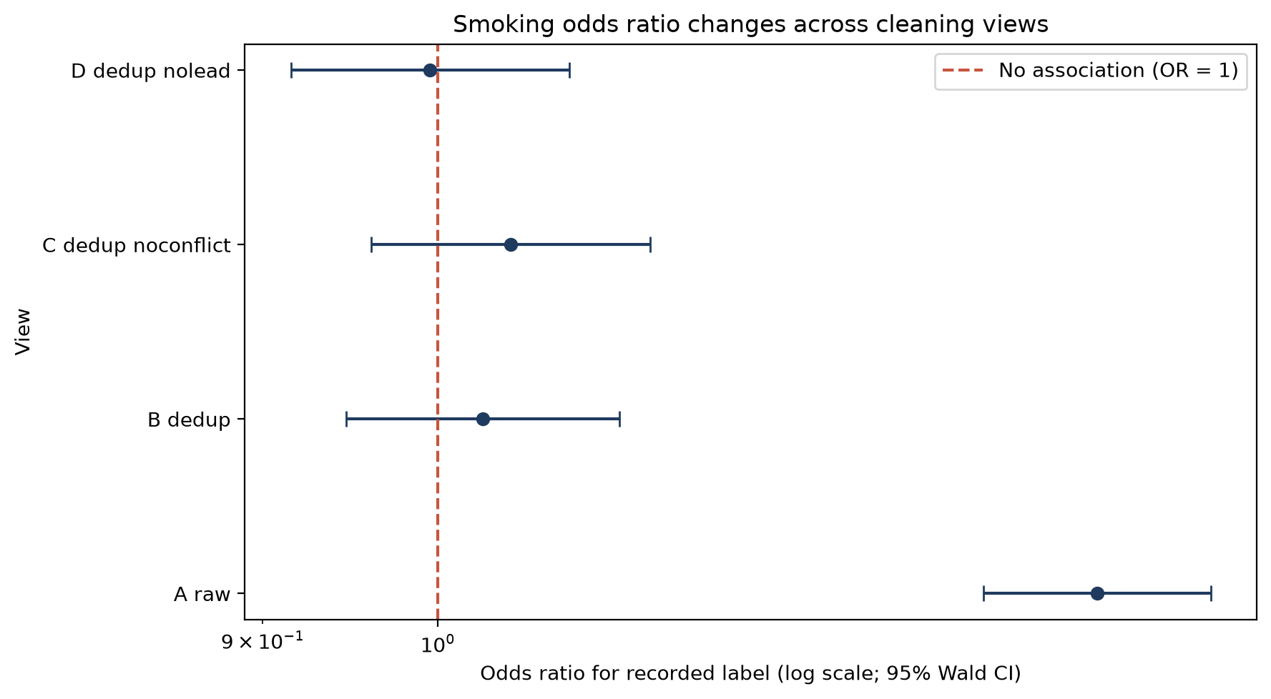
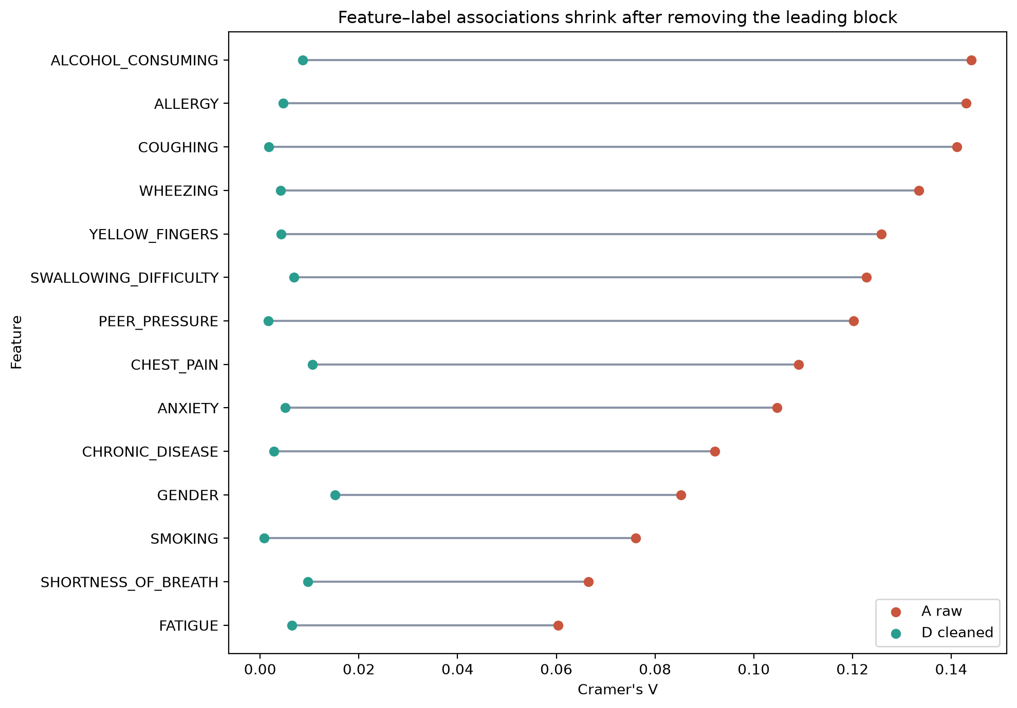
The smoking association moves toward the null after cleaning
View A OR 1.49 (1.39–1.59).
View D OR 1.00 (0.92–1.08). | View D H4 minimum q = 0.46. | The file does not establish a population or causal conclusion.
Research prototype - not a diagnostic tool 11 / 18
Notes:
Start with Figure 7: describe view, smoking odds ratio, 95% intervals, and the OR=1 reference. Then use Figure 6 to show the feature-level Cramer's V comparison from A to D. These are associations in this file, not population conclusions.

Slide 12
Feature construction is transparent, not evidence of prediction
F0: 15 raw features; F1: 19 with selected descriptors.
F2: 5 domain-prior candidates.
Age scaling must be fitted inside training folds in any future model.
The smoking-by-age feature is a proxy, not screening eligibility.
Research prototype - not a diagnostic tool 12 / 18
Notes:
Summarize the three sets and the rationale for retaining F2 as a candidate. State that univariate screening did not select features and no model was fitted.

Slide 13
The file supports an integrity finding, not a clinical claim
After removing the leading block, smoking OR is 1.00.
After BH correction in D, the minimum q is 0.46.
Provenance, label meaning, representativeness, and external validity are unresolved.
All conclusions are limited to this supplied file.
Research prototype - not a diagnostic tool 13 / 18
Notes:
Answer the central question directly. Explain that small effects after structural cleaning are about this file only and do not negate external evidence.

Slide 14
Next steps are planned, not completed
Verify source, licence, checksum, label definition, and sampling frame.
If authorized, plan grouped/source-aware validation on independent data.
Select metrics and calibration checks with the intended use in mind.
Clean-clone testing and timed presentation rehearsal remain to be done.
Research prototype - not a diagnostic tool 14 / 18
Notes:
Use future tense for all uncompleted work. Do not claim that external validation, model training, USB backup, or rehearsal has occurred.

Slide 15
Backup: sensitivity estimates by view
A_raw: OR 1.49, 95% CI 1.39–1.59, p 4.45e-30.
B_dedup: OR 1.03, 95% CI 0.95–1.12, p 0.521.
C_dedup_noconflict: OR 1.04, 95% CI 0.96–1.14, p 0.304.
D_dedup_nolead: OR 1.00, 95% CI 0.92–1.08, p 0.911.
Research prototype - not a diagnostic tool 15 / 18
Notes:
Backup sensitivity values. Keep interpretation descriptive and point to the integrity audit.

Slide 16
Backup: feature-family BH results
A_raw: minimum p 2.12e-103, minimum q 0.000, maximum V 0.144.
B_dedup: minimum p 0.029, minimum q 0.365, maximum V 0.016.
C_dedup_noconflict: minimum p 0.006, minimum q 0.079, maximum V 0.020.
D_dedup_nolead: minimum p 0.033, minimum q 0.458, maximum V 0.015.
Research prototype - not a diagnostic tool 16 / 18
Notes:
Backup multiple-testing family summary. The H4 tests are descriptive, not evidence of causation.

Slide 17
Backup: detectable risk-difference approximation
View D group sizes: 11,080 smoking-code YES and 8,701 NO.
Alpha 0.05; target power 0.8.
Approximate minimum detectable risk difference: 0.0135.
Planning calculation only; its assumptions are not established by the file.
Research prototype - not a diagnostic tool 17 / 18
Notes:
Explain that this is a planning calculation under assumptions, not evidence that a smaller association is absent.

Slide 18
Backup: optional leakage model was not run
The guide proposes a raw-versus-deduplicated cross-validation experiment.
The project scope excludes model fitting; no AUC from that experiment is reported.
Current leakage evidence comes from row order, duplicates, and ID-only AUC.
Research prototype - not a diagnostic tool 18 / 18
Notes:
This optional experiment is intentionally not run under the governing no-model-training constraint. Do not quote an unmeasured raw or cleaned model score.

