Slide 1

Attendance Tracking
System

Slide 2
Attendance Tracking System
Charles Aaron P. Caparas
Nicko G. Lumbera
Neal L. Buendia
Zid Chester R. Loyola
Erl Jei R. Santarin

Slide 3
Attendance Tracking
System
The NFC Attendance Tracker Application enables Professors to record attendance for their classes with increased speed and accuracy when compared to traditional methods of manually recording attendance.

Slide 4
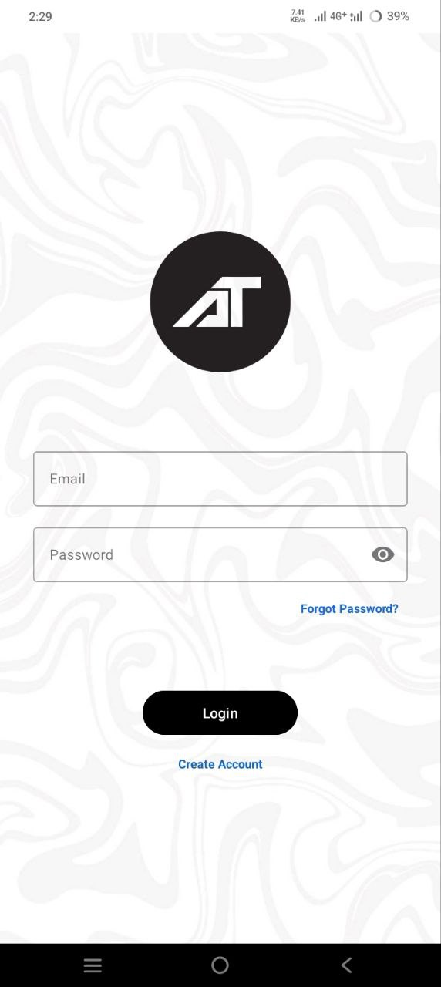
Attendance Tracking System
Login Screen
The main gateway for accessing the Attendance Tracking System.

Slide 5
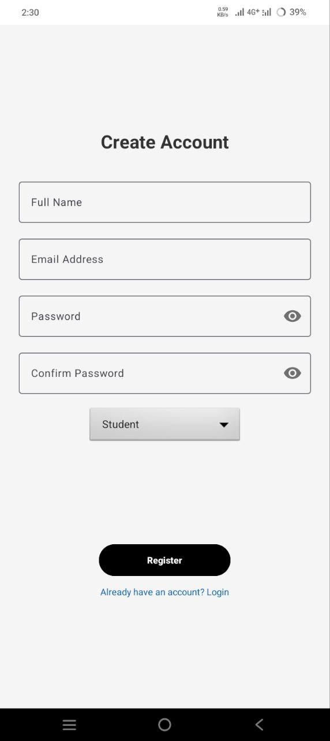
Attendance Tracking System
Account Creation
The Account creation interface for Attendance Tracking System.

Slide 6
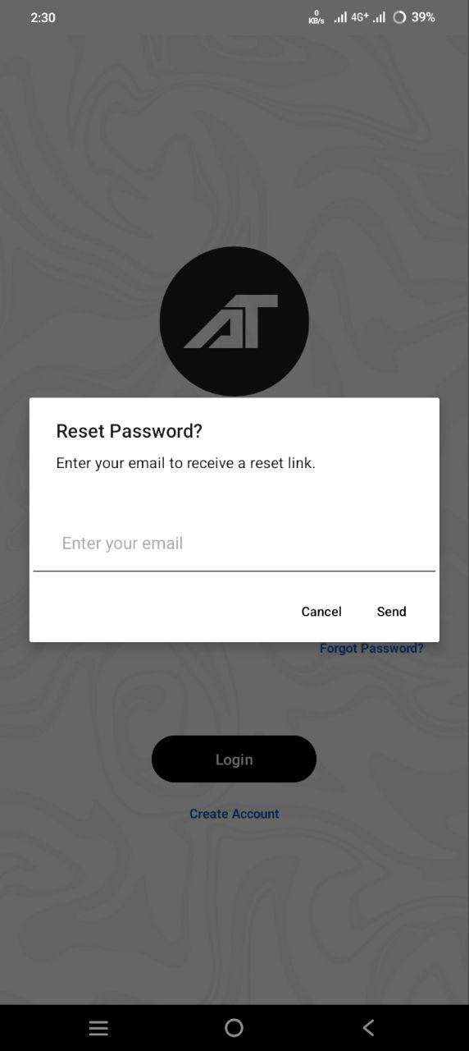
Attendance Tracking System
Reset Password
Allow users to securely reset their passwords to regain account access.

Slide 7
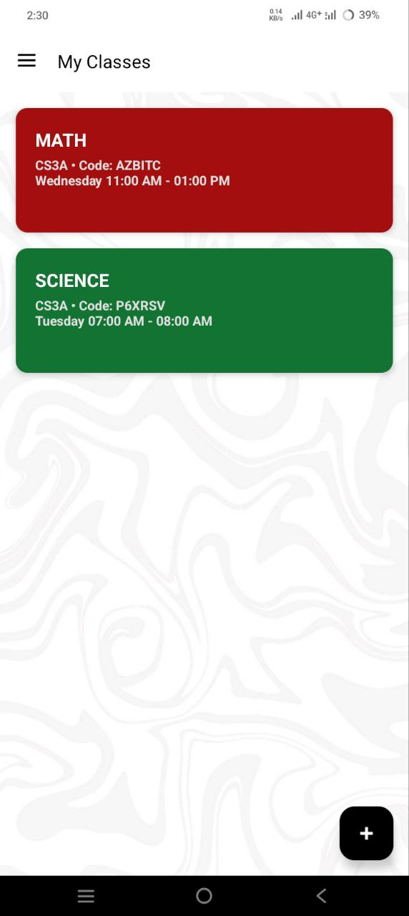
Attendance Tracking System
Dashboard
Main screen of the Attendance Tracking System

Slide 8
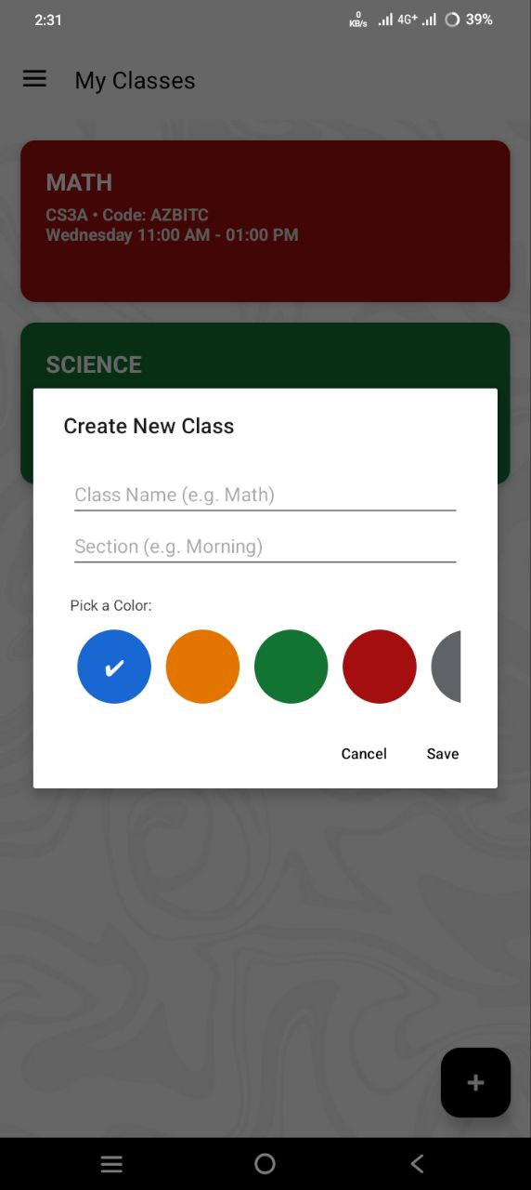
Attendance Tracking System
Create Class
Creating and customizing how a class would look.

Slide 9
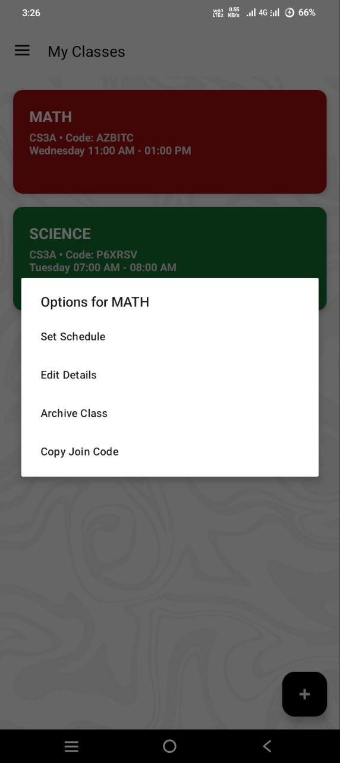
Attendance Tracking System
Class Options
This is where the professor can edit, add a schedule, archive a class and copy the class code to join the class

Slide 10
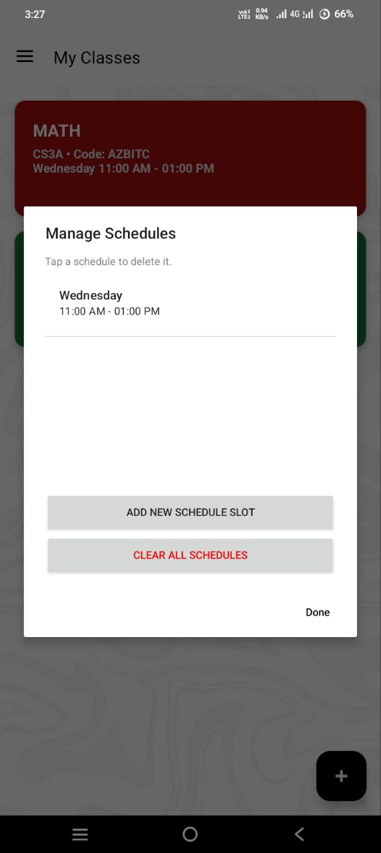
Attendance Tracking System
Schedule Management
This is where the professor can manage the class schedule

Slide 11
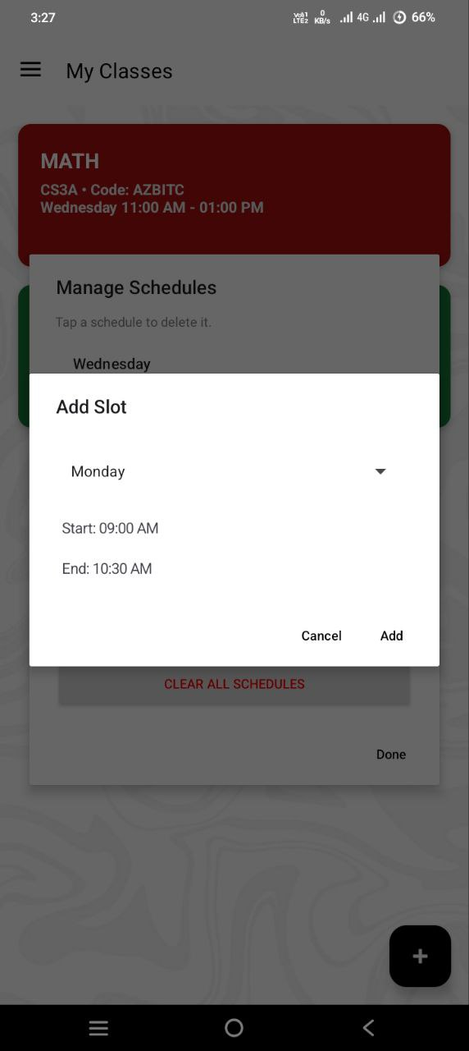
Attendance Tracking System
Adding a Schedule Slot
This is where the professor can add a slot

Slide 12
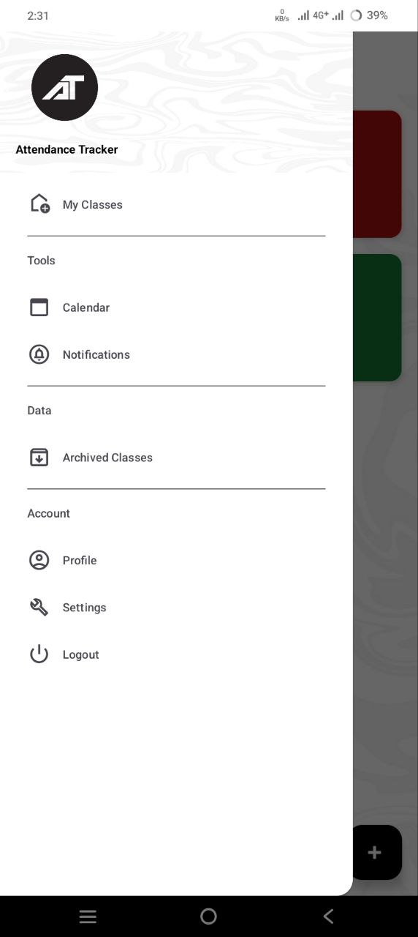
Attendance Tracking System
Navigation Sidebar
What users will see when they navigate through the Attendance Tracking System

Slide 13
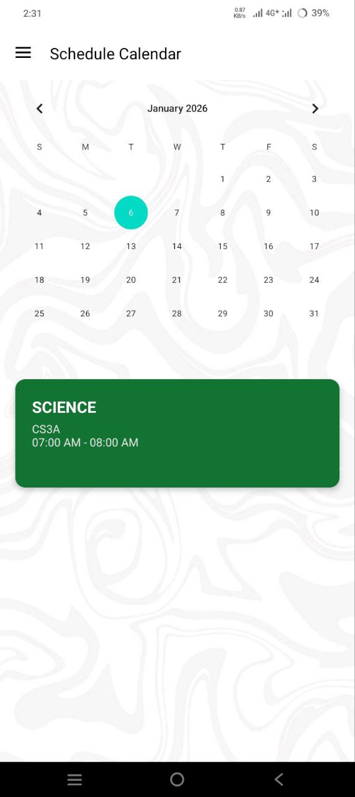
Attendance Tracking System
Schedule Calendar
This is where the users will see their schedule for the date selected

Slide 14
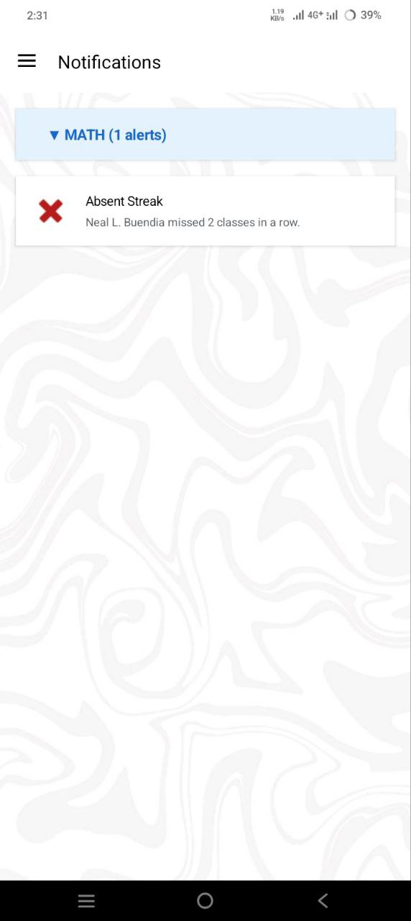
Attendance Tracking System
Notifications
This is where the users will see their notifications

Slide 15
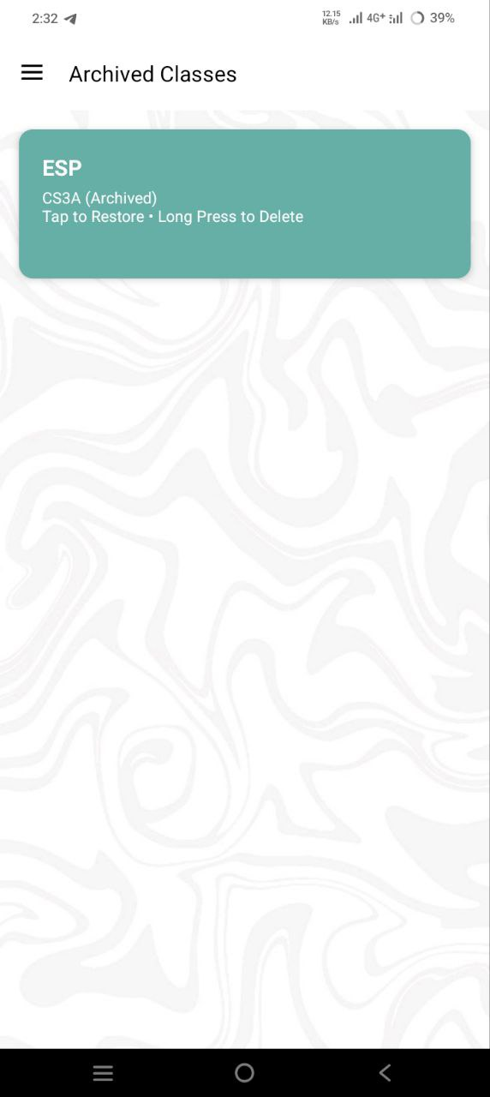
Attendance Tracking System
Archived Classes
This is where the users will see their archive classes

Slide 16
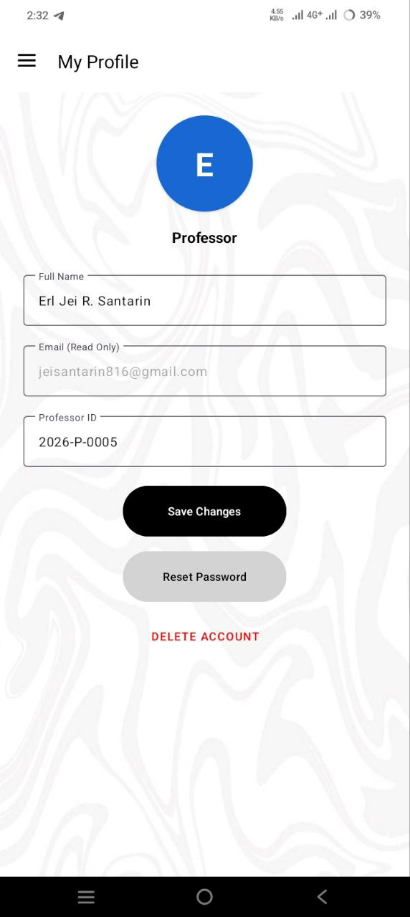
Attendance Tracking System
Account Profile
This is where the users will edit their profile information

Slide 17
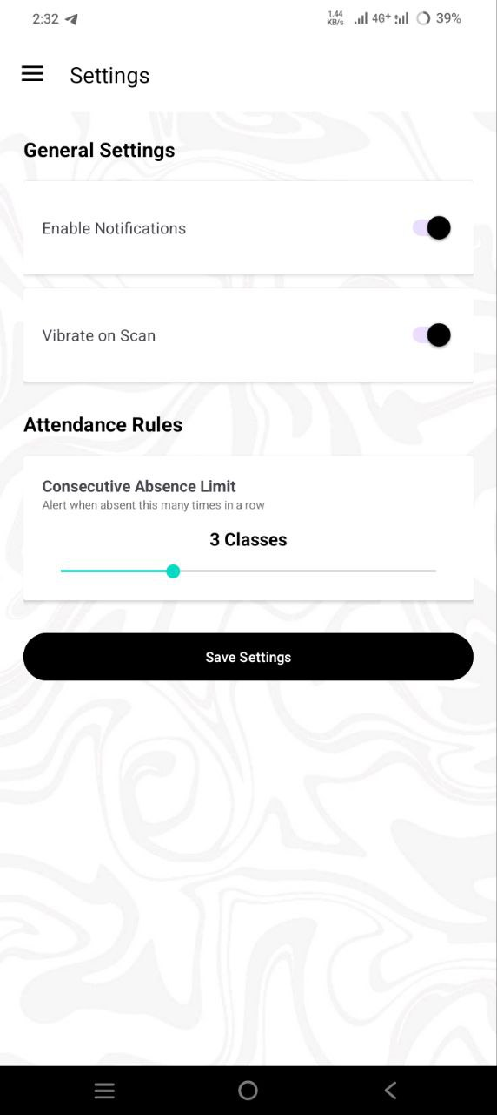
Attendance Tracking System
Settings
This is where the users will see the settings for the attendance tracking system

Slide 18
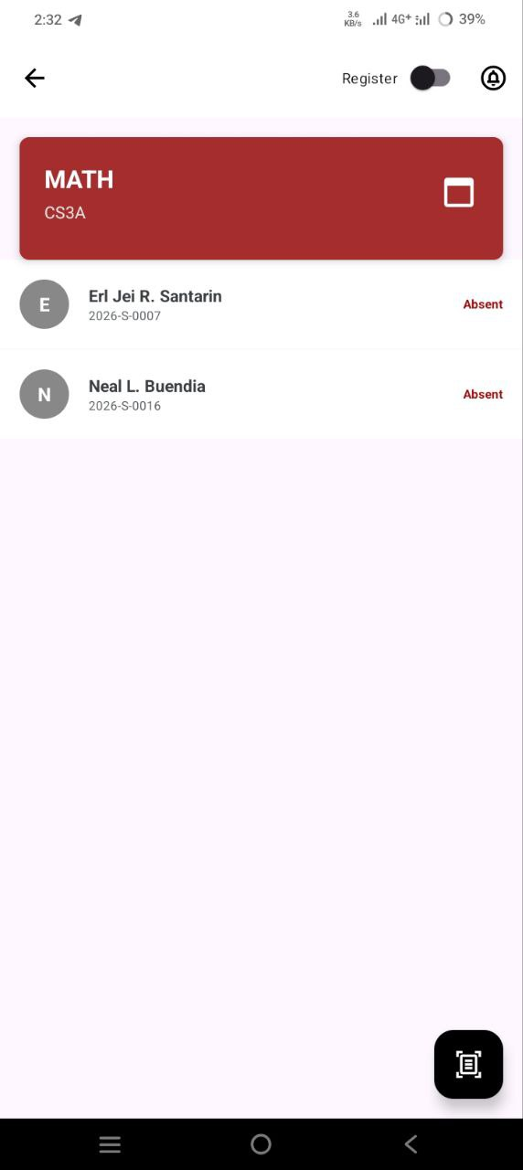
Attendance Tracking System
Class List
This is where the professor can see the class list, register a student, scan the NFC of a student, and track the attendance of the students.

Slide 19
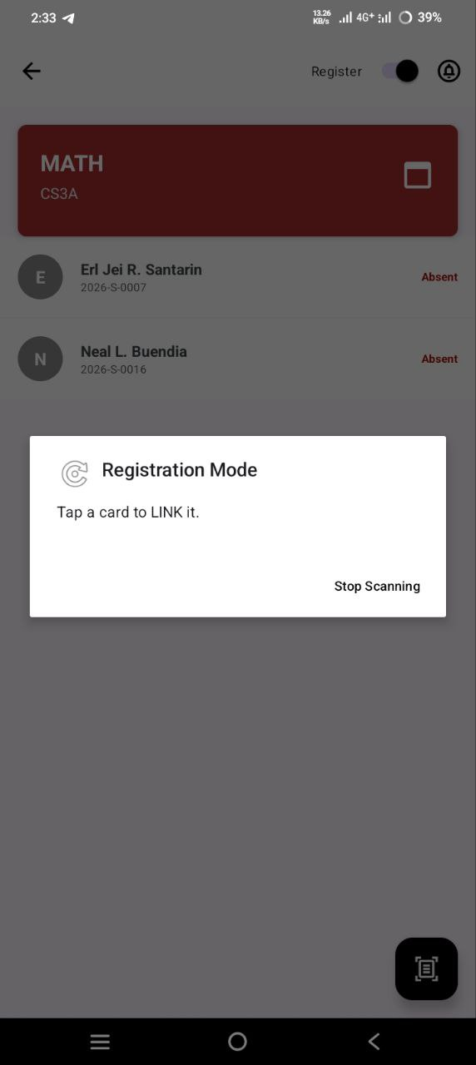
Attendance Tracking System
Registration
This is where the professor can register a student’s NFC tag

Slide 20
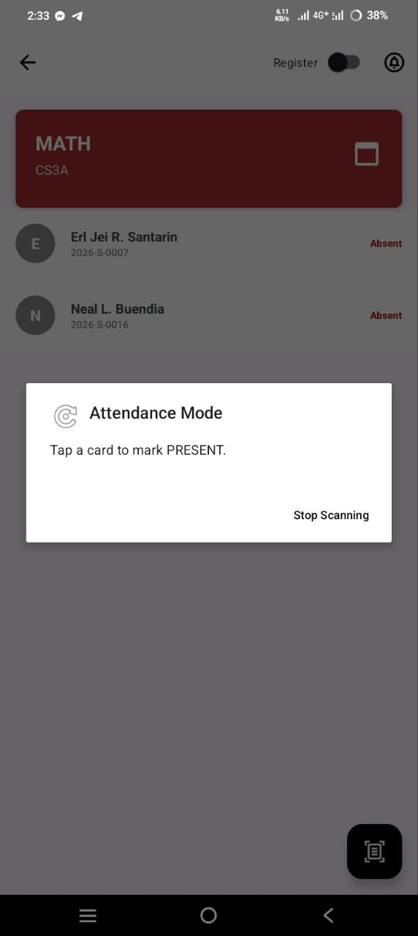
Attendance Tracking System
Attendance mode
This is where the professor will scan the NFC tag of the students

Slide 21
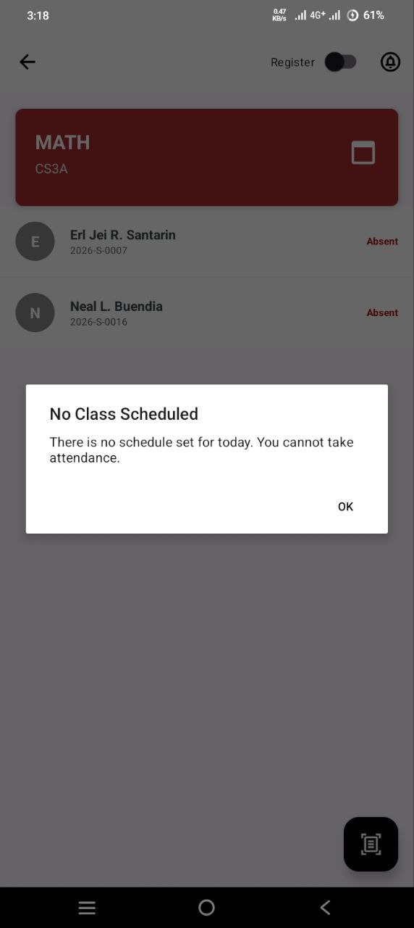
Attendance Tracking System
No Class Schedule
The professor cannot scan NFC tags if there is no class schedule for that day

Slide 22
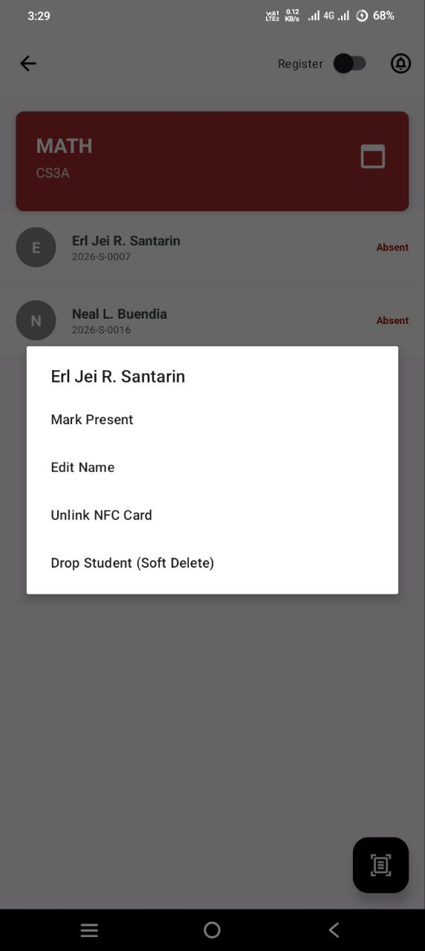
Attendance Tracking System
Student Option for the Professor
The Professor can edit, mark present, unlink NFC card and drop a student

Slide 23
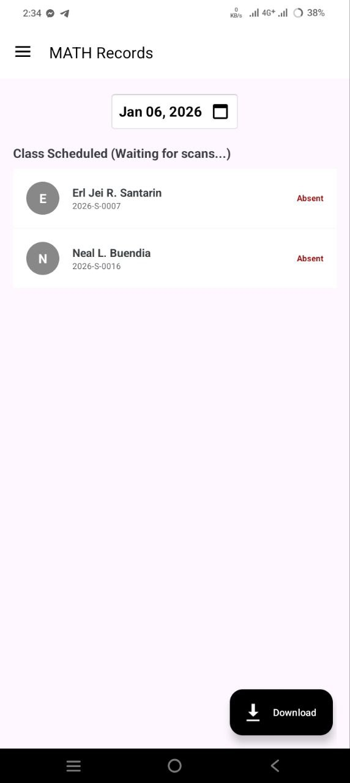
Attendance Tracking System
Attendance Records
This is where the professor can see all the attendance records of the class

Slide 24
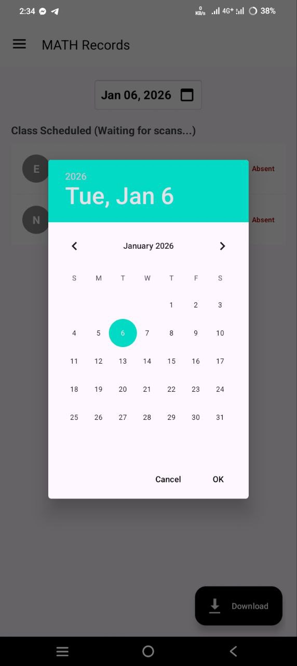
Attendance Tracking System
Records Calendar
This is where the professor can see the past attendance records of a class

Slide 25
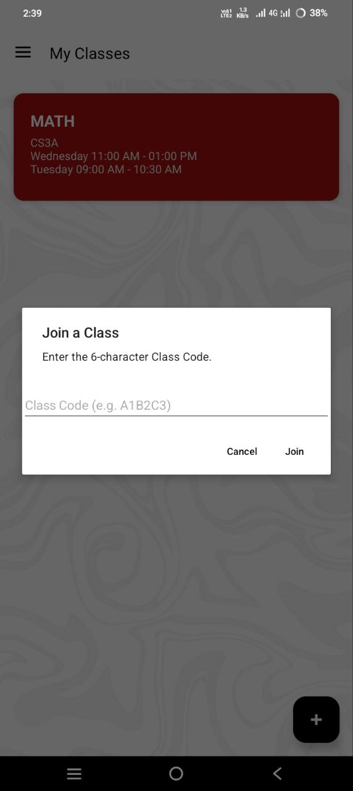
Attendance Tracking System
Joining a Class
This is where the student can join a class by asking the professor for the class code

Slide 26
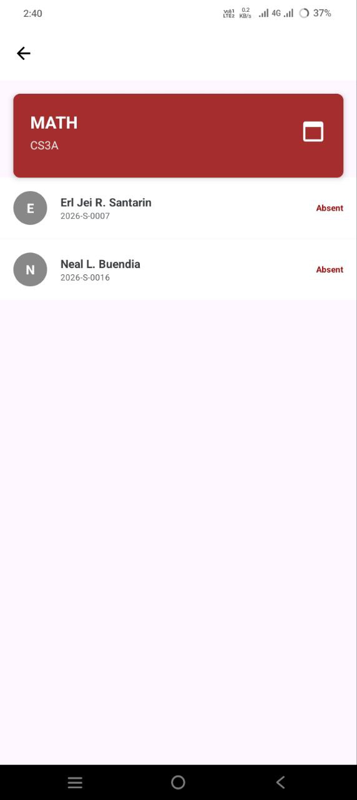
Attendance Tracking System
Classroom
This is where the student can see the classroom

Slide 27
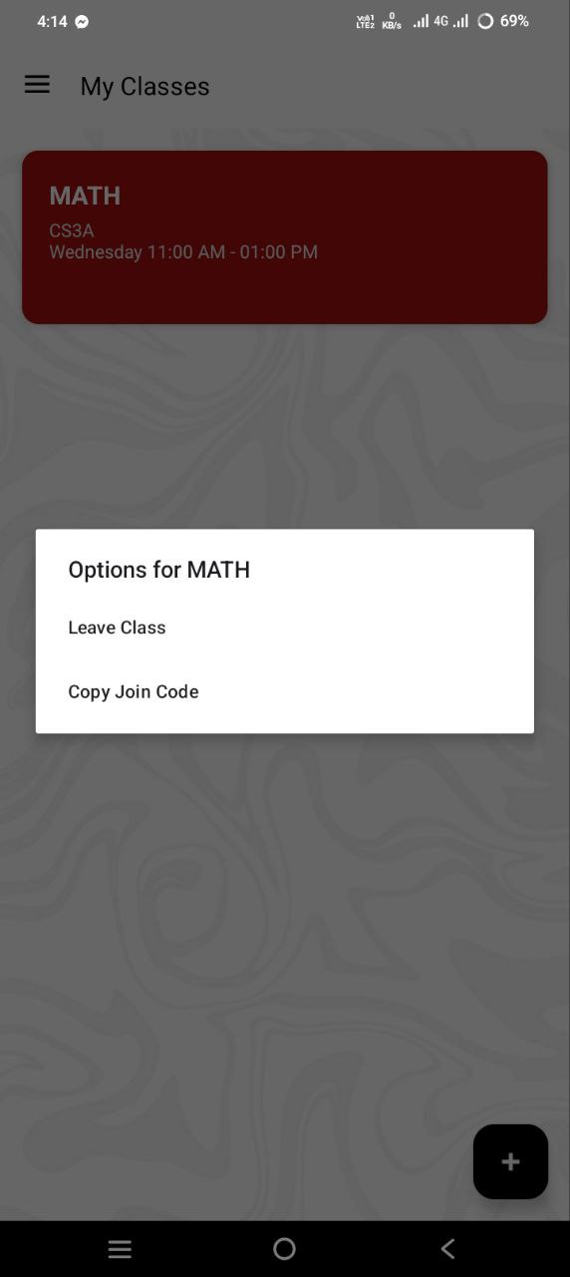
Attendance Tracking System
Class Options for Student
The Student can choose to leave or copy the class code

