Slide 1

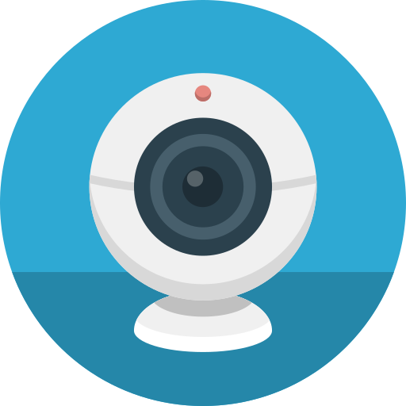
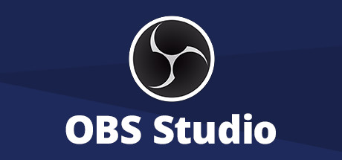
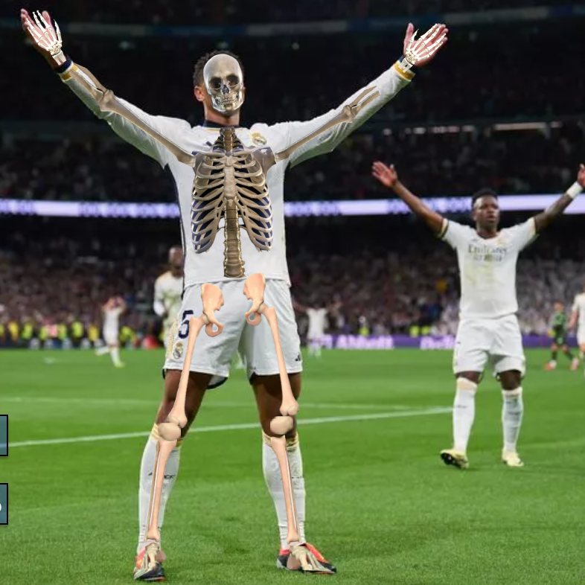
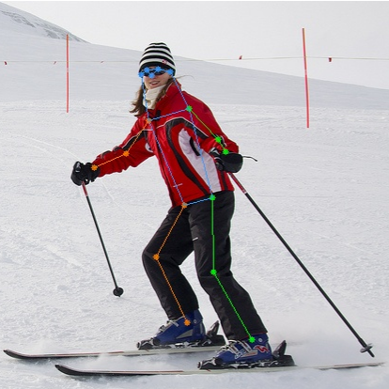
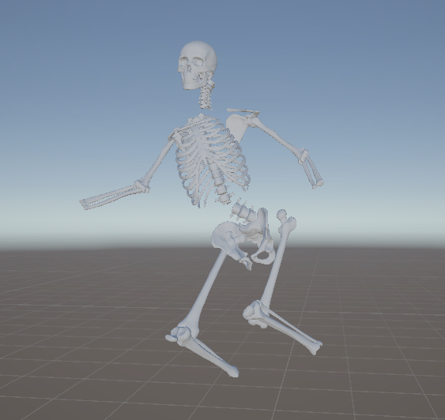
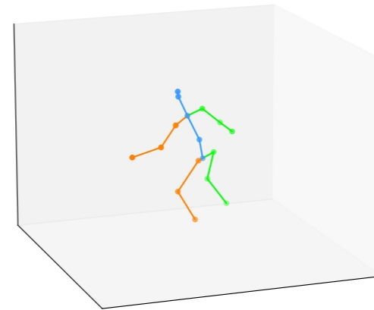


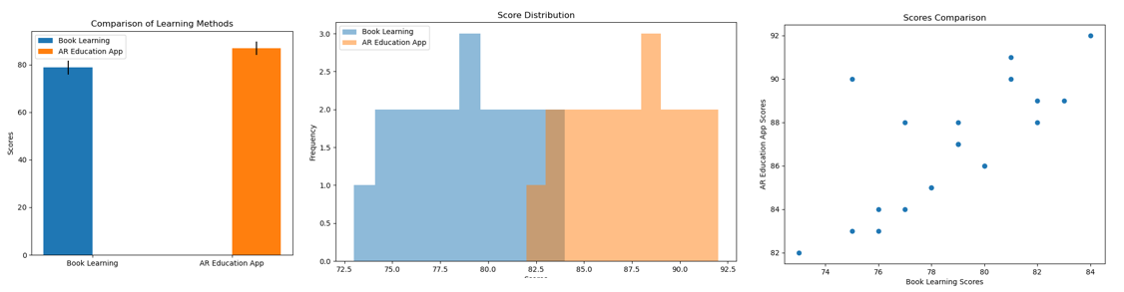
Magic Mirror -- An Educational AR Application using Monocular RGB Camera
Haonan Zhang¹, Zejun Ma¹, Zixiao Xu¹
Whiting School of Engineering Johns Hopkins University
Introduction
A magic mirror is an augmented reality (AR) application that overlays three-dimensional (3D) models of internal body tissues, such as bone skeletons, onto images of people in real time. The spatial positioning and sizes of these 3D models dynamically adjust according to the pose information derived from the people's real-time movements captured in the video stream. The main contribution includes:
Educational Enhancement: Aims to enrich anatomy education and improve student understanding.
Accessible Technology: Uses commonly available monocular RGB cameras instead of professional depth cameras.
Simple Deployment: Requires only a computer with a GPU and a webcam, enabling easier setup and increased accessibility.
Method
3D Human Pose Estimation (HPE): To estimate 3D human poses from monocular RGB images, we use a pretrained RTMPose (Cao et al., 2019) model as a 2D HPE module followed by a MotionBeRT (Zhu et al., 2023) model which estimates 3D HPE given 2D HPE.
Skeleton Animation and Overlaying: We use Unity built-in functions to animate the skeletons according to the real-time output of 3D HPE and then map them to pixel coordinates and scales for overlaying.
Inter-program Communication: We use ZeroMQ to connect the HPE module (Python) and the animation module (C#). The camera input is multi-streamed by OBS studio for HPE input and animation background.
Camera Input
Multi-streaming
Overlaying
HPE Module
ZeroMQ Connection
Skeleton
Animation
Results
Conclusions
Our experiment compares the effectiveness of learning anatomy with the proposed AR app versus a traditional textbook among forty high school students. The independent variable is the learning method and the dependent variable is learning efficiency measured by a quiz after a short learning period. The experiment verifies the hypothesis that using the proposed AR app to learn anatomy instead of traditional tools like textbooks will help students gain a better understanding of anatomical skeleton knowledge. The visualization of the test results is as below:
In our experiment, the group using the proposed AR application displayed superior statistical results, confirming our hypothesis that our magic mirror app enhances anatomy learning. While implementing the applications, we honed technical skills such as the deployment of deep learning (DL) models, applying the DL models to real-world applications, environment, and real-time data connection setup for multi-program cooperation employing libraries like ZeroMQ and Unity 3D URP project development for. Moreover, we learned valuable lessons in project design and execution, ensuring feasibility and user-friendliness. Our current project enables real-time correspondence between the user's body and a Unity skeleton, enhancing understanding. Next, we aim to enhance interactivity to create a more engaging AR "textbook" experience.

