Slide 1
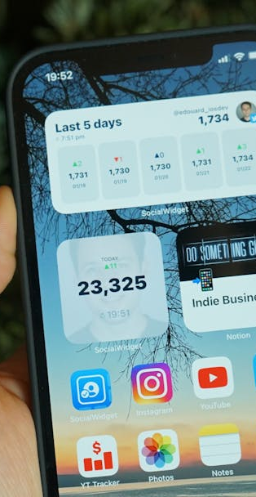
E-Pravesh
CREATED BY: Zek Furtado DATE: January-2026
Smart Visitor Management System for BARTI

Slide 2

Visitor Challenges
E-Pravesh
Visitor Registration Issues
Manual visitor registration is time-consuming and error-prone. Employees unaware of visitor arrivals in advance. No centralized tracking system for visitor history. Difficulty in managing multiple visitors simultaneously. Lack of real-time communication between gatekeepers and employees. Security concerns with unauthorized access.

Slide 3
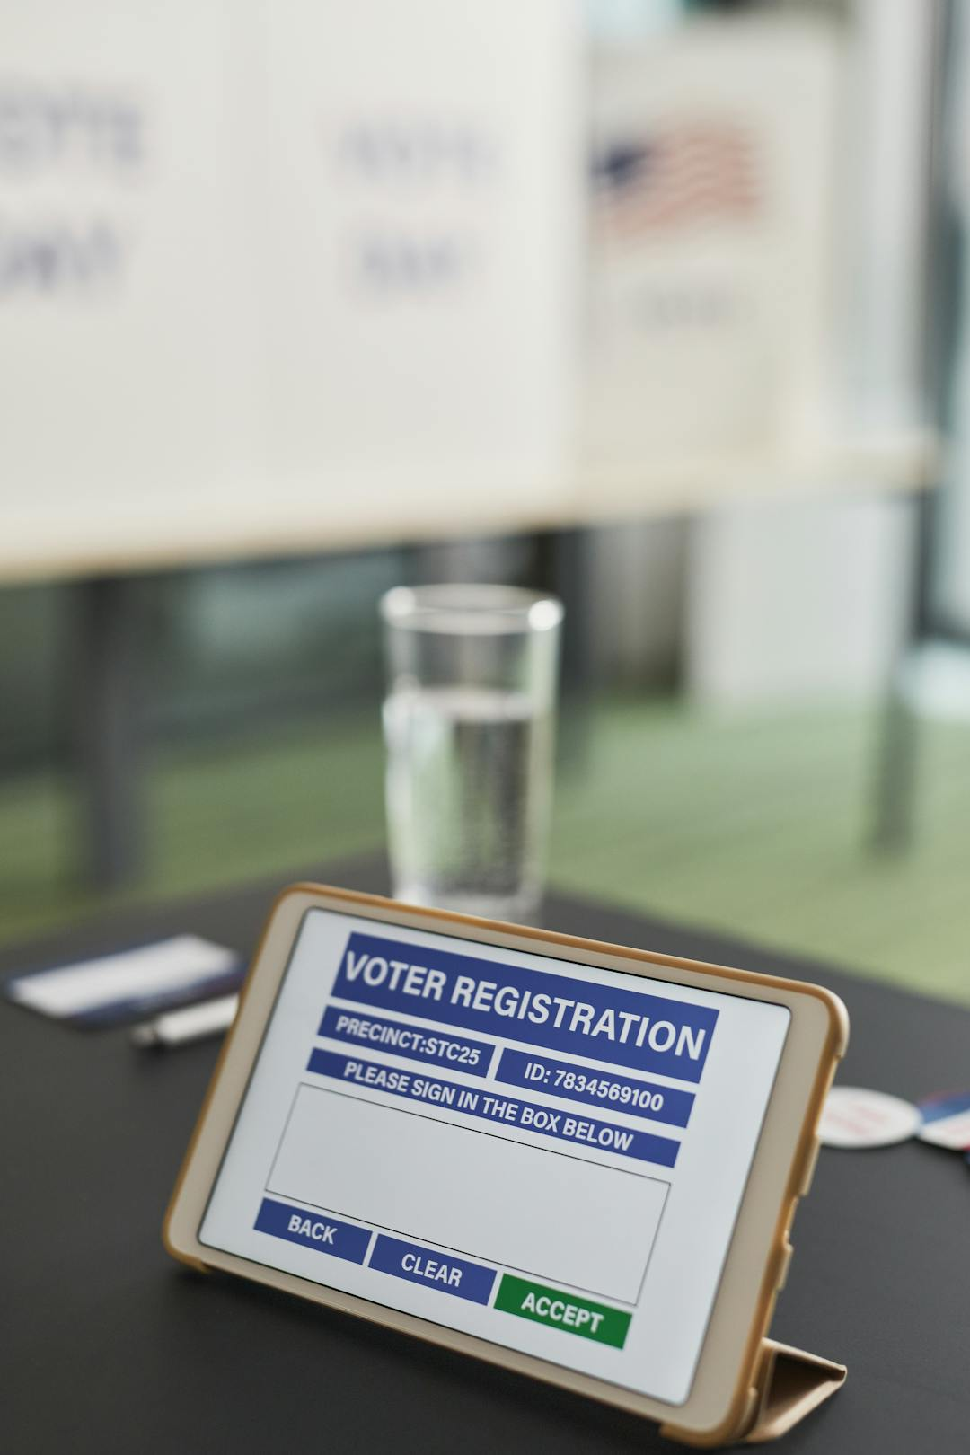
Solution Overview
E-Pravesh
Features
Smart Registration: Auto-detects returning visitors by phone number. Real-Time Notifications: Instant push notifications to employees. Photo Capture: Visual identification with camera integration. Dual Interface: Separate workflows for gatekeepers and employees. History Tracking: Complete visitor profile and visit history. Cloud-Based:

Slide 4
System Architecture
E-Pravesh
Architecture Layers
Technical Stack
Built on Clean Architecture Principles Architecture Layers: 1. Presentation Layer - BLoC/Cubit state management - Flutter UI components - Real-time updates 2. Domain Layer - Business entities - Use cases - Repository contracts 3. Data Layer - Firebase integration - Cloud Firestore - Firebase Storage - FCM notifications
Technical Stack: - Flutter (Cross-platform) - Firebase Auth, Firestore, Storage, FCM - GetIt (Dependency Injection) - Clean Architecture + TDD

Slide 5
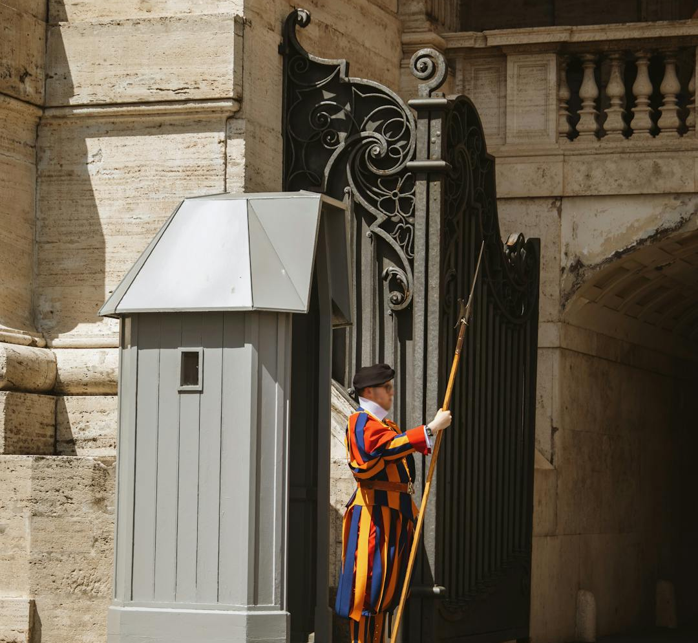
Role-Based Access
E-Pravesh
User Roles
User Roles: 1. Gatekeeper - Front desk personnel - Register visitors - Manage visitor flow - View all statistics

Slide 6

Employee Capabilities
E-Pravesh
Staff Responsibilities
- Staff members - Approve/reject visitors - View personal visitor requests - Access visit history

Slide 7

Authentication Features
E-Pravesh
Authentication Options
- Firebase email/password authentication - Secure registration with role assignment - Additional fields: name, job role, department, phone - Profile pictures - Persistent login sessions - Splash screen with auto-login

Slide 8

Visual Suggestion
E-Pravesh
Personas and Features
Two personas with role icons and feature lists

Slide 9

Confirmation & Timing
E-Pravesh
Confirmation Process
Real-Time Workflow
Phase 4: Confirmation & Entry (Gatekeeper) 16. System updates visitor status in real-time 17. Gatekeeper receives notification of decision 18. Gatekeeper checks dashboard for updated status 19. If approved: Allows visitor entry 20. If rejected: Informs visitor politely 21. All actions logged with timestamps
Real-Time Workflow in Action T+0 seconds: Registration Begins - Gatekeeper starts visitor registration - Phone number entered triggers auto-search - Average time: 30 seconds with auto-fill T+30 seconds: Photo Capture - Visitor photo captured or selected - Uploaded to Firebase Storage - Average time: 10 seconds T+40 seconds: Form Completion -

Slide 10

Real-Time Features
E-Pravesh
Key Real-Time Features
Key Real-Time Features: Instant push notifications (< 2 seconds) Live dashboard updates via Firestore streams No manual refresh required Background notification delivery Offline-capable with sync when online

Slide 11

Returning Visitor
E-Pravesh
Visitor Registration Process
Scenario 1: Returning Visitor (Common Case) 1. Gatekeeper enters phone number 2. System finds existing visitor profile 3. Form auto-fills with: name, email, company, latest photo 4. Gatekeeper only updates: employee to meet, purpose, duration 5. New visit added to visitor's history 6. **Time Saved:** 60% faster than first-time registration

Slide 12

First-Time Visitor
E-Pravesh
Visitor Process
Scenario 2: First-Time Visitor 1. Gatekeeper enters phone number 2. System confirms "New visitor" 3. Gatekeeper fills all fields manually 4. Photo captured 5. New visitor profile created 6. First visit recorded in history

Slide 13
Concurrency & Exceptions
E-Pravesh
Scenario 3: Multiple Simultaneous
Scenario 4: Employee
1. Multiple gatekeepers can register visitors simultaneously. 2. Each visitor gets unique ID and timestamp. 3. Multiple employees receive their respective notifications. 4. No conflicts or data loss. 5. Real-time sync ensures all data is accurate.
1. Visitor registered (status: pending). 2. Notification sent to employee. 3. If employee doesn't respond immediately: - Request remains in pending list - Visible in employee's dashboard whenever they check - Gatekeeper can see pending status - Can be approved later (no timeout).

Slide 14
Rejections & VIPs
E-Pravesh
Visitor Rejection
Emergency/VIP Visitor
Scenario 5: Visitor Rejection 1. Employee rejects visitor request 2. Gatekeeper notified immediately 3. Gatekeeper informs visitor professionally 4. Visit recorded in history (status: rejected) 5. Useful for future reference and analytics
Scenario 6: Emergency/VIP Visitor 1. Gatekeeper can add priority notes 2. Employee sees notes in visitor details 3. Can approve immediately upon notification 4. Fast-track workflow for urgent cases

Slide 15

Firebase Storage & Role
E-Pravesh
Storage Functions
- Receives visitor photos - Generates secure download URLs - Stores images with visitor ID reference

Slide 16
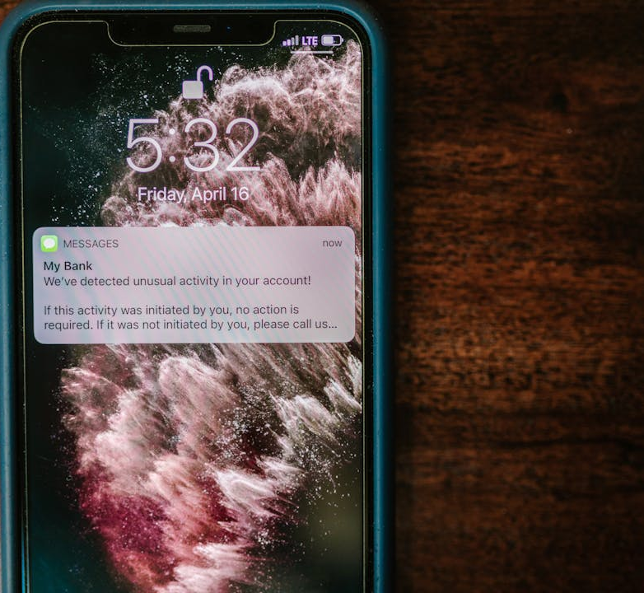
FCM Notifications
E-Pravesh
Notification Process
Receives notification requests. Routes to correct employee device. Delivers push notifications. Handles background delivery.

Slide 17
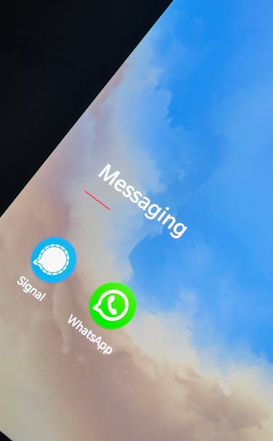
Employee App Flow
E-Pravesh
App Workflow
Receives push notification. Fetches visitor data from Backend. Displays visitor card with photo. Sends approval/rejection back to Backend.

Slide 18

Real-Time Sync & Data Flow
E-Pravesh
Data Flow Overview
- Firestore streams update both apps instantly. No polling required. Bi-directional data flow. Conflict resolution handled by Firebase.

Slide 19
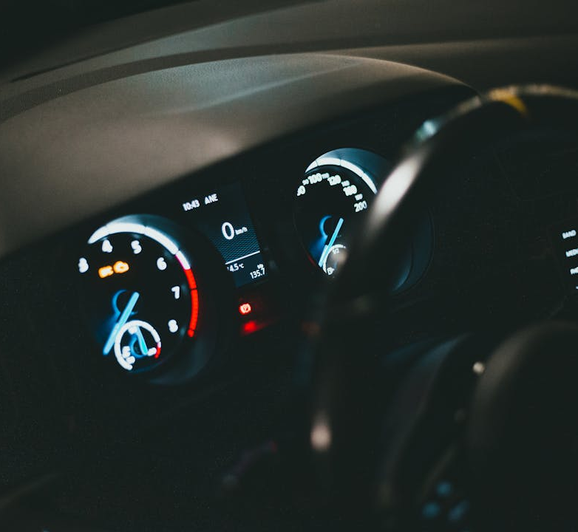
Gatekeeper Dashboard
E-Pravesh
Dashboard Overview
**Title:** Gatekeeper Home Screen - Command Center **Dashboard Components:** **Welcome Card:** - Personalized greeting with name and role - Current date and time **Real-Time Statistics:** - Total visitors today - Pending approvals count - Approved visitors today - Rejected visitors today **Quick Action Cards:** - Register New Visitor - View

Slide 20
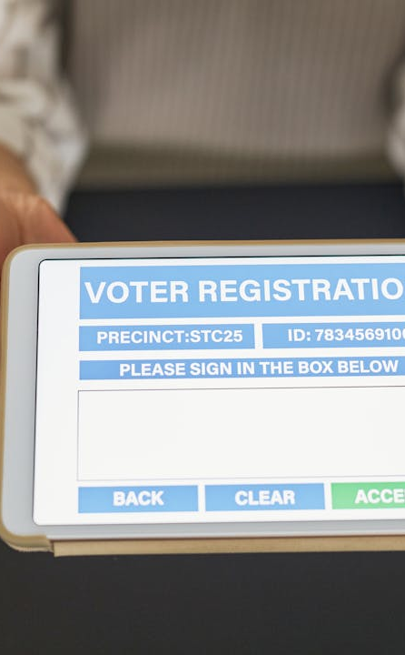
Visitor Registration Form
E-Pravesh
Registration Details
Required Fields: - Full name - Origin/Company name - Purpose of visit - Phone number (with auto-search) - Employee to meet (searchable directory) - Visitor photo (camera or gallery) Optional Fields: - Email address - Expected duration (30 min, 1 hour, 2 hours, 4 hours, Full day) - Additional notes for the employee

Slide 21
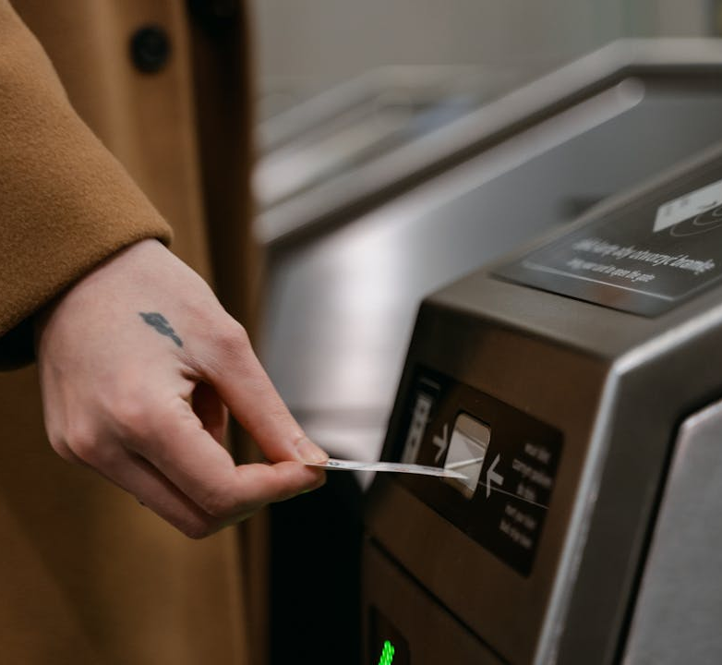
Form Capabilities
E-Pravesh
Form Features
- Real-time validation - Employee search dialog with department/role display - Photo capture with camera or gallery selection - Form reset functionality - Error handling with user-friendly messages

Slide 22
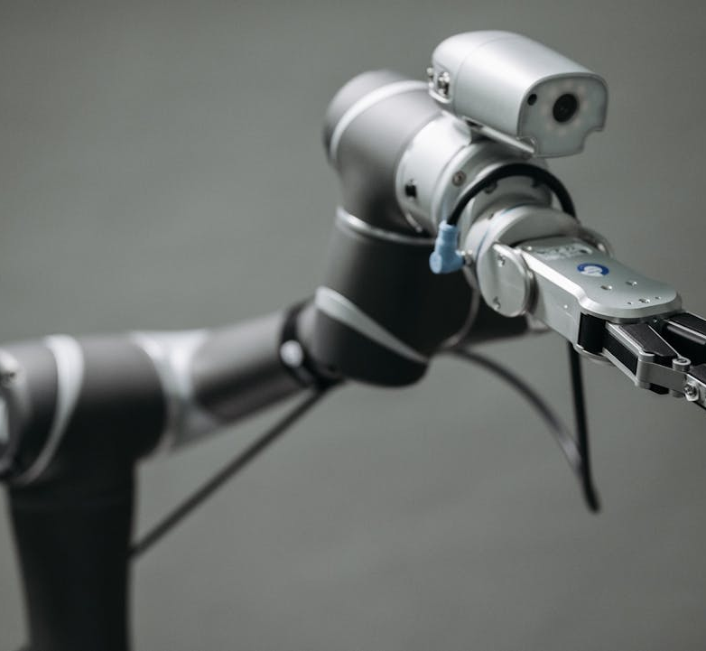
Photo Capture System
E-Pravesh
Photo Features
Camera Integration: Direct camera capture within app. Gallery Selection: Choose existing photos. Photo Display: Visitor photo shown in registration form. Cloud Storage: Automatic upload to Firebase Storage. Photo Visibility: Displayed in all visitor cards and profiles.

Slide 23
Photo Use Cases
E-Pravesh
Use Cases
Benefits
Use Cases: - Security identification - Employee recognition before meeting - Historical records with visual reference - Quick visitor verification
Benefits: - Enhanced security - Faster visitor identification - Professional appearance - Digital record keeping

Slide 24
Employee Dashboard
E-Pravesh
Welcome Card
Pending Visitor Cards
Statistics Panel
Recent Activity Feed
Welcome Card: - Employee name, job role, and department - Personalized greeting
Pending Visitor Cards (Up to 5 displayed): - Visitor photo - Name and origin/company - Purpose of visit - Expected duration - Direct Approve/Reject buttons on each card
Statistics Panel: - Pending approvals count - Approved visitors today - Rejected visitors today
Recent Activity Feed: - Recently approved/rejected visitors - Time since action (e.g., "2 hours ago") - Quick overview of daily activity

Slide 25

Visitor Status Tracking
E-Pravesh
Visitor Status
- Pending (awaiting approval) - Approved (cleared for entry) - Rejected (declined request) - Completed (visit finished)

Slide 26
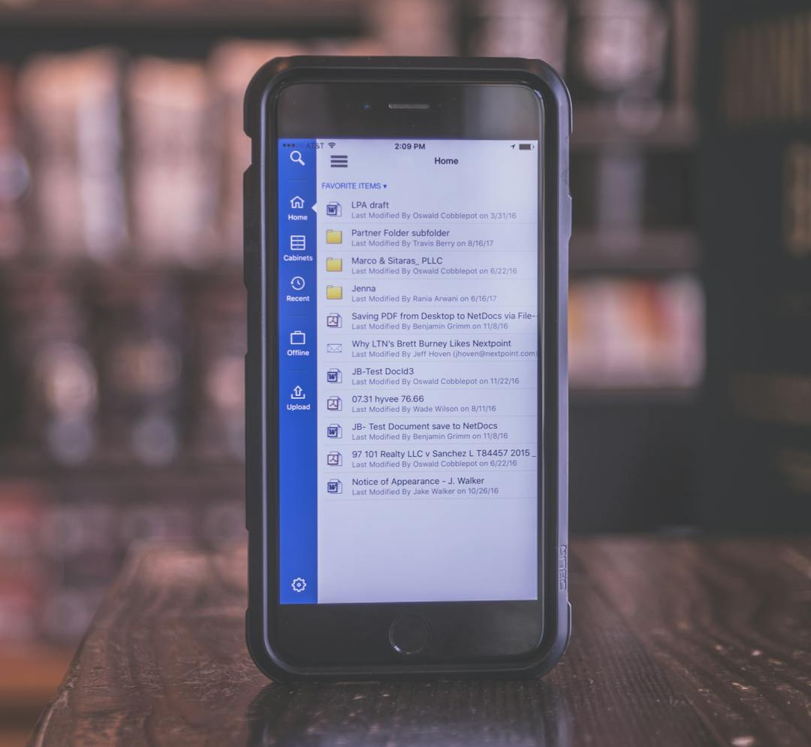
Real-Time Notifications
E-Pravesh
Notification Types
1. Request Notification - Sent to employee when new visitor registered - Contains visitor details and photo 2. Approval Notification - Sent to gatekeeper when employee approves - Updates visitor status immediately 3. Rejection Notification - Sent to gatekeeper when employee rejects - Includes rejection confirmation

Slide 27

Notification Features
E-Pravesh
Notification Features
- In-App Notification Center: Centralized notification hub - Unread Badge Count: Visual indicator of pending notifications - Mark as Read: Individual or bulk mark as read - Tap Navigation: Tap notification to view relevant content - Real-Time Delivery: Instant push notifications - Background Handling: Notifications work even when app is closed

Slide 28
Background Service
E-Pravesh
Android Features
iOS Features
Background Service Features: Android: - Battery optimization management - Background service monitoring - Persistent notification service - Device settings configuration guide
iOS: - Background app refresh support - Notification permission handling - APNs integration

Slide 29
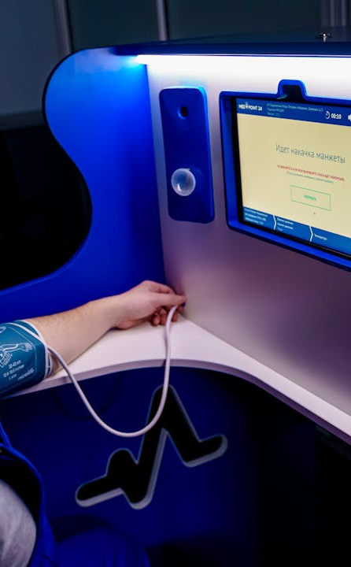
Reliability Features
E-Pravesh
Reliability Features
- Service status monitoring screen - Manual service restart option - Platform-specific instructions - Permission status indicators - Direct links to device settings Benefits: - Notifications delivered even when app is closed - No missed visitor requests - Reliable real-time communication - User-friendly troubleshooting Visual Suggestion: Phone

Slide 30
Dashboard Analytics
E-Pravesh
Statistics Dashboard
Employee View
Real-Time Features
Gatekeeper View (All Statistics): - Total visitors today - Total pending approvals (all employees) - Total approved visitors today - Total rejected visitors today - Last updated timestamp
(Personal Statistics): - Pending approvals for specific employee - Approved visitors for employee - Rejected visitors for employee - Personal activity metrics
- Auto-refreshing statistics via Firestore streams - Live updates without manual refresh - Color-coded stat cards - Visual icons for each metric - Error handling with retry functionality

Slide 31
Employee Directory
E-Pravesh
Employee Directory Features
Employee Selection Dialog
Employee Information
Employee Directory Features: - Complete employee list - Search by name functionality - Department and job role display - Visual avatars with initials - Active status indicators
Employee Selection Dialog: - Searchable dropdown during visitor registration - Department filtering - Job role display for context - Profile pictures - Quick selection interface
Employee Information: - Name, email, phone - Job role and department - Profile picture - Office location - Join date - Active status

Slide 32

Technical Excellence
E-Pravesh
Development Approach
Development Approach: Clean Architecture: Separation of concerns, maintainable code Test-Driven Development (TDD): Quality-first approach BLoC Pattern: Predictable state management Dependency Injection: GetIt service locator pattern

Slide 33

Key Technical Features
E-Pravesh
Technical Features
- Real-time data synchronization with Firestore streams - Secure authentication with Firebase Auth - Cloud storage for photos (Firebase Storage) - Cross-platform support (Android & iOS) - Responsive UI with Material Design 3 - Centralized error handling - Offline capability considerations

Slide 34

Code Quality
E-Pravesh
Code Quality Aspects
- Flutter analyze for code quality - Consistent formatting - Comprehensive error handling - User-friendly error messages

Slide 35
Security Features
E-Pravesh
Authentication Security
Data Security
Firebase Authentication. Secure password handling. Role-based access control. Session management. Persistent login with token management.
Cloud Firestore with security rules. Role-based data access. Encrypted data transmission. Secure photo storage. User data privacy.

Slide 36
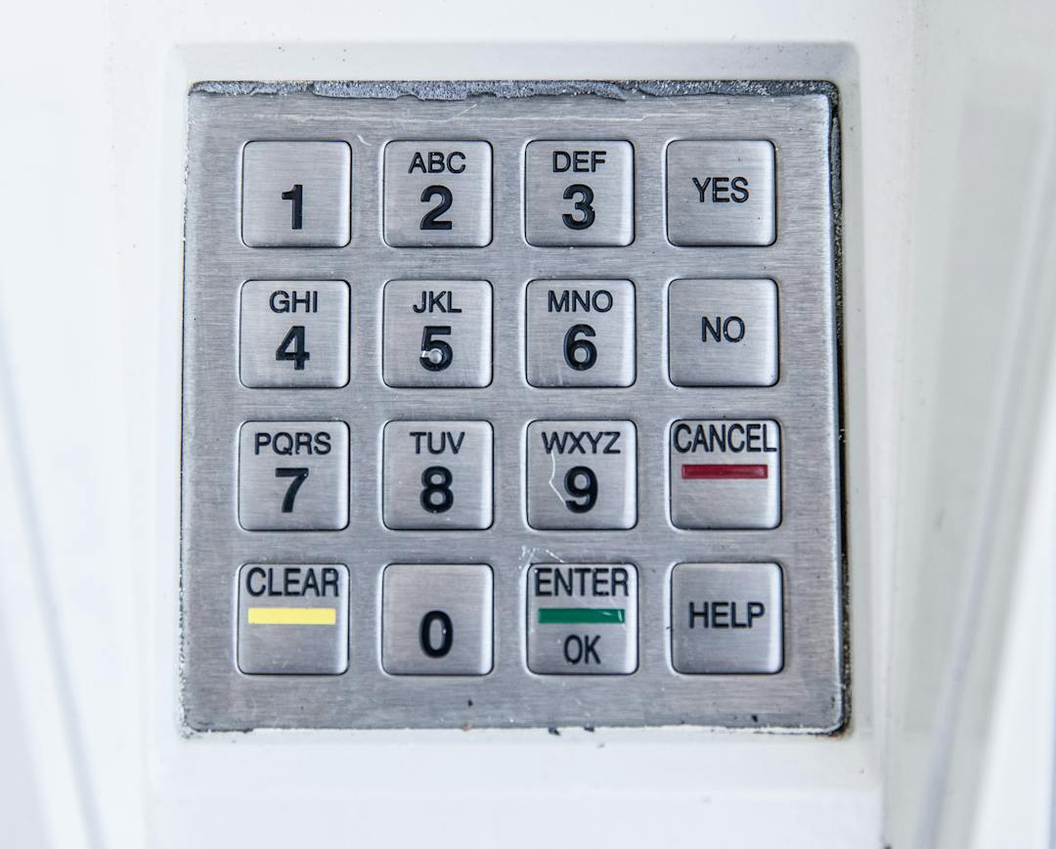
Access & Compliance
E-Pravesh
Access Control
Compliance
Access Control: - Gatekeepers: Full visitor management access - Employees: Only their visitor requests - Isolated data per user role - Audit trail with timestamps
Compliance: - Data stored in secure Firebase infrastructure - GDPR-compliant data handling - User consent for photo capture

Slide 37
Benefits by Stakeholder
E-Pravesh
For Gatekeepers
For Employees
For the Organization
For Gatekeepers: - 60% faster visitor registration with auto-fill - Reduced data entry errors - Complete visitor tracking - Real-time status updates - Digital record keeping
For Employees: - Advance notification of visitors - Mobile approval from anywhere - No interruptions for unexpected visitors - Complete visitor information before meeting - Historical visitor records
For the Organization: - Enhanced security and access control - Digital audit trail - Real-time analytics and reporting - Professional visitor experience - Reduced paper waste and manual processes - Scalable solution for growth

Slide 38

Roadmap & Vision
E-Pravesh
Planned Features
Short-Term: - Check-in/Check-out functionality - Visitor ID card printing - QR code generation for approved visitors - SMS notifications for visitors - Visitor pre-registration portal Medium-Term: - Analytics dashboard with charts and graphs - Export visitor reports (PDF, Excel) - Multi-location support - Visitor badge printing integration -

Slide 39

E-Pravesh Visitor Management
E-Pravesh
Visitor Management Features
E-Pravesh revolutionizes institutional visitor management with: - Smart, efficient registration - Real-time notifications - Complete visitor tracking - Professional, secure solution

Slide 40

Key Achievements
E-Pravesh
Achievements Overview
- 7 feature modules - 78+ Dart files - Clean Architecture implementation - Cross-platform mobile app (Android & iOS) - Enterprise-ready solution - Powered by Flutter & Firebase

Slide 41
Contact & Identity
E-Pravesh
Website
Phone
Email
Location

Slide 42

Call to Action
E-Pravesh
Next Steps
Ready to modernize your visitor management with E-Pravesh? Let's discuss implementation!

Slide 43

Design & Branding Notes
E-Pravesh
Branding Elements
Branding: - App Name: E-Pravesh (ई-प्रवेश) - prominently display on title slide and footer - Logo Suggestion: Gateway/door icon combined with digital elements (circuit, waves) - Brand Colors: Modern, professional, trustworthy (blue/green theme) - Include Hindi text "ई-प्रवेश" with English "E-Pravesh" for cultural relevance Color Scheme

Slide 44
Presentation Flow & Tips
E-Pravesh
Layout Tips
Presentation Flow
Visual Suggestion
Maximum 6-7 bullet points per slide. Use two-column layouts for comparisons. Include visual breaks with images/icons. Maintain consistent spacing. Use slide numbers. Add subtle slide transitions.
1-5: Introduction and context (title, problem, solution, architecture, roles). 6-9: Complete workflow explanation (end-to-end, timing, scenarios, data flow). 10-16: Feature deep-dives (dashboards, registration, photos, approval, history). 17-19: Technical capabilities (notifications, background services, analytics).
E-Pravesh logo, QR code for demo, and contact information.

