Slide 1
Git Workshop
Hosted by Computing for Compassion

Slide 2
What is Git?
Git is a free and open source distributed version control system designed to handle everything from small to very large projects with speed and efficiency.
https://git-scm.com/
Git is a version control system (VCS), also called a source-control system, designed to simplify the task of managing source code revisions and handle collaboration with ease.
Designed originally by Linus Torvalds (Linux author) while making Linux.

Slide 3
Why do we need Git?
Naïve methods
Shortcomings
Physical data transfer (flash drives, hard drives, floppy disks, etc.)
Email
Same machine
No authorship tracking
No revision history
No ways to combine changes
No easy ways to deal with conflicting changes
No backups
No separation of concerns (independent feature development)
No easy way to exclude binaries from file sharing
No user permission system
No safeguards
No non-linear workflows

Slide 4
Some quick terminology
A commit is the basic atomic unit of work in Git. A commit is a snapshot of the project tree at that point in time.
These commits are contained in repositories in a commit tree (example on the next slide).
Local repositories are repositories on a user’s machine; the repository that they directly interact with.
Remote repositories are repositories off-site somewhere, usually on a company server or third-party service (GitHub, etc.).
The working directory refers to the current state of files in your project folder.

Slide 5
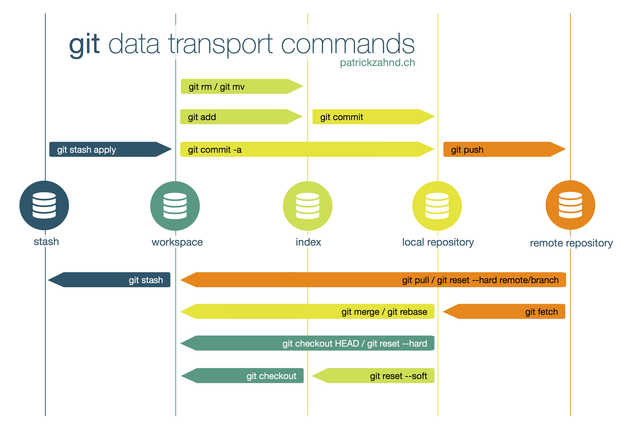
Some quick terminology
The staging area or index is the snapshot of current changes to be bundled together into a single commit.
feature
X
Y
M₁
Z
master
A
B
C
D
M₂

Slide 6
Some quick terminology
Each commit has a parent, the snapshot that it is based off.
A branch is a series of commits. The primary branch of of a Git project (the trunk) is called master.
X
Y
M₁
Z
feature
A
B
C
D
M₂
master

Slide 7
Creating a Git repository
Make a new folder
Inside of the folder run the command git init
Notice the creation of the .git folder

Slide 8
The first commit
Create a file called hello-world.cpp
Run git status to see the status of the current project.
Run git add hello-world.cpp to stage the file. This will put the changes into the index.

Slide 9
The first commit
Run git commit –m “Initial commit” to commit the changes.
Initial commit is the commit message. Commits are also assigned hashes.
Run git status to confirm commit.

Slide 10
Other information-gathering commands
Setup
git status
Make a new file called goodbye-planet.cpp
Edit hello-world.cpp to say “Hello, world!” instead.
Do not commit your changes yet.
This command tells us information about which files have been changed (added, modified, deleted, moved). It is the basic command for checking project status.

Slide 11
Other information-gathering commands
git diff
git diff HEAD
Before moving on…
The diff commands tell you the difference between your working directory and index or working directory and a commit.
Above, HEAD is a special pointer to the latest commit of a branch. So, this will compare your working changes to the HEAD commit.
Before moving on, stage and commit your changes.
git add . allows you to stage all of your changes at once.
Commit your changes with a meaningful commit message.

Slide 12
Other information-gathering commands
git log
git show
git show <commit>
The log command gives you a list of commits on your current branch. It tells you:
Commit messages
Authors
Branches
Times
Commit hashes
To see more information about a particular commit, use the show command. This will show you information about the most recent commit or the specified commit. This includes:
Everything to the left
A list of changes (a diff)

Slide 13
Pushing to a remote
Create the remote repository on GitHub
Add the remote: git remote add origin <url>
Push your local commit tree: git push
(git push –u origin master)

Slide 14
Collaboration using Git
git fetch
Fetch information about the remote repo
git pull
Pull the remote changes to your local working directory
git push
Push your local commit tree to the remote repository
git clone <url>
git init
git remote add ...
git pull

Slide 15
Merging, part I
When two commits have the same parent, it creates two branches.
These branches can have names. Otherwise, they are technically sub-branches off of the same primary branch.
Let’s try it:
LR1: commit and push a new file called merge-A.txt
LR2: commit a new file called merge-B.txt
Attempt to push

Slide 16
Merging, part I (simple merge)
origin/master
(1) git commit
(1) git push
(2) git commit
(2) git pull
(2) git push
(1) git pull
master (2)
master (2)
master
C
M₂
A
B
master (2)
master
master (1)
origin/master
origin/master

Slide 17
Merging, part I (merge conflict)
origin/master
(1) git commit
(1) git push
(2) git commit
(2) git pull
(2) git commit (MC)
(2) git push
(1) git pull
master (2)
master (2)
master
C
M₂
A
B
master (2)
master
master (1)
origin/master
origin/master

Slide 18
Branching
feature
When two commits have the same parent, it creates two branches. All commits go onto the checked out (selected) branch.
git branch
List current branches of the project and the currently checked out branch.
git branch <branch>
Create a new branch with the specified name.
git checkout <branch>
Switch to the specified branch.
git checkout -b <branch>
git branch <branch>
git checkout <branch>
X
Y
A
B
C
master
When referencing a branch, we refer to the HEAD (last commit) of that branch!

Slide 19
Merging, part II (merging branches)
(1) [master]
git checkout –b my-first-branch
(1) [my-first-branch]
git commit
(1) [my-first-branch]
git push –u origin my-first-branch
(2) [master]
git merge my-first-branch
(2) [master]
git push
(1) [my-first-branch]
git checkout master
origin/my-first-branch
my-first-branch
X
HEAD (1)
A
B
M₂
master
master
git merge <branch>
Merge the changes from the specified branch into the checked-out branch
origin/master
origin/master
HEAD (2)
my-first-branch
HEAD (2)
HEAD (1)
HEAD (1)
HEAD (2)
HEAD (1)

Slide 20

Feature branching
X
Y
M₁
Z
feature
A
B
C
D
M₂
master

Slide 21
Undoing changes
Un-staging a file
git rm --cached <file>
Undoing changes before committing (reset file(s))
git checkout <file>
git checkout HEAD
git checkout <ref> [file]
Undoing changes after committing but before pushing
git reset <ref>
Undo commit(s) but keep changes.
git reset --hard <ref>
Undo commit(s) and discard changes.
Undoing changes after committing and after pushing
git revert HEAD~<#>
git revert <ref>
Create commit(s) which undo previous commit(s).

Slide 22
Ignoring files (.gitignore)
# This is a comment, Git will ignore this line
# Ignore specific files
specificFile.txt
data/specificFile.csv
# Globbing (wildcards)
# * - 0 or more characters
# ? - 0 or 1 character
# [a-z] - any character in this range
*.secret
test?.txt
names_that_start_with_[a-z].csv
# ** tells Git to recurse through folders
# Ignore directory called "build"
build/
# Ignore files or directories called "build"
build
# Ignore everything in folder
build/**
# Match all "test.txt" files inside of a folder
**/test.txt
# Match all "bar" directories inside of a "foo" directory
**/foo/bar/

Slide 23
Stashing
git stash push
git stash <file> [file...]
Add some changes to the stash and reset working directory to HEAD
git stash apply
Apply the stashed changes to the working directory
git stash drop
Remove the latest entry from the stash
git pop
git stash apply
git stash drop
git stash list
List all stashed changes
git stash show stash@{<#>}
See a diff for a particular stashed change
The stash allows us to delay making some changes by storing them for later.
Useful when pulling or checking out different branches (really, any action that will reset the working directory).
The stash is a stack, meaning changes will be applied in the reverse order that you put them in.
The stash is independent of the commit tree and is only ever in the local repository.

Slide 24
X
Y
M₁
Z
feature
A
B
C
D
M₂
master

Slide 25
X
Y
feature
A
B
C
master

Slide 26
X’
Y’
Z
feature
A
B
C
D
M₁
master

