Slide 1


Are You a Fraud!?
By: Zeke Herrera and Nathan Dwyer

Slide 2
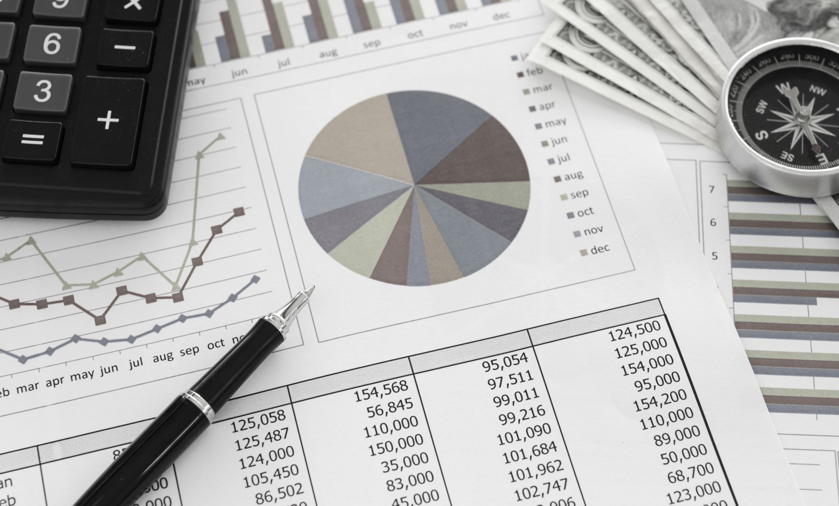
Overview
This project takes a data set of credit card transactions found on Kaggle, of which we used varying lines to predict credit card fraud.
In our analysis we will test machine learning models against trained sets to predict credit card fraud and analyze the results to see if there is a correlation between any of the variable found in the data set and fraud.

Slide 3

Motivation
Do we have enough data?
What model will be the most effective?
Which variables help indicate a fraudulent charge?
Does increasing the dataset size improve the predictive capabilities of the model?
How accurate will the fraud detection model be?

Slide 4
Machine Learning Models
K-Nearest Neighbors
Gradient Boosting
XGBoosting

Slide 5
Module Summary
K-Nearest Neighbors:
K-Nearest Neighbors is a classification algorithm that classifies a data point based on the majority class of its k-nearest neighbors.
KNN can be effective in identifying fraudulent transactions by considering the similarity of features among transactions. It works well when fraudulent transactions exhibit patterns similar to their neighboring data points.
Gradient Boosting:
Gradient Boosting is an ensemble learning technique that combines multiple weak learners to create a strong predictive model.
Gradient Boosting is powerful for detecting anomalies and outliers, making it suitable for identifying fraudulent transactions. It can capture complex relationships and dependencies in the data.
XGBoost:
XGBoost (Extreme Gradient Boosting) is an optimized gradient boosting algorithm known for its speed and performance.
XGBoost excels in handling imbalanced datasets, which is common in fraud detection. Its ability to prioritize misclassified instances can improve the model's accuracy in identifying fraudulent transactions.

Slide 6
Achieving Project Goals (Steps)
Read in
Read in dataset
Exploration
Visualize the data and try to find correlations in the dataset using a heat map
Create
Create the data set and then split it into a train and test data set
Scale
Scale, fit, transform, predict
Repeat
Repeat these steps for the Gradient Boosting model and XGBoost model
Visualized
Visualized classification report as well as the feature importance
Visualize feature importance

Slide 7
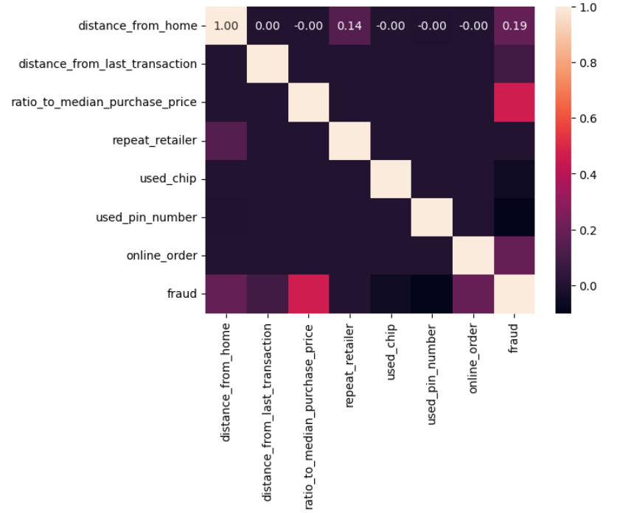
Correlation

Slide 8

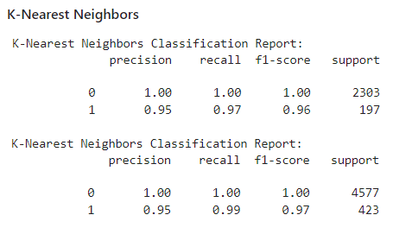



K-Nearest Neighbors Classification Report

Slide 9
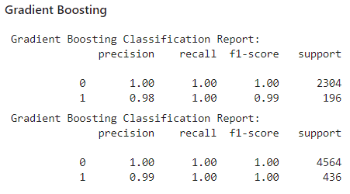
Gradient Boosting Classification Report

Slide 10
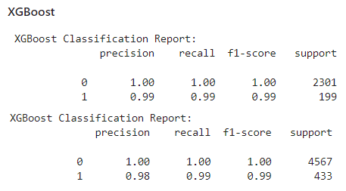
XGBoosting Classification Report

Slide 11
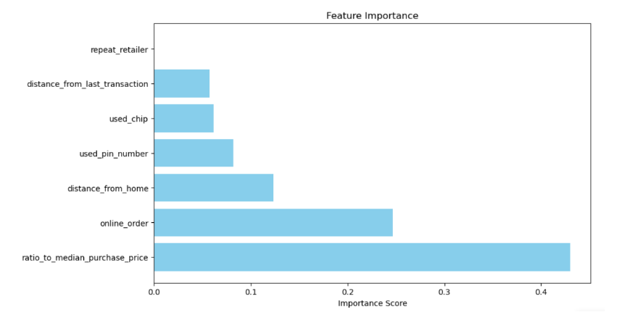
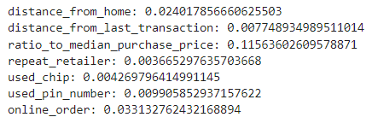
Conclusions/Analysis
As shown in our Feature Importance visual, we saw the highest correlation with ratio to median purchase price and online orders.
On the opposite end you have repeat retailer and distance from retailer, which was contrary to what we had initially thought it would be at the beginning on this assignment( used chip and used pin number).

Slide 12
Trials and Tribulations
Project Ideas ( Took 2 classes!)
New Machine Learning Model to Use (Gradientboosting)
Visualizing correlation
To much data!

Slide 13
Q & A

