Slide 1


Are You a Fraud!?
By: Zeke Herrera and Nathan Dwyer

Slide 2

Overview
This project takes a data set of credit card transactions found on Kaggle, of which we used a varying lines to predict credit card fraud.
In our analysis we will test machine learning models against trained sets to predict credit card fraud and analyze the results to see if there is a correlation between any of the variable found in the data set and fraud.

Slide 3
Motivation
Do we have enough data?
What model will be the most effective?
Which variables help indicate a fraudulent charge?

Slide 4

Data Collection
Collection
Utilized a dataset from Kaggle of fraudulent and non-fraudulent credit card charges
Used 30,000 of the 1 million
Issues
To much data

Slide 5
Presentation Agenda
Machine Learning Models Utilized
Machine Leaning Model Classification Reports showing10k data points vs. 20k data points
Data Exploration
Data visualization
Conclusion

Slide 6
Machine Learning Models
K-Nearest Neighbors
Gradient Boosting
XGBoosting

Slide 7
Achieving Project Goals (Steps)
Read in dataset
Visualize the data and try to find correlations in the dataset using a heat map
Create the data set and then split it into a train and test data set
Scale, fit, transform, predict
Repeat these steps for the Gradient Boosting model and XGBoost model

Slide 8

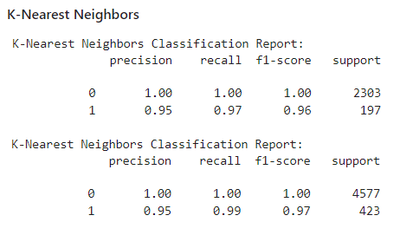



K-Nearest Neighbors Classification Report

Slide 9
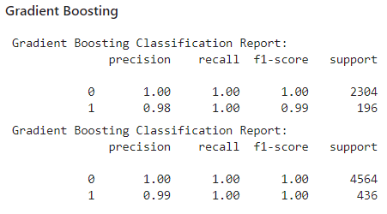
Gradient Boosting Classification Report

Slide 10
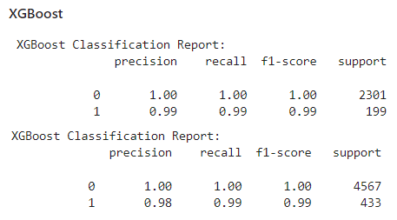
XGBoosting Classification Report

Slide 11
Conclusions/Analysis

Slide 12
Q & A

