Slide 1
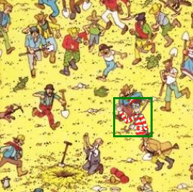
Can you find Wally?
Sem 1 Workshop 5
Teaching a CNN to draw a box around him
One of our generated training pictures. The green box is where we pasted Wally.
Notes:
[~1 min] Welcome. Last workshop: a CNN that says WHAT is in a picture. Today: WHERE something is. By the end of the notebook your model will look at a busy Where's Wally scene and draw a box around him, trained from scratch in about 2 minutes.

Slide 2
A Quick Intro to Today’s Activity
PART 1
A quick tour, so you know where each step is going
Notes:
[a few seconds] Part 1: the big picture of the notebook.

Slide 3
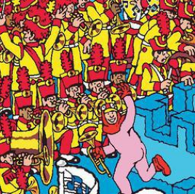

The goal: one picture in, one box out
4 numbers
(x1, y1, x2, y2)
our CNN
(WaldoFinder)
the top-left and bottom-right corners of a box around Wally
a 256 × 256 picture
Green box = where Wally really is. Red box = where the model thinks he is.
Notes:
[~1 min] The whole task in one line: a picture goes in, four numbers come out. Those four numbers are the corners of a box. We'll always draw the true box in green and the model's guess in red. This is called object LOCALISATION: we're not asking "is there a Wally?", we're asking "where is he?".

Slide 4






The notebook in 7 steps
Step 1
Step 2
Step 3
Step 4
Make our own pictures
Feed them to PyTorch
Build the CNN
Loss + optimiser
paste Wally on 286 backgrounds, write down the box
Dataset + DataLoader serve batches of 32
4 conv blocks + a heatmap head
MSE says how wrong, Adam fixes it
Step 5
Step 6
Step 7
Train
Score the boxes
Test on new pictures
10 epochs × 32 batches, about 2 min on GPU
IoU: how much the boxes overlap
green vs red boxes, heatmaps, worst cases
Notes:
[~1.5 min] Walk through the 7 steps quickly. Steps 1-2 are about DATA, step 3 is the MODEL, steps 4-5 are TRAINING, steps 6-7 are CHECKING how good it is. Every code cell does one small job and has an explanation above it, plus Think questions to discuss with your neighbour.

Slide 5
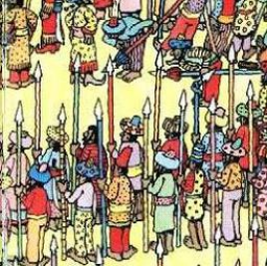
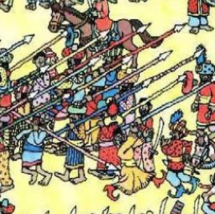
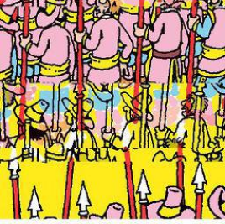

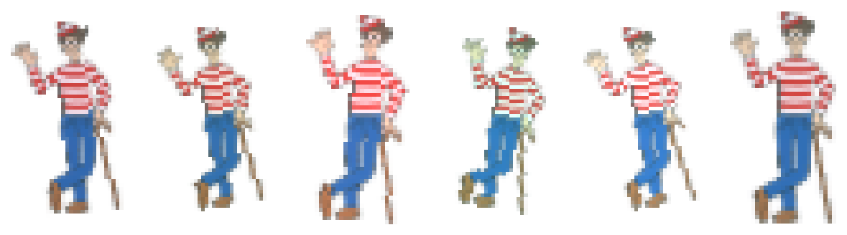

Step 1: we make our own training pictures
Paste with the alpha mask
Only Wally's own pixels are copied, not the white rectangle around him.
Tweak him every time
286 backgrounds
Small rotation, brightness and colour changes, so the model can't just memorise 5 pictures.
Labels for free
We placed him, so we already know the true box. No hand-labelling 5000 pictures!
5 Wallys, each tweaked every time (augmentation)
5000 pictures → 4000 for training, 1000 kept hidden for testing
Notes:
[~1.5 min] This is called SYNTHETIC data. Labelling thousands of real pictures by hand would take days, so we cheat: we paste Wally ourselves and write down where. Three ideas: (1) the alpha (transparency) mask, so only Wally's pixels get pasted; (2) augmentation: every pasted Wally is slightly rotated, brighter/darker, a bit more red/green/blue, so the model learns "Wally" not "these 5 exact images"; (3) the test set: 1000 pictures the model never trains on, so we can check it really learned.

Slide 6
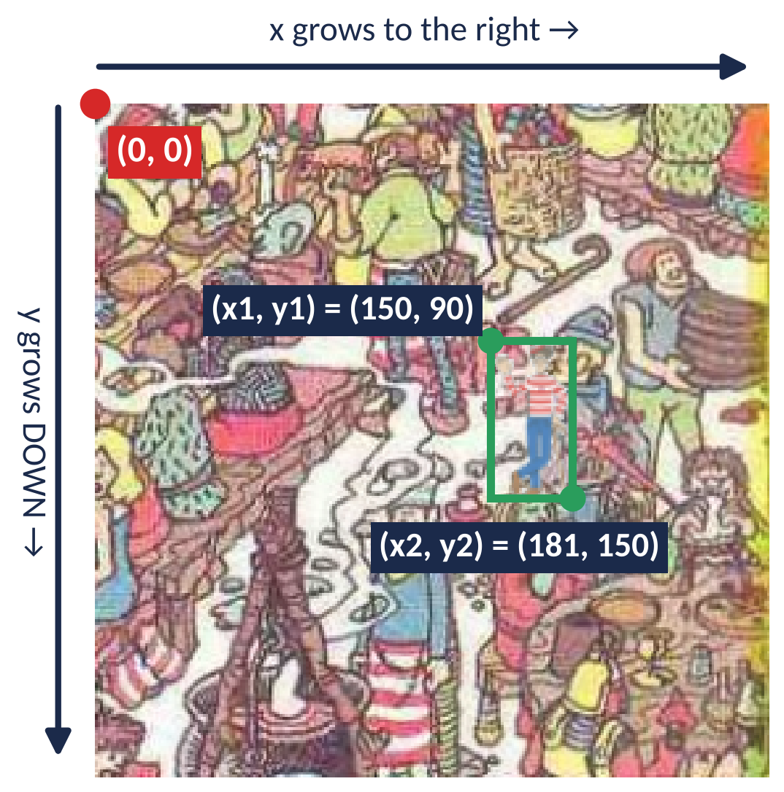
Boxes and image coordinates
(0, 0) is the top-left corner, not the bottom-left like in maths
x counts pixels to the right, y counts pixels DOWN
A box is 4 numbers: (x1, y1) top-left and (x2, y2) bottom-right
Width = x2 − x1 = 31 px, height = y2 − y1 = 60 px
Inside the model we divide by 256 so every number is between 0 and 1: (150, 90) becomes (0.59, 0.35)
Notes:
[~1.5 min] A common trip-up: in images y goes DOWN. A box is (x1, y1, x2, y2): top-left and bottom-right corners. That's the format torchvision's box_iou wants. Inside the model we divide by the image size (256), so the true boxes and the model's predictions are all between 0 and 1. Small numbers make training steadier. To draw a box we multiply back by 256.

Slide 7
Step 2: pictures become tensors, served in batches
picture file
NumPy array
tensor
a batch
image_0042.png
(256, 256, 3)
values 0–255
(3, 256, 256)
values 0–1
(32, 3, 256, 256)
(batch, channels, height, width). Most errors you'll hit today are shape errors, so print .shape when stuck!
32
32
320
images per batch
batches per epoch
updates in total
the weights are updated once per batch
1000 images ÷ 32, rounded up (the last batch has 8)
10 epochs × 32 batches
Notes:
[~1.5 min] PyTorch only understands tensors, which are like NumPy arrays that can live on a GPU. Each picture becomes (3, 256, 256): 3 colour channels first, then height and width, values scaled to 0-1. The DataLoader stacks 32 at a time. Vocabulary: a BATCH is 32 pictures looked at together, one weight update per batch. An EPOCH is one pass through all 1000 training pictures. 10 epochs = 320 updates.

Slide 8
How does a CNN see Wally?
PART 2
Convolution, edges, padding, pooling, and one full layer
Notes:
[a few seconds] Part 2: a recap of CNNs, with Wally as the example for everything.

Slide 9
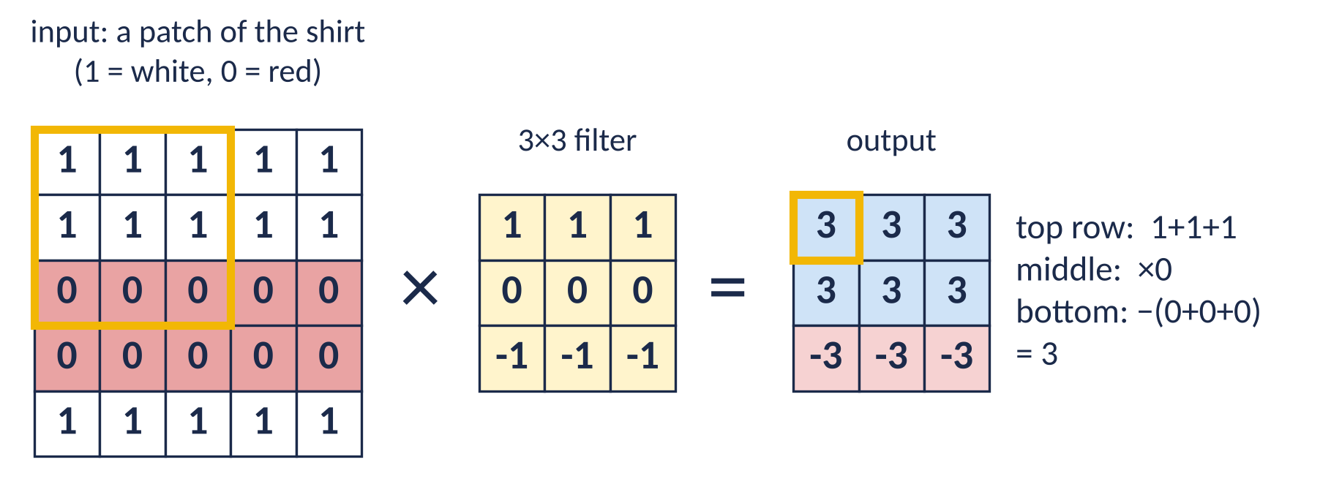
Convolution: slide, multiply, add
1
Place
2
Multiply and add
3
Slide
Put the 3×3 filter on a 3×3 patch of the picture (gold square).
Multiply each pixel by the filter number on top of it, then add all 9 up. That gives ONE number.
Move one pixel along and repeat. All the numbers together make a new grid: a feature map.
Notes:
[~2 min] Use the shirt example. White = 1, red = 0 (very simplified!). The filter has 1s on top, 0s in the middle, -1s at the bottom. Put it on the top-left patch: top row 1+1+1 = 3, middle row times 0, bottom row minus (0+0+0). Answer 3. Slide along: the output is big and positive where white is ABOVE red, big and negative where red is above white. So this filter is a detector for "a horizontal stripe edge here". Ask: what would the output be on a plain white wall? (0, because the top and bottom cancel.)

Slide 10
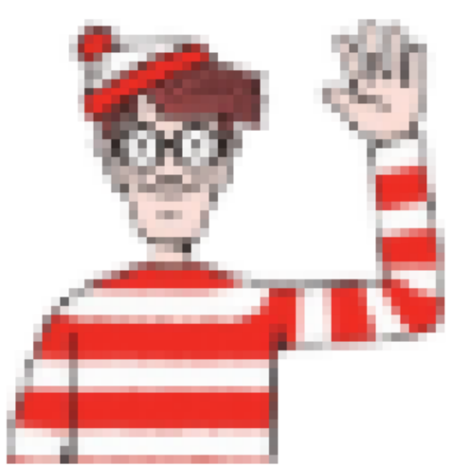
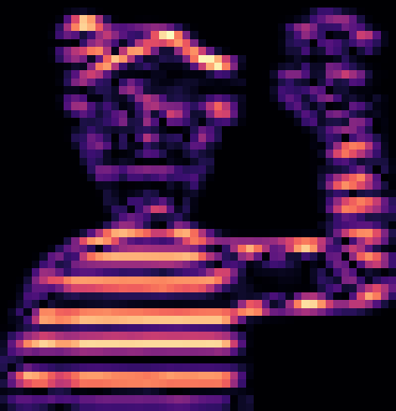
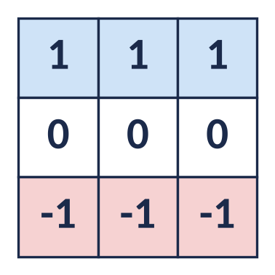
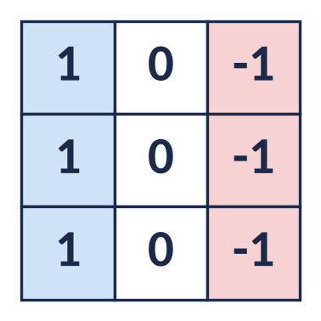
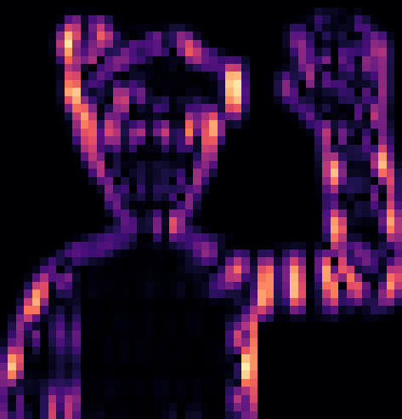
Horizontal and vertical edge detectors on Wally
input
horizontal-edge filter
vertical-edge filter
the stripes on his shirt light up
the sides of his arm and face light up
Bright = strong response. Same picture, different filter, different pattern found. In a CNN, nobody writes these filters by hand: the model learns them.
Notes:
[~2 min] These are real results: I ran the two filters over one of our Wally images. The horizontal filter (1s on top, -1s on the bottom) lights up on the horizontal stripes of his shirt and hat. Turn the filter 90 degrees (1s on the left, -1s on the right) and it lights up on vertical edges instead: the sides of his raised arm and his face. Key point: in our CNN the filters start random and are LEARNED. The first layer usually ends up with edge and colour detectors like these.

Slide 11
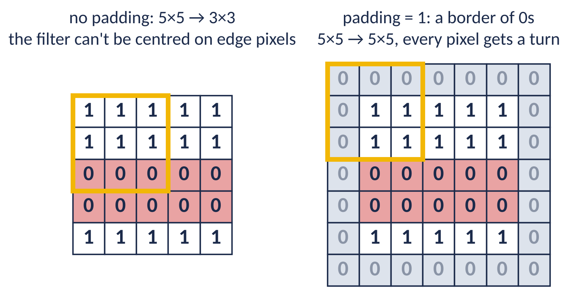
Padding: keeping Wally at the edge in view
The filter makes one number for each position it can be centred on
Without padding it can't sit on the edge pixels: 256 → 254, and Wally at the very edge gets ignored
padding = 1 adds a border of zeros, so 256 → 256 and every pixel gets a turn
nn.Conv2d(3, 16, kernel_size = 3, padding = 1)
Notes:
[~1.5 min] Every pixel IS covered as the filter slides, but the output has one number per position where the filter can be CENTRED. Without padding, the filter can't be centred on an edge pixel because it would stick out. So the grid shrinks by 1 on each side, and if Wally is right at the edge he barely gets looked at. padding=1 adds a ring of zeros so the filter can be centred on every real pixel: same size in, same size out. In our notebook only MaxPool changes the size.

Slide 12
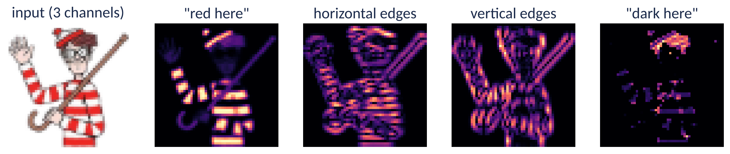
Many filters, many channels
nn.Conv2d(3, 16, kernel_size = 3)
Deeper layers combine simple patterns
3 in: red, green and blue
16 out: 16 different filters, each making its own map (a channel)
each filter is 3 × 3 × 3: it looks at all 3 colours at once
block 1: edges, "red here"
block 2: stripes, corners
blocks 3 and 4: striped shirt, bobble hat, round glasses
Notes:
[~2 min] One filter finds one pattern. So we use lots of them. Conv2d(3, 16) means: 3 colour channels come in, 16 filters run over them, 16 feature maps come out. These four maps are simplified examples I made, but they're the kind of thing a first layer learns: where is it red, where are horizontal edges, vertical edges, dark bits like hair and glasses. The next layer takes these maps as its input and combines them, e.g. "red AND horizontal edges" = striped shirt. That's why our channels grow 16 → 32 → 64.

Slide 13
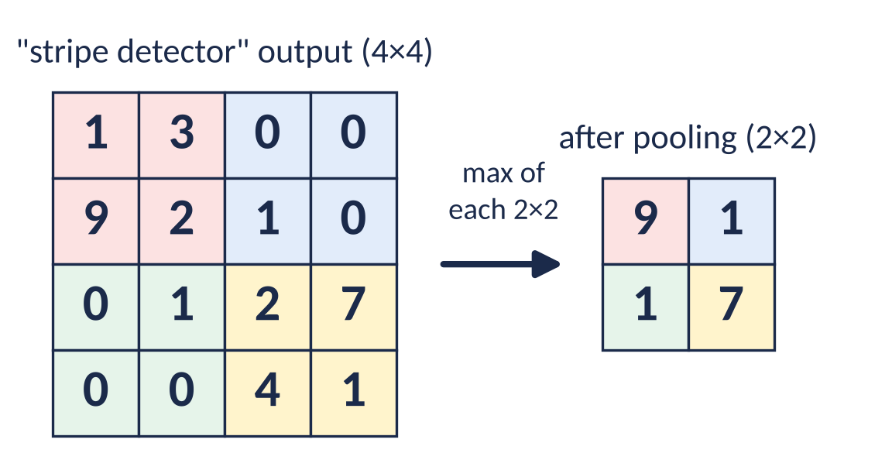
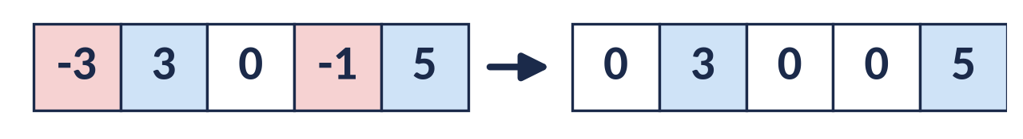
ReLU and max pooling
ReLU: keep the positives
Max pooling: keep the strongest
negative numbers become 0, positive ones stay
"no stripes here" and "anti-stripes here" both just mean 0
without it, stacking layers would be no better than one layer
keeps the biggest number in each 2 × 2 square: half the width and height
"there are stripes somewhere around here" is all we need
next layer sees a wider area of the picture, and there's less to compute
Notes:
[~1.5 min] ReLU: after each convolution, negatives become zero. It's what lets the network learn curvy, complicated rules instead of straight lines. Max pooling: from every 2x2 square keep only the biggest number. The stripe detector said 9 in the top-left corner, so after pooling we still know "strong stripes, top-left", just less precisely. Each pool halves the size, so later layers see a bigger chunk of the picture: big enough to see a whole Wally.

Slide 14
One layer of a conv network, worked through
input picture
16 filters, 3×3×3
+ 1 bias each
16 feature maps
ReLU
MaxPool 2×2
256 × 256 × 3
conv
256 × 256 × 16
negatives → 0
128 × 128 × 16
How many weights does it learn?
Wally example: one output number
each filter: 3 × 3 × 3 = 27 weights + 1 bias = 28
16 filters: 16 × 28 = 448
filter #5 learned "white above red"
on Wally's shirt: 27 multiplications added up = 3.0, plus bias −0.5 = 2.5
ReLU: 2.5 stays 2.5 (on a plain wall: −0.5 → 0)
MaxPool: 2.5 survives if it's the biggest in its 2 × 2 square
compared with 12.6 million for a fully connected layer
Notes:
[~2 min] This is exactly block 1 of our model. Input: a 256x256 picture with 3 colours. 16 filters, each 3x3x3 plus a bias. Output: 16 feature maps, same size thanks to padding. ReLU zeroes the negatives. MaxPool halves it to 128x128x16. Count the weights: 28 per filter, 448 for the whole layer. Walk through one number: a "white above red" filter on Wally's shirt gives 3, the bias shifts it to 2.5, ReLU keeps it, pooling keeps it if it's the strongest nearby. On a plain wall the same filter gives -0.5, which ReLU turns into 0: "nothing here". (Numbers simplified.)

Slide 15
Stack 4 blocks: from pixels to a map of descriptions
 | shape (channels × height × width) | what it might detect
input | 3 × 256 × 256 | colours
block 1 | 16 × 128 × 128 | edges, "red here"
block 2 | 32 × 64 × 64 | stripes, corners
block 3 | 64 × 32 × 32 | striped shirt, hat shape
block 4 | 64 × 16 × 16 | whole-Wally parts
The final 16 × 16 grid
the picture cut into 256 squares, each 16 × 16 pixels
each square has 64 numbers describing what's in it
each square "sees" a patch about 46 px wide: big enough for a whole Wally
the grid shrinks while the filters grow: we trade WHERE detail for WHAT detail
Only MaxPool shrinks the grid: 256 → 128 → 64 → 32 → 16.
Notes:
[~1.5 min] Our model repeats that block 4 times. Each time the grid halves and the number of channels grows. By the end we no longer have a picture: we have a 16x16 map where every square has 64 numbers describing it, like "strong stripes, some hat, no glasses". Each square effectively sees a 46-pixel patch, big enough for a whole Wally. Next question: how do we turn that map into an answer?

Slide 16
Classification vs localisation
Classification: WHAT is in it?
Localisation: WHERE is it?
Wally? yes 97%
no 3%
(0.53, 0.14,
0.66, 0.36)
output: one probability per class (softmax)
output: 4 numbers, the box corners
loss: mean squared error (how far off)
today! Same CNN body, different head
Notes:
[~1.5 min] The conv blocks (the "body") are the same for both jobs. Only the HEAD at the end changes. Classification: "is this Wally, yes or no?", a probability per class, trained with cross-entropy. That was last workshop. Localisation: four numbers for the box, trained with mean squared error. Important: today's notebook does ONLY localisation. It always assumes exactly one Wally is in the picture and always draws one box. A Think question at the end asks what it does with zero or two Wallys. Real detectors like YOLO do both at once.

Slide 17
What's new in today's notebook
PART 3
The heatmap head, the training loop and IoU
Notes:
[a few seconds] Part 3: three ideas you'll meet in the notebook that weren't in the last workshop.

Slide 18
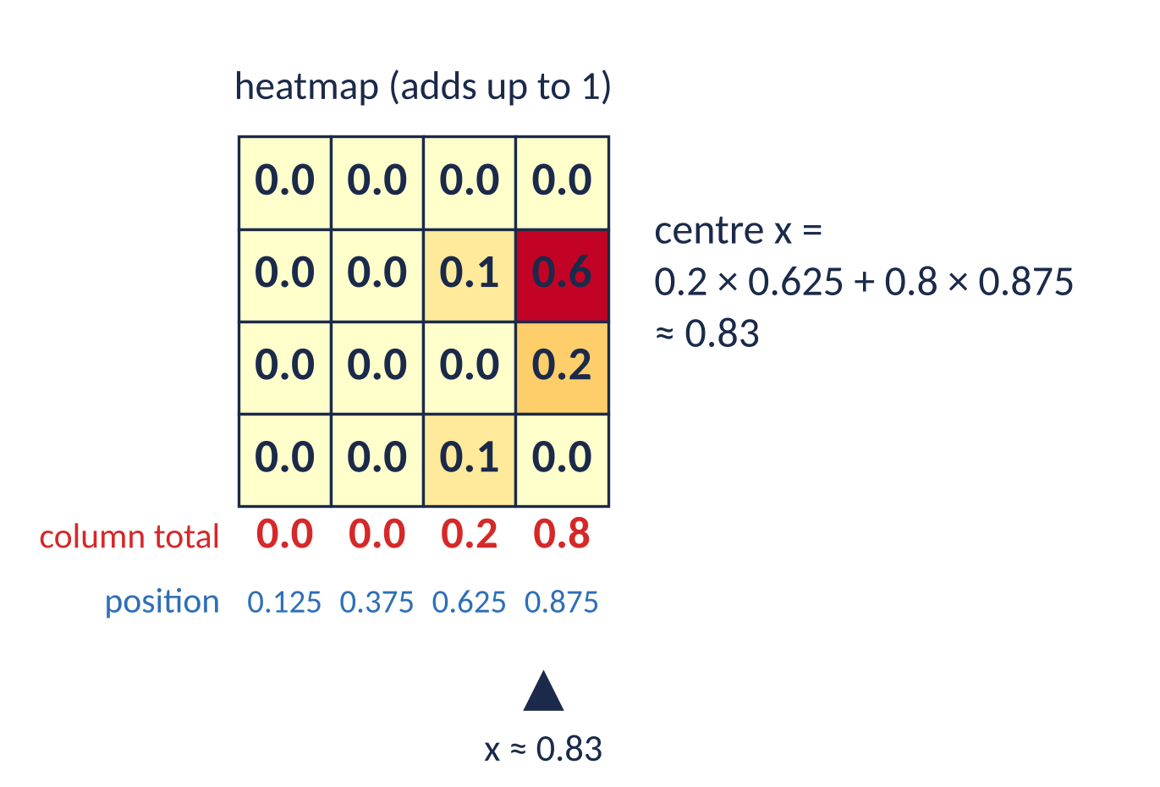
The heatmap head: "which square is Wally in?"
1
Score every square
a 1×1 conv asks each of the 256 squares "how Wally-like are you?"
2
Softmax
turns the scores into probabilities that add up to 1: the heatmap
3
Weighted average
of the square positions gives the centre (x, y)
4
Size
the strongest response of each of the 64 channels → width and height
Why? The simple "flatten → Linear → 4 numbers" head just guessed the middle of every picture (IoU 0.03). One shared "is this Wally?" detector works anywhere.
Notes:
[~2.5 min] This is the one idea that's genuinely new. Instead of asking the network to output 4 numbers directly, we ask every square of the 16x16 grid the same question: "how Wally-like are you?". Softmax turns that into probabilities that add up to 1: the heatmap. The centre is the weighted average of the square positions. In the example, column 3 has 0.2 and column 4 has 0.8, so x = 0.2 × 0.625 + 0.8 × 0.875 ≈ 0.83. Why a weighted average and not just "pick the biggest"? Picking can't be trained (no gradient); the average moves smoothly. Size comes from the strongest response of each channel. Why bother: the simpler flatten-then-Linear head never learned and always guessed the middle of the picture (IoU 0.03). You can try that yourself in "What's next".

Slide 19
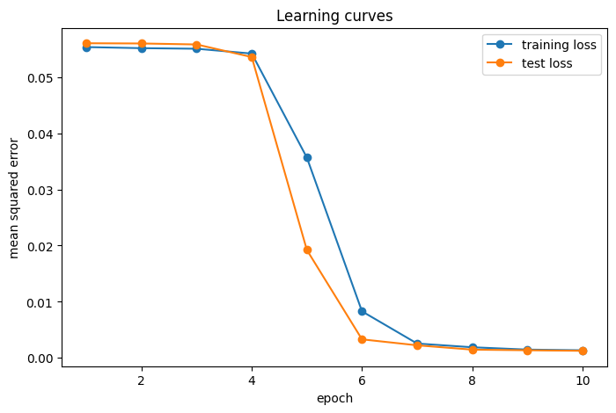
Step 5: the training loop, 320 times over
1
Guess
predictions = model(images)
2
How wrong?
loss = loss_function(predictions, boxes)
3
Clear old gradients
optimizer.zero_grad()
4
Work out the fix
loss.backward()
5
Nudge the weights
Both lines go down: it's learning
Test much higher than training: overfitting (memorising)
Flat at first? normal here: it finds Wally around epoch 4–5
optimizer.step()
Learning rate (0.001) = how big each nudge is. Too big: it overshoots. Too small: it takes forever.
Notes:
[~2 min] Five lines that every PyTorch training loop has. Guess, measure how wrong with the loss (mean squared error), clear the old gradients (PyTorch adds them up otherwise), backward works out which way to nudge every weight, step nudges them. Learning rate is the size of the nudge. The learning curve from my run: flat for about 4 epochs while it hunts for Wally, then it drops sharply. Train and test stay close together, so it's learning Wally, not memorising the pictures.

Slide 20
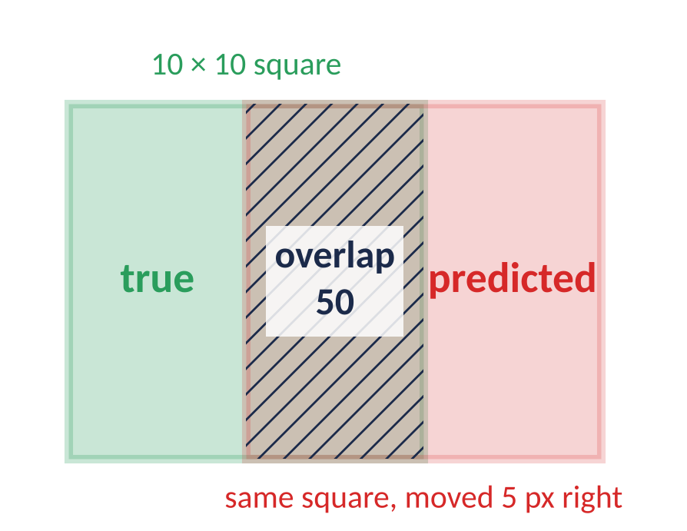
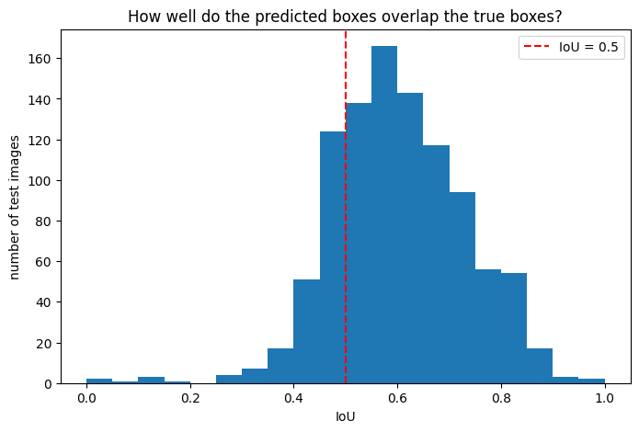
Step 6: scoring boxes with IoU
IoU = overlap ÷ total area covered
= 50 ÷ (100 + 100 − 50) = 0.33
1 = perfect match, 0 = the boxes don't touch
IoU > 0.5 counts as "found Wally" (red dashed line)
IoU is strict: just 5 px off on a small box already drops it to 0.33
Notes:
[~1.5 min] The loss says "it's improving" but MSE = 0.0002 is hard to picture. IoU asks: how much do the two boxes overlap? Overlap area divided by the total area covered by both. Worked example: a 10x10 box and the same box shifted 5 pixels: overlap 50, total 150, IoU 0.33. So IoU is harsh on small objects like Wally. The rule of thumb: above 0.5 counts as a correct detection. The histogram is from my run on the 1000 test pictures.

Slide 21
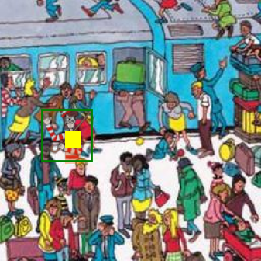
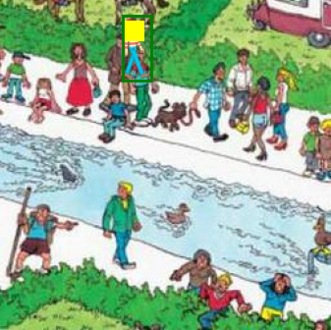
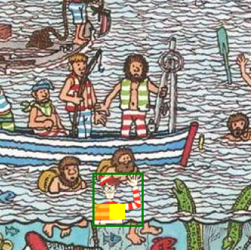
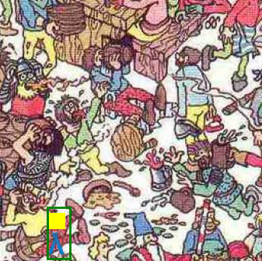
What you should get by the end
0.60
79%
~2 min
mean IoU on 1000 unseen test pictures
found (IoU > 0.5)
training time on a Kaggle GPU
Where the model is looking: the bright squares of the heatmap on 4 test pictures it has never seen
Notes:
[~1 min] These are the numbers from a full run of the notebook. Mean IoU around 0.6 and roughly 4 in 5 Wallys found, after about 2 minutes of training. Your numbers will be close to this because of the seed. In Step 7 you'll also draw the heatmap: the yellow squares are where the model thinks Wally is. Then look at the WORST pictures and discuss why it failed.

Slide 22





Before you start
Turn on the GPU
Run cells in order
Making 5000 pictures takes ~1 min
Settings → Accelerator → GPU. Training takes about 2 minutes instead of 10+.
Every cell uses variables from the ones above. Restarted? Run from the top.
Run it once. Re-running wipes the folder and starts again.
Stuck? Print the shape
Do the Think questions
Finished early?
Most errors are shapes: (batch, channels, height, width).
Discuss them with your neighbour. They're the point of the workshop.
Try "What's next": more images, other learning rates, the flatten head.
Notes:
[~2 min] Practical tips. GPU on. Run in order. The data generation cell takes about a minute, only run it once. When you get an error, print the shapes. And please actually discuss the Think questions: they're where the learning happens. If you finish early, the last section has experiments to try.

Slide 23
Now go find Wally!
Questions? Then open the notebook and start at Step 0.
The model looking at a picture it has never seen.
Notes:
[~1 min] Questions, then start. You have 45 minutes.

