Slide 1


Object Detection & Tracking In Space
SMART-AI

Slide 2



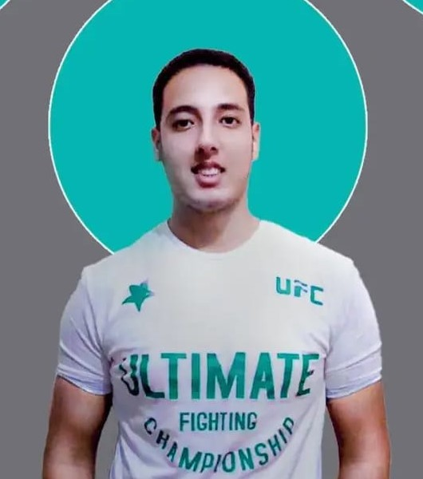


Meet Our
Best Team
Ibrahim ElSadat
Zakaria Ahmed
Abanoub Fekry
Ibrahim Nashaat
Ahmed Ibrahim
Ahmed Mohamed

Slide 3
PROBLEM
SMART-AI

Slide 4

Problem
Difficulty in accessing many places in different environments and identifying and identifying the things inside them without human intervention .

Slide 5
SOLUTION
SMART-AI

Slide 6
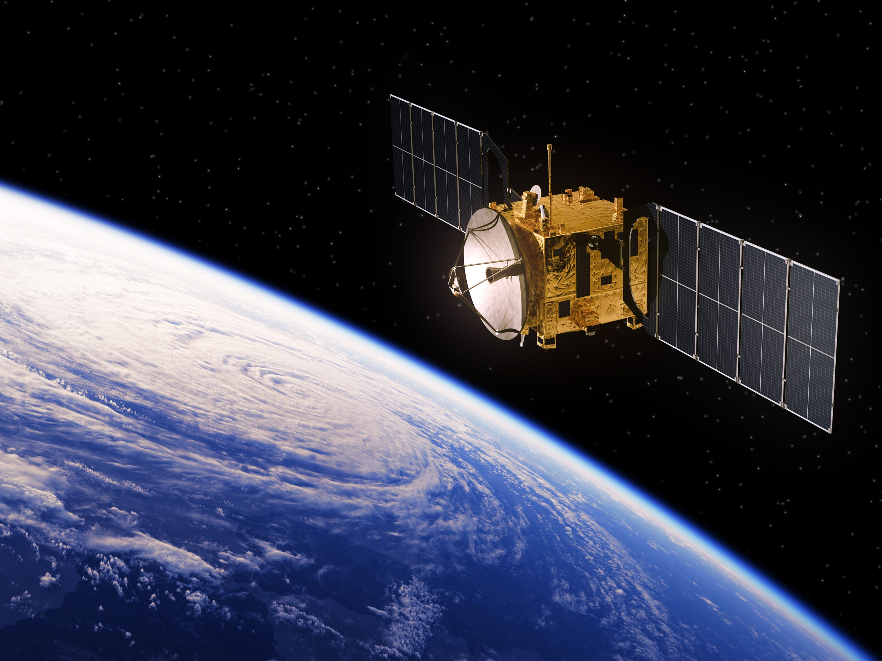
Solution
Through our device, other satellites and strange objects can be tracked by camera and their movement tracked to protect our satellite from colliding with it and losing its tracks.

Slide 7

Solution
Before launching the satellite, you can know the space environment and weather conditions and send them to the station through the mobile application
FINDING YOUR CREATIVE NICHE | CHC 2020

Slide 8

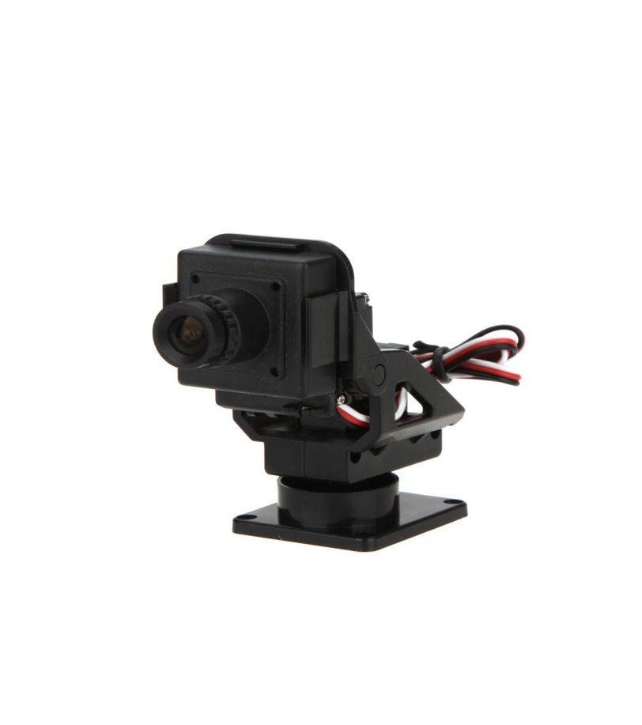
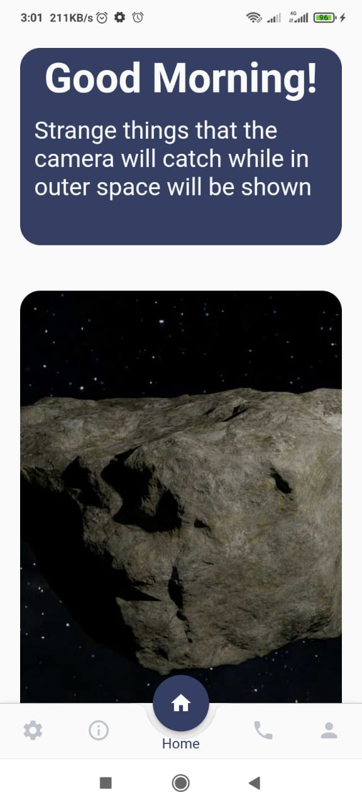
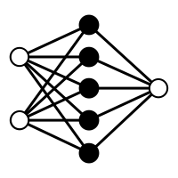
STEP 1
STEP 2
The deep learning model recognizes objects and sends their images to the application
STEP 3
We made an application to make it easy to see strange objects
We used the embeded systems and (IOT) to move the camera to capture objects
STEPS
TO BEGIN

Slide 9
FEATURE
SMART-AI

Slide 10
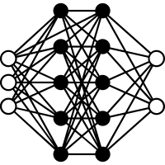
Deep Learning model :
The Convolutional Nueral Network (CNN) model
The accuracy of the model was 83%.

Slide 11
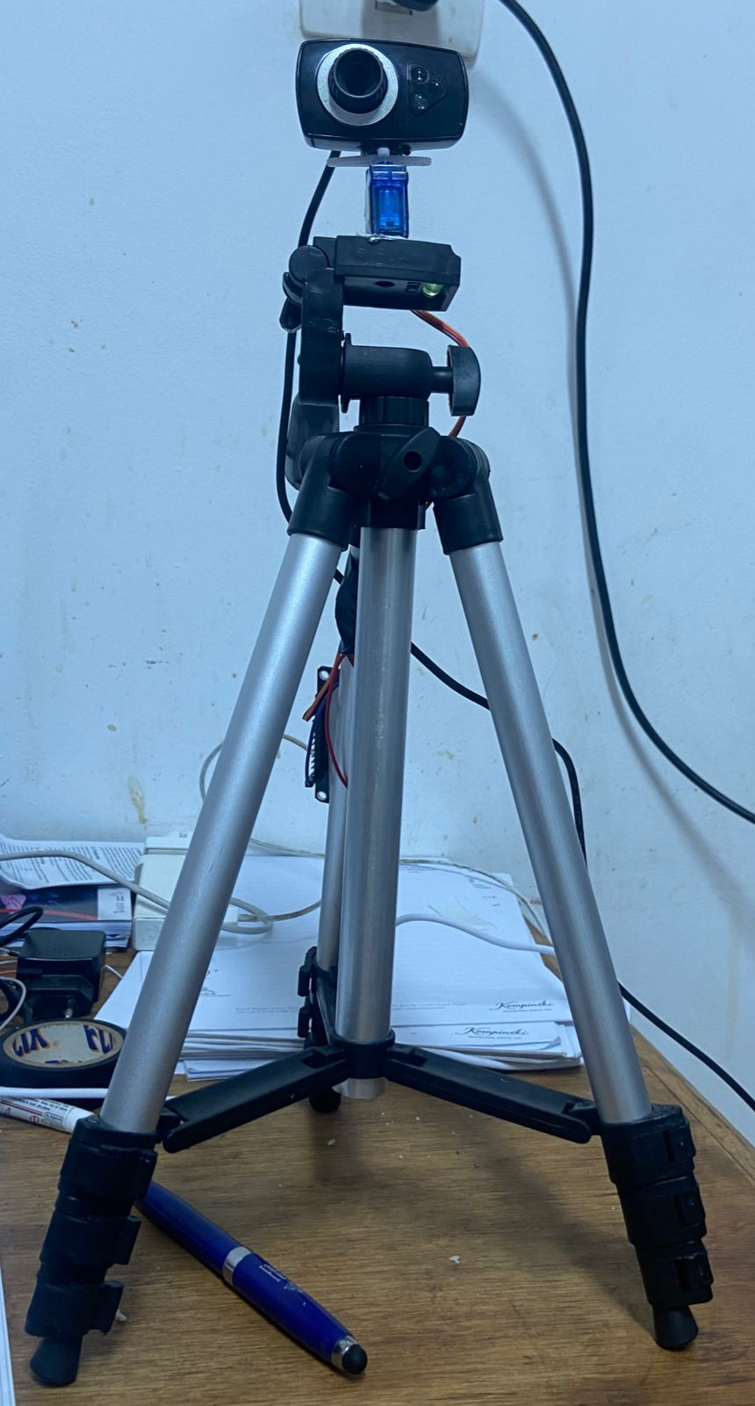
The device rotates at an angle from 0 to 180, Then the model shows the angle by the value of x and y and sends it through the socket server, so it moves at the required angle to track things
Embeded Systems :
We use :
Stand
Motor servo 180
Camera
Node MCU

Slide 12

We used the socket programming protocol to connect the esp32 with a deep learning model to make the servo motor take action with movement.
Internet of Things :
We used the web server protocol by sending this data via an IP address

Slide 13

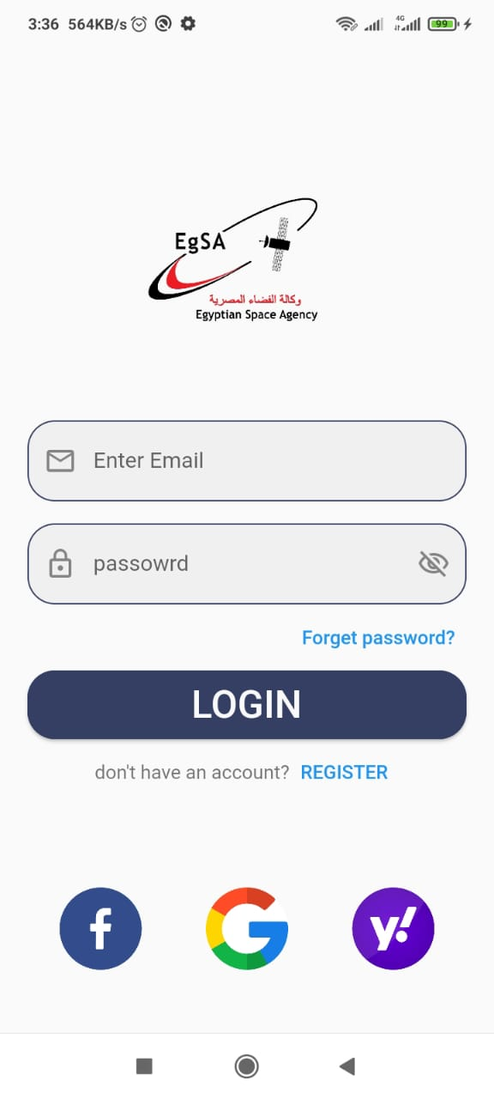
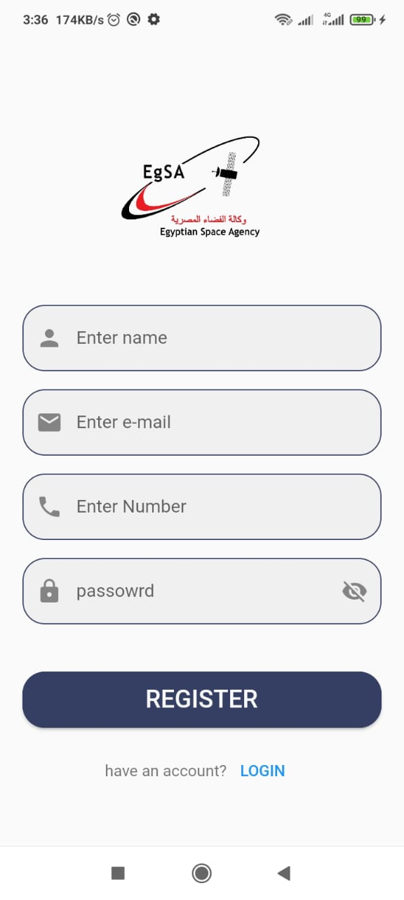
Mobile Application :
Using the application, you can communicate with space stations to find out weather conditions and know status of satellites

Slide 14
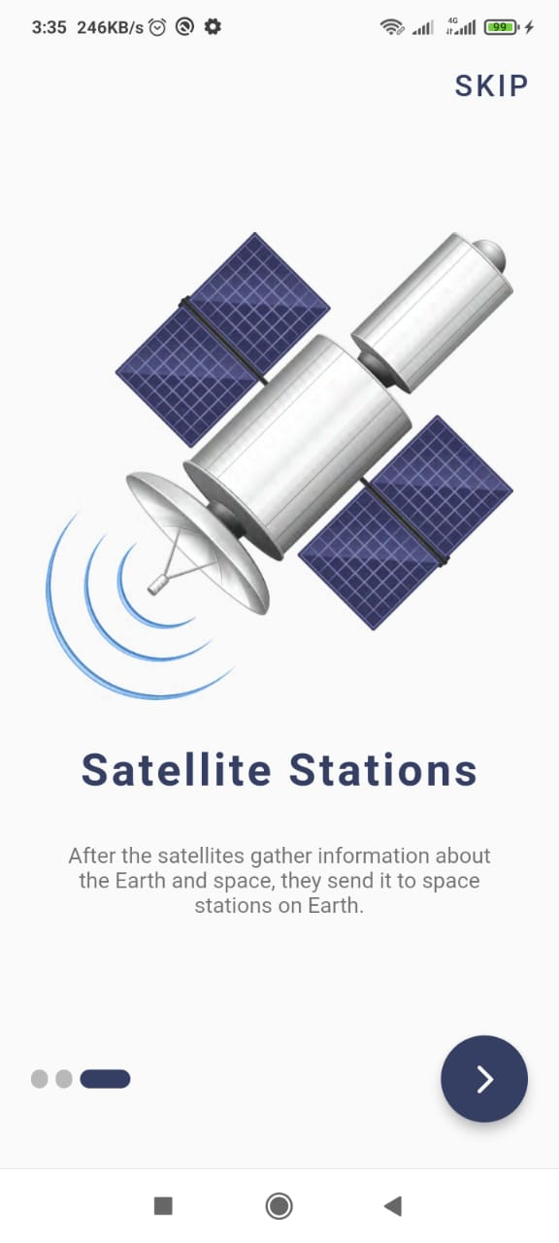
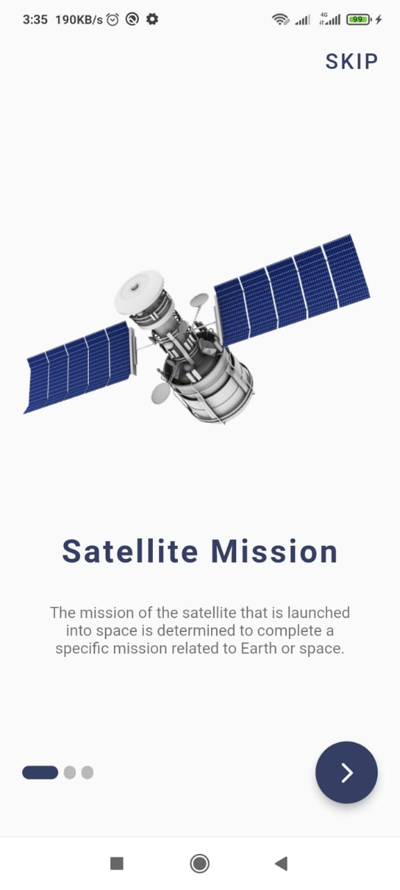
Mobile Application :
The camera takes pictures of any unfamiliar object and sends it to the app by firebase
APP send some information about space and satellites

Slide 15

What will we do in the future ?
Developing the model to be able to recognize any strange object to reach 99% of the accurcy.
Develop the camera so that you can take pictures at a far distance with high quality

Slide 16

THANK YOU
SMART-AI

