Slide 1

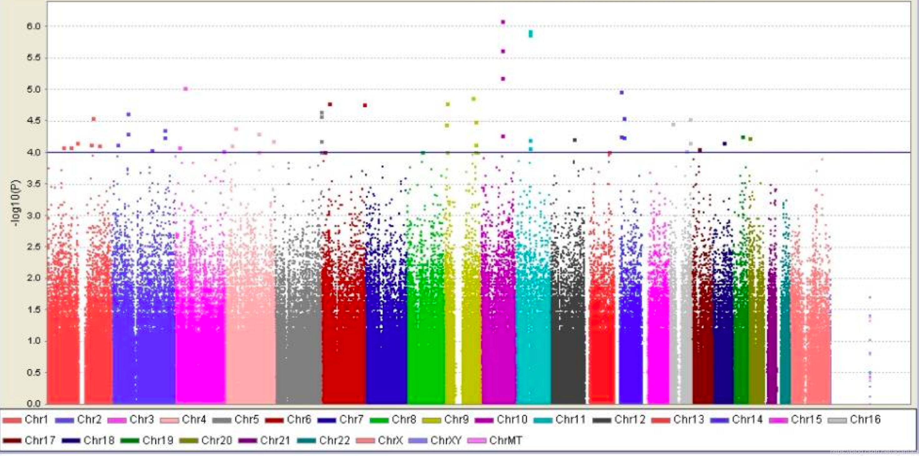
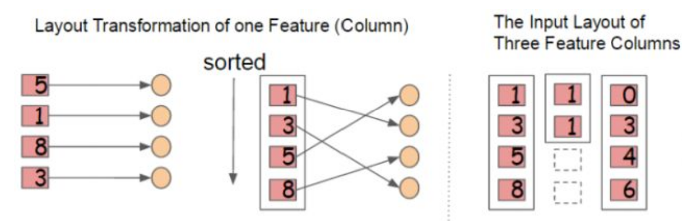
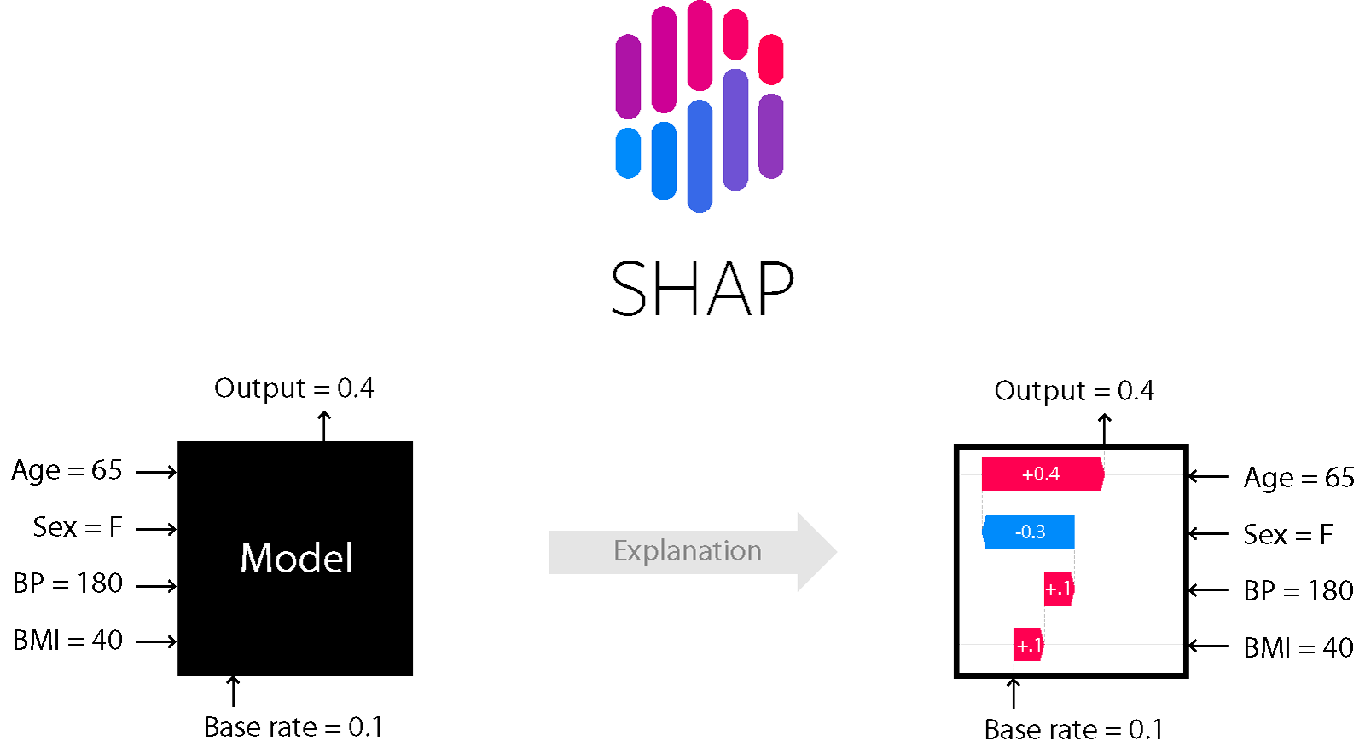

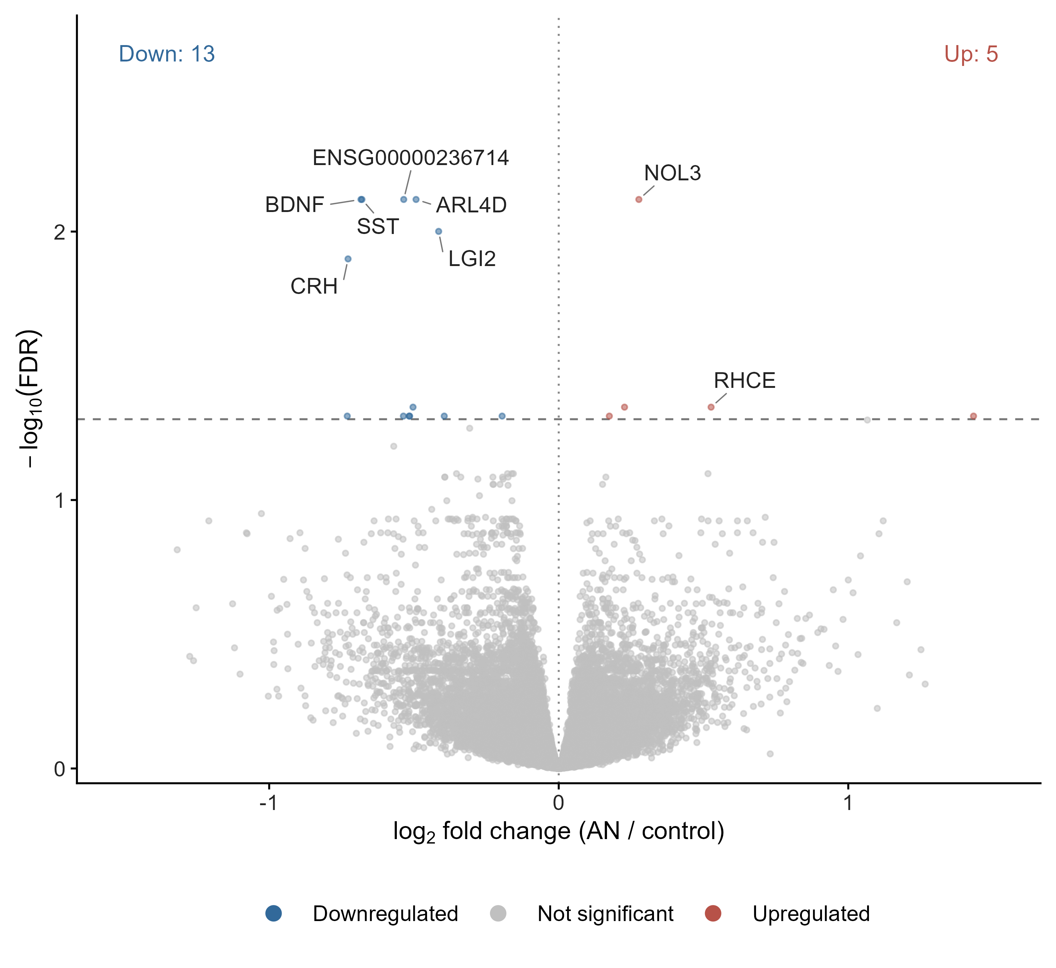
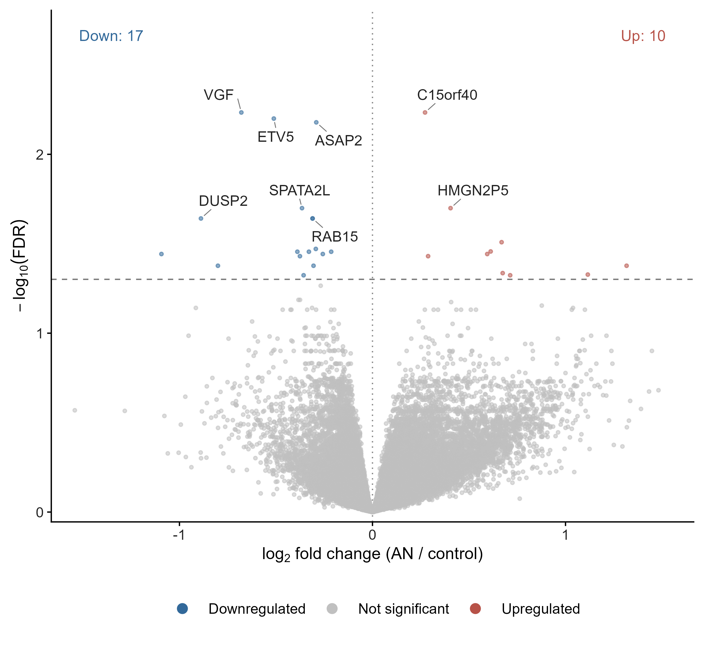
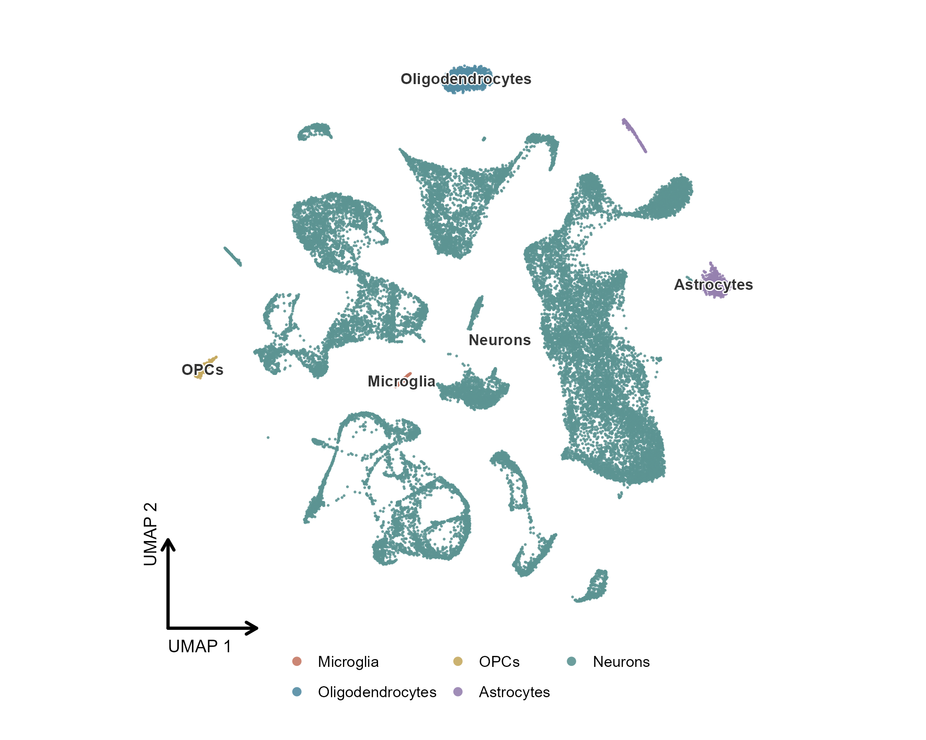
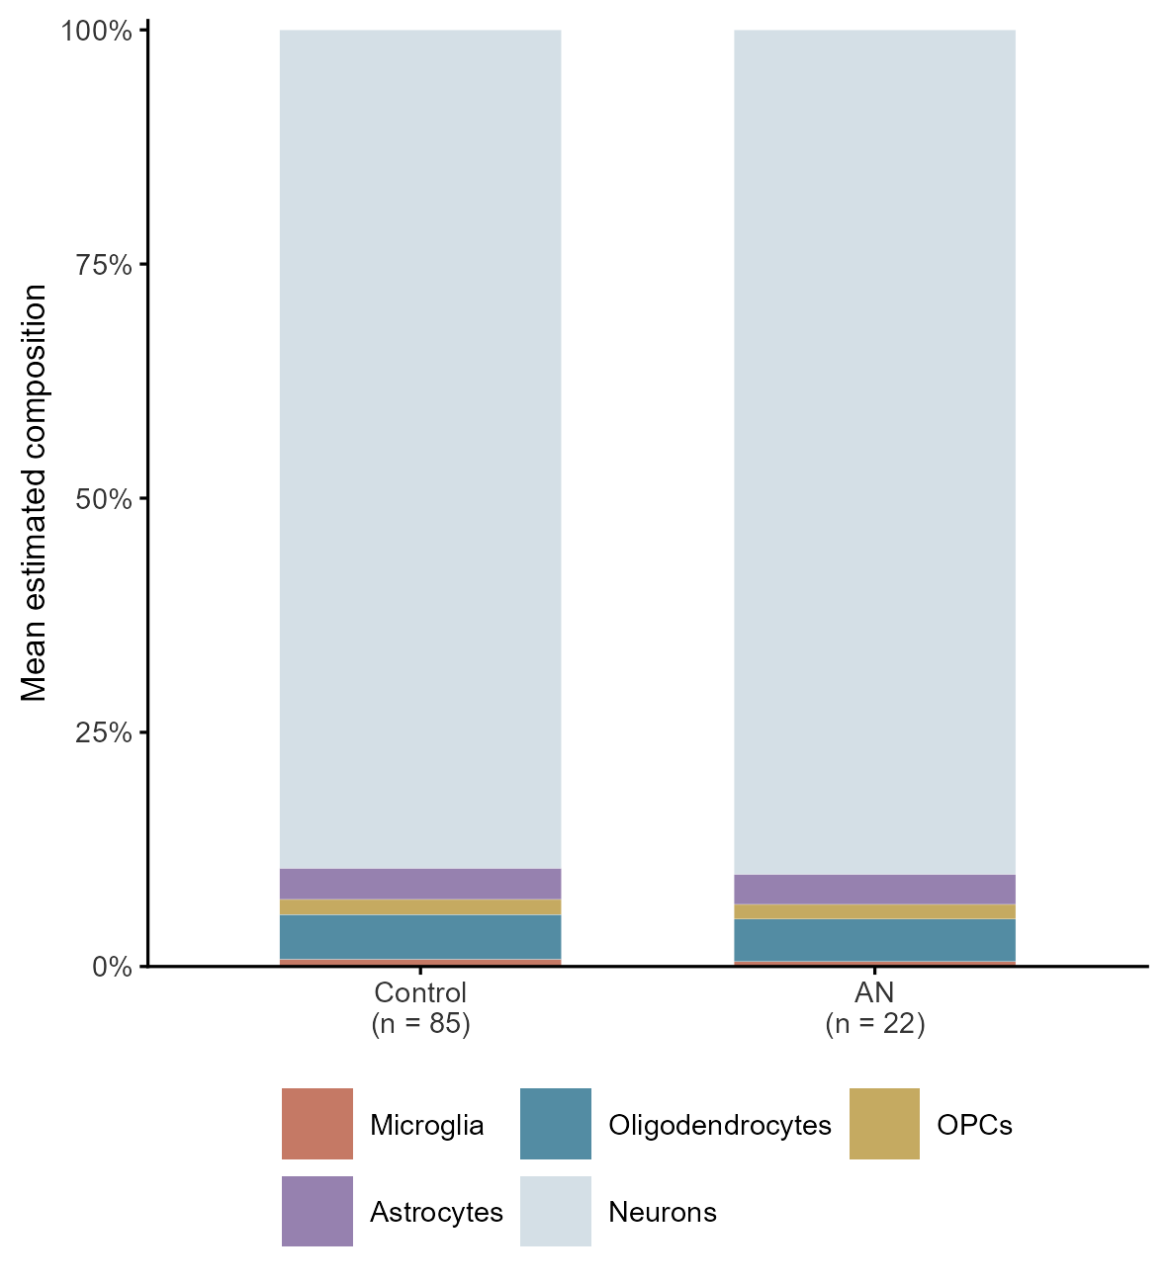
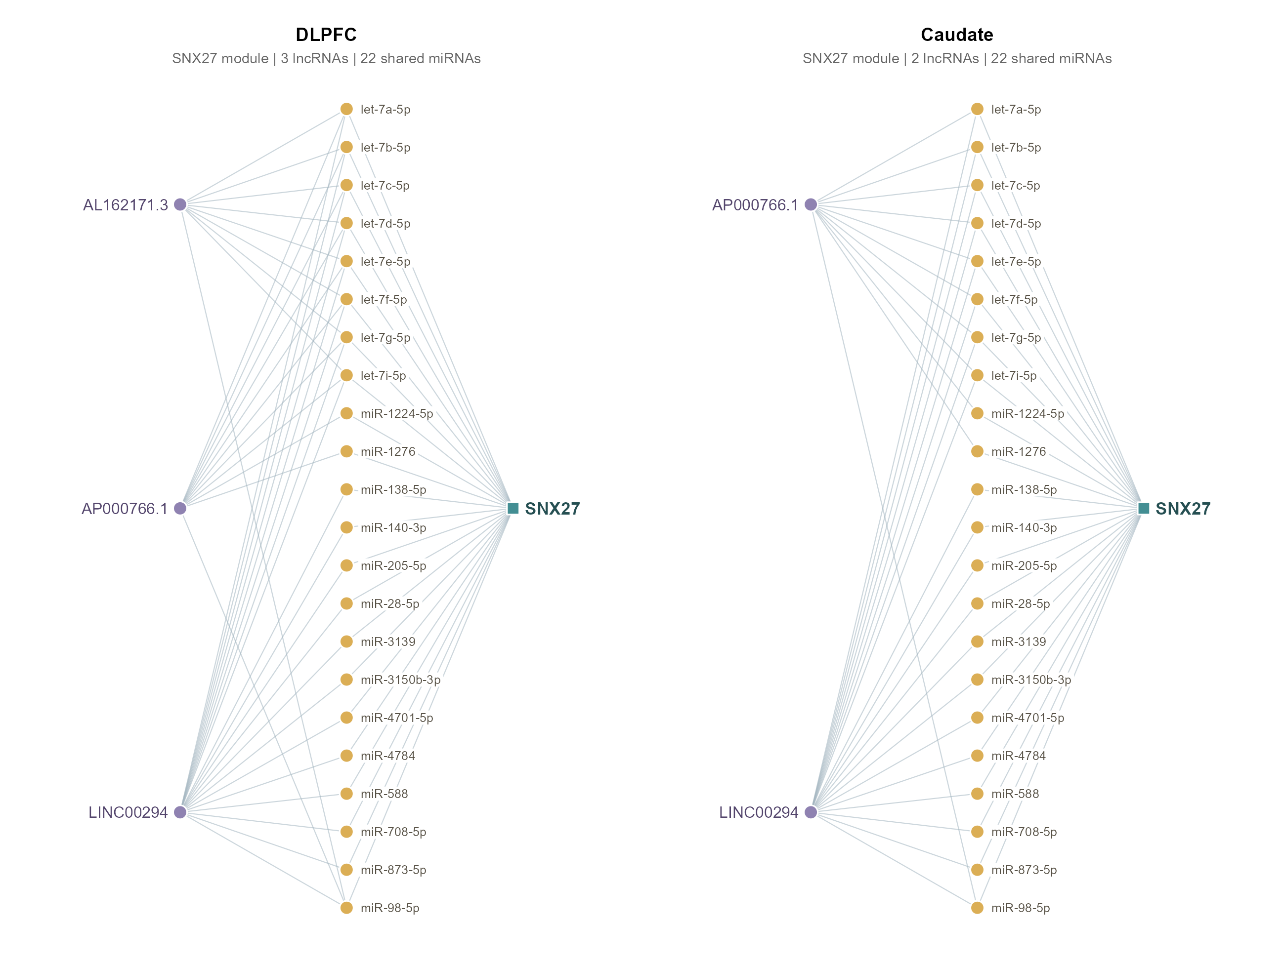
Records identified from the following sources
Database source:
PubMed, WoS, Embase database
PubMed (653)
Web of Science (621)
Embase (346)
Cochrane Library (115)
A total of 1120 duplicate studies were screened
Search formula:
"Eating Disorders" OR
"Anorexia Nervosa" OR
"Bulimia Nervosa" OR
"Psychogenic Vomiting"
Filter by article and title
(n = 580)
Filter records (n = 615)
Full-text articles evaluated for eligibility
(n = 35)
Article content filtering
The content of the article does not match
(n = 5)
Poor quality of articles (n = 3)
Inconsistent intervention modality (n = 1)
Study data discrepancies (n = 1)
Non-English literature (n = 1)
Eight influencing factors of eating disorders were analyzed and established
Search and obtain valid cases through database
(n = 32)
Meta-analysis
Included literature (n = 24)
Literature quality evaluation
Assignment and necessity analysis
Directly perform configuration analysis
Analysis of results
Obtain the core factors and the edge factors
14 configurations were obtained
MR estimates for dietary traits
and AN, BN and EDs
NHANES population-based analysis
Inclusion of dietary-related indicators and baseline characteristics
Macronutrient energy percentages
Genetic instruments
Mendelian randomization analysis
Survey-weighted regression + XGBoost/SHAP
Fat energy percentage and appetite/eating symptoms
Human AN and mouse HFD/chow
brain transcriptomes (GEO)
Genetic / transcriptomic integration
Brain cell-type analyses
Putative regulatory networks
Human AN differential expression
Single-nucleus reference and BisqueRNA
Supported SNX27 ceRNA module

