Slide 1
JUNIPER SALON / THE OPENING DESK
More filled appointments.
Less time chasing replies.
Lena and Carla currently coordinate Square, a spreadsheet, and texts.
Separate replies have left two clients believing they had the same slot.
8–12
~3
≥50%
late cancellations each week
currently refilled
Lena’s refill target
Customer estimates and target, not measured prototype results. Source: Lena interview, turns 4 and 9.
1 / 4
Notes:
Source: evidence/customer-interview.txt, turns 4 and 9. Lena estimated 8–12 cancellations inside 48 hours weekly and around 3 refills. The target is at least half refilled without repeatedly checking. No financial impact or time-saving result is claimed.

Slide 2
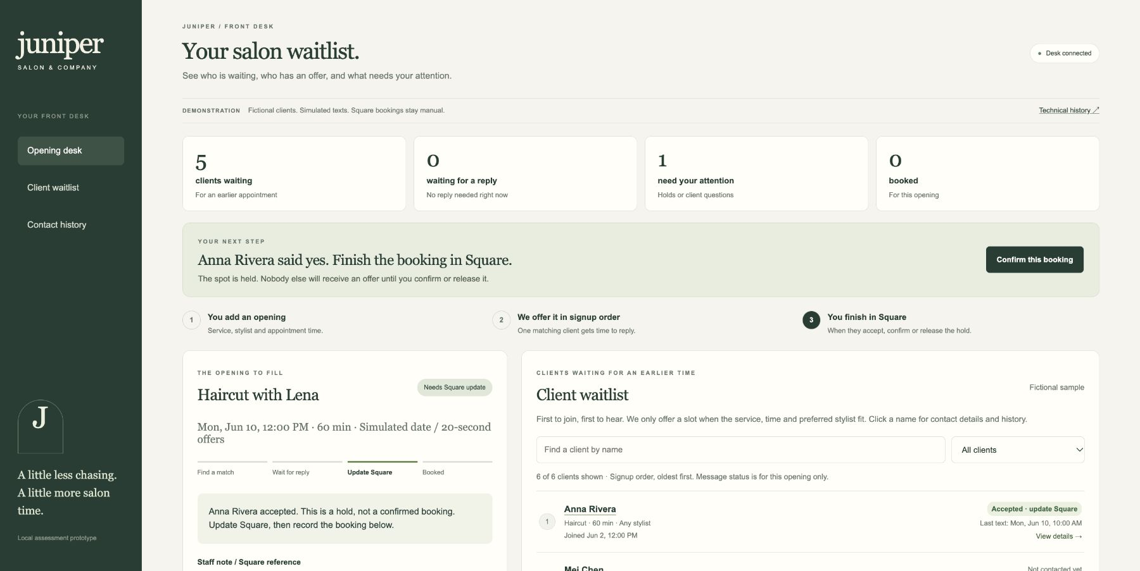
JUNIPER SALON / THE OPENING DESK
An acceptance holds the spot
Staff complete the booking in Square before recording confirmation.
01 Match the waitlist
Service, duration, stylist, time,
and permission to contact.
02 Offer one at a time
Earliest eligible client gets
an exclusive 15-minute offer.
03 Hold, then confirm
Lena or Carla updates Square.
2 / 4
Notes:
Actual local browser screenshot. Demo clients and messages are simulated. Screenshot uses June 10, 2030 and 20-second offers; standard mode uses real Los Angeles time and 15 minutes. Client acceptance reserves a hold; the app cannot verify a real Square update. Source: customer interview turns 2–8,13–15.

Slide 3
JUNIPER SALON / THE OPENING DESK
What happens when things go wrong?
Temporal remembers who has the offer and how long they have to answer.
The app stops while someone is deciding
A client replies after their time is up
We stopped and restarted the software handling
the waitlist. It remembered the same client
and their original deadline.
They see that their offer has expired.
They cannot claim a spot now offered
to someone else.
A text won’t go through
A client taps “yes” twice
For a temporary problem, the demo tries sending
again. If delivery fails, it offers the opening
to the next client who fits.
Their spot stays held. The second tap
does not create another reservation.
We tested these situations in the prototype. Text messages are simulated.
3 / 4
Notes:
Observed evidence: evidence/worker-recovery.json records SIGKILL, unchanged offer ID/deadline, one offer, and successful acceptance after restart. tests/workflow.test.ts covers expired replies, repeated acceptance, retries, and permanent delivery failure. The restart test stopped the background Worker, not the entire Temporal service. No real SMS side-effect guarantee is claimed. Staff confirmation and release remain described on slide 2 and in the demo.

Slide 4
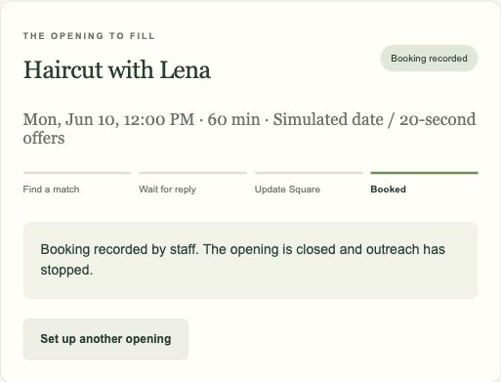
JUNIPER SALON / THE OPENING DESK
A two-week trial with Lena and Carla
2 weeks
≥50%
0
trial length
openings refilled: target
slots promised to two clients
Before the first real text
Connect real texts and the waitlist.
Add staff sign-in and permission to text clients.
Check Square before confirming each booking.
Demo: fictional clients and texts.
Staff still update Square manually.
1 OCT 4
2 OCT 18
3 NOV 1
Prepare the checklist
Start the two-week trial
1 opening at a time
Review refills and
staff follow-ups
Example dates, not a commitment. Start only after setup and testing. Targets are not results.
4 / 4
Notes:
Illustrative timeline requested by the user, based on October 4, 2026: two weeks of preparation to October 18, followed by a proposed two-week pilot ending November 1. Dates are not a delivery commitment and launch depends on setup and testing. Lena and Carla were confirmed as pilot owners in customer interview turn 15. At least 50% refilled is Lena’s target, not observed performance. Zero conflicting booking promises is the proposed trust criterion. Refill rate means confirmed refills divided by eligible openings. Track staff follow-ups against baseline; no numerical staff-time target was established. The screenshot shows a fictional demo booking. Live messaging and waitlist integration, staff sign-in, consent records, and checking Square against the app are prerequisite work. One active opening at a time.

