Slide 1

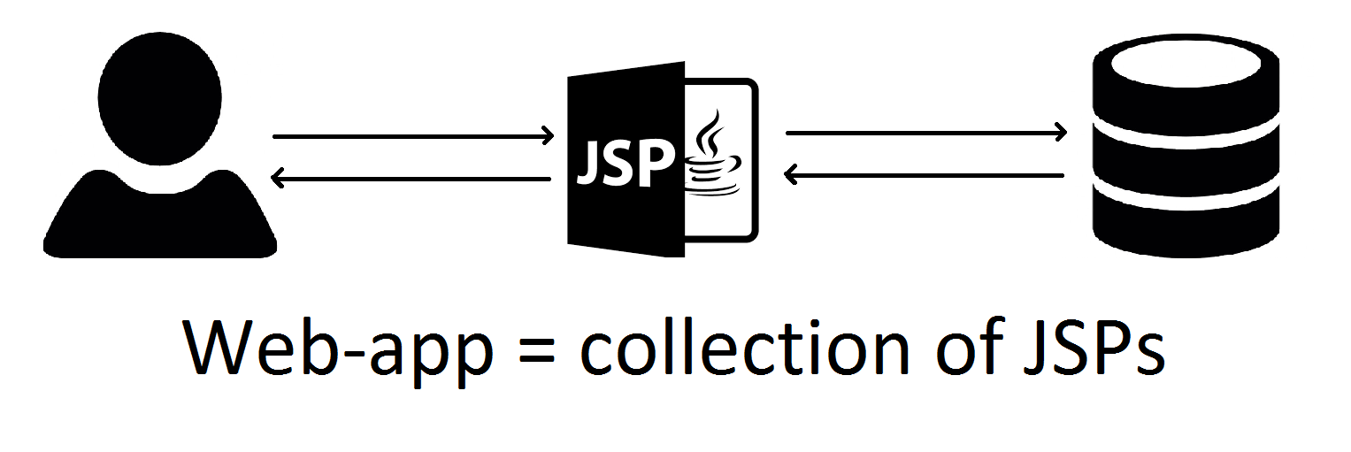
Starcraft Database
Educational project made by Zelenov A.

Slide 2
Web-interface
Minimalistic
Easy to use
Error tolerant

Slide 3
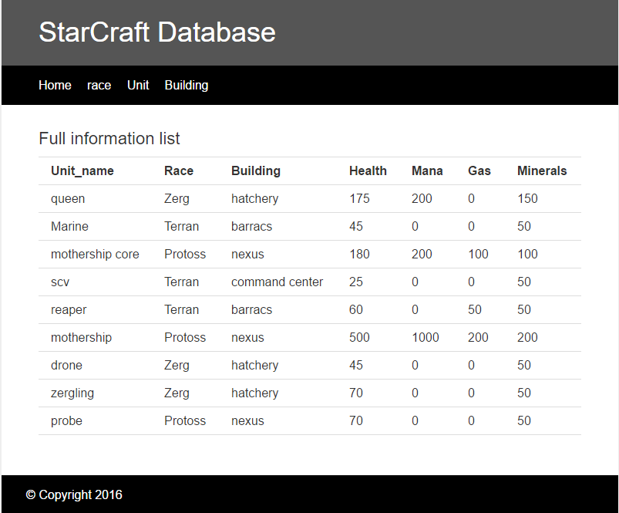
Starcraft Database interface

Slide 4
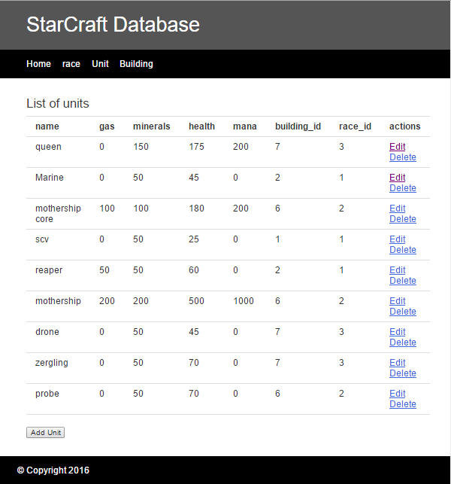
Starcraft Database interface

Slide 5
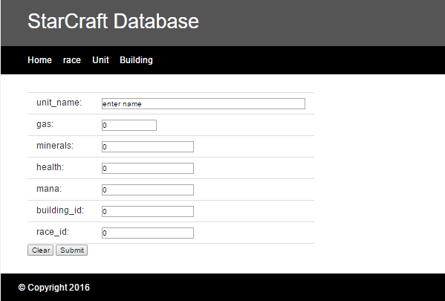
Starcraft Database interface

Slide 6
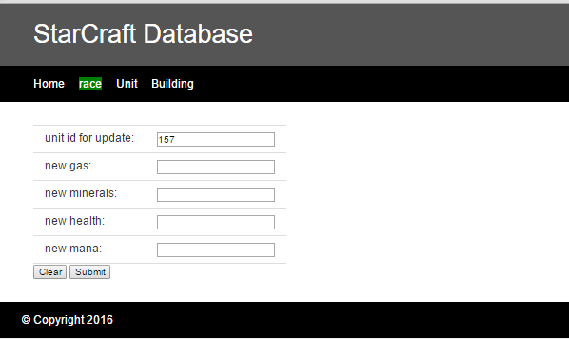
Starcraft Database interface

Slide 7
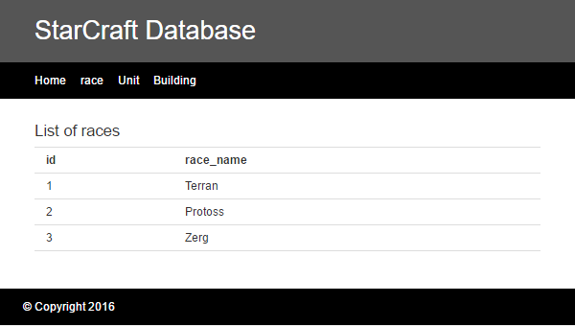
Starcraft Database interface

Slide 8
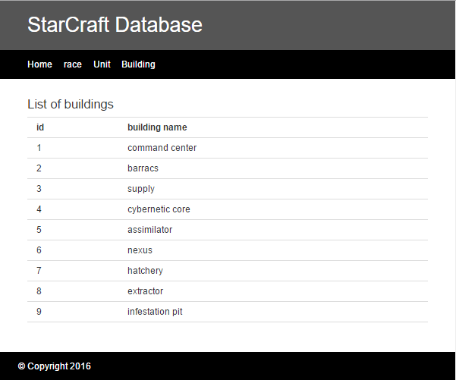
Starcraft Database interface

Slide 9
Technologies
Oracle XE database
JDBC
JSP
Apache-tomcat-8.0.33

Slide 10
Results
+ Easy to use
+ Convenient for small projects
- Mix of presentation, business & data access logic

Slide 11
Thank you!
Zelenov Aleksey, 2016.

