Slide 1
The Eclipse Project
An introduction to the Eclipse Project
Notes:
Version 0.1, Sept. 2008
Toby McClean, Zeligsoft, 2008

Slide 2
Overview
In this module we will explore the Eclipse Project including the different aspects of the Eclipse Workbench.
We will also explore how to develop and deploy plug-ins to extend the Eclipse Workbench.
Some content taken from
Developing Plug-ins for Eclipse (http://www.eclipse.org/resources/)
by Dwight Deugo and Nesa Matic
Notes:
Version 0.1, Sept. 2008
Toby McClean, Zeligsoft, 2008

Slide 3
Goals
Following the completion of this module and its exercises you will
  Have an understanding of the Eclipse Workbench
  Know some of the terminology used within the Eclipse Workbench
  Have an understanding of the Eclipse architecture
  Have an understanding of how Eclipse is extended
  Be able to develop and deploy a basic plug-in

Slide 4
Agenda
What is Eclipse?
The Eclipse Workbench
The Eclipse Architecture
Extending the Workbench
Notes:
Version 0.1, Sept. 2008
Toby McClean, Zeligsoft, 2008

Slide 5
What is Eclipse?
Eclipse is an open source project
  http://www.eclipse.org
  Consortium of companies, including IBM
  Launched in November, 2001
  Designed to help developers with specific development tasks
Notes:
Version 0.1, Sept. 2008
Toby McClean, Zeligsoft, 2008
The Eclipse Project was designed to provide a platform for building of highly integrated development tools. It was initiated by IBM with a consortium of companies, which now include companies such as Borland, Fujitsu, HP, Hitachi, Object Management Group, Oracle, Parasoft, QNX Software Systems, Red Hat, SAP, and Sybase, in 2001.

Slide 6
Projects
On topic
  Business Intelligence and Reporting Tools (BIRT)
  Device Software Development Platform
  Eclipse Project
  Eclipse Modeling Project
Off topic
  Data Tools Platform
  Eclipse RT
  SOA Tools
  Eclipse Technology Project
  Tools Project
  Test and Performance Tools Platform Project
  Eclipse Web Tools Platform Project
http://www.eclipse.org/projects/listofprojects.php
Notes:
Version 0.1, Sept. 2008
Toby McClean, Zeligsoft, 2008

Slide 7
Brief History of Eclipse
1994
  VisualAge for Smalltalk
1996
  VisualAge for Java
1996-2001
  VisualAge Micro Edition
2001
  Eclipse Project
Notes:
Version 0.1, Sept. 2008
Toby McClean, Zeligsoft, 2008
In 1994 IBM has released VisualAge for Smalltalk, an IDE written in Smalltalk, meant to be used for developing Smalltalk applications.
When Java became popular, IBM has released VisualAge for Java, a Java IDE that was written in Smalltalk as well. Soon, the IDE gained great popularity.
In 2001 IBM has started Java based open-source initiative called Eclipse.

Slide 8
The Motivation Behind Eclipse
Support for the construction of application development tools
Support for the development of GUI and non-GUI application development
Support for multiple content types
  Java, HTML, C, XML
Facility the integration of tools
Cross-platform support
Notes:
Version 0.1, Sept. 2008
Toby McClean, Zeligsoft, 2008

Slide 9
Eclipse Architecture
Workbench
Help
Tool
Plug-in
Tool
Plug-in
Tool
Plug-in
Workspace
Team
Platform Runtime
Notes:
Version 0.1, Sept. 2008
Toby McClean, Zeligsoft, 2008
The picture on this slide represents the high-level architecture of the Eclipse Platform.
All plug-ins must be added to the platform before it痴 started. When platform is started, the Platform Runtime figures out what plug-ins are available and creates plug-in in-memory registry.
Team and Help on the picture represent existing 塗ooks� in Eclipse for adding help and team support to the applications and environment.
The Platform has 2 main components: the Workbench and the Workspace. The Workbench represents set of tools available for the user in the Eclipse environment and Workspace represents set of user

Slide 10
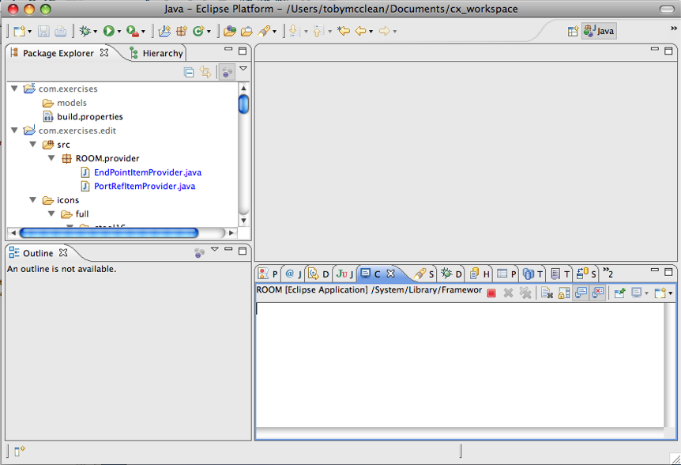
Workbench
The desktop development environment
  Tools for resource management
  Common of navigating through resources
Multiple workbenches can be opened at the same time
  Different workspaces
Notes:
Version 0.1, Sept. 2008
Toby McClean, Zeligsoft, 2008
The term Workbench refers to the desktop development environment. The Workbench aims to achieve seamless tool integration and controlled openness by providing a common paradigm for the creation, management, and navigation of Workbench resources.
Each Workbench window contains one or more perspectives. Perspectives contain views and editors and control what appears in certain menus and tool bars. More than one Workbench window can exist on the desktop at any given time.

Slide 11
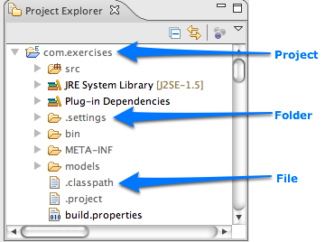
Workspace
Represents the user data
A set of resources
  Projects
    Collection of files and folders
  Folders
    Contain other folders or files
  Files
Notes:
Version 0.1, Sept. 2008
Toby McClean, Zeligsoft, 2008
The central hub for your user's data files is called a workspace. You can think of the platform workbench as a tool that allows a user to navigate and manipulate the workspace. The resources plug-in provides APIs for creating, navigating, and manipulating resources in a workspace. The workbench uses these APIs to provide this functionality to the user. Your plug-in can also use these APIs.
From the standpoint of a resource-based plug-in, there is exactly one workspace, and it is always open for business as long as the plug-in is running. The workspace gets opened automatically when the resources plug-in is activated, and closed when the platform is shut down. If your plug-in requires the resources plug-in, then the resources plug-in will be started before your plug-in, and the workspace will be available to you.
The workspace contains a collection of resources. From the user's perspective, there are three different types of resources: projects, folders, and files. A project is a collection of any number of files and folders. It is a container for organizing other resources that relate to a specific area. Files and folders are just like files and directories in the file system. A folder contains other folders or files. A file contains an arbitrary sequence of bytes. Its content is not interpreted by the platform.
A workspace's resources are organized into a tree structure, with projects at the top, and folders and files underneath. A special resource, the workspace root resource, serves as the root of the resource tree. The workspace root is created internally when a workspace is created and exists as long as the workspace exists.
A workspace can have any number of projects.
Files and folders are similar to files and directories in the file system.
In the picture above we see MyServlet and MyWeb defined as projects and we see an images folder containing two files: .project and index.html

Slide 12
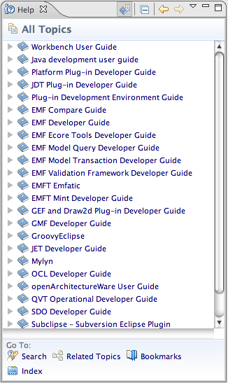
Help
For the creation and publishing of documentation
Supports both
  User guides
  Programmer guides
Created using
  HTML for content
  XML for navigation
Support for context sensitive help
Notes:
Version 0.1, Sept. 2008
Toby McClean, Zeligsoft, 2008
The online help system provides access to the documentation, and lets you browse, search, and print it. The documentation is organized into sets of information that are roughly analogous to books. These, along with a full-text search engine and context-sensitive interface help, are designed to help you find the information you need.
The Eclipse platform's help facilities provide you with the raw building blocks to structure and contribute documentation to the platform. It does not dictate structure or granularity of documentation. You can choose the tools and structure for your documentation that suits your needs. The help plug-in allows you to describe your documentation structure to the platform using a table of contents (toc) file.
Your plug-in's online help is contributed using the org.eclipse.help.toc extension point. You can either contribute the online help as part of your

Slide 13
Team
Provides support for
  Versioning
  Configuration management
  Integration with team repository
Allows team repository provider to hook into environment
  Team repository providers specify how to intervene with resources
Has optimistic and pessimistic locking support
Notes:
Version 0.1, Sept. 2008
Toby McClean, Zeligsoft, 2008
The Eclipse Platform provides basic hooks for plugging team repository into the environment. There are different workflows for different team repository providers, and the platform lets providers to make decisions how resource management will be implemented.
In the pessimistic model, user checks out the resource and than the resource is locked for everybody else.
In the optimistic model, user can modify the resource while somebody else is modifying it as well. This usually results into manual intervention of modified resource � merging of two resource modifications.

Slide 14
How is Eclipse Used?
As an Integrated Development Environment
  Supports the manipulation of multiple content types
  Used for specifying and designing applications
    Requirements, models, documentation, etc.
  Used for writing code
    Java, C, C++, C#, Python, ...
As a product base
  Supported through plug-in architecture and customizations
Notes:
Version 0.1, Sept. 2008
Toby McClean, Zeligsoft, 2008

Slide 15
Eclipse as an IDE
Java Development Tooling
  Editors, compiler integration, ant integration, debugger integration, etc.
C/C++ Development Tooling
  Editors, compiler integration, make integration, debugger integration, etc.
Dynamic languages
  Editors, interpreter and compiler integration, debugger integration, etc.
Modeling projects
Notes:
Version 0.1, Sept. 2008
Toby McClean, Zeligsoft, 2008

Slide 16
Eclipse as a Product Base
Eclipse can be used a Java product base
Its flexible architecture can be used as product framework
  Reuse plug-in architecture
  Create new plug-ins
  Customize the environment
Support for branding
Rich client platform support
Notes:
Version 0.1, Sept. 2008
Toby McClean, Zeligsoft, 2008
When you use Eclipse as a product platform, you add your new features as plug-in to the standard directories of Eclipse: ..eclipse¥plugins, and ⑻clipse¥features. You then update the install.ini file to identify your primary features you use eclipse.exe to start the user interface. More details steps are identified in other modules.

Slide 17
Rich Client Platform
A minimal set of Eclipse plug-ins necessary for building a product
Control over resource model
Control over look and feel
But still capable of leveraging existing plug-ins
Notes:
Version 0.1, Sept. 2008
Toby McClean, Zeligsoft, 2008

Slide 18
Summary
In this module we explored
  Eclipse, its background and the components that form its foundation
  Eclipse use cases
Notes:
Version 0.1, Sept. 2008
Toby McClean, Zeligsoft, 2008

Slide 19
Agenda
What is Eclipse?
The Eclipse Workbench
The Eclipse Architecture
Extending the Workbench
Notes:
Version 0.1, Sept. 2008
Toby McClean, Zeligsoft, 2008

Slide 20
The Eclipse Project
The Eclipse Workbench
Notes:
Version 0.1, Sept. 2008
Toby McClean, Zeligsoft, 2008

Slide 21
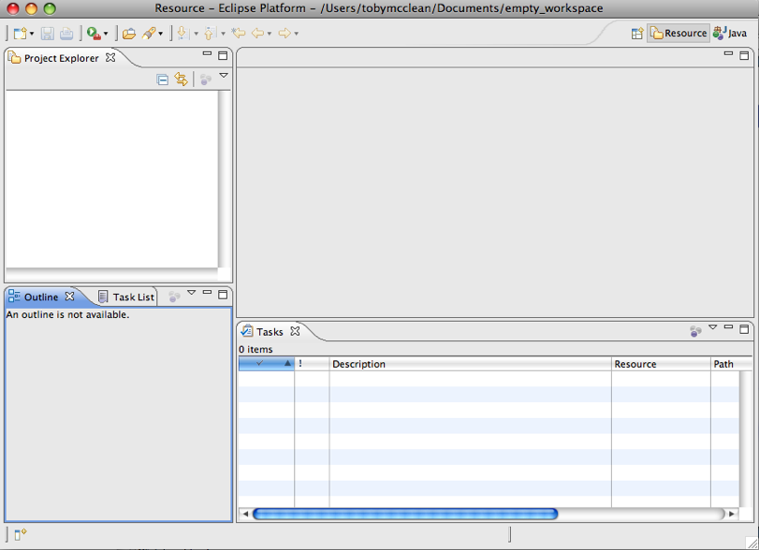
What is the Workbench?
The working environment in Eclipse
Notes:
Version 0.1, Sept. 2008
Toby McClean, Zeligsoft, 2008

Slide 22
Multiple Workbench Instances
Instance of Workbench comes up when Eclipse is launched
It is possible to open another window for the Workbench
  Window → New Window
  This opens up a new Workbench window
  Can have different perspectives open in the different windows
  Same result is not achieved by launching Eclipse twice
Notes:
Version 0.1, Sept. 2008
Toby McClean, Zeligsoft, 2008
When you try to launch Eclipse twice it will not allow you to use the same workspace.

Slide 23
Resources in a Workbench
When working in Eclipse, you work with Resources
Resources are organized in file/directory structure in the Workbench
  They correspond to the actual files and directories in the Workspace
  There are four different levels of resources:
    Workspace root
    Projects
    Folders
    Files
Resources form the file system can be dragged into the workbench
Notes:
Version 0.1, Sept. 2008
Toby McClean, Zeligsoft, 2008
The Workspace is where your resources are stored. The default Eclipse workspace is under the ¥workspace¥ directory off the Eclipse installation directory.
The workspace root resource has special properties found under preferences General → Workspace

Slide 24
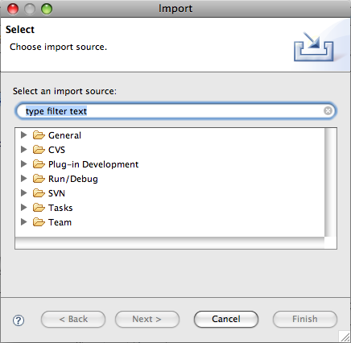
Importing Resources
Available through
  Menu option File → Import...
  Right-click menu Import... option on a Folder or Project
Notes:
Version 0.1, Sept. 2008
Toby McClean, Zeligsoft, 2008
Importing/Exporting feature of the Workbench is used a lot when moving work between different machines for example.
Files that are imported can be linked to the files on the file system or they can be copied into the workspace
Files can be imported from an archive

Slide 25
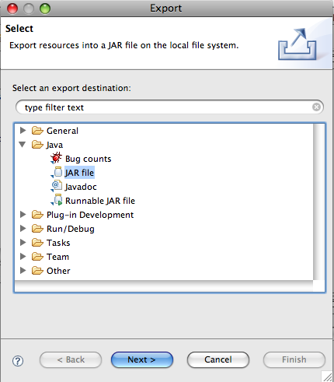
Exporting Resources
Available through
  Menu option File → Export...
  Right-click menu Export... option on a Resource in the Workbench
Notes:
Version 0.1, Sept. 2008
Toby McClean, Zeligsoft, 2008
Depending on the plug-ins that are installed the Export options will vary, but examples are exporting to an archive, deploying a plug-ing, packaging Java into a jar

Slide 26
Refreshing Workbench
Used for refreshing resources that change in the Workspace outside the workbench
For example, if a file added to a directory in the Workspace
  Select the project or directory in the workbench
  Choose Refresh from its context menu
  Alternatively you can press the F5 button on your keyboard
Best practice
  Work with the resources from within the Workbench when possible
Notes:
Version 0.1, Sept. 2008
Toby McClean, Zeligsoft, 2008

Slide 27
Resource History
Changing and saving a resource results in a new version of the resource
  All resource versions are stored in local history
  Each resource version is identified by a time stamp
  This allows you to compare different versions of the resource
There are two actions to access the local history of a resource, from its context menu
  Compare With → Local History...
  Replace With → Local History...
Notes:
Version 0.1, Sept. 2008
Toby McClean, Zeligsoft, 2008
Comparing local history and different versions of the resources may be important when frequently changing Java methods for example. This feature of Eclipse allows you to go back to previous versions of Java methods you change.

Slide 28
Workbench Components
The Workbench contains Perspectives
A Perspective has Views and Editors
Notes:
Version 0.1, Sept. 2008
Toby McClean, Zeligsoft, 2008
Currently opened perspective is shown in the Workbench title bar. The default perspective that opens with Workbench is Resource perspective. We will talk about perspectives, views and editors in next few slides.

Slide 29
Perspectives
Perspective defines the initial layout of views in the Workbench
Perspectives are task oriented, i.e. they contain specific views for doing certain tasks
Notes:
Version 0.1, Sept. 2008
Toby McClean, Zeligsoft, 2008
Perspectives are what you will be, when developing applications, switching often between. Some perspectives open by default when an event occur. For example, if a breakpoint is encountered in the application, the Debugger perspective will open. In this perspective you can debug your code. We will talk more about debugging later in the module.

Slide 30
Choosing a Perspective
To change the current perspective of the Workbench
  Window → Open Perspective →
  Clicking on the Perspective shortcut button
Notes:
Version 0.1, Sept. 2008
Toby McClean, Zeligsoft, 2008
If you choose either option for opening perspective, a short list of perspectives available shows up. Full list of perspectives is shown than by choosing Other� from the proffered short list.

Slide 31
Saving a Perspective
Arrangement of views and editors can be modified and saved for perspectives
  Window → Save Perspective As...
  It can be saved under an existing name or a new name creating a user-defined perspective
Notes:
Version 0.1, Sept. 2008
Toby McClean, Zeligsoft, 2008

Slide 32
Resetting a Perspective
Sometimes views and editors for a perspective need to be reset to the defaults
  Window → Reset Perspective...
This only applies to default Eclipse perspectives not user-defined ones
Notes:
Version 0.1, Sept. 2008
Toby McClean, Zeligsoft, 2008

Slide 33
Customizing Perspectives
The shortcuts and commands for the current perspective can be customized
  Window → Customize Perspective...
This is in addition to the customization of the views that are available in the perspective
Notes:
Version 0.1, Sept. 2008
Toby McClean, Zeligsoft, 2008

Slide 34
Closing Perspectives
The upper right corner of the workbench shows the open perspectives
It is possible to close a perspective
  Window → Close Perspective
  Window → Close All Perspectives
Notes:
Version 0.1, Sept. 2008
Toby McClean, Zeligsoft, 2008

Slide 35
Editors
An editor for a resource opens when you double-click on a resource
  Editor type depends on the type of resource
  An editor stays open when the perspective is changed
  Active editor contains menus and toolbars specific to the editor
  When a resource has been changed an asterisk in the editor’s title bar indicates unsaved changes
Notes:
Version 0.1, Sept. 2008
Toby McClean, Zeligsoft, 2008
There is number of editors associated with particular file types in Eclipse. These are default editors, and they open automatically when you double-click on a resource in the Navigator view. You can also open an editor on a resource by choosing Open With option from the context menu on a resource in the Navigator view. This lets you choose another available editor for the selected resource type.
µ

Slide 36
Editors and Resource Types
It is possible to associate an editor with a resource type by the following actions
  Window → Preferences
  Select General
  Select Editors
  Select File Associations
  Select the resource type
  Click the Add button to associate it with a particular editor
In same dialog the default editor can be set
Others are available from Open With in the resources context menu
Notes:
Version 0.1, Sept. 2008
Toby McClean, Zeligsoft, 2008

Slide 37
Views
The main purpose of a view is
  Support editors
  Provide alternative presentation and navigation
Views can have their own menus and toolbars
  Items available in menus and toolbars are only available in that view
Notes:
Version 0.1, Sept. 2008
Toby McClean, Zeligsoft, 2008

Slide 38
More Views
Views can
  Appear on their own
  Appear stacked with other views
Layout of views can be changed by clicking on the title bar and moving views
  Single views can be moved together with other views
  Stacked views can be moved to be single views
Notes:
Version 0.1, Sept. 2008
Toby McClean, Zeligsoft, 2008

Slide 39
Adding Views to the Perspective
To add a view to the current perspective
  Window → Show View → Other...
  Select the desired view
  Click the Ok button
Notes:
Version 0.1, Sept. 2008
Toby McClean, Zeligsoft, 2008

Slide 40
Stacked Views and Stacking Views
Stacked views appear in a notebook form
  Each view is a page in the notebook
A view can be added to a stack by dragging into the area of the tab area of the ‘notebook’
Similarly a view can be removed from a stack by dragging its tab away from the ‘notebook’
Notes:
Version 0.1, Sept. 2008
Toby McClean, Zeligsoft, 2008

Slide 41
Fast Views
A fast view is hidden and can be quickly opened and closed
Created by
  Dragging an open view to the shortcut bar
  Selecting Fast View from the view’s menu
A fast view is activated by clicking on its Fast View pop-up menu option
  Bottom right of the workbench
Deactivates as soon as focus is given to another view or editor
Notes:
Version 0.1, Sept. 2008
Toby McClean, Zeligsoft, 2008

Slide 42
Summary
In this module we explored
  Components of the Eclipse workbench
    Perspectives;
    Editors; and
    Views
Notes:
Version 0.1, Sept. 2008
Toby McClean, Zeligsoft, 2008

Slide 43
Agenda
What is Eclipse?
The Eclipse Workbench
The Eclipse Architecture
Extending the Workbench
Notes:
Version 0.1, Sept. 2008
Toby McClean, Zeligsoft, 2008

Slide 44
The Eclipse Project
Eclipse Architecture
Notes:
Version 0.1, Sept. 2008
Toby McClean, Zeligsoft, 2008

Slide 45
Eclipse Architecture
Flexible, structured around
  Extension points
  Plug-ins
Architecture allows for
  Other tools to be used within the platform
  Other tools to be extended
  Integration between tools and the platform
Notes:
Version 0.1, Sept. 2008
Toby McClean, Zeligsoft, 2008
The Eclipse platform is structured around the concept of extension points. Extension points are well-defined places in the system where other tools (called plug-ins) can contribute functionality.
Each major subsystem in the platform is itself structured as a set of plug-ins that implement some key function and define extension points. The Eclipse system itself is built by contributing to the same extension points that third party plug-in providers can use. Plug-ins can define their own extension points or simply add extensions to the extension points of other plug-ins.

Slide 46
More Eclipse Architecture
Tool
Plug-in
Workbench
Help
PDE
JFACE
SWT
Tool
Plug-in
JDT
Workspace
Team
Tool
Plug-in
Platform Runtime
Eclipse SDK
Notes:
Version 0.1, Sept. 2008
Toby McClean, Zeligsoft, 2008
The platform subsystems typically add visible features to the platform and provide APIs for extending their functionality. Some of these components supply additional class libraries that do not directly relate to an extension point, but can be used to implement extensions. For example, the workbench UI supplies the JFace UI framework and the SWT widget toolkit.
The Eclipse SDK includes the basic platform plus two major tools that are useful for plug-in development. The Java development tooling (JDT) implements a full featured Java development environment. The Plug-in Developer Environment (PDE) adds specialized tools that streamline the development of plug-ins and extensions.

Slide 47
Platform Runtime
Everything is a plug-in except the Platform Runtime
  A small kernel that represents the base of the Platform
All other subsystems build up on the Platform Runtime following the rules of plug-ins
  i.e. they are plug-ins themselves_x0013_
Notes:
Version 0.1, Sept. 2008
Toby McClean, Zeligsoft, 2008

Slide 48
Extension Points
Describe additional functionality that could be integrated with the platform
  Integrated tools extend the platform to bring specific functionality
Two levels of extending Eclipse
  Extending the core platform
  Extending existing extensions
Extension points may have corresponding API interface
  Describes what should be provided in the extension
Notes:
Version 0.1, Sept. 2008
Toby McClean, Zeligsoft, 2008

Slide 49
Plug-ins
External tools that provide additional functionality to the platform
Define extension points
  Each plug-in defines its own set of extension points
Implement specialized functionality
  Usually key functionality that does not already exist in the platform
Provide their own set of APIs
  Used for further extension of their functionalities
Notes:
Version 0.1, Sept. 2008
Toby McClean, Zeligsoft, 2008
Since the run-time workbench instance will represent a collection of features provided by plug-ins from two different places (your current workspace and the original host installation), PDE recognizes these plug-ins as two different "species."
External plug-ins are plug-ins that arrived with the basic platform installation and are simply referenced from their original location without modification. You can reference them, browse them, view their source and debug them, but they are considered read-only.
Workspace plug-ins are those plug-ins under development in your host workbench. They are under your control and can be added, deleted and modified in any way (the exception are binary plug-ins that will be described later in the guide).
External and workspace plug-ins are treated differently by PDE because of their location. For example, opening the plug-in manifest of a workspace plug-in will launch an editor on that manifest file in the workspace. The same operation for an external plug-in will launch an editor on an external URL that references the plug-in's manifest file in the host install location.
These differences are fairly transparent to PDE users, but should be understood.

Slide 50
More Plug-ins
Plug-ins implement behavior defined through extension point API interface
Plug-in can extend
  Named extension points
  Extension points of other plug-ins
Plug-in can also declare an extension point and can provide an extension to it
Plug-ins are developed in the Java programming language
Notes:
Version 0.1, Sept. 2008
Toby McClean, Zeligsoft, 2008
Extension points can be used by the plug-in itself or another plug-in.
When defining an extension point, you must provide an id and name. The id needs to be simple name. Other plug-ins will use the fully qualified version that uses your plug-in id as a prefix. For example, extension point foo must be referenced using com.example.xyz.foo.
Extensions are the central mechanism for contributing behavior to the platform. Unless your plug-in is a simple Java API library made available to other plug-ins, new behavior is contributed as an extension.
Plug-ins contribute to the extension points defined by those plug-ins that they require. Your extension syntax must match the extension point definition in order to be processed correctly.

Slide 51
What Makes Up a Plug-in?
Plug-ins consist of
  Java code
    Binaries
    Source (optional)
  plugin.xml
    Defines plug-in extensions, and
    Declares plug-in extension points
  plugin.properties
    For localization and configuration
  manifest.mf
    describes the plug-in
Notes:
Version 0.1, Sept. 2008
Toby McClean, Zeligsoft, 2008
manifest
The manifest describes the plug-in
version
name
vendor
dependencies on
execution environment
other plug-ins
packages or API’s that are contributed to the workbench

Slide 52
Publishing Plug-ins
Prepares plug-in for deployment on a specific platform
Manual publishing
  Using Export Wizard
  Using Ant Scripts
Automatic publishing is available by using PDE Build
Notes:
Version 0.1, Sept. 2008
Toby McClean, Zeligsoft, 2008

Slide 53
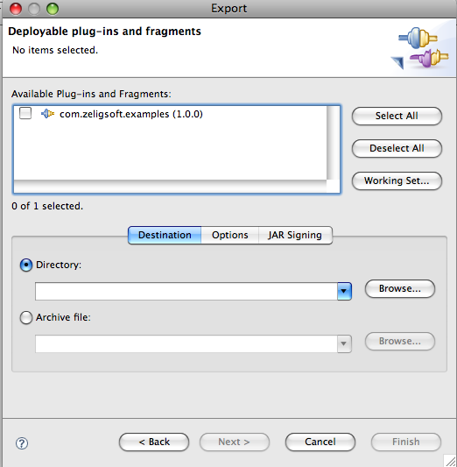
Manually Publishing a Plug-in
A plug-in can be published manually by
  File → Export...
  Select Deployable plug-ins and fragments
  Click Next > button
Parameters configure how the plug-in published
Can be saved as an Ant script
Notes:
Version 0.1, Sept. 2008
Toby McClean, Zeligsoft, 2008

Slide 54
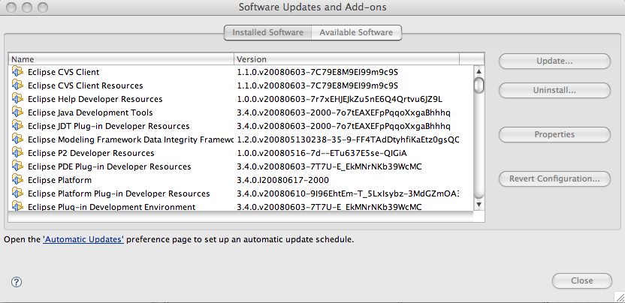
Installing Plug-ins
Plug-ins are installed under \plugins\ directory of Eclipse installation
Plug-ins can be installed from a update site
  Help → Software Updates..
  Typically as part of a feature
Restart workbench
Notes:
Version 0.1, Sept. 2008
Toby McClean, Zeligsoft, 2008
You install a plug-in into a directory underneath the platform's plug-in directory. This directory corresponds to your plug-in id, which must be unique. The standard practice for plug-in directory names is to use the plug-in's fully qualified id, including the dots, for example, com.examples.helloworld. (The plug-in directory is named plugins and is typically located underneath the main directory where you installed the platform.) Copy the JAR file and the plugin.xml to this new directory. If you have other resources such as about.html or icons, they also need to be copied to the directory.

Slide 55
Features
An Eclipse feature is a collection of plug-ins
  Represents smallest unit of separately downloadable and installable functionality
Installed into \features\ directory of Eclipse installation
Features can be installed from an update site
Feature
Plug-in
Plug-in
Plug-in
Notes:
Version 0.1, Sept. 2008
Toby McClean, Zeligsoft, 2008
On disk, an Eclipse-based product is structured as a collection of plug-ins. Each plug-in contains the code that provides some of the product's functionality. The code and other files for a plug-in are installed on the local computer, and get activated automatically as required. A product's plug-ins are grouped together into features. A feature is the smallest unit of separately downloadable and installable functionality. (The notion of a feature is new for Eclipse 2.0; it replaces the similar notion of component in Eclipse 1.0.)
The fundamentally modular nature of the Eclipse platform makes it easy to install additional features and plug-ins into an Eclipse-based product, and to update the product's existing features and plug-ins. You can do this either by using traditional native installers running separately from Eclipse, or by using the Eclipse platform's own update manager. The Eclipse update manager can be used to discover, download, and install updated features and plug-ins from special web-based Eclipse update sites.

Slide 56
Product
Stand-alone application built on Eclipse platform
Typically include the JRE and Eclipse platform
Defined by using an extension point
Configurable
  Splash screen
  Default preference values
  Welcome pages
Customized installation
Notes:
Version 0.1, Sept. 2008
Toby McClean, Zeligsoft, 2008

Slide 57
Summary
In this module we explored
  Eclipse architecture
  Extension points
  Plug-ins
  Features
  Products
Notes:
Version 0.1, Sept. 2008
Toby McClean, Zeligsoft, 2008

Slide 58
Agenda
What is Eclipse?
The Eclipse Workbench
The Eclipse Architecture
Extending the Workbench
Notes:
Version 0.1, Sept. 2008
Toby McClean, Zeligsoft, 2008

Slide 59
The Eclipse Project
Plug-ins
Notes:
Version 0.1, Sept. 2008
Toby McClean, Zeligsoft, 2008

Slide 60
Integration Between Plug-ins
Supported through the ability to contribute actions to existing plug-ins
  New plug-in contributes an action to existing plug-in
  Allows for tight integration between plug-ins
There are many areas where actions can be contributed
  Context menus and editors
  Local toolbar and pull-down menu of a view
  Toolbar and menu of an editor - appears on the Workbench when editor opens
  Main toolbar and menu for the Workbench
Notes:
Version 0.1, Sept. 2008
Toby McClean, Zeligsoft, 2008
Actions can be, in general, contributed to the editors and views. Views and editors can have actions contributed to their context menus, pull-down menus and tool bars.

Slide 61
Extending Views
Changes made to a view are specific to that view
Changes can be made to view’s
  Context menu
  Menu and toolbar
Notes:
Version 0.1, Sept. 2008
Toby McClean, Zeligsoft, 2008
Changes can be made that are specific to a view, such as changes to its context menu, menu and toolbar.

Slide 62
Extending Editors
When extending an editor changes can be made to
  Editor’s context menu
  Editor’s menu and toolbar
Actions defined are shared by all instances of the same editor type
  Editors stay open across multiple perspectives, so their actions stay the same
  When new workspace is open, or workbench is open in a new window, new instance of editor can be created
Notes:
Version 0.1, Sept. 2008
Toby McClean, Zeligsoft, 2008
One feature of Eclipse is that Editors remain open across multiple perspectives. In fact, it is the same instance of the editor that is used by all perspectives.

Slide 63
Action Set
Allows extension of the Workbench that is generic
  Should be used for adding non-editor, or non-view specific actions to the Workbench
  Actions defined are available for all views and editors
Allows customization of the Workbench that includes defining
  Menus
  Menu items
  Toolbar items
Notes:
Version 0.1, Sept. 2008
Toby McClean, Zeligsoft, 2008
The action set extension point is used to add menus, menu items and toolbar buttons to the common areas in the workbench window. These contributions are collectively known as an action set and appear within the workbench window by user preference.

Slide 64
Choosing What to Extend
Eclipse has a set of predefined extension points
  Called Platform extension points
    Comprehensive set of extension points
    Detailed in the on-line help
It is possible to create new extension points
  Requires id, name, and schema to be defined
  Done through Plug-in Development Environment (PDE)
Notes:
Version 0.1, Sept. 2008
Toby McClean, Zeligsoft, 2008
When defining new extension points, a point id, name and schema must be defined. The id is unique identifier that other plug-ins using the extension point will refer to, and schema is an XML schema that contains validation rules for the extension point. We will look into defining new extension points in details later.

Slide 65
Some Common Extension Points
Popup Menus for editors and views
  org.eclipse.ui.popupMenus
Menu and toolbar for views
  org.eclipse.ui.viewActions
Menu and toolbars for editors
  org.eclipse.ui.editorActions
Menu and toolbar for the Workbench
  org.eclipse.ui.actionSets
Complete set of extension points located in Eclipse help
  Search on “Platform Extension Points”
Notes:
Version 0.1, Sept. 2008
Toby McClean, Zeligsoft, 2008
To find documentation about extension points, check out Eclipse痴 help facility. If you wish, go directly to a plug-in directory and by convention any documentation will be located in its 電oc� directory.

Slide 66
How to Extend the Workbench?
Steps for adding a plug-in
  Define Plug-in project
    Plug-in nature
    Java nature (optional)
  Write the plug-in code
    Create Java class
    Add appropriate protocols to the class
  Package the class
  Create plugin.xml and MANIFEST.MF
  Test the plug-in
  Deploy the plug-in
Notes:
Version 0.1, Sept. 2008
Toby McClean, Zeligsoft, 2008
The steps above are generic steps for creating Eclipse plug-in.
We will extend the workbench with toolbar and menu items. The Java code for the plug-in will simply do nothing, but the class that handles click on menu item or toolbar item must be defined.

Slide 67
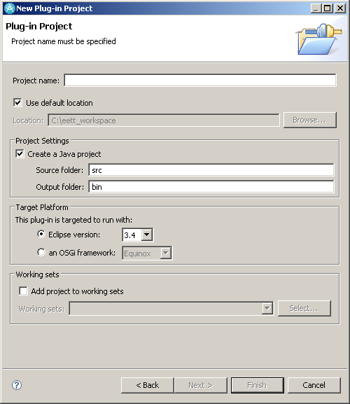
Creating Plug-in Project
Plug-in project are created with the New Project wizard
  File → New → Project…
Project will contain
  source code for the plug-in
  manifest and property files
Implementation details
Notes:
Version 0.1, Sept. 2008
Toby McClean, Zeligsoft, 2008
Always remember to choose good project names. In addition, think hard about your package naming. Since the convention is to use a directory name that mimics your package structure, e.g., org.apache.ant_1.5.3, you should name your packages accordingly.

Slide 68
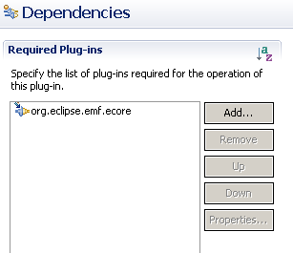
Updating Project’s Dependencies
To make classes required for the plug-in visible for the project, update its dependencies
  You add a dependency on another plug-in
  You can add a jar that is not part of a plug-in to the build path
Implementation details
Notes:
Version 0.1, Sept. 2008
Toby McClean, Zeligsoft, 2008
If your plug-in requires other plug-in, make sure to update your project痴 build path. Make sure to add the following:
The jFace.jar is in c:¥....¥eclipse¥plugins¥org.eclipse.jface_3.0.0
The source is in c:¥...¥eclipse¥plugins¥org.eclipse.platform.source_3.0.0¥src¥org.eclipse.jface_3.0.0¥jfacesrc.zip.
The swt.jar file is in c:¥....¥eclipse¥plugins¥org.eclipse.swt.win32_3.0.0¥ws¥win32
The source is in c:¥....¥eclipse/plugins/org.eclipse.platform.win32.source_3.0.0/src/org.eclipse.swt.win32_3.0.0/ws/win32/swtsrc.zip
The workbench.jar file is in c:¥....¥eclipse¥plugins¥org.eclipse.ui.workbench_3.0.0.
The source is in c:¥....¥eclipse¥plugins¥org.eclipse.platform.source_3.0.0¥src¥org.eclipse.ui

Slide 69
Creating a Class
For menu actions, define a class that
  Subclasses client delegate class
  Implements interface that contributes action to the Workbench
Implementation details
Notes:
Version 0.1, Sept. 2008
Toby McClean, Zeligsoft, 2008
When creating class that will handle actions, i.e. that will participate in the action delegation, it is important to know which class it should inherit from and which interfaces it should implement.
In our example we are creating action delegate class for participating in the change of the Workbenches toolbar and menu.
When changing the toolbar it is possible to add a pull-down menu to the toolbar item. In this case the action class would need to implement IWorkbenchWindowPulldownDelegate interface instead of IWorkbenchWindowActionDelegate interface.

Slide 70
Interface IWorkbenchWindowActionDelegate
Extend IActionDelegate and define methods
  init(IWorkbenchWindow) - Initialization method that connects action delegate to the Workbench window
  dispose() - Disposes action delegate, the implementer should unhook any references to itself so that garbage collection can occur
Interface is for an action that is contributed into the workbench window menu or toolbar
Implementation details
Notes:
Version 0.1, Sept. 2008
Toby McClean, Zeligsoft, 2008
Implementers of the interface can use selectionChanged() method to change the availability of the action or to modify other presentation properties. When the selection changes, the action enablement state is updated based on the criteria specified in the plugin.xml file. Then the delegate is notified of the selection change regardless of whether the enablement criteria in the plugin.xml file is met.

Slide 71
Class ActionDelegate
Abstract base implementation for client delegate action (defines same methods as interface)
In addition it also defines
  runWithEvent(IAction, Event)
    Does the actual work when action is triggered
    Parameters represent the action proxy that handles the presentation portion of the action and the SWT event which triggered the action being run
    Default implementation redirects to the run() method
  run(IAction)
    Inherited method, does the actual work as it’s called when action is triggered
  selectionChanged(IAction, ISelection)
    Inherited method, notifies action delegate that the creation in the Workbench has changed
Implementation details
Notes:
Version 0.1, Sept. 2008
Toby McClean, Zeligsoft, 2008

Slide 72
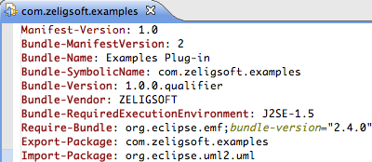
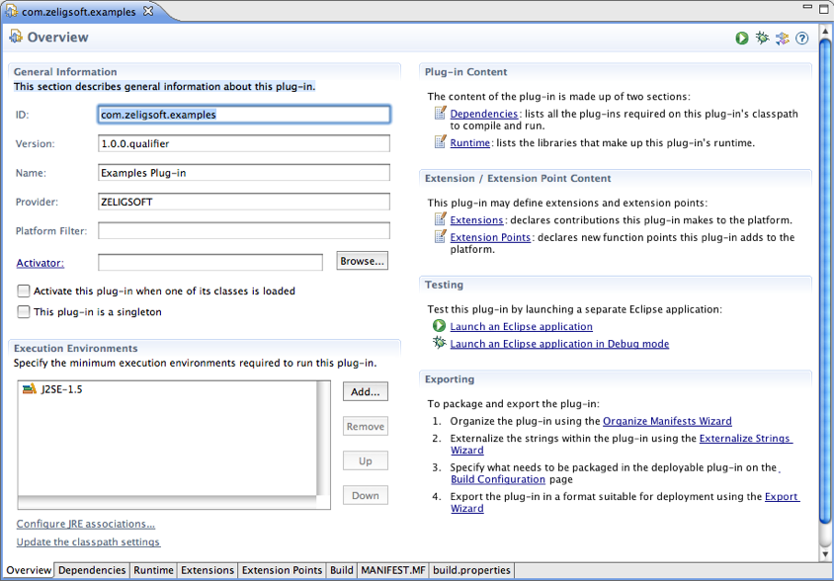
Defining Manifest
MANIFEST.MF file
  In the META-INF directory
Defines
  Plug-in name
  Plug-in version
  Plug-in vendor/provider
  Plug-in dependencies
  Packages exported
Manifest editor available
Implementation details
Notes:
Version 0.1, Sept. 2008
Toby McClean, Zeligsoft, 2008
There are many ids used in a manifest file. Individual extension points often define configuration parameters that require ids (such as the category id used above for the views extension point). We also define a plug-in id. In general, you should use Java package name prefixes for all of your ids in order to ensure uniqueness among all the installed plug-ins.
The specific name that you use after the prefix is completely up to you. However, if your plug-in id prefix is exactly the same name as one of your packages, you should avoid using class names from that package. Otherwise it will become difficult to tell whether you are looking at an id name or a class name.
You should also avoid using the same id for different extension configuration parameters. In the above manifest, we have used a common id prefix (org.eclipse.examples.helloworld) but all of our ids are unique. This naming approach helps us to read the file and see which ids are related.
Required plug-ins are plug-ins that are not part of the feature but must be present in the target platform as a prerequisite for installing the feature. If any of these plug-ins are missing, the feature will not be installed.

Slide 73
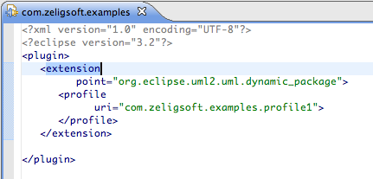
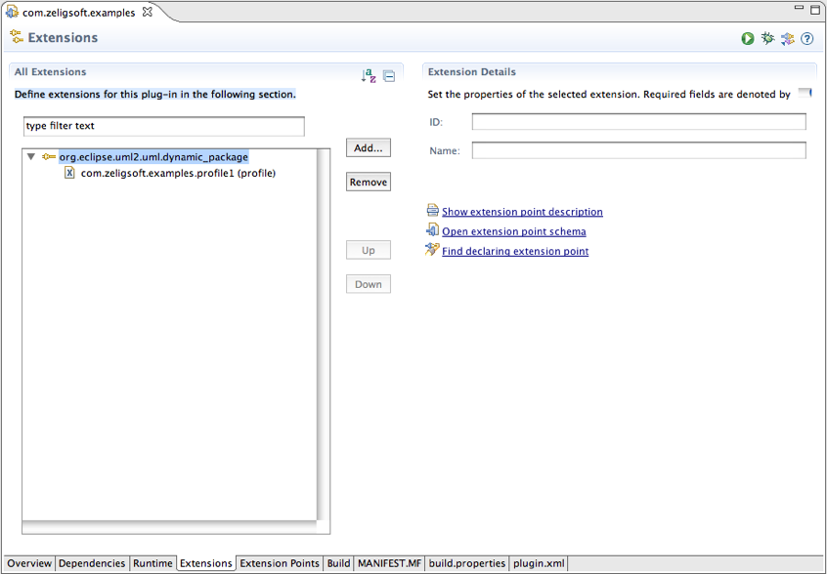
Defining plugin.xml
In the root of the project
Defines
  Extensions
  Extension points
Extension editor
  Includes wizards
Extension point editor
Implementation details

Slide 74
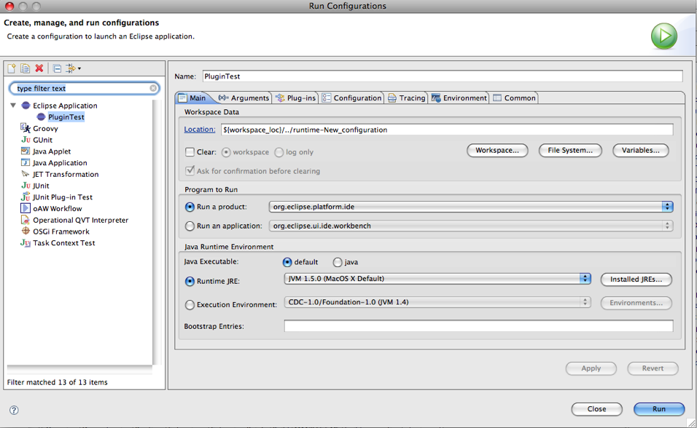
Testing Plug-in from Workbench
Available by opening new Workbench instance
  Run → Run As → Eclipse Application
Used when developing plug-in within the platform
Can be configured
  Run → Run Configurations...
  Eclipse Application
Debug available
  Run → Debug As →
  Eclipse Application
Implementation details
Notes:
Version 0.1, Sept. 2008
Toby McClean, Zeligsoft, 2008
If for some reason the runtime Workbench doesn稚 work properly, and it won稚 start up properly again, you can look at the runtime-workspace directory of the Eclipse install directory. This directory contains meta-data that is used for starting another instance of the Workbench. For example, the log file will provide info for the missing classes, missing plug-ins, etc. To force the platform to create new version of the meta-data, you can simply delete everything under the runtime-workspace directory and restart the new instance of the Workbench.

Slide 75
Getting Ready to Export Plug-in
Create a build.properties file in your project
source.. = src/
output.. = bin/
bin.includes = META-INF, \
.,\
plugin.xml, \
plugin.properties
Build properties editor available
  Open with → Build Properties Editor
Implementation details

Slide 76
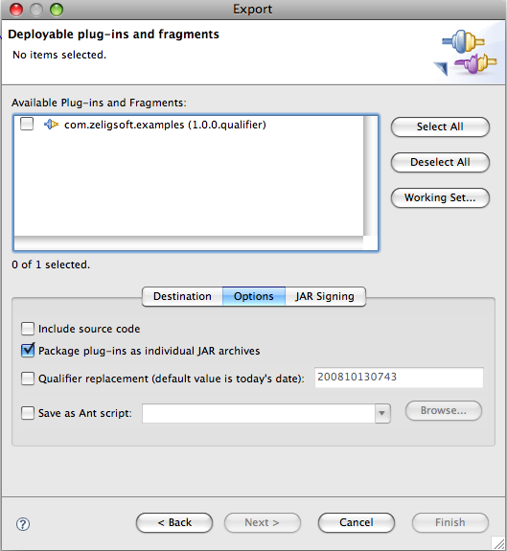
Exporting a Plug-in
File → Export...
  Deployable Plug-ins and Fragments
Configure export
  Archive vs. Directory
  Packaging
  Include source?
Can save as ant script
Ready to install
Implementation details
Notes:
Version 0.1, Sept. 2008
Toby McClean, Zeligsoft, 2008
Every plug-in has its unique identifier. Our plug-in will be installed in the directory com.espirity.course.plugins.workbench located under plugins directory of the Eclipse. This directory must be unique and that痴 the reason why it follows Java packaging naming convention.

Slide 77
Plug-in Registry
Too see what plug-ins are registered within a Workbench instance
  Window → Show View → Other...
Implementation details
Notes:
Version 0.1, Sept. 2008
Toby McClean, Zeligsoft, 2008
It is possible to view registered and available plug-ins. The Plug-in Registry view displays details about plug-ins. This view can be useful in the run-time workbench instance to see whether your plug-in has been started and what plug-in artifacts (extensions, extension points, libraries, etc.) are recognized by the platform. Detailed properties of the selected objects in the Registry view are shown in the Properties view.

Slide 78
Summary
In this module we explored
  Plug-ins
  MANIFEST
  Plug-in descriptors
  Testing plug-ins
  Exporting plug-ins

Slide 79

Questions

