Slide 1
_x0014_Eclipse and Rational Modeling Tools
Notes:
Version 0.1, Sept. 2008
Toby McClean, Zeligsoft, 2008

Slide 2
Overview
In this module we explore the eclipse modeling tools in more detail
Look at the different projects and how they relate

Slide 3
Goals
After this module you will
  Have an understanding of Eclipse modeling projects
  How they extend each-other
  How they can be transformed into models and text
  You will also have a roadmap for the rest of the training

Slide 4
Agenda
Modeling in Eclipse
  EMF, GMF, TMF, TCS
Tooling in Eclipse
  MDT, EMFT,
Transformations
  M2M, M2T

Slide 5

Eclipse Modeling Project
Model-based development technologies
  Frameworks
  Tooling
  Implementations of standards

Slide 6
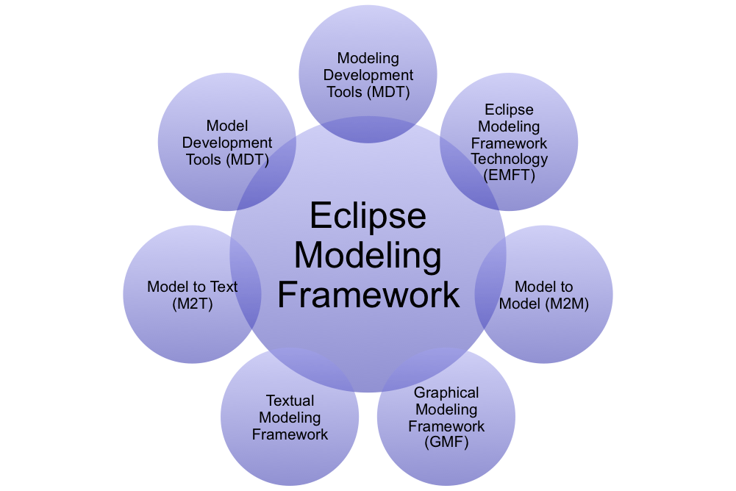
Ecosystem of the Modeling Project

Slide 7

Eclipse Modeling Framework (EMF)
Framework and generation for metamodels
Sub-projects
  CDO - distributed shared EMF models and server based O/R mapping
  Model Query - specification and execution of queries against and EMF model
  Model Transaction - model management layer
  Net4j - extensible client-server system using Eclipse Runtime and Spring Framework
  SDO - EMF implementation of service data objects, data application development in a SOA architecture
  Teneo - database persistency for EMF models
  Validation Framework - model integrity
Notes:
Version 0.1, Sept. 2008
Toby McClean, Zeligsoft, 2008
framework and generation for metamodels
runtime
persistence
basic editors
model transaction
support for managing multiple clients reading and writing to models
integration with the Eclipse undoable operations framework
model validation
batch and “live” validation or domain model instances, by default constraints can be defined in Java and OCL, while additional languages can be provided
model query
EMF models can be queried using provided Java APIs, but the Model Query component of EMF provides OCL and SQL-like alternatives
framework to help traversal of EMF model instances
SQL inspired set of classes to formulate queries, as well as a rich class hierarchy

Slide 8

Graphical Modeling Framework (GMF)
Runtime and tooling for developing a graphical concrete syntax
Built on-top of EMF and GEF
Feature rich graphical model editors
Notes:
Version 0.1, Sept. 2008
Toby McClean, Zeligsoft, 2008

Slide 9
Textual Modeling Framework (TMF)
Runtime and tooling for developing textual concrete syntax
Generation of editors and other tooling from a grammar
Sub-projects
  TCS
  xtext
Notes:
Version 0.1, Sept. 2008
Toby McClean, Zeligsoft, 2008
enables the definition of a concrete textual syntax for an abstract syntax
projects provide tooling for creating editors and other Eclipse tooling for a grammar
editors include
syntax highlighting
code completion
builders

Slide 10
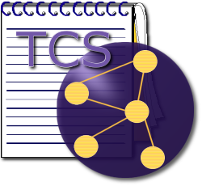
TMF - TCS
TCS - Textual Concrete Syntax
Built on top of EMF
Non-standards based language for annotating an abstract syntax model with textual syntax
Able to generate
  Grammar
  Editor
  Model to text transformation with traceability

Slide 11

TMF - xtext
Developed as part of the openArchitectureWare
Built on-top of EMF and ANTLr
From proprietary grammar language
  Generate editor - syntax highlighting and code completion
  Generate EMF abstract syntax model
  Generate integration with generation framework
  Generate integration with semantic validation framework

Slide 12
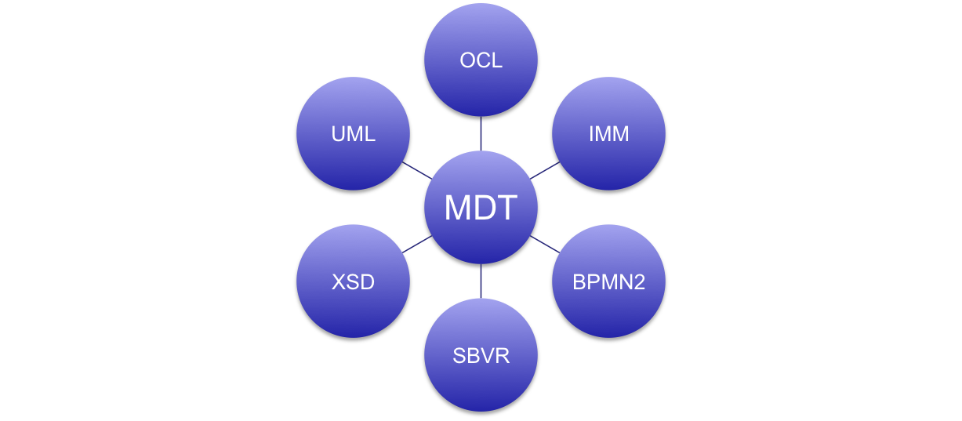
Model Development Tools (MDT)
Project that focuses on industry stand models
Notes:
Version 0.1, Sept. 2008
Toby McClean, Zeligsoft, 2008
project to focus on modeling capabilities for industry standard models
e.g. UML, XSD, BPEL,
XSD
special annotations are added to the model created when importing an XSD, which allows EMF to serialize these model instances as valid XML documents conforming to their schema definition
allows for importing XML schema to create a EMF model and then to ensure that the serialized format will comply with the schema
UML2
implementation of the UML 2.1 Superstructure specification
UML2 tools
diagramming to complement the metamodel implementation provided by the UML2 component
Object constraint language
implementation of the OMG’s OCL2 specification

Slide 13
Eclipse Modeling Framework Technology (EMFT)
A proving ground for EMF projects
  Research projects
  Incubation projects
When a project matures it is moved or promoted
  To another modeling sub-project
  To its own sub-project
Examples
  EMF runtime for the .NET platform
  Tools for building Ecore models
Notes:
Version 0.1, Sept. 2008
Toby McClean, Zeligsoft, 2008
model search
rich model search capabilities and integrates into the familiar Eclipse Search dialog
model search provides regular expression and OCL-based search of EMF and UML2 models
model compare
generic compare and merge support for any Ecore based model
JCR Management
allow for persitence of EMF model instances in JSR-170 compliant repository

Slide 14
Model to Model (M2M)
Project that focuses on technologies for model to model transformation
Work with EMF based as well as other input models
Sub-projects include
  QVT
  ATL
Notes:
Version 0.1, Sept. 2008
Toby McClean, Zeligsoft, 2008
produce one more output models from one or more input models
work on EMF based models
xTend (not an official project)

Slide 15
M2M - QVT
Implementation of OMG’s Query/View/Transformation specification
Three languages for performing M2M transformation
  Operational - currently supported
  Relational - in development
  Core - planned
QVT editor, debugger and interpreter
Notes:
Version 0.1, Sept. 2008
Toby McClean, Zeligsoft, 2008
QVT
standards based

Slide 16

M2M - ATL
ATL - ATLAS Transformation Language
Developed by ATLAS group at INRIA & LINA
Proprietary M2M language
  Similar to the QVT operational language
ATL editor, debugger and virtual machine
Notes:
Version 0.1, Sept. 2008
Toby McClean, Zeligsoft, 2008
ATL
Similar to QVT but standardized language
Matured from an EMFT project

Slide 17
Model to Text (M2T)
Project that focuses on technologies for model to text transformation
Work with EMF based as well as other input models
Sub-projects
  JET
  xPand
Notes:
Version 0.1, Sept. 2008
Toby McClean, Zeligsoft, 2008
projects for the generation of textual artifacts from one or more input models
tools provide the ability to define transformations of EMF based as well as other input models
JET
used by EMF
xPand
used by GMF

Slide 18
M2T- JET
JET - Java Emitter Templates
Template based language with an JSP like syntax
Editor for developing templates/transformations
Execution engine for executing transformation
Used by EMF to generate code

Slide 19
M2T - xPand
Developed as part of the openArchitectureWare
  Maturing into an Eclipse project
Template based language with a non-standards based syntax
Editor for developing templates/transformations
Execution engine for interpreting templates
An extended version is used by GMF to generate code

Slide 20
Summary
The projects are nicely layered
Good effort to keep things separated
Ability for users to pick and choose what they want
Lots of content to go through this week

Slide 21

Questions

